Slide 1

HER
HEALTH
Batch No:C14
Guide:Mrs.T.Divya Kumari
By:
K.Ridhika-22251A05H3
S.Durgamanogna-23255A0517
K.Deepika-23255A0520
S.Mounika-23255A0515

Slide 2
INTRODUCTION
.
This study examines the role of websites in supporting women's health. Websites play a crucial role by sharing information, providing support, and facilitating access to healthcare. This study will analyze existing studies and various women's health websites to assess their effectiveness. Key areas of focus include user-friendly designs, accuracy of information, interactive features, and inclusivity.

Slide 3
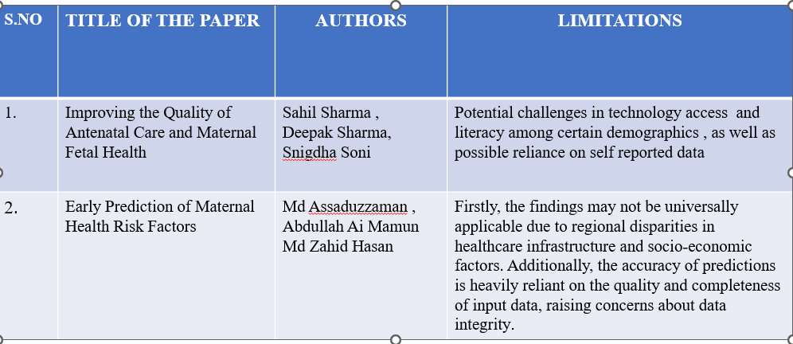
LITERATURE SURVEY

Slide 4
Problem Statement
Developing a website that helps in taking care of pregnant woman health under the monitoring of nurse by sending alerts to nurse and the patients about their checkup dates.

Slide 5
Existing and Proposed System
Existing System
1,Personal healthcare kit for pregnant ladies and healing facilities to maintain a strategic distance from the passing rate of pregnant women. And furthermore to decrease the proportion of maternal ladies death and making pregnancy the joyful experience.
2,No frequent communication between doctor and patient.
Proposed System
1,There will be a nurse who will be taking care of patient
2,It acts as interface between consultant doctor and patient

Slide 6
Objectives
Main objective is to create a website that helps women in taking care of their health under the monitoring of a nurse.
It mainly focuses on the gynecologic issues.
Giving alerts to the patients about their weekly or monthly checkups.

Slide 7
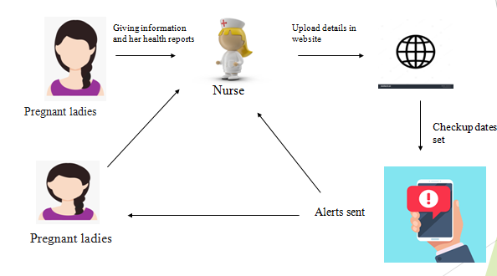

Slide 8
METHODOLOGY
The methodology of Her Health likely involves several key components designed to support maternal health:
The website provides comprehensive guides and information on pregnancy, childbirth, and postpartum care. This includes articles, videos, and infographics to educate mothers on various aspects of maternal health.
2. Health Monitoring Tools: Her Health offers tools and apps to help mothers track important health metrics such as weight, blood pressure, and fetal movements. These tools are designed to help mothers monitor their health and identify any potential issues early.

Slide 9
4. Community Engagement: Her Health fosters a community of mothers who can share their experiences, offer support, and provide encouragement to one another. This sense of community can be vital for emotional and mental well-being.
5. Data-Driven Insights: By collecting and analyzing data from its users, Her Health can provide tailored recommendations and insights to improve maternal health outcomes. This data-driven approach helps in creating personalized health plans and identifying trends that can benefit the wider community.
Overall, Her Health combines education, technology, professional support, community engagement, and data analysis to create a comprehensive support system for mothers

Slide 10
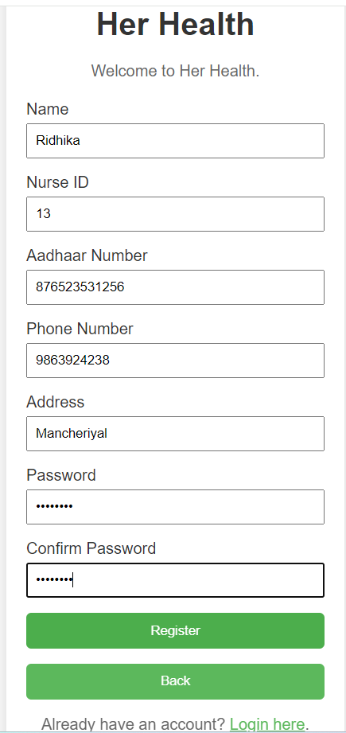
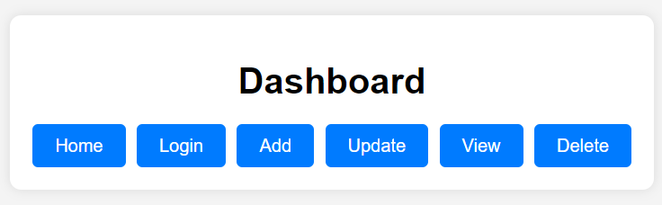
IMPLEMENTATION
Registration of nurse
Options for Nurse

Slide 11
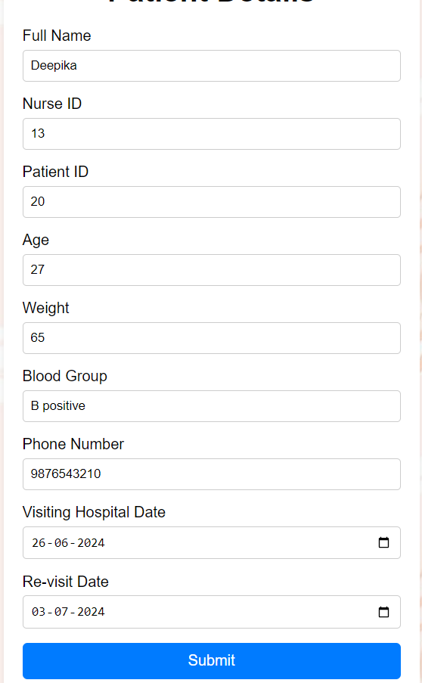

Adding Patients Details
Patients Details in database.

Slide 12
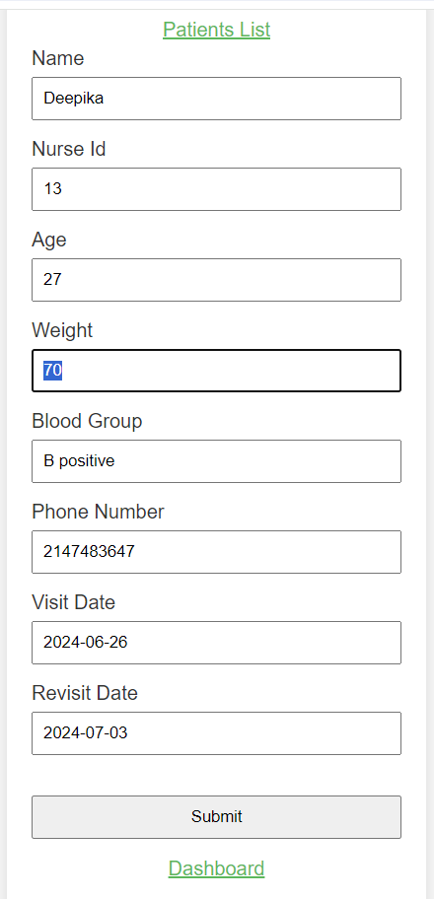
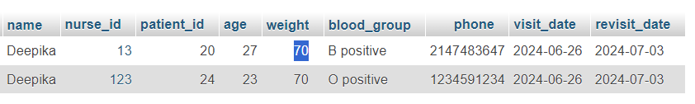
Updating Patients details
Patients details updated

Slide 13
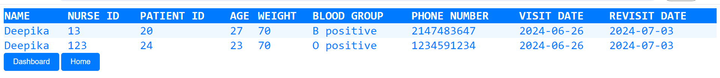
View Patients details

Slide 14
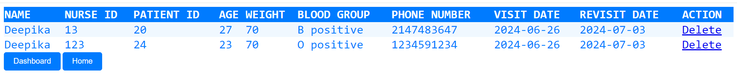

Delete Patient Details

Slide 15
CONCLUSION
This website is a helpful resource for pregnant women and new mothers. It provides guides and tips on what to expect during pregnancy and childbirth, tools to help monitor health metrics like weight, blood pressure, and baby movements, and access to experts and health professionals for personalized advice.
Additionally, it offers a platform for connecting with other moms for support and sharing experiences. Overall, Save Mom supports mothers in having healthier pregnancies and better postpartum experiences.

Slide 16
FUTURE SCOPE
To develop this idea into a mobile application.

Slide 17
REFERENCES
https://www.savemom.in/
https://www.liebertpub.com/doi/10.1089/jwh.2021.0298
https://ieeexplore.ieee.org/document/9907054/

