Slide 1
RAG Search Engine: Intelligent Document Querying
Leveraging LangChain and AWS Bedrock for Enhanced Information Retrieval
Presenter: Mounikesh Goud Bairagoni
Date: May 7, 2025

Slide 2
The Challenge: Unlocking Knowledge in Documents
Vast amounts of unstructured text data (PDFs, reports, manuals)
Traditional search provides keywords, not precise answers
LLMs are powerful but lack domain-specific, up-to-date knowledge (risk of hallucinations)
Need for accurate, contextual, and grounded information retrieval
Visual: Icon of documents + magnifying glass or question mark

Slide 3
Our Solution: Retrieval Augmented Generation (RAG)
RAG combines information retrieval with large language models (LLMs)
Steps:
• Retrieve relevant info from knowledge base
• Augment context to the LLM
• Generate an informed, accurate answer
Benefits: reduces hallucinations, provides grounded answers, uses proprietary data
Visual: Flow diagram: Query → Retriever → LLM → Answer

Slide 4
Core Technologies: LangChain & AWS Bedrock
LangChain: open-source framework orchestrating LLM workflows, data ingestion, prompt management
AWS Bedrock: fully managed service providing foundation models (Claude, Llama 3, Titan) with scalability and security
Visual: Logos for LangChain & AWS Bedrock

Slide 5
System Architecture: How It Works
User Interface: Streamlit web app
Data Ingestion: PDF documents processed
Embeddings: Text → vectors via Bedrock Embeddings
Vector Store: FAISS for similarity search
LLM Integration: AWS Bedrock (Claude 2.1 / Llama 3) generates responses
Visual: Flow diagram showing data flow: User → Streamlit → PDF loader → Text splitter → Embeddings → FAISS → Query → LLM → Answer

Slide 6
Building the Knowledge Base: Data Ingestion
Source: PDFs (e.g., “Data” folder)
Process:
• PyPDFDirectoryLoader: loads PDFs
• RecursiveCharacterTextSplitter: splits text into chunks (chunk_size=10,000, overlap=1,000)
• BedrockEmbeddings (amazon.titan-embed-text-v1): transforms text chunks into vectors
• Storage: FAISS vector store for fast similarity search
Visual: PDF icon → vector icons → database icon

Slide 7
Intelligent Generation with AWS Bedrock LLMs
Models:
• Anthropic Claude 2.1 (conversational AI, reasoning)
• Meta Llama 3 (8B Instruct, instruction-following)
LangChain integrates with Bedrock for smooth LLM interaction
Custom PromptTemplate guides LLM for detailed, concise answers (~250 words)
Visual: Logos for Claude & Llama 3

Slide 8
Answering Questions: The RetrievalQA Chain
User inputs query via Streamlit UI
Query embedded and similarity searched against FAISS (top k=3)
Retrieve top relevant document chunks
LLM generates grounded response based only on retrieved context
Minimizes hallucination, improves accuracy
Visual: Detailed flow: Query → Embed → FAISS Search → Retrieve Context → LLM → Answer

Slide 9
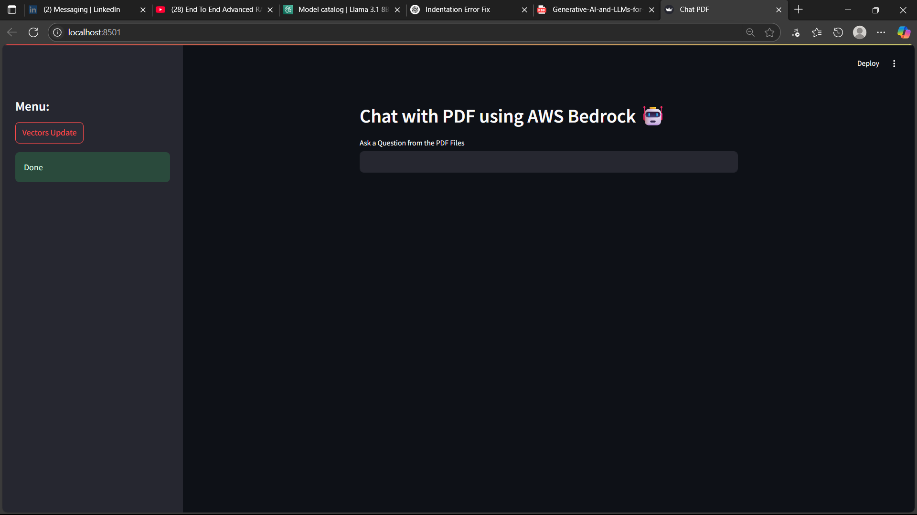
Interactive Experience: Streamlit Web App
Simple, user-friendly interface for question input
Features:
• Text input box
• "Vectors Update" button to re-ingest documents
• Clear display of generated answers
Enables easy interaction with backend AI
Visual: Screenshots 263 & 265 with annotations

Slide 10
Under the Hood: Key Code Components
requirements.txt dependencies overview
data_ingestion() function: PDF loading & splitting
get_vector_store(): FAISS vector store creation
get_claude_llm() / get_llama2_llm(): Bedrock LLM integration
PROMPT template structure for LLM prompt engineering
Visual: Clean snippets or screenshot of requirements.txt (Screenshot 266)

Slide 11
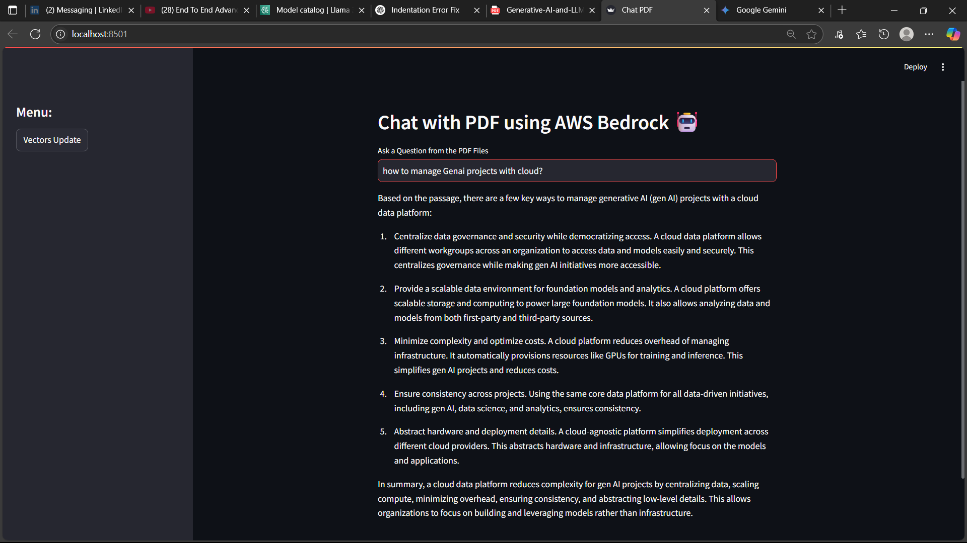
Live Demo & Impressive Results
Recap problem and solution
Sample query: "How to manage Generative AI projects with cloud?"
Show detailed, accurate answer generated from documents
Highlight effectiveness and quality of response

Slide 12
Roadmap & Scalability
Support additional document formats (Word, webpages, databases)
Implement hybrid search & re-ranking methods
Add user management & authentication
Introduce monitoring, analytics for usage & performance
Integrate AWS services (S3 storage, OpenSearch, RDS for vector scalability)
Visual: Growth & scalability icons

Slide 13
Conclusion & Questions
Successfully built an intelligent RAG search engine
Key takeaway: accurate, contextual, grounded answers from your data
Leveraging LangChain for orchestration, AWS Bedrock for AI models
Thank You!
Questions?
Visual: Project logo or simple impactful image

