Slide 1
Analysis of Gauge Testing Framework
By
Aishwarya Santhosh Nair
Mounisha Kosana

Slide 2
Overview
About Gauge
Demo
Strengths
Weakness
Conclusion

Slide 3
About Gauge
Gauge is a free and open source test automation framework.
Gauge makes writing and maintaining acceptance tests very easy.
It is easy to set up because there are no prerequisites for installing and running Gauge.
Gauge specifications are written in Markdown format. Markdown is a popular easy-to-write and easy-to-read plain text format, In short it is easy to learn.
It supports many programming languages like C#, Java, JavaScript, Python and Ruby.
Gauge is modular by design and extensible using plugins. You can write plugins for Gauge in any language.

Slide 4
Demo

Slide 5
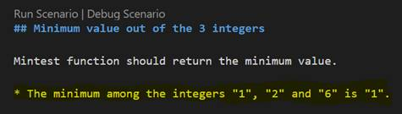
Strengths
Steps

Slide 6
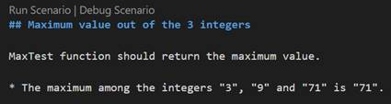
Strengths
Gauge is user-friendly

Slide 7
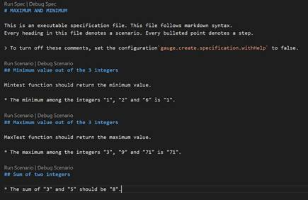
Strengths
We can re-use the steps in different specification files under the same project.

Slide 8
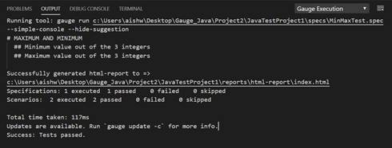
Strengths
Clear Output

Slide 9
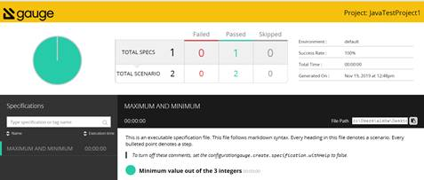
Strengths
Detailed reports generated.

Slide 10
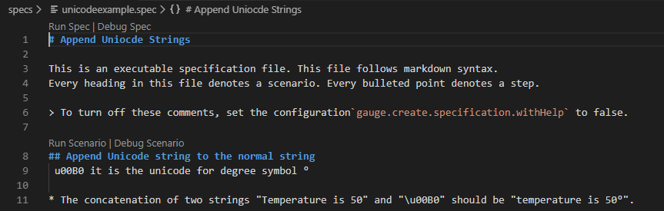
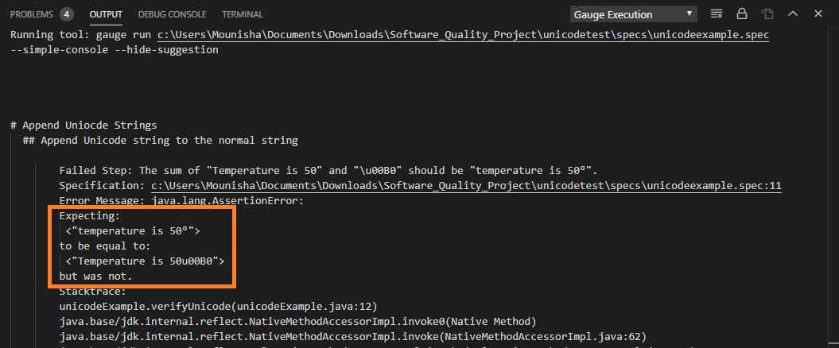
Weaknesses
No Unicode Compliance

Slide 11
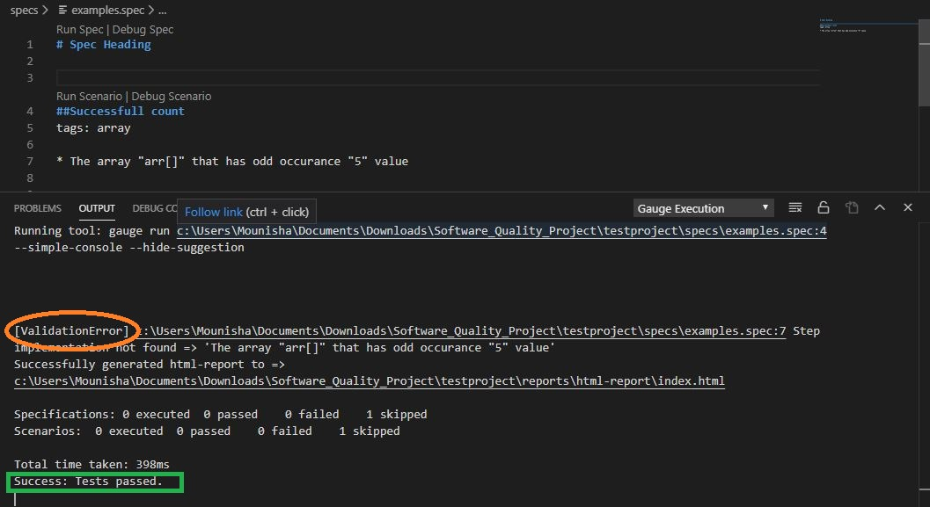
Weaknesses
False status of the tests.

Slide 12
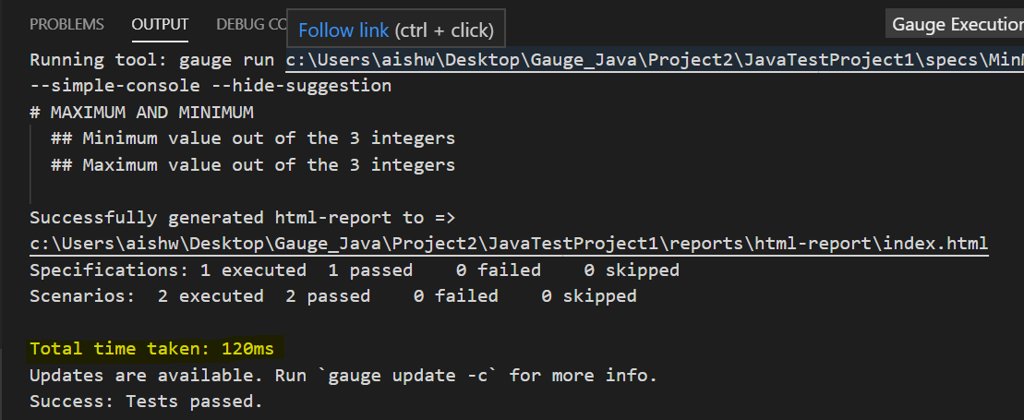
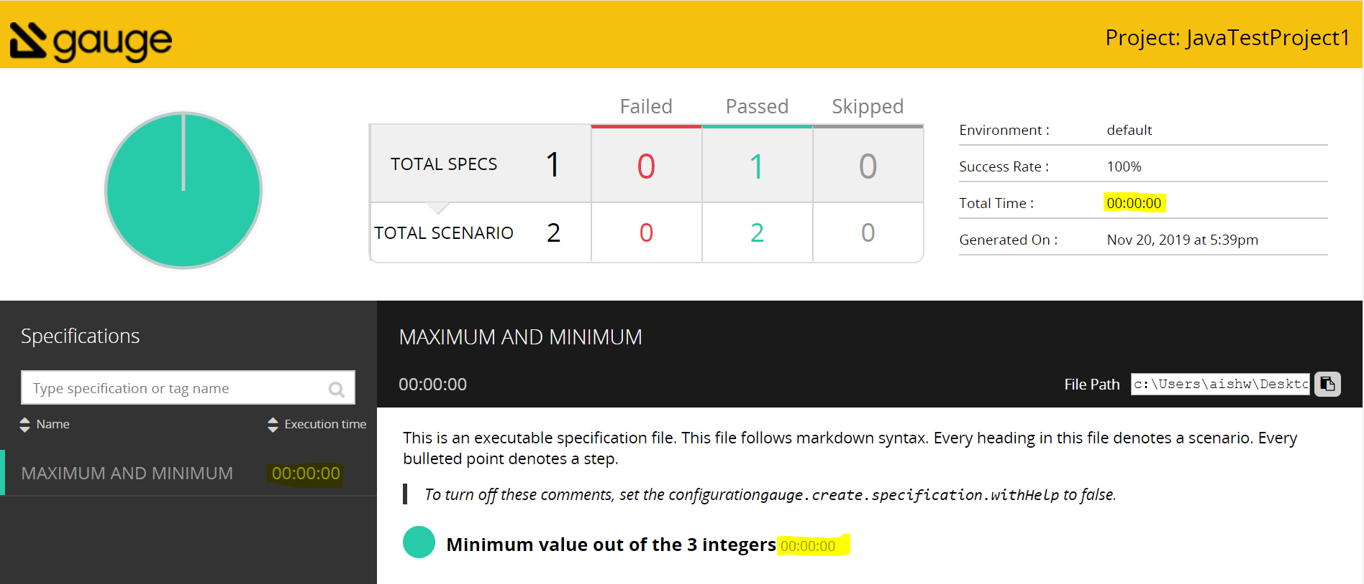
Weaknesses
Reports generated with no total time taken in case the time is in milliseconds

Slide 13
Weaknesses
It is still on their early versions and does not have support for many languages.
The one and only way to learn this tool is through the documentation provided on their site.

Slide 14
Conclusion
It’s a good new test automation framework with best features.

Slide 15
THANK YOU !!

