Slide 1
Objectives
  In this lesson, you will learn about:
    Layers in JDBC architecture
    Types of JDBC drivers
    Classes and interfaces of JDBC API
    Steps to create JDBC applications

Slide 2
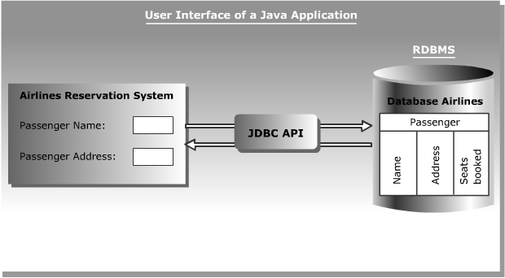
Database Connectivity
  Sun Microsystems has included JDBC API as a part of J2SDK to develop Java applications that can communicate with databases.
  The following figure shows the Airline Reservation System developed in Java interacting with the Airlines database using the JDBC API:

Slide 3

Database Connectivity (Contd.)
  JDBC Architecture:
    Provides the mechanism to translate Java statements into SQL statements.
    Can be classified into two layers:
      JDBC application layer
      JDBC driver layer

Slide 4
Database Connectivity (Contd.)
  JDBC Drivers:
    Convert SQL statements into a form that a particular database can interpret.
    Retrieve the result of SQL statements and convert the result into equivalent JDBC API class objects.
    Are of four types:
      JDBC-ODBC Bridge driver
      Native-API Partly-Java driver
      JDBC-Net Pure-Java driver
      Native Protocol Pure-Java driver

Slide 5
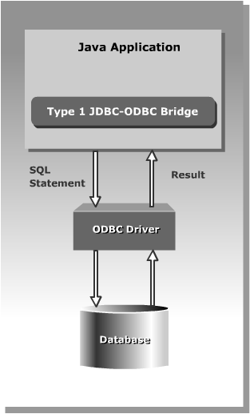
Database Connectivity (Contd.)
  JDBC-ODBC Bridge driver

Slide 6
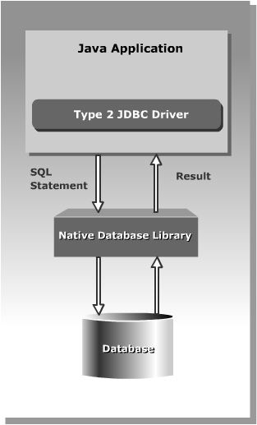
Database Connectivity (Contd.)
  Native-API Partly-Java driver

Slide 7
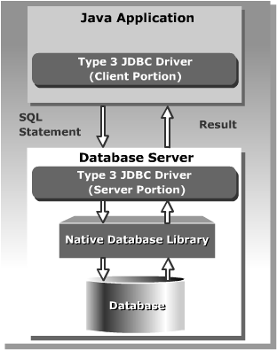
Database Connectivity (Contd.)
  JDBC-Net Pure-Java driver

Slide 8

Database Connectivity (Contd.)
  Native-Protocol Pure-Java driver

Slide 9
Using JDBC API
  The JDBC API classes and interfaces are available in the java.sql and the javax.sql packages.
  The commonly used classes and interfaces in the JDBC API are:
    DriverManager class: Loads the driver for a database.
    Driver interface: Represents a database driver. All JDBC driver classes must implement the Driver interface.
    Connection interface: Enables you to establish a connection between a Java application and a database.
    Statement interface: Enables you to execute SQL statements.
    ResultSet interface: Represents the information retrieved from a database.
    SQLException class: Provides information about the exceptions that occur while interacting with databases.

Slide 10
Using JDBC API (Contd.)
  The steps to create JDBC application are:
    Load a driver
    Connect to a database
    Create and execute JDBC statements
    Handle SQL exceptions

Slide 11
Using JDBC API (Contd.)
  Loading a Driver
    Programmatically:
      Using the forName() method
      Using the registerDriver()method
    Manually:
      By setting system property

Slide 12
Using JDBC API (Contd.)
  Using the forName() method
    The forName() method is available in the java.lang.Class class.
    The forName() method loads the JDBC driver and registers the driver with the driver manager.
    The method call to use the the forName() method is:
    Class.forName("sun.jdbc.odbc.JdbcOdbcDriver");

Slide 13
Using JDBC API (Contd.)
  Using the registerDriver()method
    You can create an instance of the Driver class to load a JDBC driver.
    This instance enables you to provide the name of the driver class at run time.
    The statement to create an instance of the Driver class is:
    Driver d = new sun.jdbc.odbc.JdbcOdbcDriver();
    You need to call the registerDriver() method to register the Driver object with the DriverManager.
    The method call to register the JDBC-ODBC Bridge driver is:
    DriverManager.registerDriver(d);

Slide 14
Using JDBC API (Contd.)
  Setting System Property
    Add the driver name to the jdbc.drivers system property to load a JDBC driver.
    Use the –D command line option to set the system property on the command line.
    The command to set the system property is:
    java –Djdbc.drivers=sun.jdbc.odbc.JdbcOdbcDriver SampleApplication

Slide 15
Using JDBC API (Contd.)
  Connecting to a Database
    The DriverManager class provides the getConnection() method to create a Connection object.
    The getConnection()method method has the following three forms:
      Connection getConnection (String <url>)
      Connection getConnection (String <url>, String <username>, String <password>)
      Connection getConnection (String <url>,Properties <properties>)

Slide 16
Using JDBC API (Contd.)
  Creating and Executing JDBC Statements
    The Connection object provides the createStatement() method to create a Statement object.
    You can use static SQL statements to send requests to a database to retrieve results.
    The Statement interface contains the following methods to send static SQL statements to a database:
      ResultSet executeQuery(String str)
      int executeUpdate(String str)
      boolean execute(String str)

Slide 17
Using JDBC API (Contd.)
  Various database operations that you can perform using a Java application are:
    Querying a table
    Inserting rows in a table
    Updating rows in a table
    Deleting rows from a table
    Creating a table
    Altering and dropping a table

Slide 18
Using JDBC API (Contd.)
  Querying a Table
    The SELECT statement is executed using the executeQuery() method and returns the output in the form of a ResultSet object.
    The code snippet to retrieve data from the authors table is:
      String str = "SELECT * FROM authors";
      Statement stmt = con.createStatement();
      ResultSet rs = stmt.executeQuery(str);

Slide 19
Using JDBC API (Contd.)
  Inserting Rows in a Table
    The executeUpdate() method enables you to add rows in a table.
    The code snippet to insert a row in the authors table is:
    String str = "INSERT INTO authors (au_id, au_lname, au_fname, address, city, state, contract) VALUES ('998-72-3568', 'Ringer','Albert','801 826-0752 67 Seventh Av.', 'Salt Lake City','UT','1')";
    Statement stmt = con.createStatement();
    int count = stmt.executeUpdate(str);

Slide 20
Using JDBC API (Contd.)
  Updating Rows in a Table
    The code snippet to modify a row in the authors table is:
    String str = "UPDATE authors SET address='10932 Second Av.’ WHERE au_id='998-72-3568'";
    Statement stmt = con.createStatement();
    int count = stmt.executeUpdate(str);
  Deleting Rows from a Table
    The code snippet to delete a row from the authors table is:
      String str = "DELETE FROM authors WHERE au_id='998-72-3568'";
      Statement stmt = con.createStatement();
      int count = stmt.executeUpdate(str);

Slide 21
Using JDBC API (Contd.)
  Creating a Table
    The CREATE TABLE statement is used to create and define the structure of a table in a database.
    The code snippet to create a table is:
      String str="CREATE TABLE MyProduct"
      +" (p_id INTEGER,"
      +"p_name VARCHAR(25),"
      +"rate FLOAT,"
      +"unit_msr CHAR(6))";
      Statement stmt=con.createStatement();
      stmt.execute(str);

Slide 22
Using JDBC API (Contd.)
  Altering and Dropping a Table
    DDL provides the ALTER statement to modify the definition of database object.
    The code snippet to add a column to the MyProduct table is:
    String str="ALTER TABLE MyProduct "
    +"ADD quantity INTEGER";
    Statement stmt=con.createStatement();
    stmt.execute(str);
    DDL provides the DROP TABLE statement to drop a table from a database.
    The code snippet to drop the MyProduct table from a database is:
    String str="DROP TABLE MyProduct";
    Statement stmt=con.createStatement();
    stmt.execute(str);

Slide 23
Using JDBC API (Contd.)
  Handling SQL Exceptions
    The java.sql package provides the SQLException class, which is derived from the java.lang.Exception class.
    You can catch the SQLException in a Java application using the try and catch exception handling block.
    The SQLException class contains various methods that provide error information, these methods are:
      int getErrorCode(): Returns the error code associated with the error occurred.
      String getSQLState(): Returns X/Open error code.
      SQLException getNextException(): Returns the next exception in the chain of exceptions.

Slide 24
Accessing Result Sets
  A ResultSet object maintains a cursor that enables you to move through the rows stored in a ResultSet object.
  Types of Result Sets
    The various types of ResultSet objects to store the output returned by a database are:
      Read only: Allows you to only read the rows in a ResultSet object.
      Forward only: Moves the result set cursor from first row to last row in forward direction only.
      Scrollable: Moves the result set cursor forward or backward through the result set.
      Updatable: Allows you to update the result set rows retrieved from a database table.

Slide 25
Accessing Result Sets (Contd.)
  The following table lists various fields of ResultSet interface that you can use to specify the type of a ResultSet object:
ResultSet Fields
Description
TYPE_SCROLL_SENTITIVE
Specifies that the cursor of the ResultSet object is scrollable and it reflects the changes in the data made by other users.
TYPE_SCROLL_INSENSITIVE
Specifies that the cursor of the ResultSet object is scrollable and it does not reflect changes in the data made by other users.
TYPE_FORWARD_ONLY
Specifies that the cursor of the ResultSet object moves in forward direction only from the first row to the last row.

Slide 26
Accessing Result Sets (Contd.)
  The following table lists various fields of the ResultSet interface that you can use to specify different concurrency modes of result sets:
ResultSet Fields
Description
CONCUR_READ_ONLY
Specifies the concurrency mode that does not allow you to update the ResultSet object.
CONCUR_UPDATABLE
Specifies the concurrency mode that allows you to update the ResultSet object.

Slide 27
Accessing Result Sets (Contd.)
  The following table lists various fields of the ResultSet interface that you can use to specify different cursor states of result sets:
ResultSet Fields
Description
HOLD_CURSORS_OVER_COMMIT
Specifies that a ResultSet object should not be closed after data is committed to the database.
CLOSE_CURSORS_AT_COMMIT
Specifies that a ResultSet object should be closed after data is committed to the database.

Slide 28
Accessing Result Sets (Contd.)
  The createStatement() method has the following three overloaded forms:
    Statement createStatement()
    Statement createStatement(int, int)
    Statement createStatement(int, int, int)

Slide 29
Accessing Result Sets (Contd.)
  The following tables lists the methods of ResultSet interface:
Method
Description
boolean first()
Shifts the control of a result set cursor to the first row of the result set.
boolean isFirst()
Determines whether the result set cursor points to the first row of the result set.
boolean beforeFirst()
Shifts the control of a result set cursor before the first row of the result set.
boolean isBeforeFirst()
Determines whether the result set cursor points before the first row of the result set.
boolean last()
Shifts the control of a result set cursor to the last row of the result set.
boolean isLast()
Determines whether the result set cursor points to the last row of the result set.

Slide 30
Accessing Result Sets (Contd.)
  The methods of ResultSet interface (Contd.)
Method
Description
boolean afterLast()
Shifts the control of a result set cursor after the last row of the result set.
boolean isAfterLast()
Determines whether the result set cursor points after the last row of the result set.
boolean previous()
Shifts the control of a result set cursor to the previous row of the result set.
boolean absolute(int i)
Shifts the control of a result set cursor to the row number that you specify as a parameter.
boolean relative(int i)
Shifts the control of a result set cursor, forward or backward, relative to the row number that you specify as a parameter.

Slide 31
Accessing Result Sets (Contd.)
  JDBC allows you to create an updatable result set that enables you to modify the rows in the result set.
  The following table lists some of the methods used with updatable result set:
Method
Description
void updateRow()
Updates a row of the current ResultSet object and the underlying database table.
void insertRow()
Inserts a row in the current ResultSet object and the underlying database table.
void deleteRow()
Deletes a row from the current ResultSet object and the underlying database table.
void updateString()
Updates the specified column with the given string value.
void updateInt()
Updates the specified column with the given int value.

Slide 32
Demonstration-Creating a JDBC Application to Query a Database
  Problem Statement
    Create an application to retrieve information (author id, name, address, city, and state) about the authors who are living in the city where the city name begins with the letter “O”.

Slide 33
Demonstration-Creating a JDBC Application to Query a Database (Contd.)
  Solution
    JDBC-ODBC Bridge driver is to be used for creating the application. To solve the above problem, perform the following tasks:
      Create a Data Source Name (DSN).
      Code the application.
      Compile and execute the application.

Slide 34
Summary
In this lesson, you learned:
  JDBC Architecture consists of two layers:
    JDBC application layer: Signifies a Java application that uses the JDBC API to interact with the JDBC driver manager.
    JDBC driver layer: Contains a driver, such as an SQL Server driver, which enables a Java application to connect to a database. This layer acts as an interface between a Java application and a database.
  The JDBC driver manager manages various JDBC drivers.
  The JDBC driver is software that a Java application uses to access a database.

Slide 35
Summary (Contd.)
  JDBC supports four types of drivers:
    JDBC-ODBC Bridge driver
    Native-API Partly-Java driver
    JDBC-Net Pure-Java driver
    Native Protocol Pure-Java driver
  The JDBC API consists of various classes and interfaces that enable Java applications to interact with databases.
  The classes and interfaces of the JDBC API are defined in the java.sql and javax.sql packages.
  You can load a driver and register it with the driver manager either programmatically or manually.
  Two ways to load and register a driver programmatically are:
    Using the Class.forName() method
    Using the registerDriver() method

Slide 36
Summary (Contd.)
  You can add the driver name to the jdbc.drivers system property to load and register a JDBC driver manually.
  A Connection object establishes a connection between a Java application and a database.
  A Statement object sends requests to and retrieves results from a database.
  You can insert, update, and delete data from a table using the DML statements in Java applications.
  You can create, alter, and drop tables from a database using the DDL statements in Java applications.
  A ResultSet object stores the result retrieved from a database when a SELECT statement is executed.
  You can create various types of ResultSet objects such as read only, updatable, and forward only.

