Slide 1

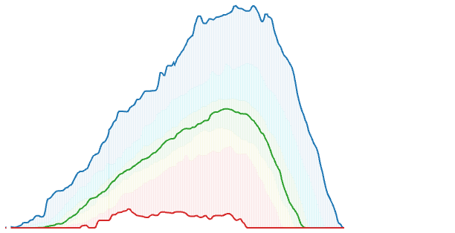

Snow Hydrology

