Slide 1
Upper Merced Hydroclimate Network
All Gage/Snow Sensor Locks Combo: 264(0)
Created August, 2014-HF
Updated August 10, 2014- HF
Updated March 21, 2017- B.Mocsny

Slide 2
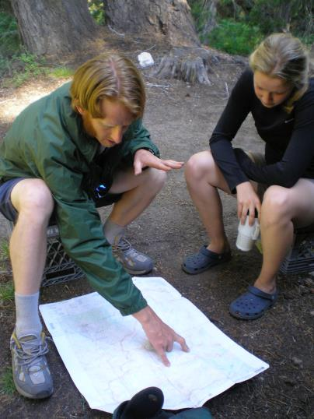
Merced Lake Ranger Station Cabin Lock requires CG 10 key
Gear Cache updated on 9/2015 N. Ernster
List on Aquarius- site visit date 20150914 or 20150915

Slide 3
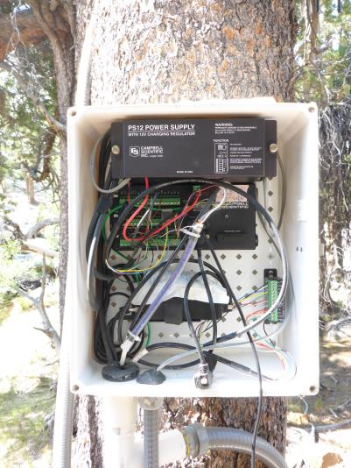
Merced River ABV HSC
Stream Gage Enclosure:
-CR1000 data logger(PB address=471)
-CS547A Conductivity Interface
-RF400 Local Radio(set to .4 mAmp-8 sec
transmission, 8/14/2014)
-CSI Yagi directional local antennae
-data cable connection to enclosure via 1 ½ inch
coupler
-enclosure door falls off when open, align hinge
grommets to reattach and close door
Power System:
-20 Watt Solarex solar panel
-PS12 Solar Controller w/7AH Battery
-External 55 AH Battery in lower ammo can.
-Power cable from solar panel to solar
controller = 40 ft.
-power cable connection to enclosure = ½ inch
conduit coupler.

Slide 4
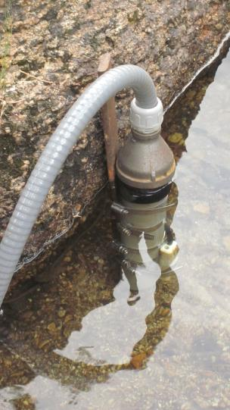
Merced River ABV HSC
Sensors:
“Alpine Stilling Tube”(CS450 PT & CS547 Cond)
Installed Aug.7,2014
CS451 Pressure Transducer/Stage Recorder
-Cable Length: 30 ft.
-Serial #: 20010250
CS547 Conductivity Sensor
-Cable Length: 30 ft.
-Calibration K: 1.380
-Serial #:6425
Offset applied to CS450 to Match Gage Height on 9/22/2014: +0.03 ft.

Slide 5
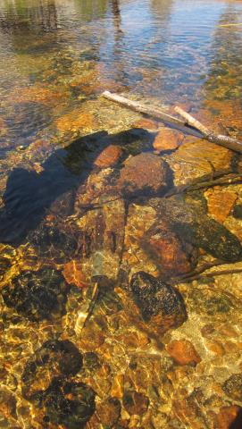
Merced River ABV HSC
Sensors:
“Original Hydroclimate Gage” Installed July 2001
Druck PT (still running)
-Cable Length: 100 ft.
-Serial Number: NA
CS 547 Cond (in situ, out of service)
-Cable cut at lower enclosure on 8/7/2014
Offset applied to Druck to Match Gage Height on 9/22/2014: -0.02 ft.

Slide 6
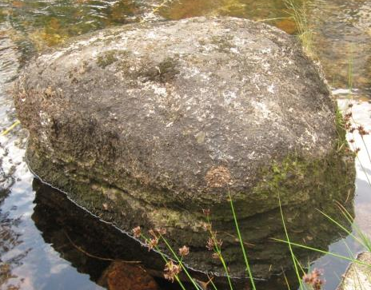
Merced River ABV HSC
Alpine
Stilling
Tube
Datum:
Tape Down Bolt
(Installed August 7, 2014)
Measure from center of “X” inscribed
on face of bolt.
Gage Height = 10ft. – / + Tape Down
If inaccessible due to high flow, use
“Original Post Tape Down”
* Measure Gage Height from both Tape Down Bolt and “Original Post Tape Down” *

Slide 7
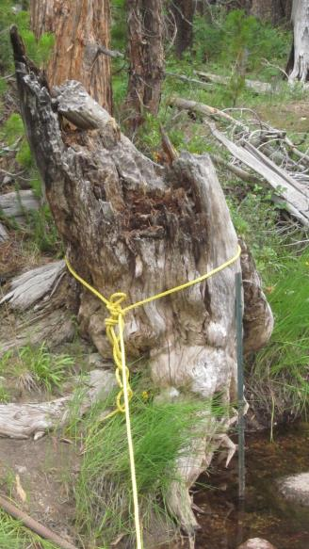
Merced River ABV HSC
Datum:
“Original Post Tape Down”
Measure from top edge of post.
Gage Height = 12.1 ft. – / + Tape Down
10 ft. on Tape Down Bolt = 7.90 on “Original Post Tape Down”
* Measure Gage Height from both Tape Down Bolt and “Original Post Tape Down” *
You should get the same Gage Height from both Tape Down locations!

Slide 8
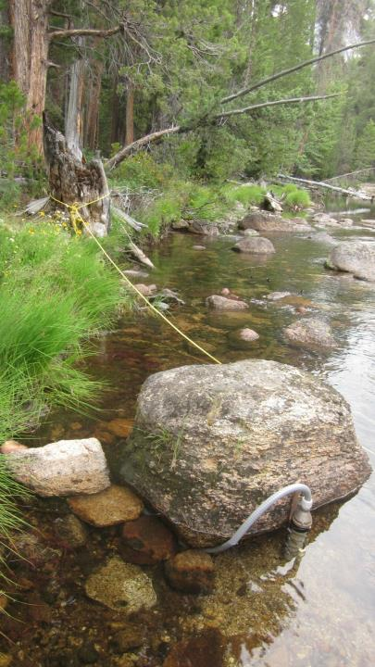
Merced River ABV HSC
Datum:
“Original Post Tape Down”
Tape Down Bolt
Sensors:
“Alpine Stilling Tube”

Slide 9
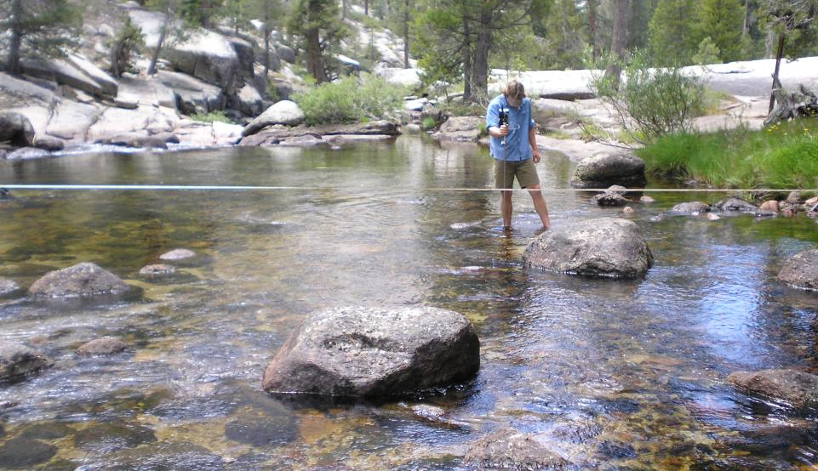
Merced River ABV HSC
Section Control
Datum:
“Original Post Tape Down”
Tape Down Bolt
Sensors:
“Alpine Stilling Tube”
Tape Down Bolt
Point of Zero Flow(PZO) / Gage Height(GHZO) = Gage Height - Depth of Water over Section Control
Gage Height of Zero Flow = (insert GH) – (insert Water Depth) = (insert PZO) on (insert date)

Slide 10
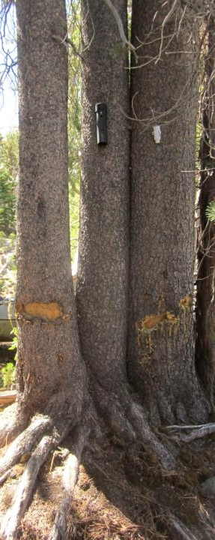
Merced River ABV HSC
Meteorology Sensors:
Hobo Temp/RH
Tidbit Temp
Barologger Enclosure/Sensor
To Stream Gage, 30 ft. SW

Slide 11
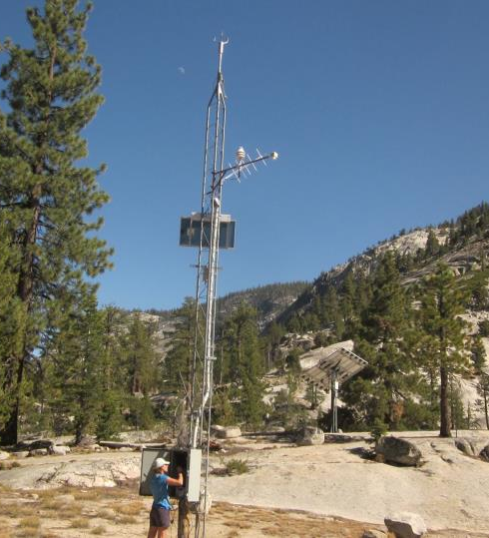
Merced River ABV HSC
Snow/Met Sensors:
Judd Snow Depth
-cable length= 15 ft.
-sensor height: 248 inches(8/14/14)
-serial #: NA
CS215-L Temperature & Relative Humidity
-cable length= 30 ft.
-serial #: E10466
-sensor height: 15 ft.
Out of service sensors to be removed September 2014:
-sonic anemometer
-solar radiation
-Viasala Temp/RH
To Stream Gage, 300 ft. SE

Slide 12
Merced River ABV HSC
Snow Sensor Enclosure;
-CR1000 Datalogger
-RF400 Radio
-CSI TX312 HDR GOES Transmitter
-CSI Omnidirectional White-Wand Local Antennae
-GOES YAGI Directional Antennae(Azimuth=191°)
Power System:
40 Watt BP solar panel
ProStar-15 solar controller
CS P100 controller(to power GOES Transmitter)
80 AH Battery

Slide 13
Merced River ABV HSC
CSI TX312 HDR GOES Transmitter
Sat Configuration:
GOES ID: c2b033ca
Timed Channel: 62
Timed Bit Rate: 300
Timed Interval: 00:01:00:00
First Timed Transmission: 00:12:30
Timed Tx Window: 10
Timed Data Format: A
Random Channel: 0
Random Bit Rate: 100
Random Randomizing Interval: 20
Random Randomizing Percentage: 50
Random Repeat Count: 5
Random Data Format: A
Random Msg Counter: N
GPS Position Fix Interval: 00:00:00

Slide 14
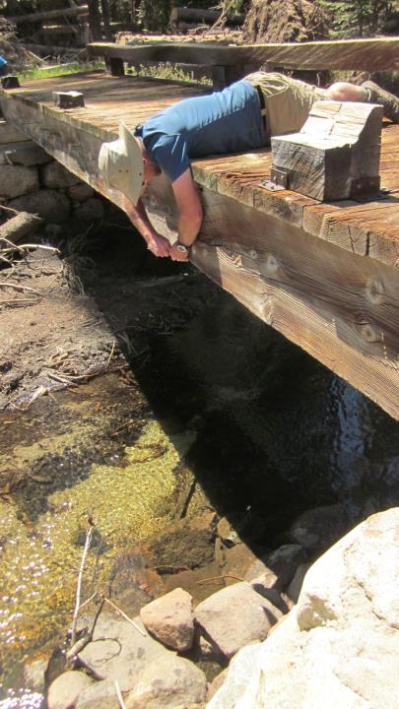
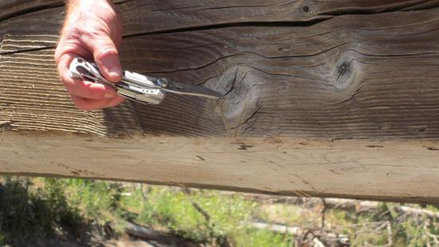
Merced River BLW Lyell Fk.
Datum:
Tape down to water surface from bridge v-notch
Solinst:
-Solinst Black Sealed PT inside pancake PT mount.
(fixed inside w/zip ties 8/14/2014)

Slide 15
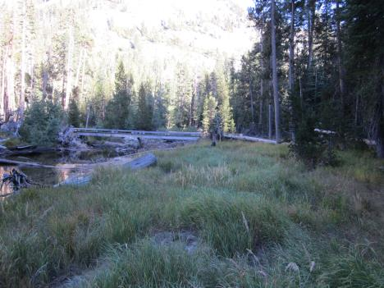
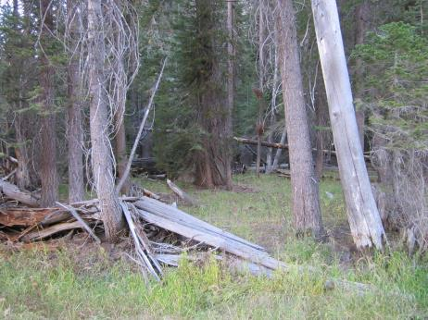
Merced River BLW Lyell Fk.
Locating the Meteorology Sensor:
HOBO Temp/RH
HOBO Tidbit Temp
Look into the forest for a large tree and
Rootwad down. Walk this direction.
Walk ~150m downstream from bridge
On RL.

Slide 16
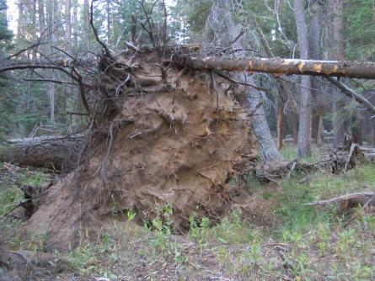
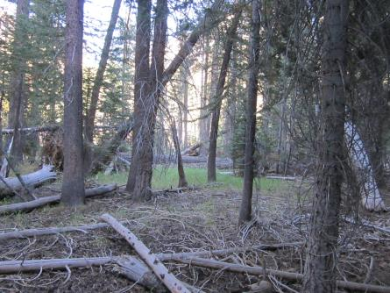
Merced River BLW Lyell Fk.
Locating the Meteorology Sensor:
HOBO Temp/RH
HOBO Tidbit Temp
This picture is taken standing at the tree with the sensors on it looking towards the rootwad.
This is the fallen tree with giant
rootwad.

Slide 17
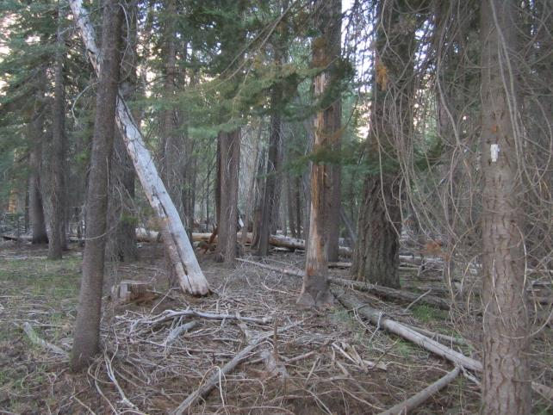
Merced River BLW Lyell Fk.
Locating the Meteorology Sensor:
HOBO Temp/RH
HOBO Tidbit Temp
Towards Trail
Towards Rootwad

Slide 18
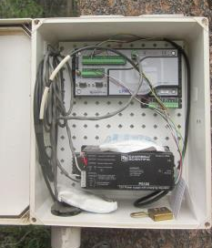
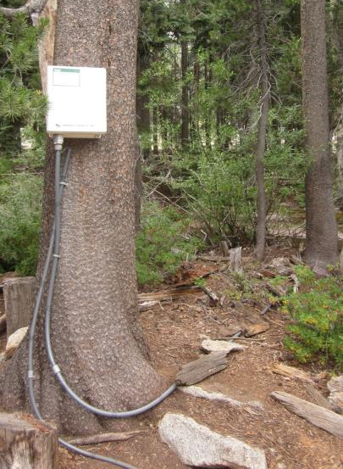
Merced Peak Fk.
Stream Gage Enclosure:
-CR800 data logger (PB address=222)
-CS547A Conductivity Interface
-data cable connection to enclosure via 1 ½ inch
coupler reduced to ¾ inch conduit coupler, ¾ inch
conduit
Power System:
-20 Watt Solarex solar panel
-PS1000 Solar Controller w/7AH Battery
-Power cable from solar panel to solar
controller = 50 ft.
-power cable connection to enclosure = ½ inch
conduit coupler, ½ inch conduit.

Slide 19
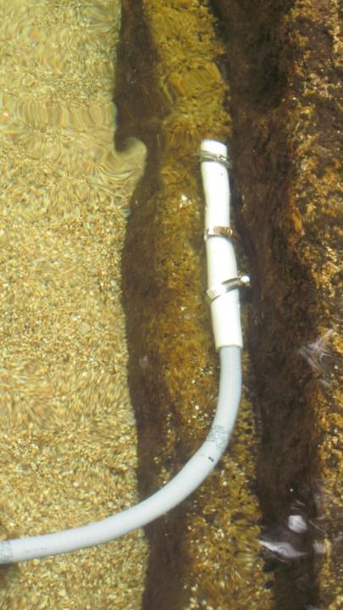
Merced Peak Fk.
Sensors:
“Piton PT Mount !”(CS450 PT)
Installed Aug.6, 2014
CS450-L Pressure Transducer/Stage Recorder
-Cable Length: 50 ft.
-Serial #: 70010415 Cal Date: 20101022
CS547 Conductivity Sensor(to be installed Sept. 2014
-Cable Length: 50 ft.
-Calibration K: 1.410
-Serial #:6659
Offset to Match Gage Height on 8/6/2014:
+7.85 ft.

Slide 20
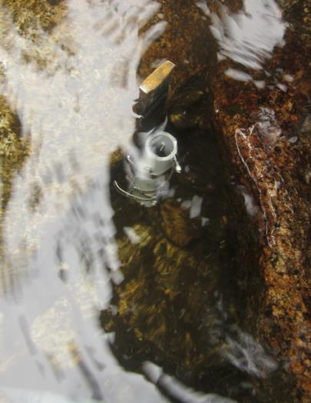
Merced Peak Fk.
Sensors:
“Simple Solinst Stake Mount”
Installed Aug.6, 2014
Solinst Black Sealed Pressure Transducer
Stainless steel set screw fixes through top eyelet on Solinst

Slide 21
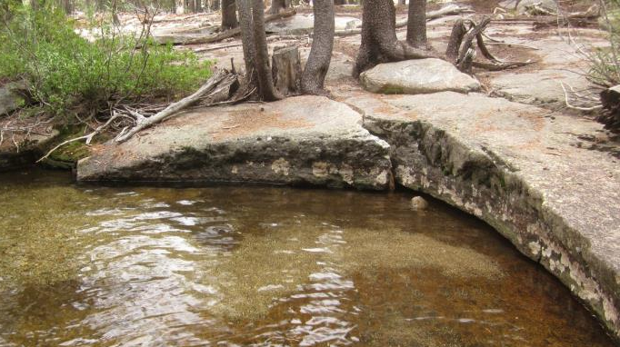
Merced Peak Fk.
Datum:
Tape Down Bolt
(Installed August 6, 2014)
Measure from center of “X” inscribed
on face of bolt.
Gage Height = 10ft. – / + Tape Down

Slide 22
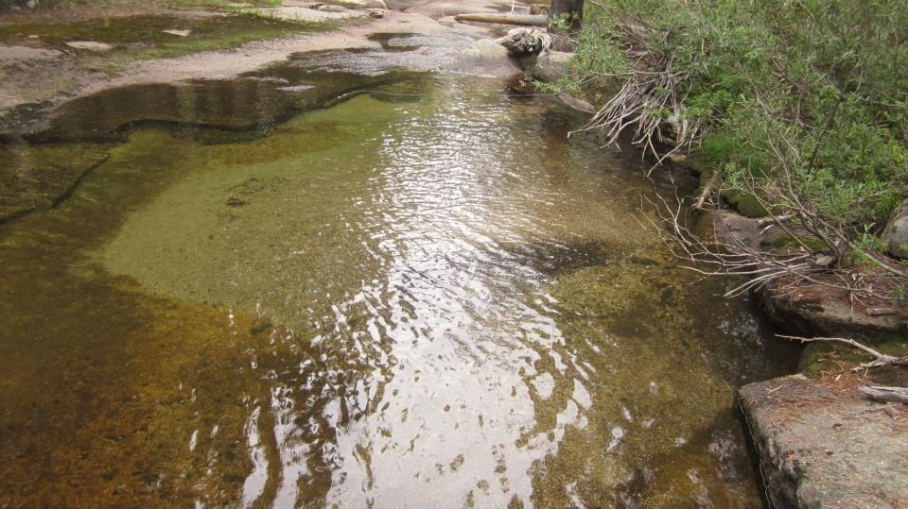
Merced Peak Fk.
Control
Datum:
Tape Down Bolt
(Installed August 6, 2014)
Measure from center of “X” inscribed
on face of bolt.
Gage Height = 10ft. – / + Tape Down
“Piton PT Mount !”
“Simple Solinst Stake Mount”
Tape Down Bolt

Slide 23
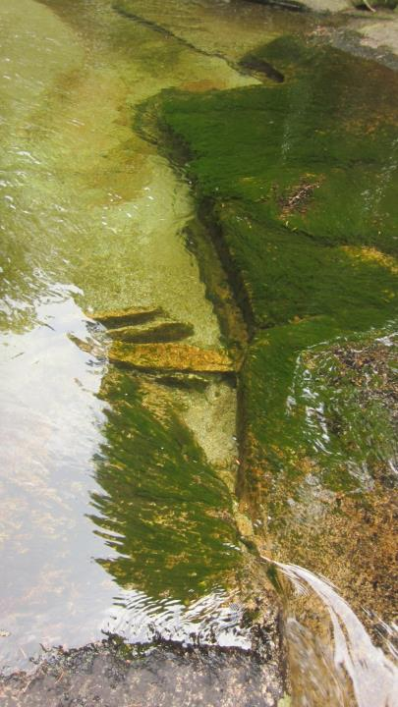
Merced Peak Fk.
Control
(Pre-“Piton PT Mount !” installation)
Point of Zero Flow(PZO) / Gage Height(GHZO) = Gage Height - Depth of Water over Control
Gage Height of Zero Flow = 9.19 - .61 = 8.58 on August 6, 2014

Slide 24
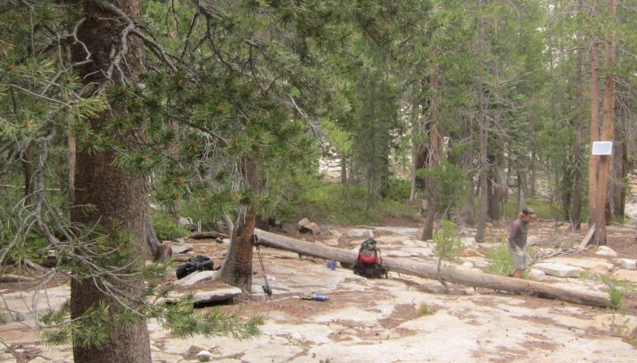
Merced Peak Fk.
Meteorology Sensors:
Hobo Temp/RH
Tidbit Temp

Slide 25
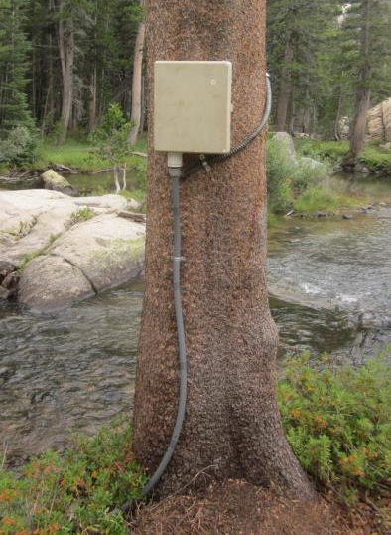
Lyell Fk. Merced River ABV High Trail
Stream Gage Enclosure:
-CR1000 data logger(PB address=296)
-CS547A Conductivity Interface
-data cable connection to enclosure via 1 ½ inch
coupler reduced to ¾ inch conduit coupler, ¾ inch
conduit
Power System:
-15 Watt Solarex solar panel
-PS100 Solar Controller w/7AH Battery
-Power cable from solar panel to solar
controller = 4 ft.
-power cable connection to enclosure = ½ inch
conduit coupler.

Slide 26
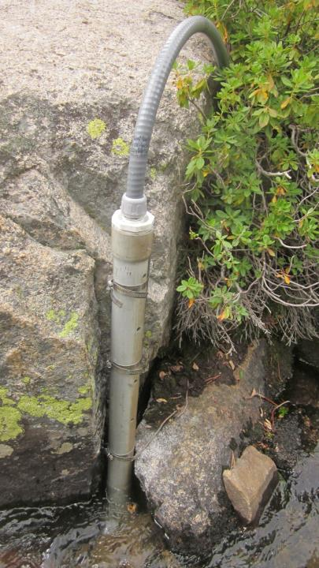
Lyell Fk. Merced River ABV High Trail
Sensors:
“Alpine Stilling Tube”(CS451-L PT & CS547 Cond)
Installed Aug.5, 2014
CS451-L Pressure Transducer/Stage Recorder
-Cable Length: 50 ft.
-Serial #: 20010336 Cal Date: 20131127
CS547 Conductivity Sensor
-Cable Length: 50 ft.
-Calibration K: 1.383
-Serial #: __61 (difficult to read)
Old Stage Post TD + 0.27ft=New Stage TD Bolt.
Offset to Match Gage Height on 8/5/2014:
+7.13 ft.

Slide 27
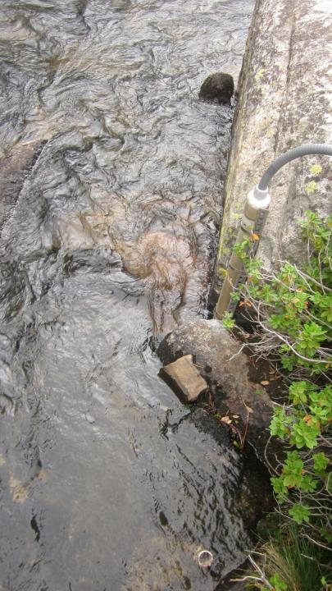
Lyell Fk. Merced River ABV High Trail
Sensors:
“Simple Solinst Stake Mount”
Installed: Unknown date
Solinst Black Sealed Pressure Transducer
Stainless steel set screw fixes through top eyelet on Solinst
“Simple Solinst Stake Mount”

Slide 28
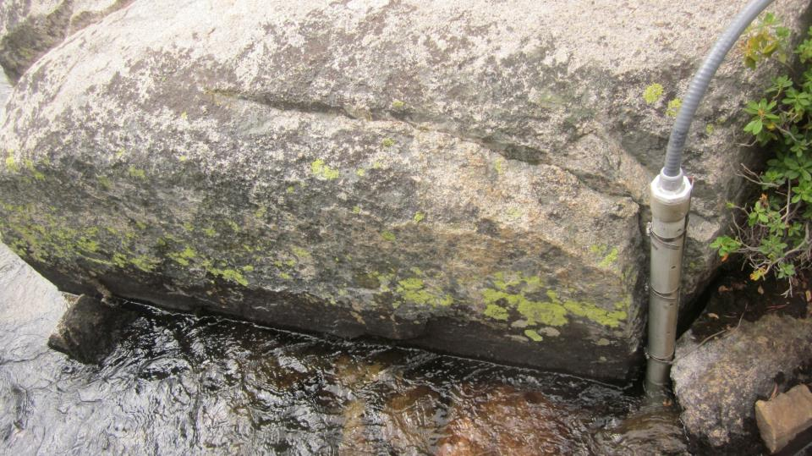
Lyell Fk. Merced River ABV High Trail
Datum:
Tape Down Bolt
(Installed August 5, 2014)
Measure from center of “X” inscribed
on face of bolt.
Gage Height = 10ft. – / + Tape Down

Slide 29
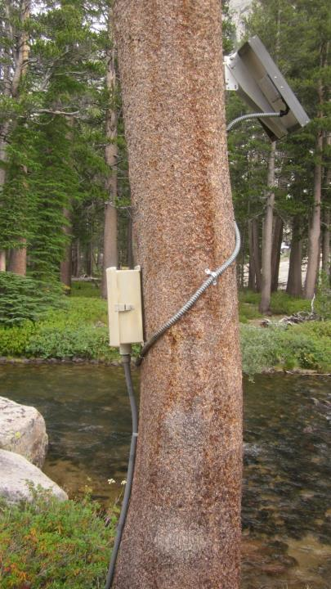
Lyell Fk. Merced River ABV High Trail
Control
Control
Point of Zero Flow(PZO) / Gage Height(GHZO) = Gage Height - Depth of Water over (deepest part of) Control
Gage Height of Zero Flow = 7.74 - .9 = 6.84 on August 5, 2014

Slide 30
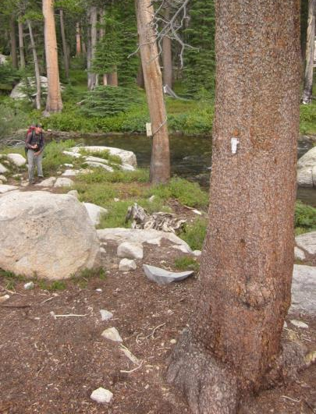
Lyell Fk. Merced River ABV High Trail
Meteorology Sensors:
Hobo Temp/RH
Tidbit Temp

Slide 31
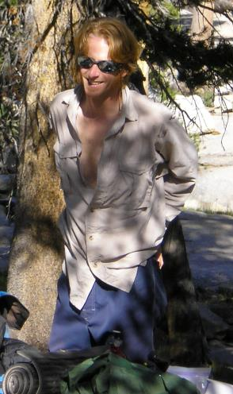
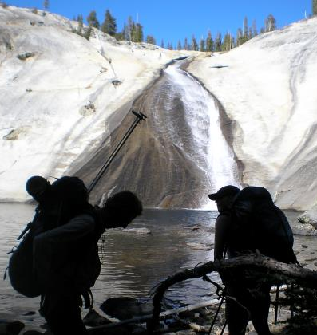
Remember the Side Burns: The integrity of each data point collected fortifies or degrades a legacy that lives on…

