Slide 1
PREDICT THE ENERGY PRODUCTION TO INCREASE THE PERFORMANCE OF THE POWER PLANTS
Nikita Jadhav
Muthyala Narendra
Pranjali Rachchawar
Sunil Chavan
Pankaj Kumar
Priyanshu Joshi

Slide 2
BUSINESS OBJECTIVE
A combined-cycle power plant comprises gas turbines, steam turbines, and heat recovery steam generators. In this type of plant, the electricity is generated by gas and steam turbines combined in one cycle.
We have to model the energy generated to Predict the energy production to increase the performance of the power plants.

Slide 3
THE VARIABLES OR FEATURES
Temperature, in degrees Celsius.
Exhaust vacuum, in cm Hg.
Ambient pressure, in millibar. (Ambient pressure)
r_humidity, in percentage. (Relative humidity)
Energy_production, in MW, net hourly electrical energy output.

Slide 4
EXPLORATORY DATA ANALYSIS (EDA)
The data types are floating point data types.
The given dataset has no null values.
The given dataset has( 9568, 5) rows and column
We found 41 duplicate values on given dataset and we cleaned that duplicate values.
Also visualize the data and check the data distribution with histplot of temperature, relative humidity, ambient pressure, exhaust vaccum.
From the dataset we found that Energy production is a dependent variable (Y)
Temperature, Relative Humidity, Ambient pressure, Exhaust vacuum are Independent variables(X)

Slide 5
Temperature
Relative Humidity
Ambient pressure Independent variable(X)
Exhaust vacuum
Energy production Dependent variable(Y)

Slide 6
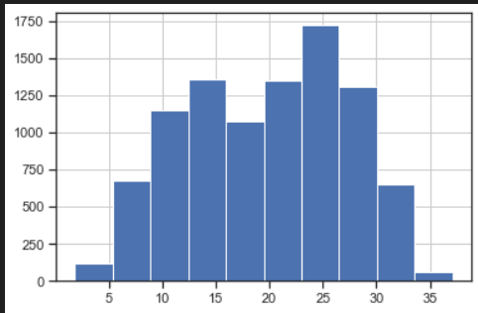
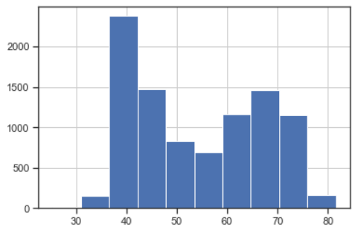
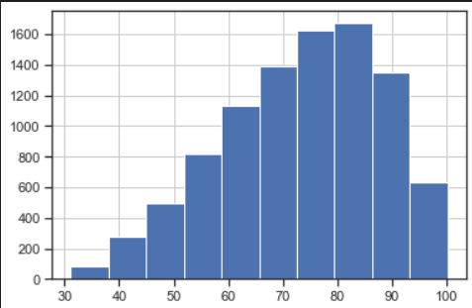
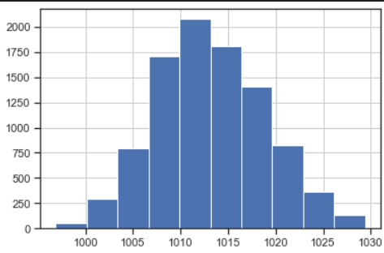
HISTPLOT
Temperature Exhaust Vacuum
Relative Humidity Ambient Pressure

Slide 7
SKEWNESS,CORRELATION AND OUTLIERS
Exhaust vacuum and Ambient pressure are right skewed or positive skewed.
Temperature and Relatively humidity are left skewed or negative skewed.
Energy productionk dependent variable is right skewed or positive skewed.
Also find outliers with some set styles.
Temperature and Exhaust vacuum are highly correlated.
We normalize data and take X is independent variable and Y is dependent variable.

Slide 8
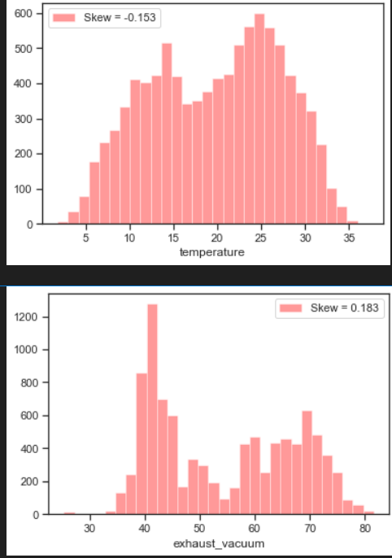
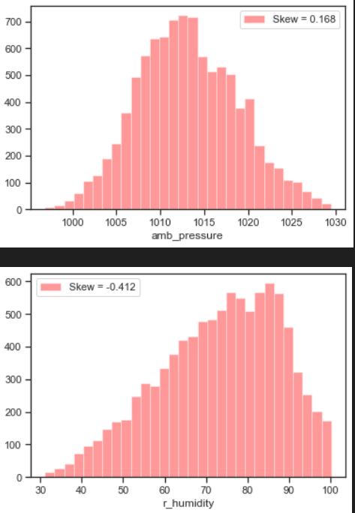
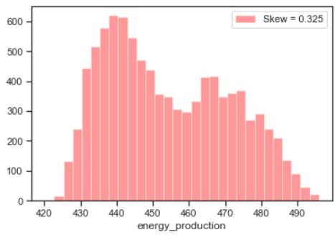
SKEWNESS

Slide 9
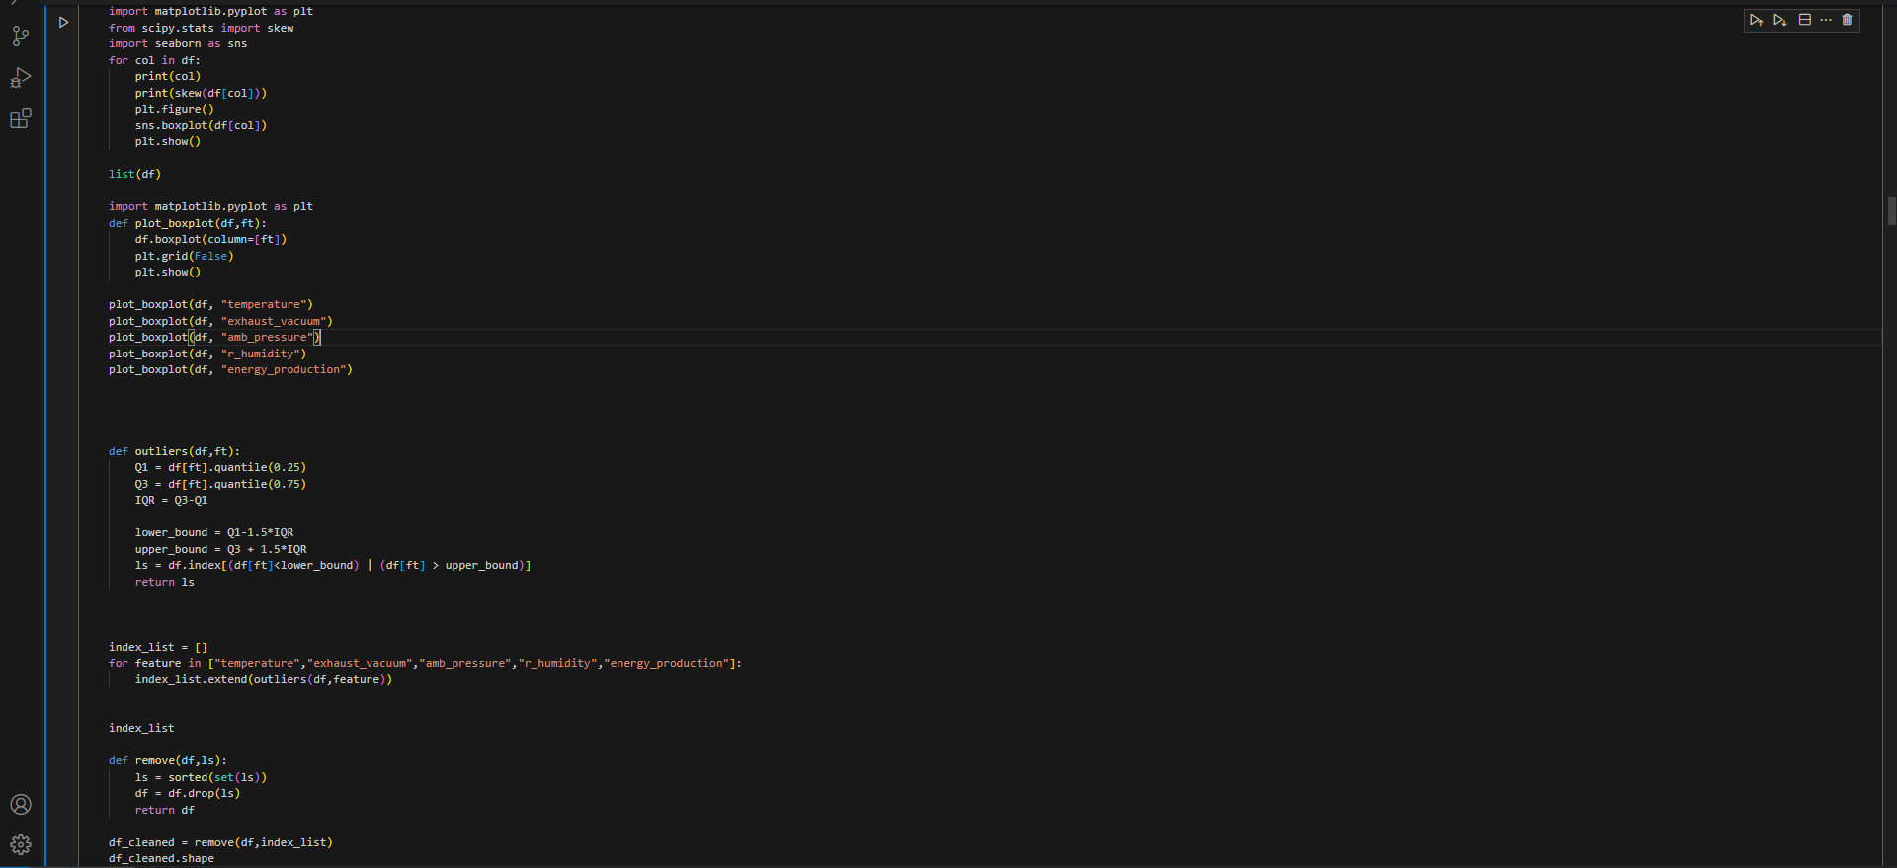
OUTLIER CHECKING USING BOX PLOT

Slide 10
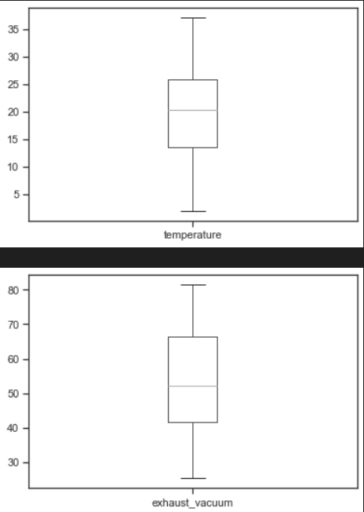
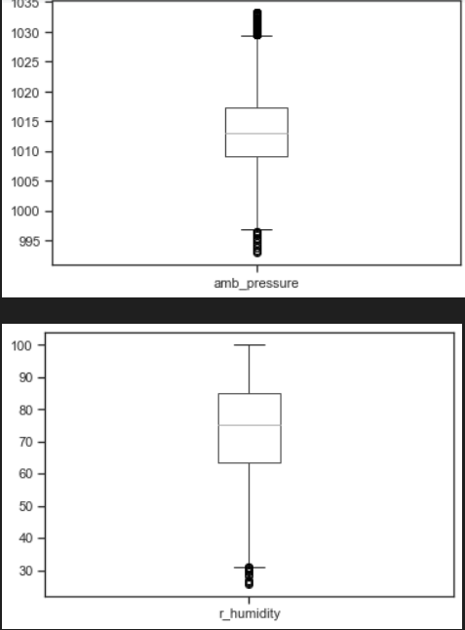
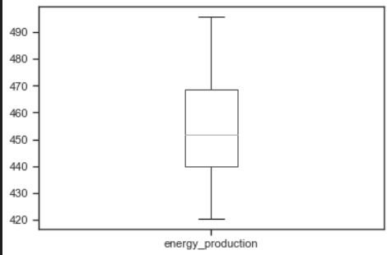

Slide 11
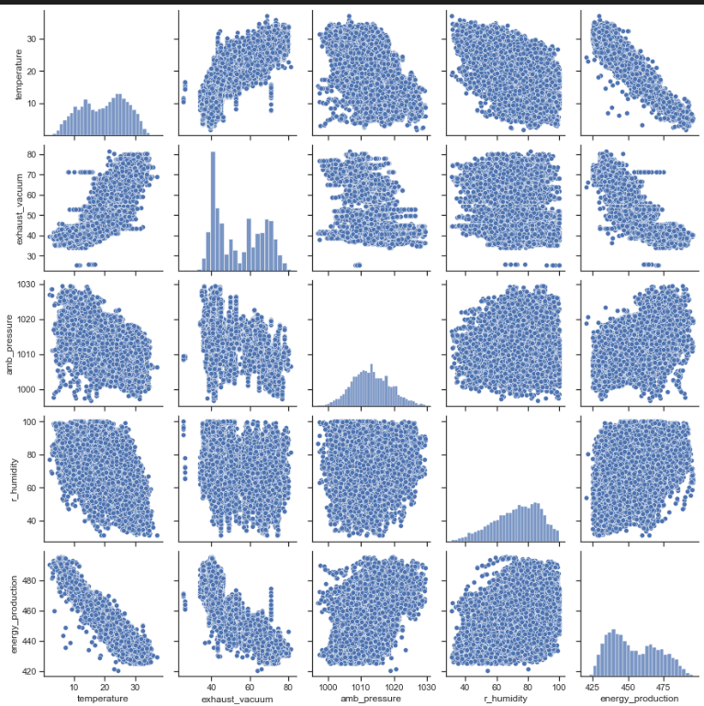
PAIRPLOT

Slide 12
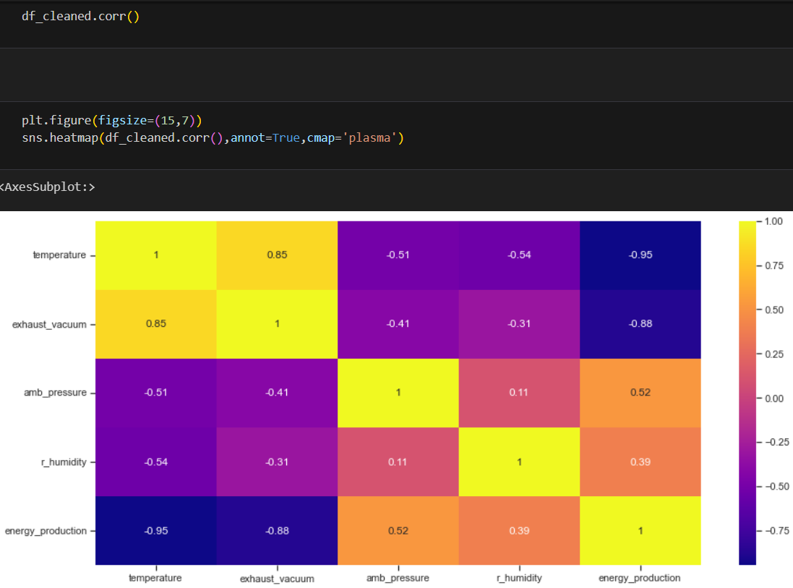
HEATMAP

Slide 13
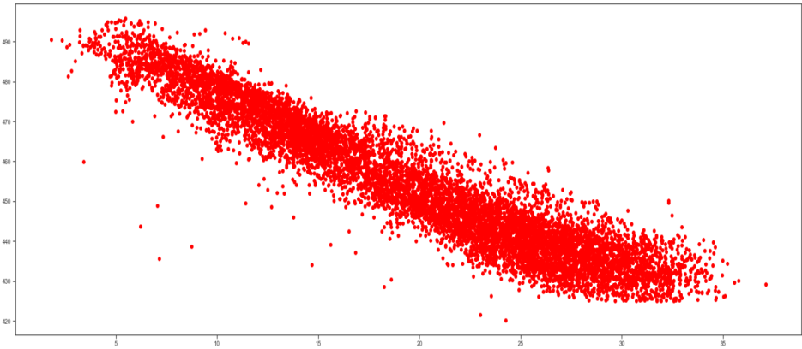
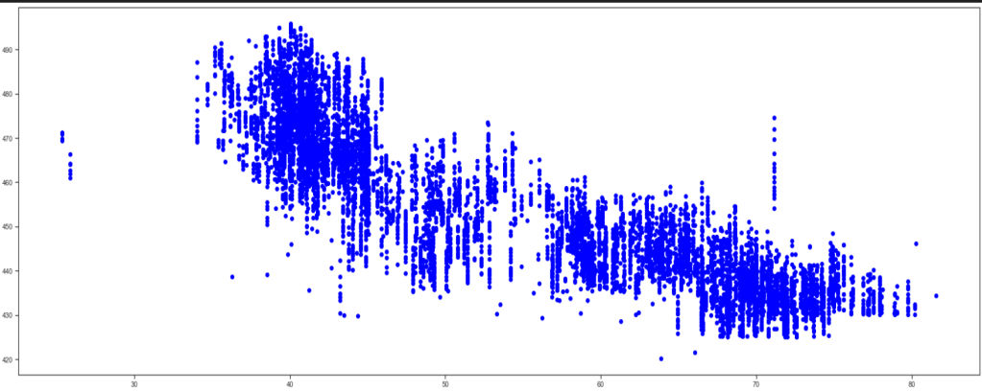
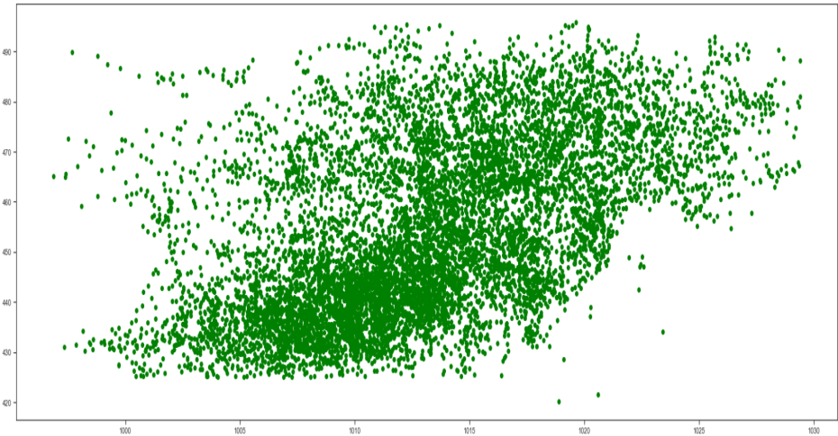
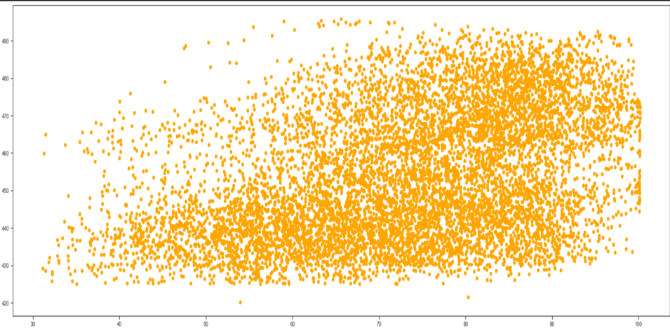
SCATTER PLOT
temperature exhaust vaccum
amb_pressure r_humidity

Slide 14
FEATURE ENGINEERING
The initial observation of the data suggests that we will need to use a linear regression model to predict the power output.
Though we have obtained a linear model earlier using the statsmodel library, it was a simple mathematical derivation using the data.
Now will use the sklearn library, which provides different machine learning models.
Feature Selection :
One of the most important steps in creating a machine learning model is to divide the data set into good predictors to train the algorithm on.

Slide 15
Model Deployment

Slide 16
Those selected features are trained on our twelve regression models,
1. Linear Regression 7. XGBoost Regression
2. Decision Tree Regression 8. Gradient Boosting Regression
3. Random Forest Regression 9. AdaBoost Regression
4. Ridge Regression
5. Lasso Regression
6. ElasticNet Regression

Slide 17
MODEL EVALUATION
For Regression problems, there are 3 key performance metrics that are used to assess how well your model is performing. There are
1.Root Mean Squared Error (RMSE): measures the average error performed by the model in predicting the outcome for an observation.
2.R-Squared: It means how much of the variation in the target variable that can be explained by the set of features used in training the model.
3.Mean Absolute Error: measures how far predicted values are away from the actual values.

Slide 18
MODEL RESULTS
Now that we have evaluated all our models, we can see that the Random Forest Algorithm (with all features) gave us the best performance. The R-squared is 0.962198 (which means that almost near by 100% of the variation in the target variable can be explained by the model).
Similarly, it yields the lowest MSE of 11.02007e⁻⁰⁷.
We can conclude from our results that Random Forest Regression should be selected as best regression model to predict future values.

Slide 19
DEPLOYMENT OF MODEL

Slide 20
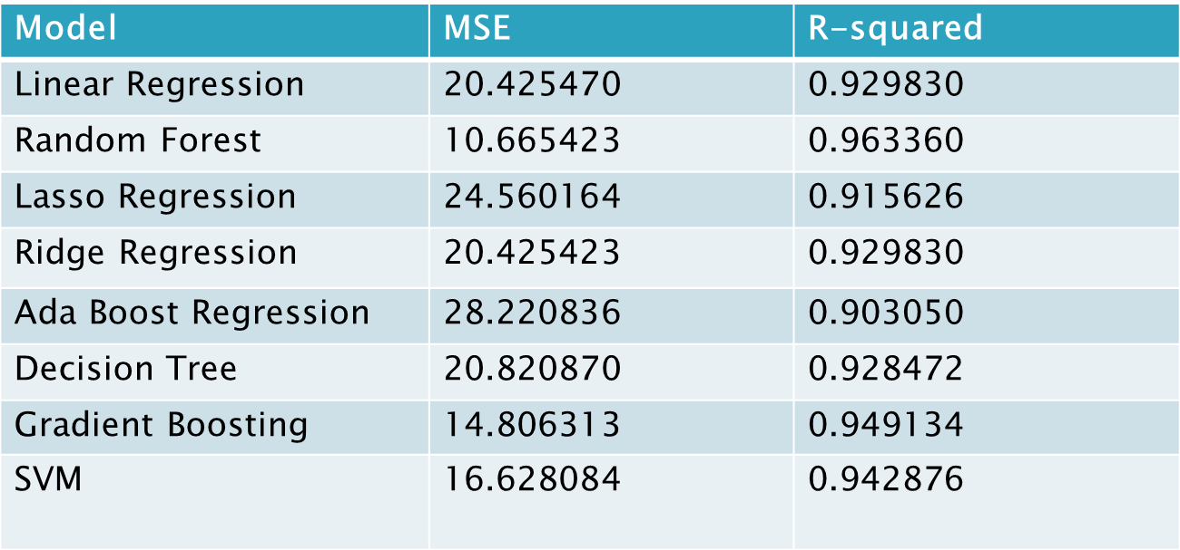

Slide 21
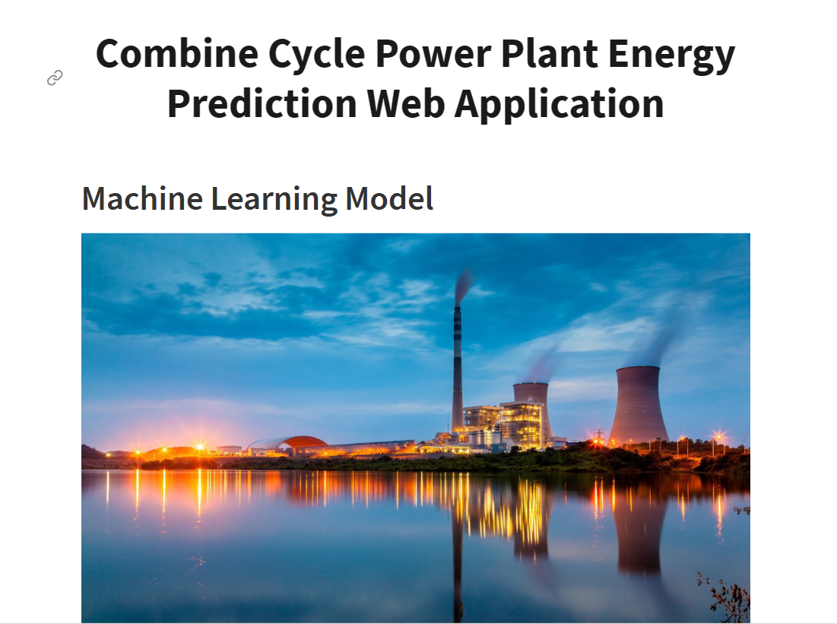

Slide 22
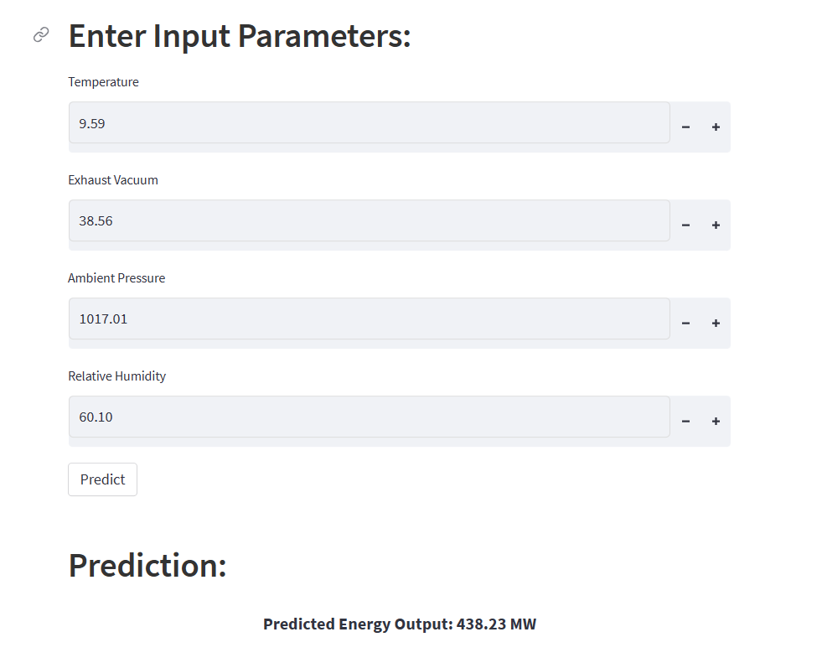

Slide 23
Thank You

