Slide 1
PREDICT THE ENERGY PRODUCTION TO INCREASE THE PERFORMANCE OF THE POWER PLANTS
Nikita Jadhav
Muthyala Narendra
Pranjali Rachchawar
Sunil Chavan
Pankaj Kumar
Priyanshu Joshi

Slide 2
BUSINESS OBJECTIVE
A combined-cycle power plant comprises gas turbines, steam turbines, and heat recovery steam generators. In this type of plant, the electricity is generated by gas and steam turbines combined in one cycle.
We have to model the energy generated to Predict the energy production to increase the performance of the power plants.

Slide 3
THE VARIABLES OR FEATURES
Temperature, in degrees Celsius.
Exhaust vacuum, in cm Hg.
Ambient pressure, in millibar. (Ambient pressure)
r_humidity, in percentage. (Relative humidity)
Energy_production, in MW, net hourly electrical energy output.

Slide 4
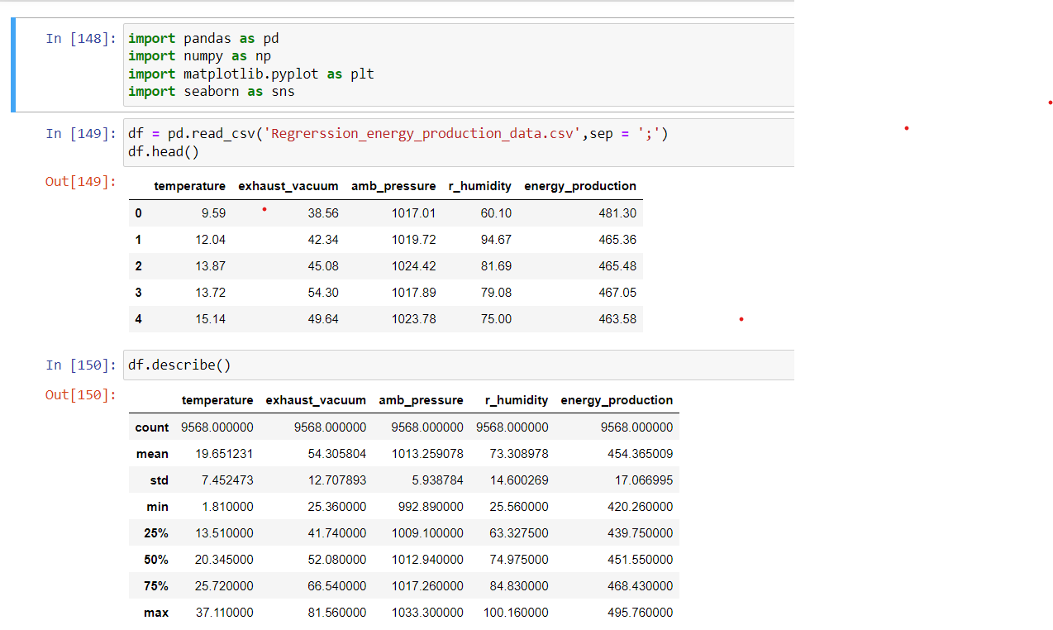
READ THE DATA INTO JUPYTER NOTEBOOK

Slide 5
Temperature
Relative Humidity
Ambient pressure Independent variable(X)
Exhaust vacuum
Energy production Dependent variable(Y)

Slide 6
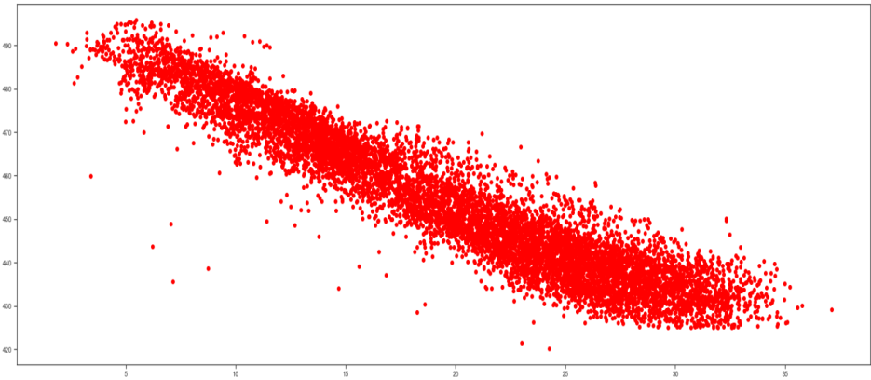
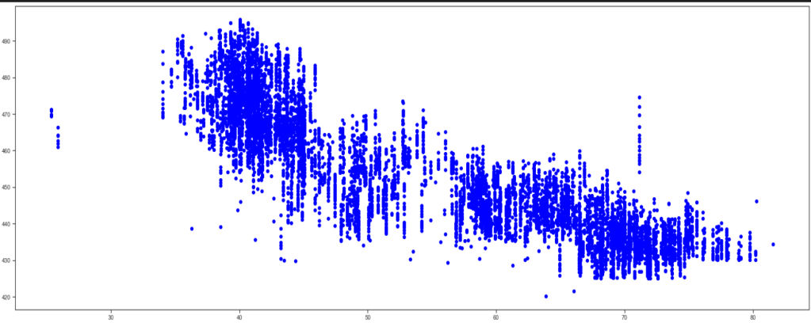
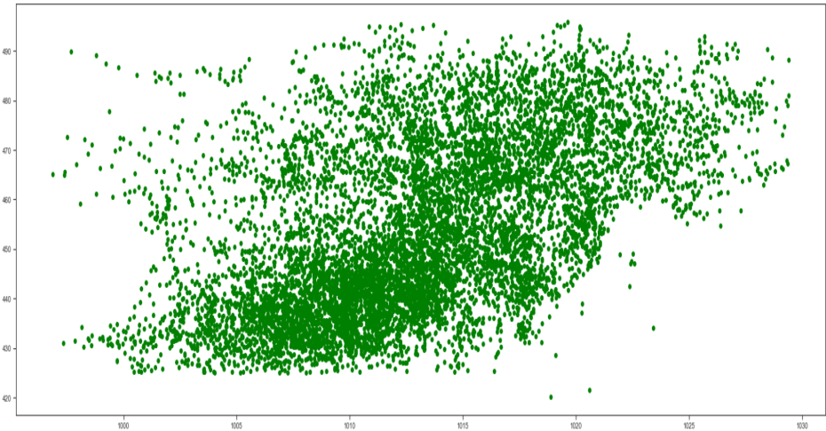
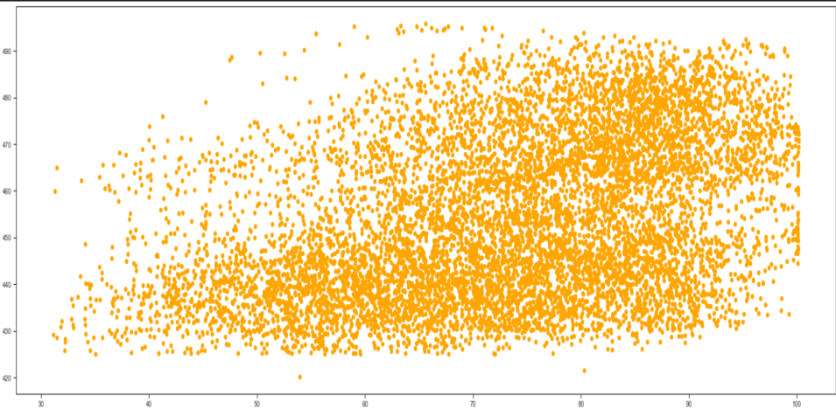
SCATTER PLOT
temperature exhaust vaccum
amb_pressure r_humidity

Slide 7
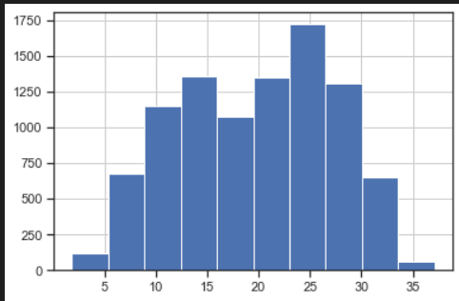
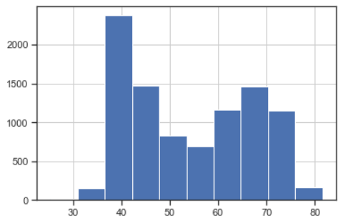
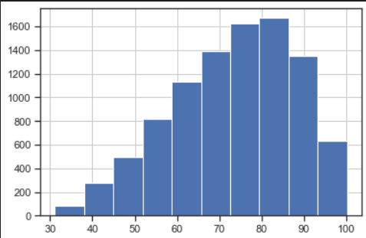
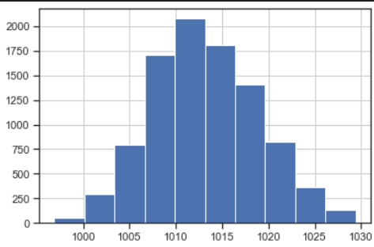
HISTPLOT
Temperature Exhaust Vacuum
Relative Humidity Ambient Pressure

Slide 8
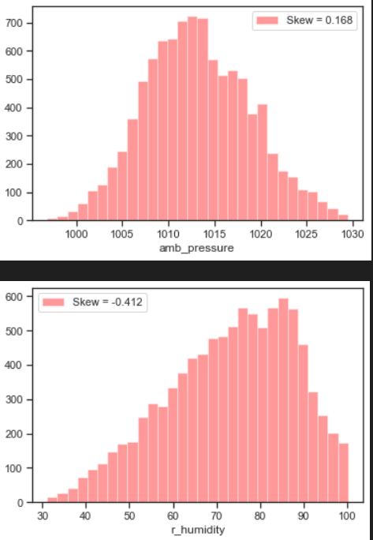
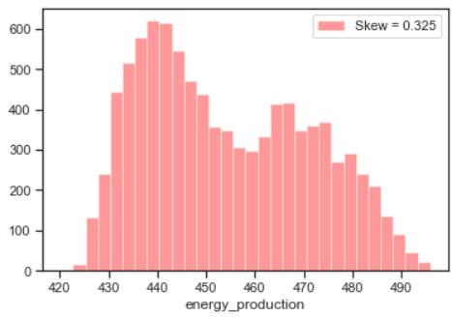
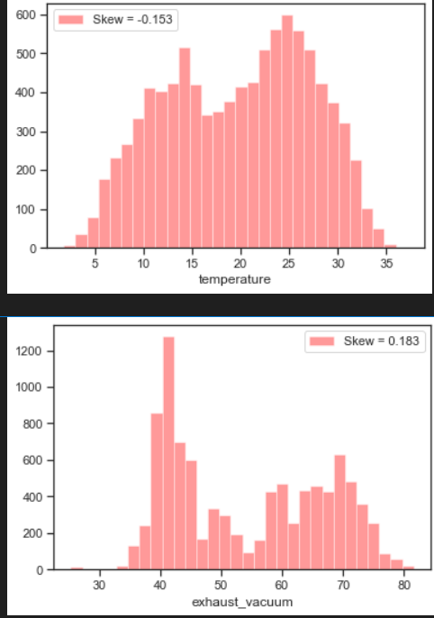
SKEWNESS
1] USING HISTOGRAM WE CHECK THE SKEWNESS OF ALL VARIABLES.

Slide 9
EXPLORATORY DATA ANALYSIS (EDA)
The data types are floating point data types.
The given dataset has no null values.
The given dataset has( 9568, 5) rows and column
We found 41 duplicate values on given dataset and we cleaned that duplicate values.
Also visualize the data and check the data distribution with histplot of temperature, relative humidity, ambient pressure, exhaust vaccum.
From the dataset we found that Energy production is a dependent variable (Y)
Temperature, Relative Humidity, Ambient pressure, Exhaust vacuum are Independent variables(X)

Slide 10
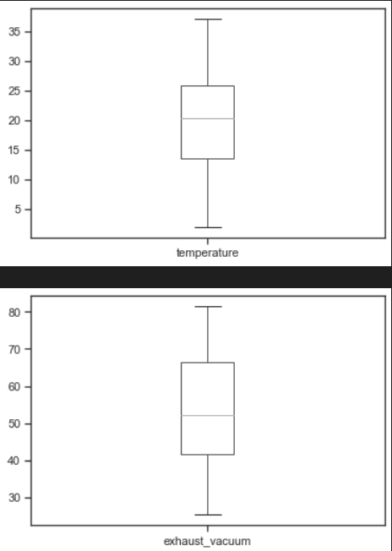
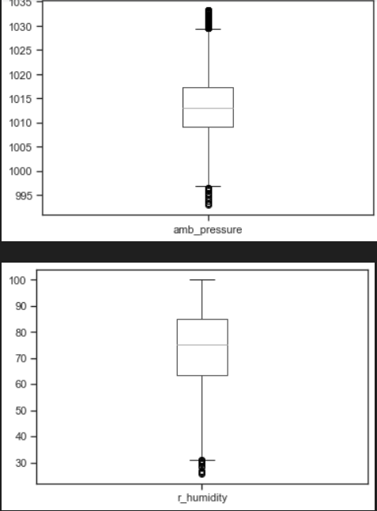
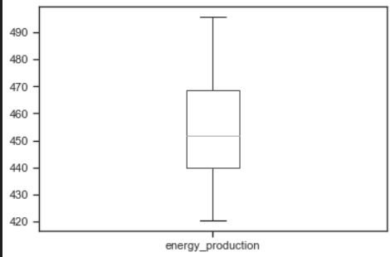
CHECKING THE OUTLIERS USING BOX PLOT .
1]WE HAVE OUTLIERS ON TWO VARIABLES.
a) AMB_PRESSURE b) R_HUMIDITY

Slide 11
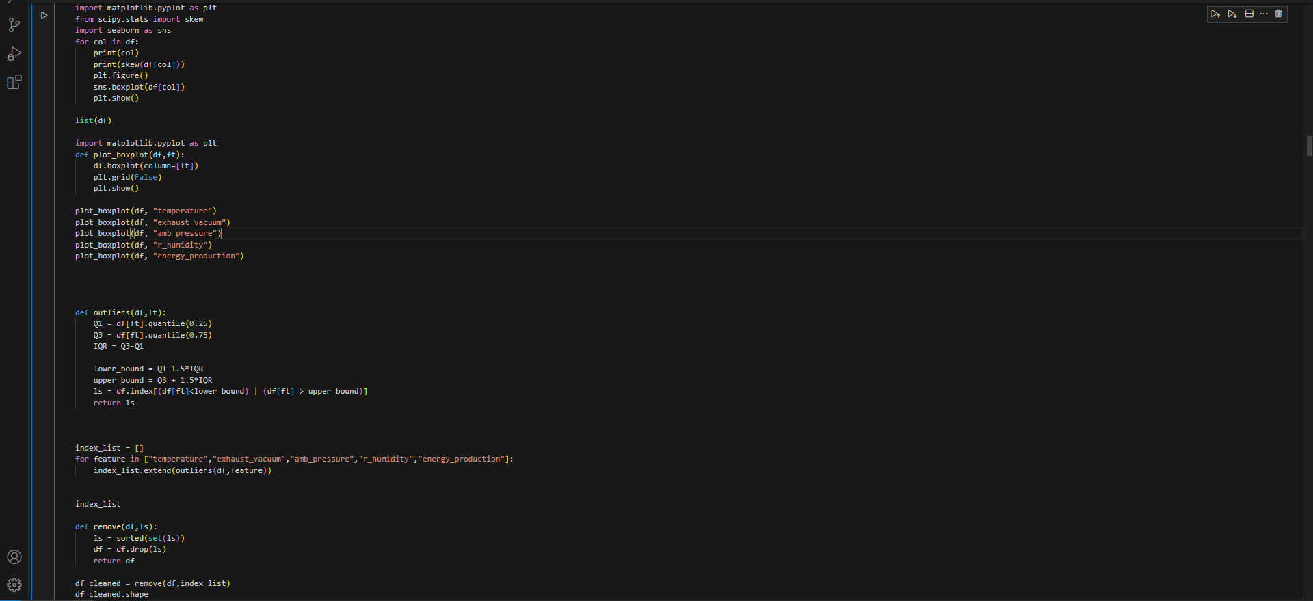
OUTLIERS
1] THIS CODE IS IDENTIFIES THE OUTLIERS.
2] IF IN CASE WE HAVE OUTLIERS THIS CODE REMOVE THE OUTLIERS.

Slide 12
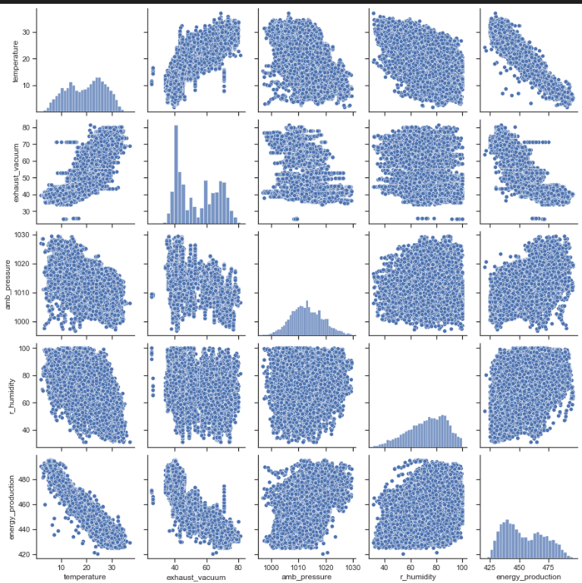
PAIRPLOT
1] USING PAIRPLOT WE CAN IDENTIFIES THE RELATIONSHIP BETWEEN INDEPENDENT VARIABLES AND DEPENDENDENT VARIABLES.
2] WE CAN ALSO IDENTIFY THE RELATIONSHIP BETWEEN INDEPENDENYT VARIANVLES ALSO.

Slide 13
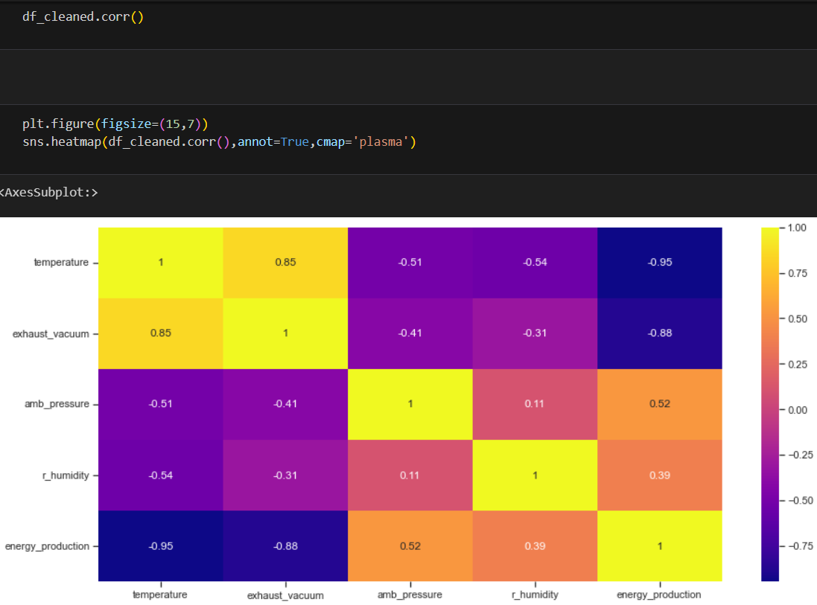
HEATMAP OF CORRELATION
1] THE CORRELATION RANGE IS LIES IN -1 TO +1.
2] -1 HIGH NEGATIVE CORRELATION. 4] O NO RELATION.
3] -0.5 WEAK NEGATIVE CORRELATION. 5] +0.5 WEAK POSITIVE CORRELATION.
6] +1 STRONG POSITIVE CORRELATION.

Slide 14
SKEWNESS,CORRELATION AND OUTLIERS
Exhaust vacuum and Ambient pressure are right skewed or positive skewed.
Temperature and Relatively humidity are left skewed or negative skewed.
Also find outliers with some set styles.
Independent variables Temperature and Exhaust vacuum are highly correlated.
Independent variable Temperature and Dependent variable Energy production are highly correlated.
We normalize our Independent variables using MinMaxScaler.

Slide 15
Thank You

