Slide 1

Growth curve inference and the related statistical problem with application in ecology
Presented by
Mouparna Mukherjee
M.Stat. (Sem-4)
Faculty Guide’s Name - Dr. Gunjan Singh
Institute Guide’s Name - Dr. Sabyasachi Bhattacharya

Slide 2
The reason behind chosing this title -
Growth curve modeling is a statistical method for analyzing the change over time points.
Research related -
Methodology of growth curve models.
Modeling population growth rates.
The density independent growth is characterized by constant per capita growth rate of the population leading to an exponential growth known as Malthusian law.
The logistic growth family is the first and most widely used candidate of the class of density dependent models. The deterministic logistic model initially proposed by Verhulst (1838).
The Gompertz Growth Curve Model (GGCM) was proposed as a model for biological growth.
Importance of Relative Growth Rate (RGR).
The autocrine regulated cell population growth curve model is an extended logistic growth law with a density dependant suppression term.
Illustration of the autocrine growth model through house lab experiment.
Conclusion.

Slide 3
Litreture Review -
Growth Curve model (Exponential,Logistic,Gompertz) is the mathematical framework of growth in applied science areas.
Growth rate (RGR,AGR) associated with the process to understand the phenomenon of growth.
Objective -
Identification of growth law and estimation of its parameters based on any dataset.
We use non-linear least squares and check other optimum parameters based on statistical inference problems.

Slide 4
Methodology of growth curve models

Slide 5
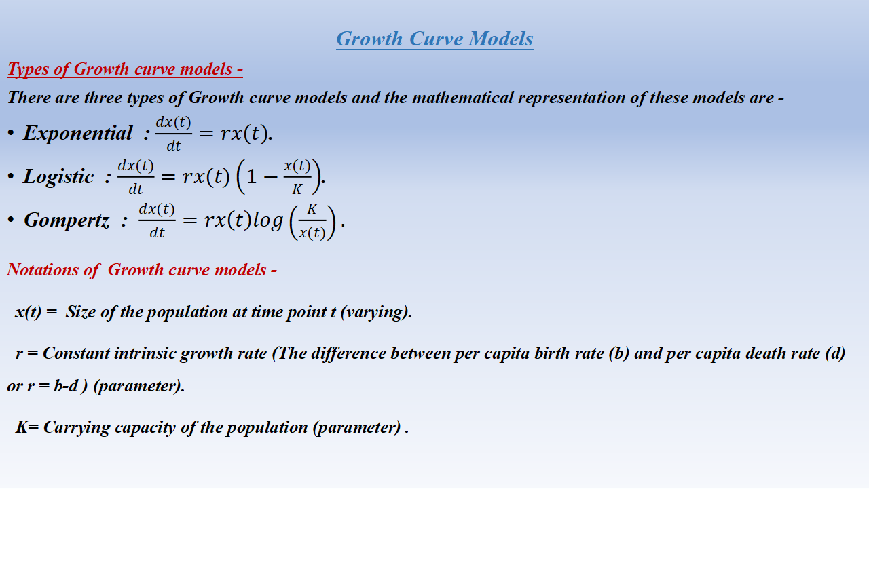
Growth Curve Models
Types of Growth curve models -
There are three types of Growth curve models and the mathematical representation of these models are -
Exponential : $\frac{dx(t)}{dt}=rx(t)$.
Logistic : $\frac{dx(t)}{dt}=rx(t)\left(1−\frac{x(t)}{K}\right)$.
Gompertz : $\frac{dx(t)}{dt}=rx\left(t\right)log\left(\frac{K}{x(t)}\right).$
Notations of Growth curve models -
x(t) = Size of the population at time point t (varying).
r = Constant intrinsic growth rate (The difference between per capita birth rate (b) and per capita death rate (d) or r = b-d ) (parameter).
K= Carrying capacity of the population (parameter) .

Slide 6
Modeling population growth rates

Slide 7
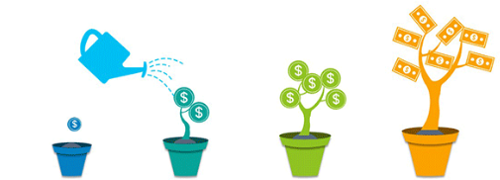
About Growth Rate
Growth rate refer to the percentage of change of a specific variable within a specific time period.
For ex: Growth of a plant (here, plant is a specific variable which are changing within a specific time period) .

Slide 8
General equation of population growth rate
A general equation for the population growth rate is dN /dt=rN.
Notations of general equation of population growth rate -
r = Constant intrinsic growth rate (The difference between per capita birth rate (b) and per capita death rate (d)) (parameter).
t = Time points (changing according to population size increasing or decreasing).
N= Population size (changing (increasing or decreasing) according to time points(t)).
Both time points (t) and population size (N) depends on each other.
From the above general equation of population growth rate we get ,
1/N*dN / dt = b-d=r (rate of relative increment (RGR)).
=> dN / dt =rN , or, r*N (rate of increment (AGR)).

Slide 9
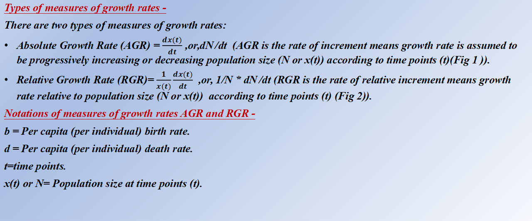
Measures of population growth rates
Types of measures of growth rates -
There are two types of measures of growth rates:
Absolute Growth Rate (AGR) = $\frac{dx(t)}{dt}$ ,or,dN /dt (AGR is the rate of increment means growth rate is assumed to be progressively increasing or decreasing population size (N or x(t)) according to time points (t)(Fig 1 )).
Relative Growth Rate (RGR)= $\frac{1}{x(t)}\frac{dx(t)}{dt}$ ,or, 1/N * dN /dt (RGR is the rate of relative increment means growth rate relative to population size (N or x(t)) according to time points (t) (Fig 2)).
Notations of measures of growth rates AGR and RGR -
b = Per capita (per individual) birth rate.
d = Per capita (per individual) death rate.
t=time points.
x(t) or N= Population size at time points (t).

Slide 10
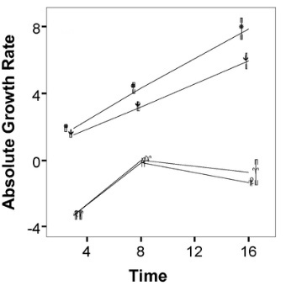
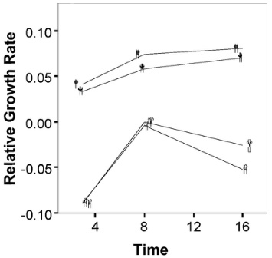
Graphical presentation of measures of population growth rates
AGR is the rate of increment (Fig 1)
From this figure, we observe that AGR is increasing from 0 to 8 and AGR is decreasing from 0 to -4.
RGR is the rate of relative increment (Fig 2)
From this figure, we observe that RGR is increasing from 0.05 to 0.10 and RGR is decreasing from 0.00 to -0.10.

Slide 11
The density independent growth is characterized by constant per capita growth rate of the population leading to an exponential growth known as Malthusian law

Slide 12
About exponential growth curve model
The exponential growth curve model refer as greater increase population size (x(t)) with passing time points (t).
For ex: Human population is increasing exponentially.

Slide 13
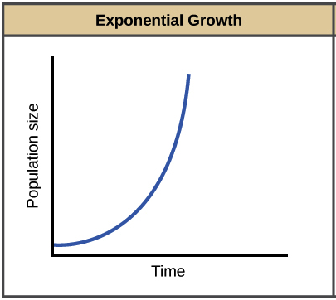
Graphical presentation of exponential growth curve model
From this figure,we can observe that the blue color line indicating the limitless growth of population size in accordance with time.
The exponential growth curve model looks like a J-Shaped curve.

Slide 14
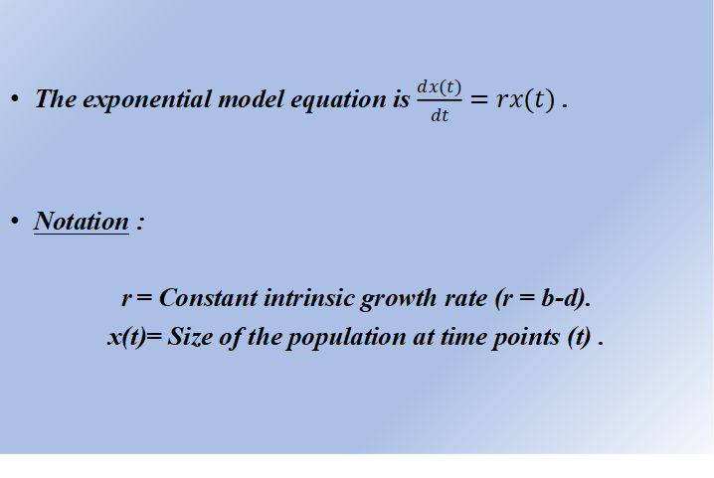
Equation of exponential growth curve model
The exponential model equation is $\frac{dx(t)}{dt}=rx(t)$ .
Notation :
r = Constant intrinsic growth rate (r = b-d).
x(t)= Size of the population at time points (t) .

Slide 15
Some properties of exponential growth curve model
The exponential growth curve model generates limitless growth .
In the exponential growth curve model,absolute growth rate (AGR) can take any r values as positive which indicate birth rate increasing (population size growing) (+r) (Fig 1),or, absolute growth rate (AGR) can take any r values as negative which indicate birth rate decreasing (population size decaying) (-r) (Fig 2) according to the time points (t).
In the exponential growth curve model, the relative growth rate (RGR) values remain always constant for the given constant intrinsic growth rate (r) .

Slide 16
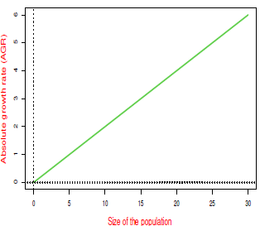
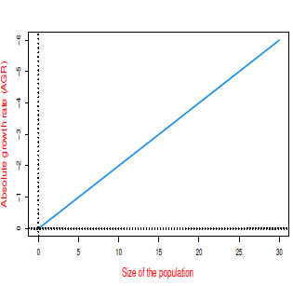
Graphical presentation of properties of exponential growth curve model
Fig 1
From this figure, we observe that AGR values increases with the increasing values of the population size for positive r values (+r).
Fig 2
From this figure, we observe that AGR values also increases with the decreasing values of the population size for negative r values (-r).

Slide 17
The logistic growth family is the first and most widely used candidate of the class of density dependent models. The deterministic logistic model initially proposed by Verhulst (1838)

Slide 18
About logistic growth curve model
In logistic growth curve model, per capita (per individual) growth rate gets smaller and smaller as population size (x(t)) approaches to maximum value which is known as carrying capacity (K) (as shown in Fig).
Logistic growth equation is an extension to the exponential model for understanding the limiting form (limited growth).
For ex : Population of seals shows real-world fluctuation.

Slide 19
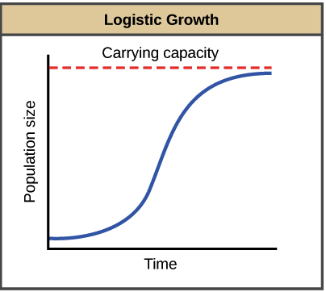
Graphical presentation of logistic growth curve model
From this figure,we can observe that the blue color line indicating that it reaches to the max. value of carrying capacity (K) (which indicated as red dotted line) in accordance with time points (t) and population size (x(t)).
The logistic growth curve model produce S-shaped curve.
Notations :
K= Carrying capacity of the population.
x(t) = Population size at time points t.

Slide 20
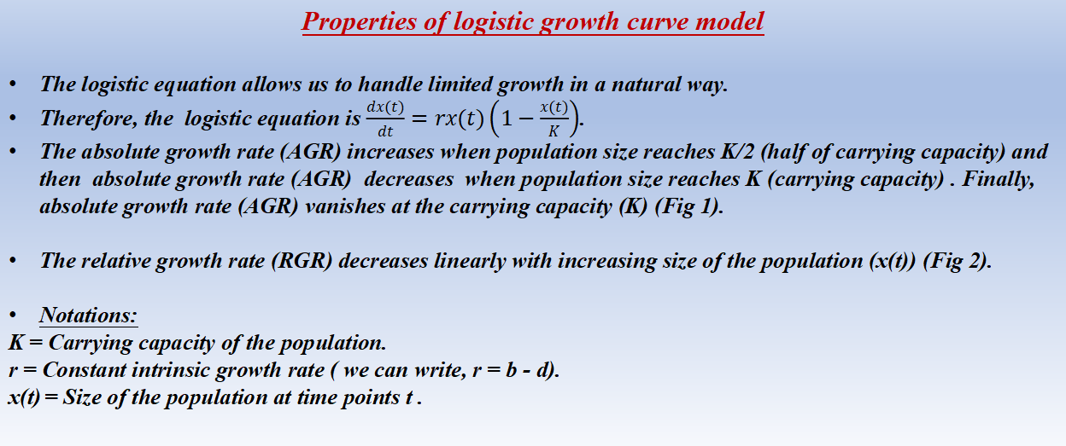
Properties of logistic growth curve model
The logistic equation allows us to handle limited growth in a natural way.
Therefore, the logistic equation is $\frac{dx(t)}{dt}=rx(t)\left(1−\frac{x(t)}{K}\right)$.
The absolute growth rate (AGR) increases when population size reaches K/2 (half of carrying capacity) and then absolute growth rate (AGR) decreases when population size reaches K (carrying capacity) . Finally, absolute growth rate (AGR) vanishes at the carrying capacity (K) (Fig 1).
The relative growth rate (RGR) decreases linearly with increasing size of the population (x(t)) (Fig 2).
Notations:
K = Carrying capacity of the population.
r = Constant intrinsic growth rate ( we can write, r = b - d).
x(t) = Size of the population at time points t .

Slide 21
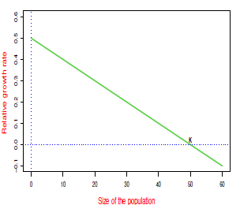
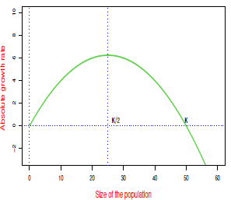
Graphical presentation of properties of logistic growth curve model
Fig 1
From this figure we observe that, AGR increases when the population size reaches K/2 and AGR decreases when population size reaches K.Finally, AGR vanishes at the carrying capacity (K) .
Fig 2
From this figure we observe that, RGR decreases linearly with the increasing size of the population .

Slide 22
The Gompertz Growth Curve Model (GGCM) was proposed as a model for biological growth

Slide 23
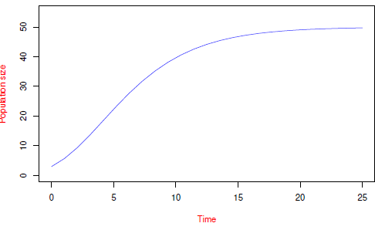
About gompertz growth curve model (GGCM)
The Gompertz model is well known and widely used in many aspects of biology.
From this figure, we observe that
GGCM looks like Sigmoid shaped or S - shaped model.

Slide 24
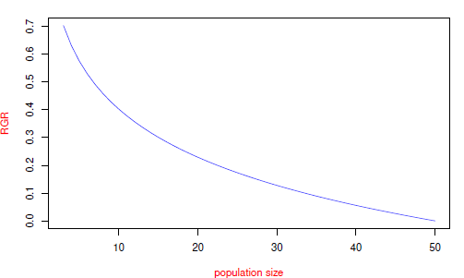
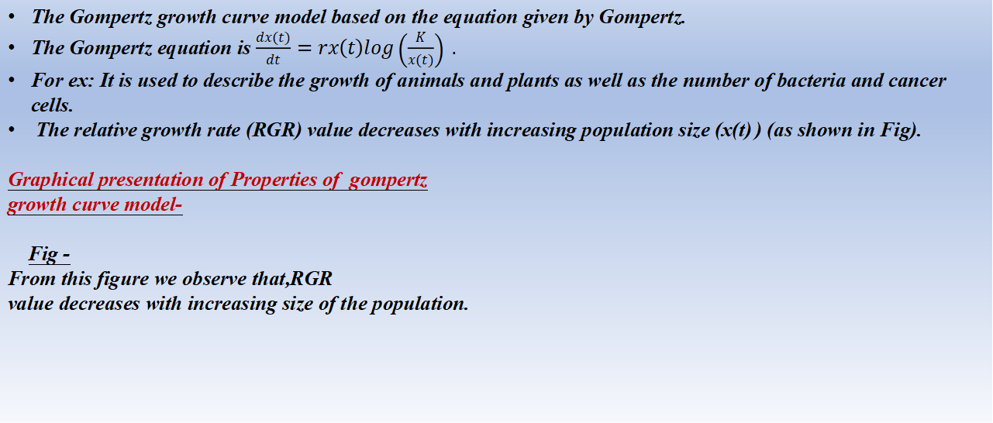
Properties of gompertz growth curve model
The Gompertz growth curve model based on the equation given by Gompertz.
The Gompertz equation is $\frac{dx(t)}{dt}=rx\left(t\right)log\left(\frac{K}{x(t)}\right) .$
For ex: It is used to describe the growth of animals and plants as well as the number of bacteria and cancer cells.
The relative growth rate (RGR) value decreases with increasing population size (x(t) ) (as shown in Fig).
Graphical presentation of Properties of gompertz
growth curve model-
Fig -
From this figure we observe that,RGR
value decreases with increasing size of the population.

Slide 25
Importance of Relative Growth Rate (RGR)

Slide 26
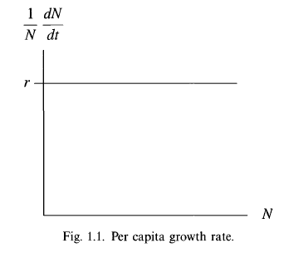
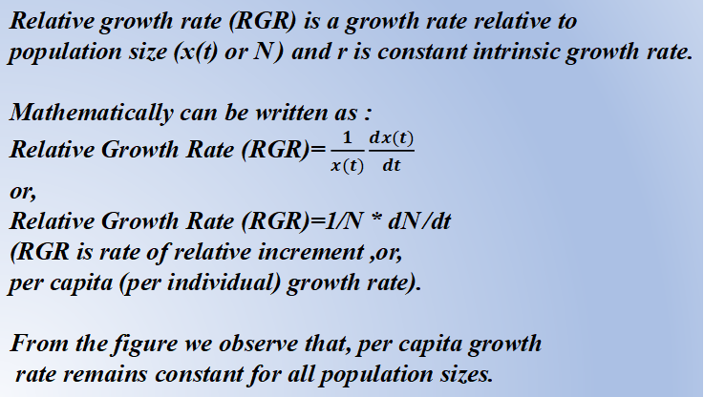
About RGR
Relative growth rate (RGR) is a growth rate relative to
population size (x(t) or N ) and r is constant intrinsic growth rate.
Mathematically can be written as :
Relative Growth Rate (RGR)= $\frac{1}{x(t)}\frac{dx(t)}{dt}$
or,
Relative Growth Rate (RGR)=1/N * dN /dt
(RGR is rate of relative increment ,or,
per capita (per individual) growth rate).
From the figure we observe that, per capita growth
rate remains constant for all population sizes.

Slide 27
Properties of RGR
RGR (r) is constant so it is density independent (cannot increase or decrease).
Reason-
RGR (r) is constant means r = 0 is constant (Fig 1) and r > 0 means population is increasing (growing) (Fig 2) and r < 0 means population is decreasing (decaying) (Fig 3).
For ex: The exponential model.

Slide 28
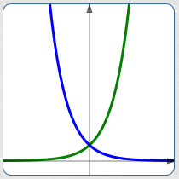
For graphically understanding of RGR
Fig1
Here, r is denoted as RGR (constant).
From this figure, we observe that the growth rate is relative to the current population.

Slide 29
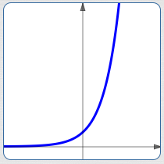
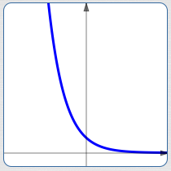
For graphically understanding of RGR
Fig 3
From this figure we observe that,when r <0 then population is decreasing (decaying).
Fig 2
From this figure we observe that,when r > 0 then population is increasing (growing).

Slide 30
Properties of RGR -
RGR is decreasing with size so it is density dependent size covariate (Fig 1).
For ex:The logistic model.
RGR is decreasing with time so it is density dependent time covariate (Fig 2).
For ex:The gompertz model.
Reasons -
From these two above lines we observe that , when per capita (per individual) growth rate changes with
increasing population density.

Slide 31
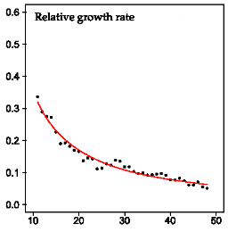
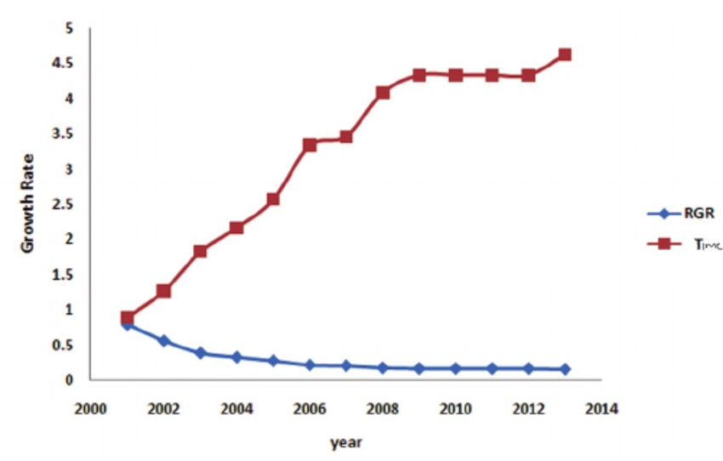
For graphically understanding of RGR
From this fig we observe that,RGR is decreasing with size so it is density dependent size covariate (Fig 1).
From this fig we observe that,RGR is decreasing with time so it is density dependent time covariate (Fig 2).

Slide 32
Autocrine regulated cell population growth curve model
The autocrine regulated cell population growth curve model is an extended logistic growth law
with a density dependant suppression term

Slide 33
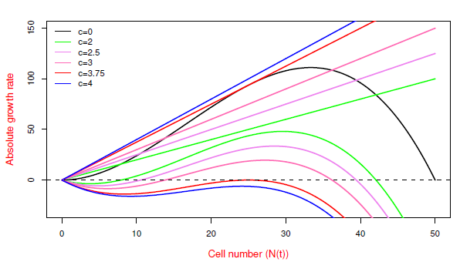
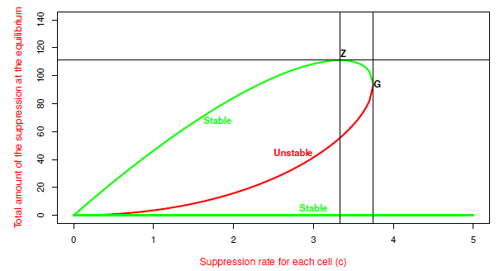
About autocrine regulated cell population growth curve model
The autocrine regulated model determines the Maximum Sustainable Total Suppression (MSTS) level on the cell population.
MSTS will maintain a healthy balance between cell proliferation and suppression of an average autocrine population’s cells.
The concept of MSTS over the model has been developed graphically in Fig 1,Fig2 and Fig3.
From these figures,we will get the idea of combined effect of proliferation and suppression of an average autocrine population’s cells. This will discuss in the next slides.
Fig 1
From this figure we observe that, effect of inhibition is observed for different values of suppression rates in autocrine regulated cell population growth.
Fig 2
From this figure we observe that,total amount of the suppression at the
nonzero equilibrium points changes with varying model parameter c.

Slide 34
Graphical presentation of autocrine regulated cell population growth curve model (1)
The figure 1 indicate that, the straight lines of different colors in the same figure represent the total amount of the suppression for different values of the suppression rate per cell (c).The curved lines of different colors show the combined effect of both proliferation and suppression on cell growth. The black color curve represents the
tumor growth in the absence of any suppression (c = 0).The total amount of the suppression (cN(t)) increases with the increment of per cell suppression rate (c).The total amount of suppression increasing the lag phase and the lag phase of cell growth is short.

Slide 35
Graphical presentation of autocrine regulated cell population growth curve model (2)
The figure 2 indicate that, the bifurcation diagram represents the total amount of the suppression at the equilibrium points against suppression rate per cell (c). Among three branches, green color curves represent the total amount of the suppression at the stable equilibrium point.The red one represents the total amount of the suppression at the unstable equilibrium point.The total suppression amount for stable equilibrium reaches its highest value at the point of Z. Hence, Z is the MSTS. The total amount of the suppression at
stable and the unstable equilibrium one collide in the break-point G disappear in a fold and we get saddle-node bifurcation.

Slide 36
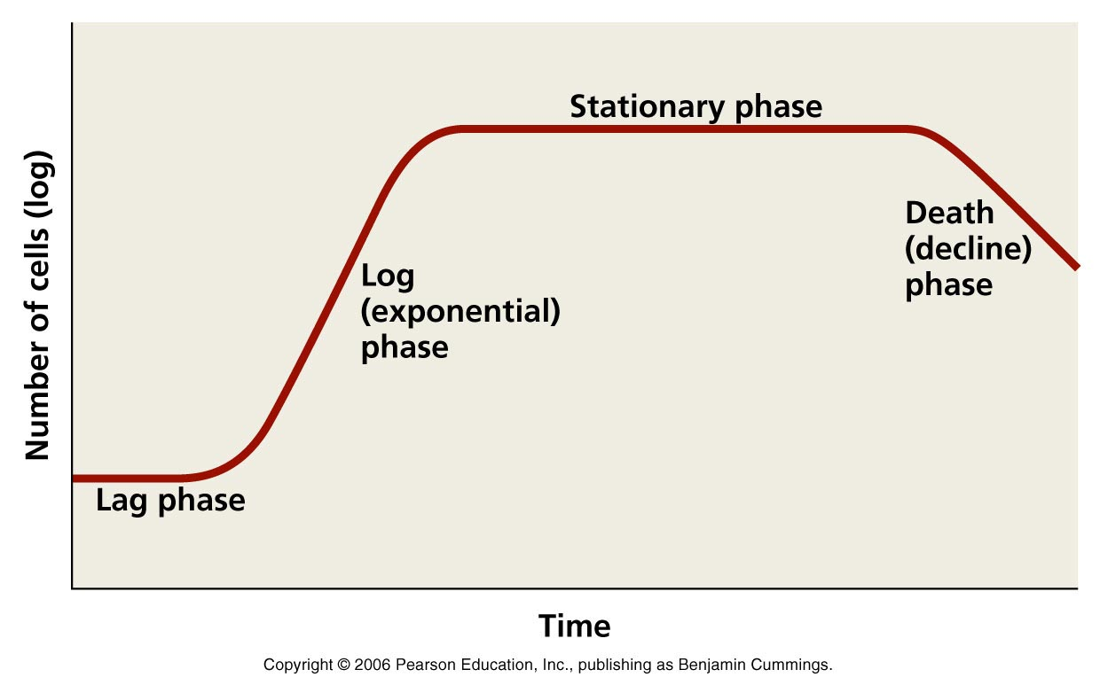
Graphical presentation of autocrine regulated cell population growth curve model (3)
Fig 3
This figure indicate that there are four phases of growth curve model. Here number of cells are growing or decaying (changing) according to the time:
Lag phase (cells start growing by their own)
Log or
exponential phase (cells grow or decay)
Stationary phase (cells remain constant)
Death phase (cells die)
Therefore, MSTS will play a significant role in controlling cell
proliferation under the autocrine system which are shown in three figures.

Slide 37
Illustration of the autocrine growth model through
house lab experiment

Slide 38
Some steps of the autocrine growth model are as follows:-
We numerically solve the autocrine growth equation for q time points using ODE solver (desolve package) of R software.
We treat the numerical solution of q* 1dimension as the population mean vector with q components of the random vector as denoted by (N(1), N(2), . . . , N(q))’.
The population variance-covariance matrix of the vector (N(1), N(2), . . . , N(q))’ is assumed to be Koopman’s structure and varying standard deviations sigma for the proliferating and decaying cell population.
We draw a random sample of size 1000 from the multivariate normal population and calculate RGR values for each of (q -1) time points.
We fit the model parameters based on the RGR equation through nonlinear least square for each of 1000 samples.
We evaluate the average of autocorrelation parameter based on the estimate obtained from 1000 samples.
We performed t-test for testing the significance of autocorrelation parameter. Here,degrees of freedom is (q-1)-2= q-3. (Here two more parameters are K=Carrying capacity,c=number of cells are taken. So, we write : (q-1)-2=q-3).
If the t-test is accepted then there is no autocorrelation in the error structure.
The non-linear regression estimates are evaluated by using steps from 1-6 for varying sigma values.
We observe the estimated values of the model parameters from the summary statistics of the fitting.
We calculate the percentage of error for the model parameter.
We calculate the require estimate equilibrium and inflection points and other important findings for the autocrine regulated cell population growth.

Slide 39
Conclusion
We have studied the growth curve models extensively in this project work. Starting from the basic Malthus law, the two other fundamental laws of size and time covariate family are focused. The review of the other extended models of the logistic family is also explored. As a tested study, we focus on the autocrine system of cell growth which is available in the existing literature. The basic steps and relative statistical inference of the model have been explored in this work. Finally, this study can give us a clue for regulating cell growth dynamics in system biology.

Slide 40
References
Kot, M., 2001. Elements of mathematical ecology. Cambridge University Press.
Chakraborty, B., Bhowmick, A.R., Chattopadhyay, J. and Bhattacharya, S., 2019. A novel unification method to characterize a broad class of growth curve models using relative growth rate. Bulletin of mathematical biology, 81(7), pp.2529-2552.
Tabatabai, G. and Weller, M., 2011. Glioblastoma stem cells. Cell and tissue research, 343(3), pp.459-465.
Sau, A., Saha, B. and Bhattacharya, S., 2020. An extended stochastic Allee model with harvesting and the risk of extinction of the herring population. Journal of Theoretical Biology, 503, p.110375.
Saha, B., Bhowmick, A.R., Chattopadhyay, J. and Bhattacharya, S., 2013. On the evidence of an Allee effect in herring populations and consequences for population survival: A model-based study. Ecological modelling, 250, pp.72-80.
Paul, A., Reja, S., Kundu, S. and Bhattacharya, S., 2021. COVID-19 pandemic models revisited with a new proposal: Plenty of epidemiological models outcast the simple population dynamics solution. Chaos, Solitons & Fractals, 144, p.110697.
Kundu, S., Mukherjee, J., Yeasmin, F., Basu, S., Chattopadhyay, J., Ray, S. and Bhattacharya, S., 2018. Growth profile of Chaetoceros sp. and its steady state behaviour with change in initial inoculum size: a modelling approach. CURRENT SCIENCE, 115(12), p.2275.

Slide 41


