Slide 1
IBM University Engagement Project Submission
“Exploring the Power of Agentic AI with IBM Granite and LangFlow”

Slide 2
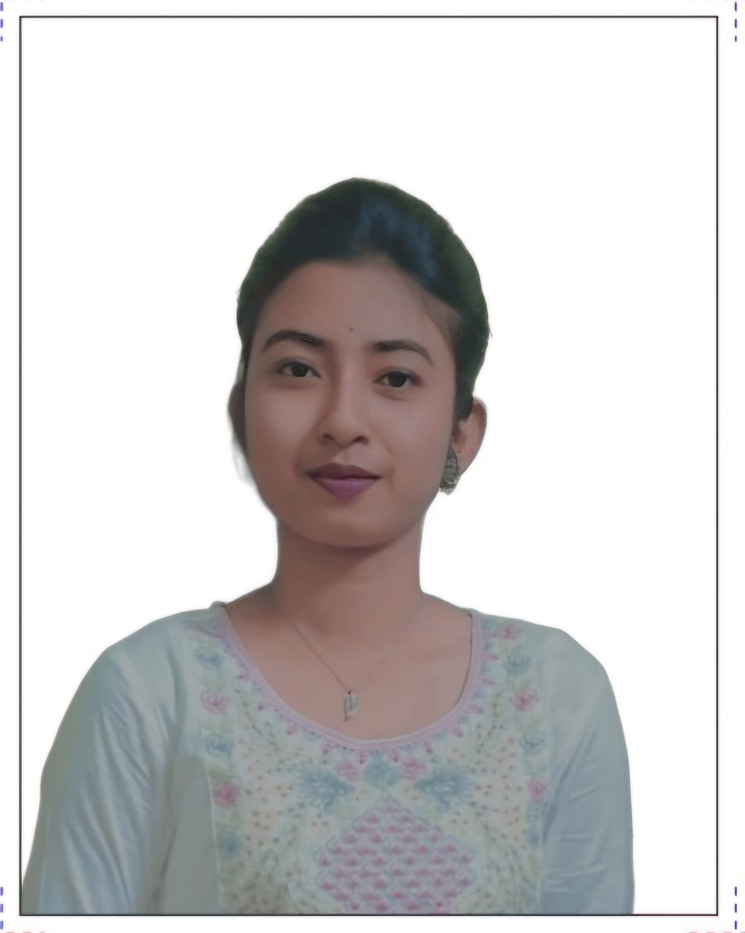
Project Tile – [Predictive Maintenance of Industrial Machinery]
Domain of Project – [Manufacturing / Industrial Engineering (Machine Learning) ]
Student Name | Recent Passport Photo | Email ID | Mobile number [WhatsApp]
Moupiya Manna |  | manna.moupiya22@gmail.com | 8420942842

Slide 3
Problem Statement - Predictive Maintenance of Industrial Machinery
The Challenge
Industrial machinery operates continuously in manufacturing environments, but unexpected equipment failures lead to costly downtime, production losses, and safety hazards. Maintenance teams currently rely on fixed schedules or reactive repairs — replacing parts too early wastes resources, while replacing them too late causes breakdowns. Without real-time, data-driven failure prediction, factories cannot distinguish between a machine operating normally and one on the verge of failure.
The Objective
Build an AI-powered Predictive Maintenance System that uses live sensor data to classify machine health and predict the type of failure before it occurs — enabling proactive maintenance decisions. The solution should:
Multi-Class Failure Detection – Identify the exact failure type: Heat Dissipation, Power Failure, Overstrain, Tool Wear, or Random Failure — not just binary fault/no-fault.
Sensor-Based Prediction – Use real operational sensor readings (air temperature, process temperature, rotational speed, torque, tool wear) as input features.
Class Imbalance Handling – Apply SMOTE oversampling and Macro-F1 optimisation to ensure rare failure classes are detected — not ignored.
Multi-Model Comparison – Train and compare Logistic Regression, Decision Tree, Random Forest, and Gradient Boosting classifiers to select the best performer.
Interactive Prediction App – Allow maintenance engineers to enter live sensor readings and receive instant failure predictions with confidence scores and recommended actions.
Responsible AI – Minimise false negatives (missed failures) which are the most dangerous outcome in industrial settings, using balanced class weights and recall-focused metrics.

Slide 4
Proposed Solution - Predictive Maintenance of Industrial Machinery
The proposed solution is an AI-powered Predictive Maintenance System built using IBM Bob IDE, scikit-learn, and Streamlit to provide real-time machine failure detection and classification. The system addresses challenges in unplanned industrial downtime, reactive maintenance, and failure type identification through a complete, end-to-end machine learning pipeline.
At its core, the solution uses a supervised multi-class classification pipeline that processes live sensor data — air temperature, process temperature, rotational speed, torque, and tool wear — to predict the exact type of machine failure before it occurs.
The system consists of four key pipeline stages:
Data Preprocessing & Feature Engineering — Cleans raw sensor data, encodes machine type (L/M/H), adds a derived thermal stress feature (Process – Air temperature), and splits data into train/validation/test sets with no data leakage.
Model Training & Comparison — Trains and compares four classifiers: Logistic Regression, Decision Tree, Random Forest, and Gradient Boosting. Uses RandomizedSearchCV with 5-fold stratified cross-validation optimised on Macro-F1 to handle class imbalance.
Model Evaluation — Evaluates all models on a held-out test set with confusion matrices, classification reports, and a final comparison table. Gradient Boosting achieved 98.13% accuracy and was selected as the best model.
Interactive Prediction Application — A Streamlit web app that allows maintenance engineers to enter real sensor values using sliders, receive instant failure type predictions with confidence scores, and view specific maintenance action recommendations per failure type.
IBM Bob IDE was used throughout the development process — writing, debugging, running, and deploying the entire pipeline using its agentic AI assistance.
Overall, this solution delivers an end-to-end intelligent maintenance assistant that helps factories shift from reactive to proactive maintenance through accurate, real-time failure prediction.

Slide 5
Technology Used
IBM Bob IDE – For designing and building the entire ML pipeline using agentic AI assistance, code generation, debugging, and project management.
Python 3.12 – Core programming language for data preprocessing, model training, evaluation, and application development.
scikit-learn – For training and comparing four machine learning classifiers: Logistic Regression, Decision Tree, Random Forest, and Gradient Boosting — with hyperparameter tuning via RandomizedSearchCV.
imbalanced-learn (SMOTE) – For handling class imbalance by synthetically oversampling rare failure classes inside cross-validation folds, making the model more trustworthy and effective on minority classes.
pandas & numpy – For data loading, cleaning, feature engineering, and all numerical computation throughout the pipeline.
Streamlit – For building and deploying the interactive web application that provides real-time failure predictions, confidence scores, and maintenance recommendations to engineers.
matplotlib & seaborn – For generating EDA visualisations, confusion matrices, and model comparison charts to analyse and communicate results.
joblib – For model persistence — saving and loading the trained best model, all models, and the preprocessing pipeline as .pkl files.
AI4I 2020 Predictive Maintenance Dataset (Kaggle) – The dataset providing 10,000 rows of real industrial sensor readings with labelled failure types used for training, validation, and testing.

Slide 6
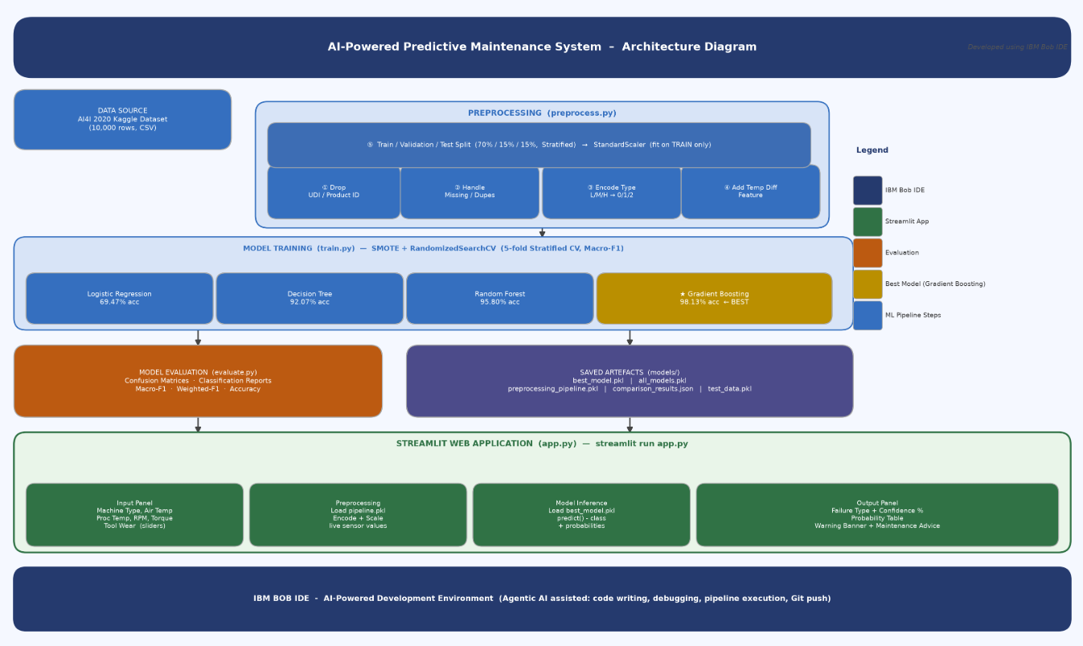
Architecture blueprint

Slide 7

Role of Agentic AI in the solution
Role of Agentic AI in Predictive Maintenance of Industrial Machinery
Agentic AI enables the Predictive Maintenance System to function as an intelligent, autonomous development and decision-support environment rather than a manually coded tool. Using IBM Bob IDE's agentic AI capabilities, the entire project — from data preprocessing to model deployment — was built, debugged, and executed through AI-assisted agent workflows.
The agentic approach played a key role at every stage of the pipeline. The AI agent autonomously read project files, understood the data structure, wrote modular Python code for preprocessing, training, evaluation, and the Streamlit application, and iteratively corrected errors without manual intervention. This multi-step autonomous execution ensured efficient task completion and accurate, production-ready results.
Agentic AI also brought context awareness to the development process — understanding the project requirements, dataset characteristics, class imbalance challenges, and engineering constraints to generate technically sound and well-structured code tailored to the specific problem.
It supported real-time adaptation, continuously refining the pipeline based on runtime errors, missing files, dependency issues, and user feedback — resolving each issue autonomously and proceeding to the next step.
Additionally, the agentic system coordinated across multiple tasks simultaneously — running the EDA, training models, evaluating results, and launching the Streamlit app — enabling seamless end-to-end project delivery.
Overall, Agentic AI made the development process proactive, intelligent, and goal-driven — acting like a smart AI pair programmer that transformed a problem statement into a fully functional, deployable Predictive Maintenance system.

Slide 8
Novelty and Uniqueness
The Predictive Maintenance System stands out by combining multi-model ML comparison, class imbalance handling, and real-time interactive prediction into a single end-to-end intelligent system.
Multi-Model Comparison & Auto-Selection – Four classifiers trained, tuned, and compared — best model automatically selected by Macro-F1 score.
Imbalance-Aware Training – SMOTE applied strictly inside CV folds, preventing synthetic data leakage — a common mistake this project deliberately avoids.
Multi-Class Failure Classification – Identifies the exact failure type (Heat Dissipation, Power Failure, Overstrain, Tool Wear, Random Failure) — not just binary fault detection.
Zero Data Leakage Design – StandardScaler fit only on training data, ensuring statistically honest evaluation results.
Actionable Maintenance Recommendations – Provides specific step-by-step maintenance actions per failure type directly in the app — not just a prediction label.
IBM Bob IDE Agentic Development – Entire pipeline built using IBM Bob's agentic AI for code generation, debugging, execution, and GitHub deployment.
Deployable & Demo-Ready – Fully functional Streamlit app with live sensor sliders, confidence scores, and probability breakdowns.
This makes the solution a smart, proactive maintenance assistant — not just a static ML model, but a complete decision-support system for industrial failure prevention.

Slide 9
Git Hub Link
Your GitHub repository link is: https://github.com/MoupiyaManna22/predictive_maintenance
·
·
·

Slide 10
Future Scope
1.Real-Time IoT Sensor Integration – Connect live industrial sensors via MQTT/OPC-UA for automated, continuous failure detection without manual input.
2. Time-Series & Deep Learning Models – Add LSTM or Temporal CNN models to capture gradual machine degradation trends over time — beyond single-snapshot prediction.
3. SHAP Explainability – Show which sensor (temperature, torque, tool wear) triggered each prediction, improving engineer trust and model interpretability.
4. REST API Deployment with FastAPI & Docker – Wrap the model as a REST API and containerise with Docker for integration with SCADA systems and enterprise factory dashboards.
5. IBM watsonx.ai Cloud Deployment – Deploy the best model on IBM watsonx.ai for managed inference, AI governance, drift detection, and multi-factory scalability.
6. Multi-Machine & Federated Learning – Support multiple machine types with individual models and apply federated learning for cross-factory improvement without sharing sensitive data.
·
·
·

Slide 11
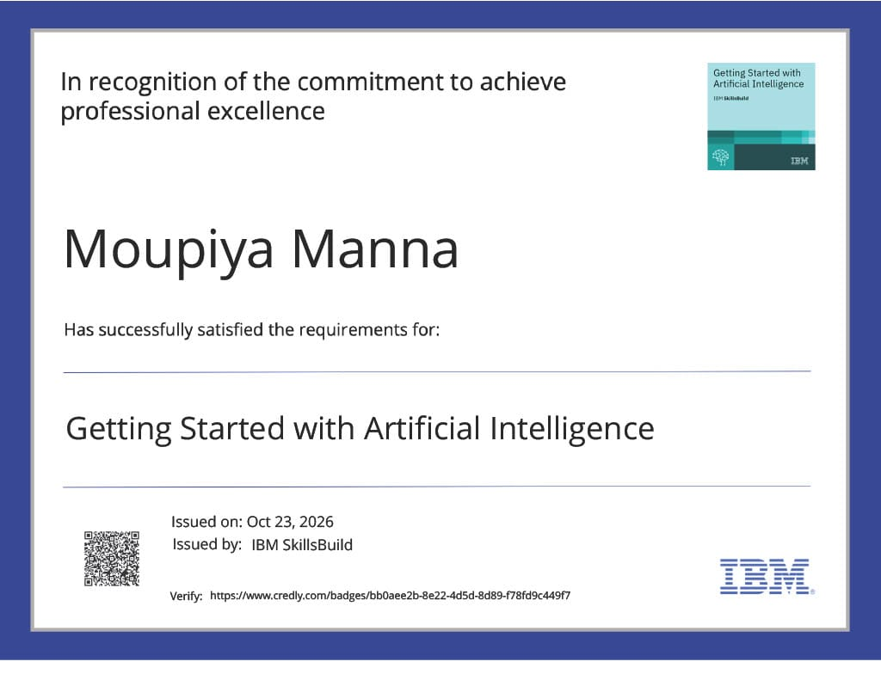
Certificates Earned:

Slide 12
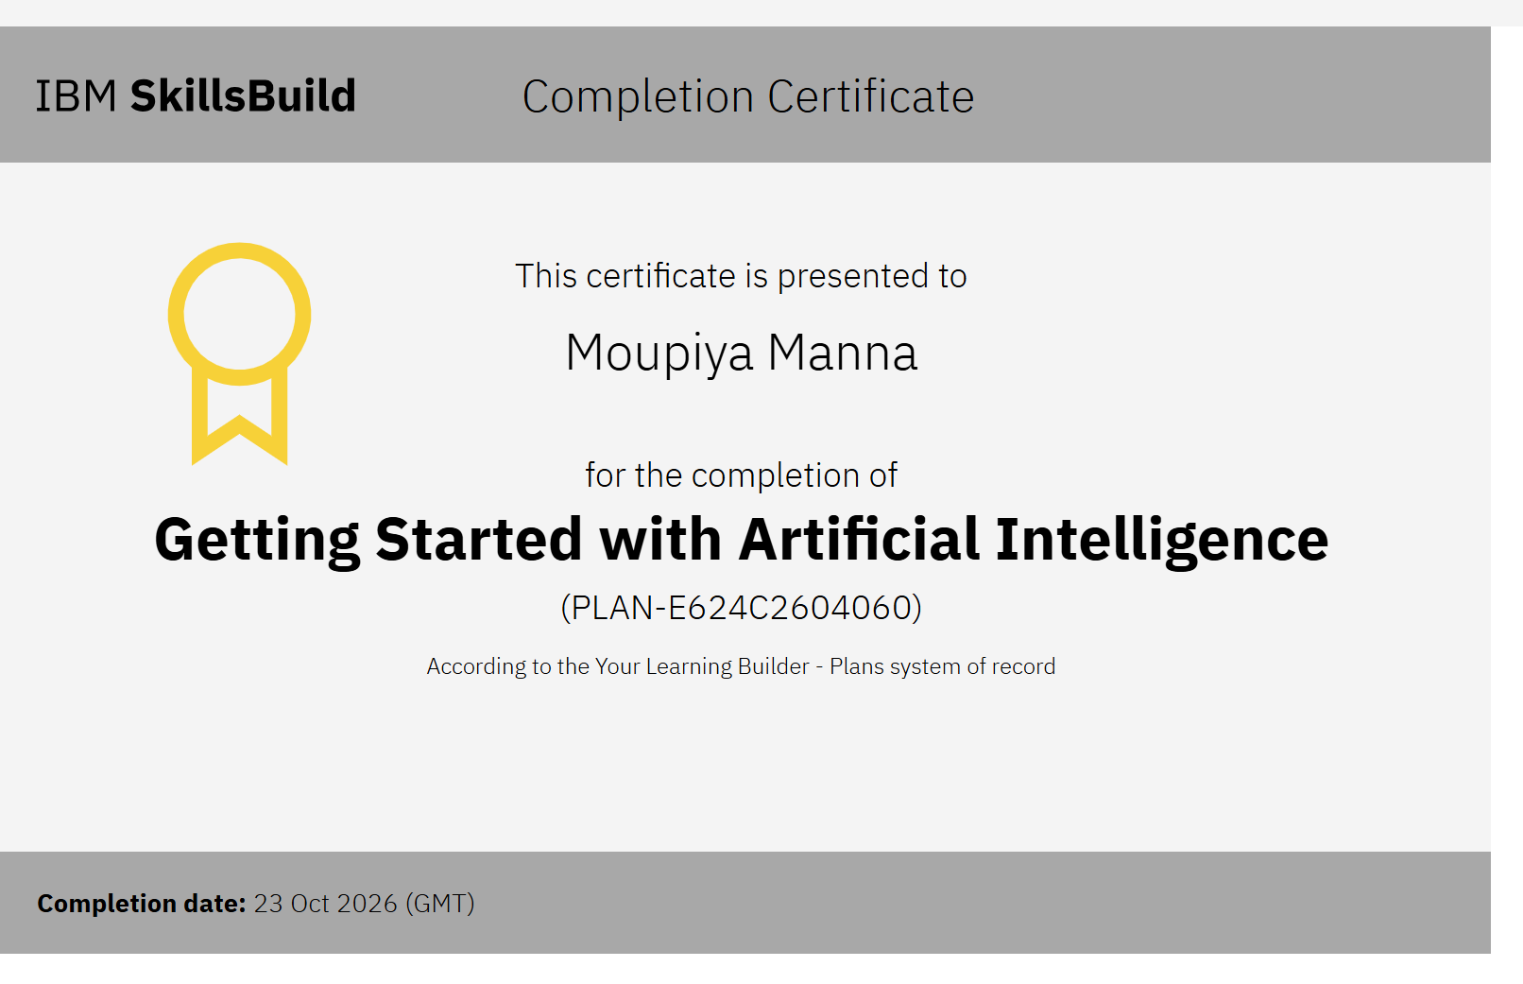
Certificates Earned:

Slide 13
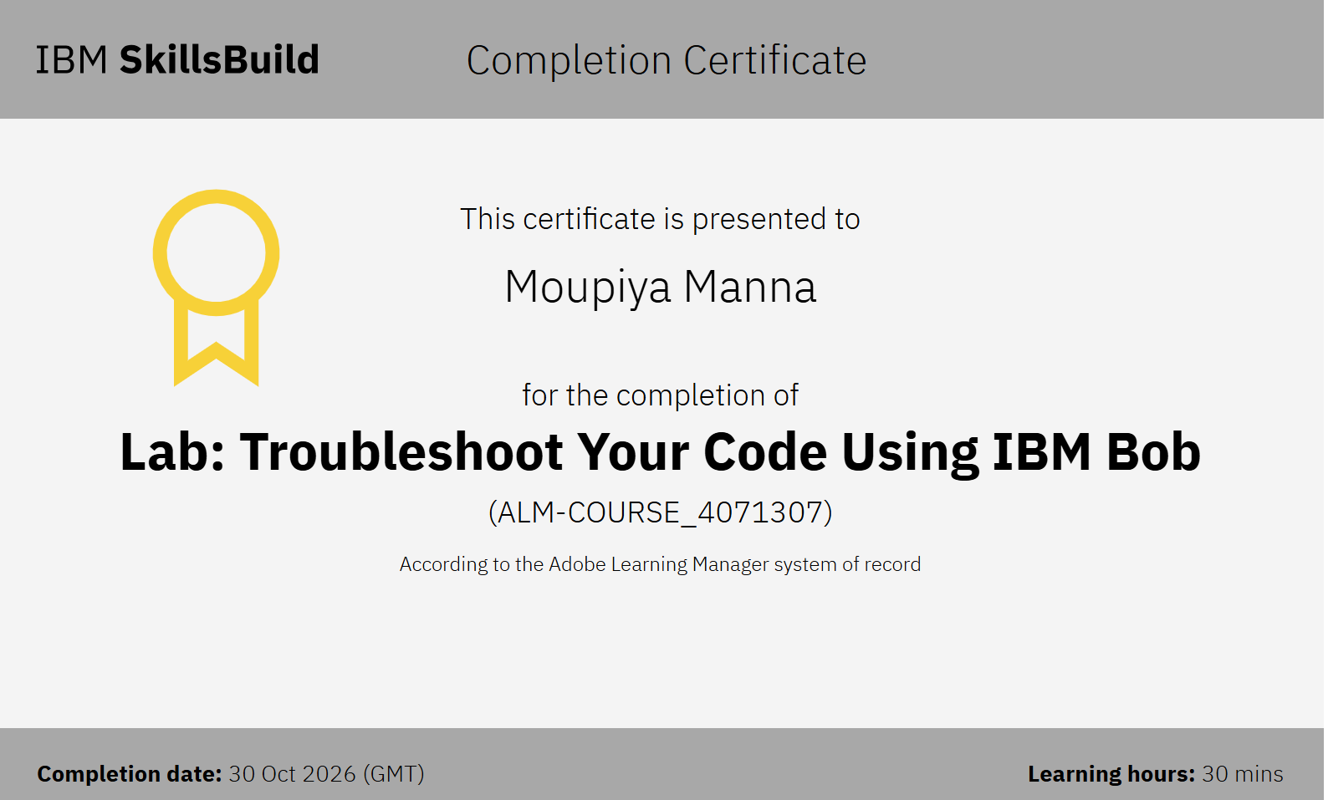
Certificates Earned:​

Slide 14


