Slide 1

Problem solving?

Slide 2
Plan
What is the Competitive programming, problem solving?
What do I need to start? From what age?
How to improve myself in problem solving?
Do I need this skill as a Software engineer?
Road map

Slide 3
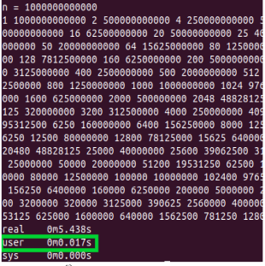
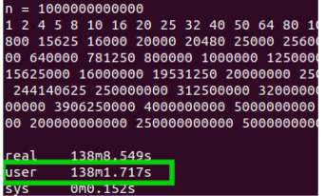
situation(1)
Your task: create a function that…….
Input: huge data
#2
#1

Slide 4


situation(2)
#1
#2
12000€
4000€

Slide 5
Requirements
Hard skills
Technical
Java, HTML, CSS, JS, PHP, .Net, React
DSA
Arrays, Trees, graphs, Linked list, ..
Good problem solver
Competitive programming
Soft skills
Communication, team work, ...

Slide 6
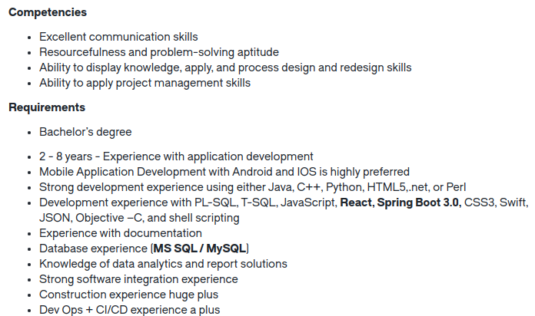

Slide 7
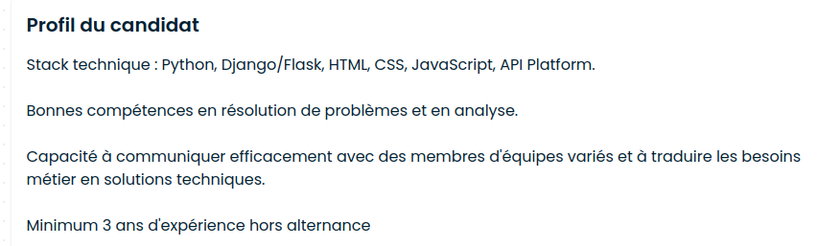

Slide 8











#1
Frameworks

Slide 9




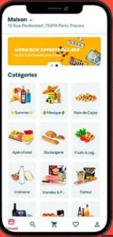
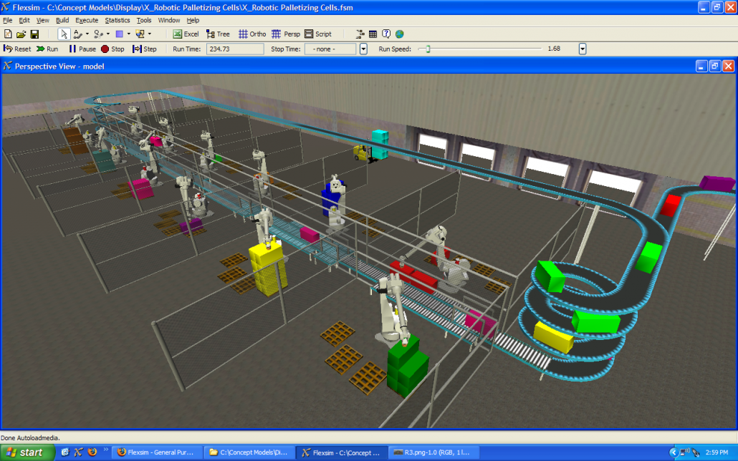
Frameworks
#2
IT

Slide 10
#3
Dev.

Slide 11
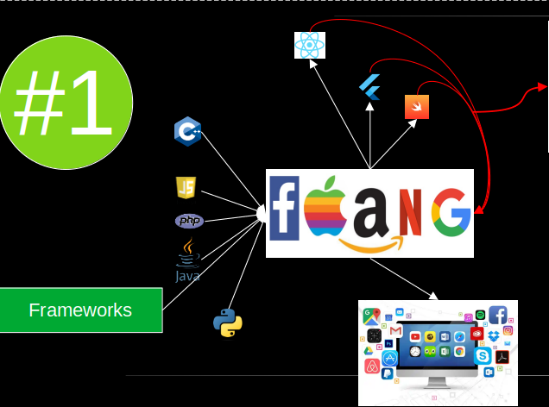
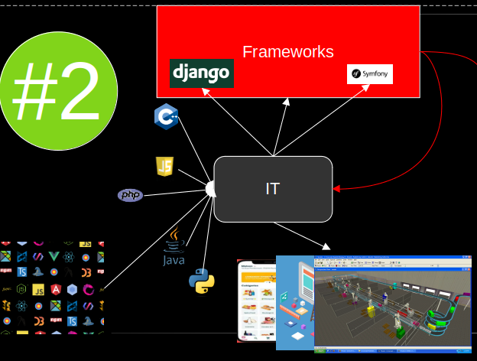
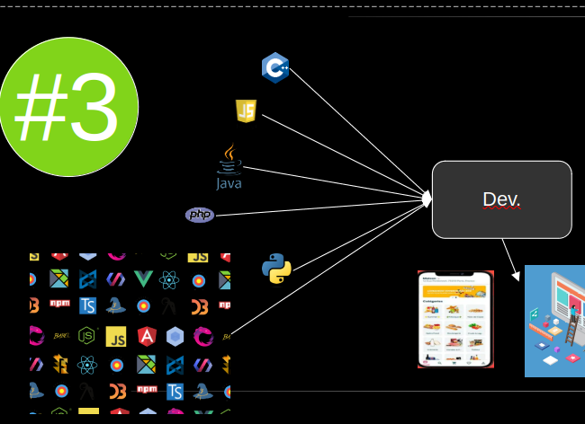
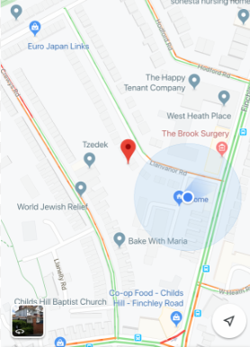
Hard skills…
#1
#2
#3
A
B
Technical skills
Technical skills
Basics DSA
Advanced DSA &
Problem solving skills
Advanced DSA &
Problem solving skills
Images: freepik

Slide 12
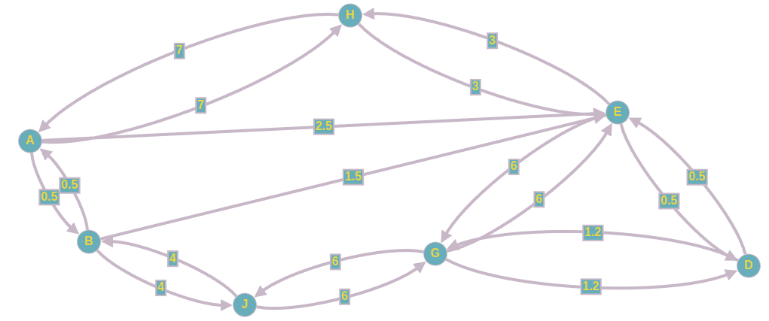
What’s problem solving?
Real world problem
Computer science problem
stemhash

Slide 13
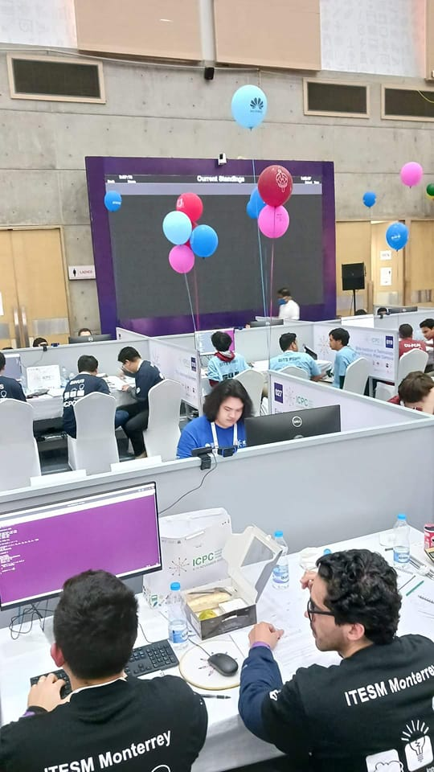

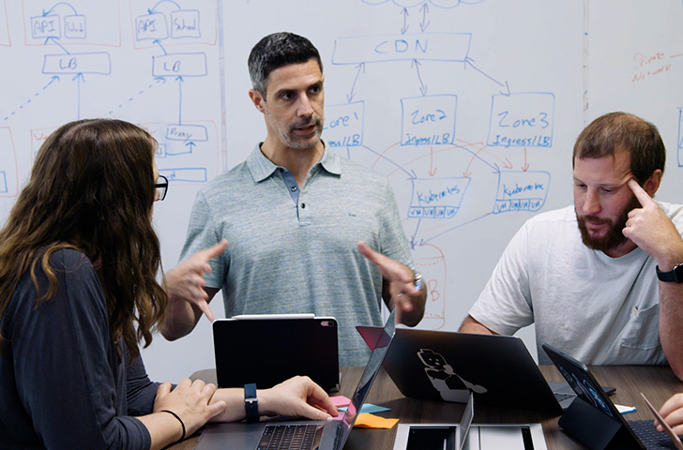
Soft skills…

Slide 14
Goal & how
Problem
solving
10^{n} hours
Of
practice
Improve your logic and problem solving skill in CS,
Work on your Soft skills

Slide 15
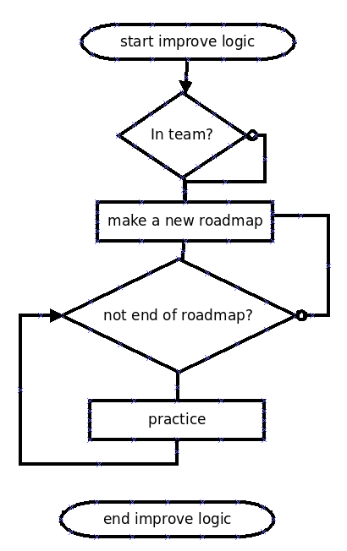
Learning never end
theoretic
https://ocw.mit.edu/courses/6-006-introduction-to-algorithms-fall-2011/video_galleries/lecture-videos/
https://ocw.mit.edu/courses/6-006-introduction-to-algorithms-spring-2020/video_galleries/lecture-videos/
https://www.youtube.com/watch?v=RBSGKlAvoiM
….
Pratice (OJs)
https://www.france-ioi.org/
https://leetcode.com/
https://www.hackerrank.com/
https://codeforces.com/
….
https://www.linkedin.com/posts/demitriswan_softwareengineering-activity-7135320103591563266-AtdD/?utm_source=share&utm_medium=member_desktop

Slide 16
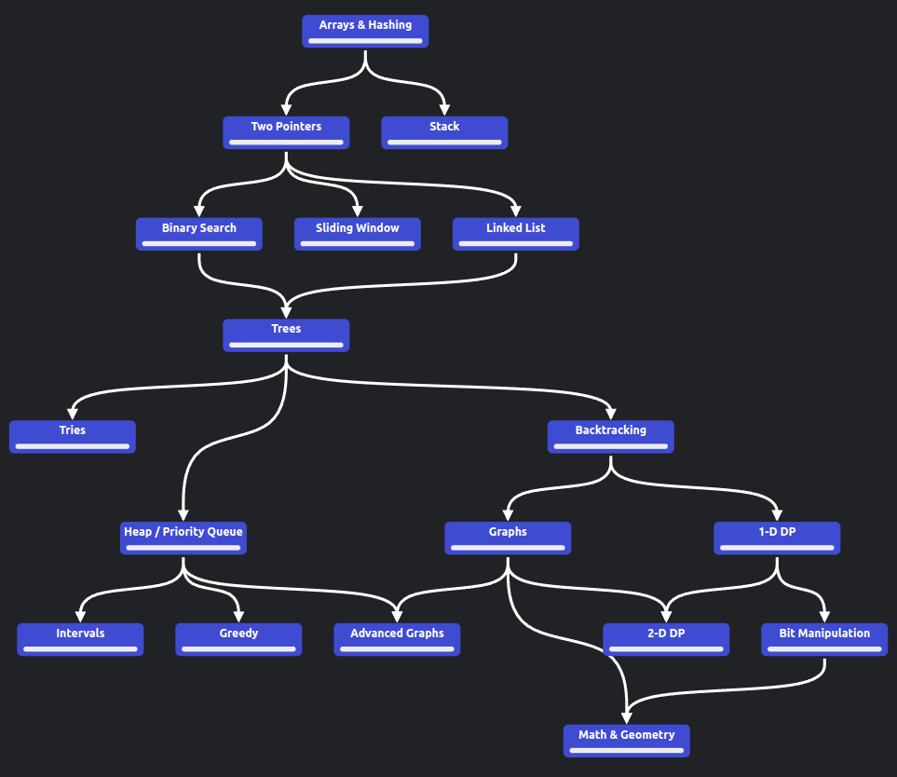
Road map
https://neetcode.io/roadmap

Slide 17
IOI
https://ioinformatics.org/page/ioi-2023/58
https://ioi-2023.github.io/
https://stats.ioinformatics.org/results/2022
https://stats.ioinformatics.org/results/2021

Slide 18
ICPC
https://icpc.global/worldfinals/past-problems
https://icpc.global/worldfinals/results
https://news.mit.edu/2022/mit-wins-international-collegiate-programming-contest-1116

Slide 19
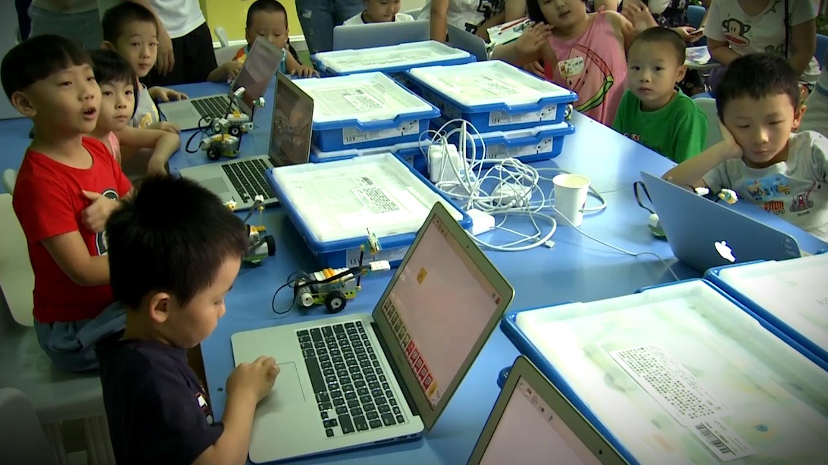

Slide 21
https://codeforces.com/gym/101883

Slide 22
B. Racetrack
3
3
3
6
9
2
2
2
4
6
4
8
12
6
12

Slide 23
Logic

Slide 24
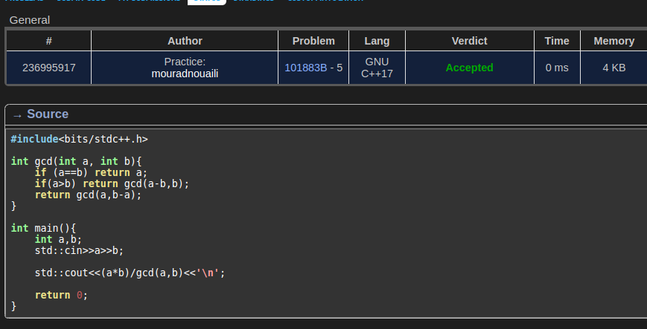
Code

Slide 25
C. Pig Latin

Slide 26
#1
#2

Slide 27


Whoami?
Mourad Nouaili (Golaa, Kébili)
Master IAG
20 years teaching
Freelance developer
Coding
  https://www.linkedin.com/in/mourad-nouaili-25252b163/
  https://github.com/Mourad-NOUAILI?tab=repositories
  https://www.youtube.com/@think_n_code/playlists

