Slide 1


Session #0: DSA & Algorithms - Competitive programming - Problem solving
Session #0: DSA & Algorithms - Competitive programming - Problem solving
arrays
sets
maps
Arabic
C++

Slide 2


Whoami?
Mourad Nouaili (Golaa, Kébili)
Master IAG
20 years teaching
Freelance developer
Coding & problem solving

Slide 3
Plan
Session #0: DSA & Algorithms - Competitive programming - Problem solving
Discussion
The roadmap
1st problem
Time & space complexities
Sets
maps

Slide 4
Discussion
Session #0: DSA & Algorithms - Competitive programming - Problem solving
As software engineer, do I need DSA & problem solving skills in my career?

Slide 5
Road map
Session #0: DSA & Algorithms - Competitive programming - Problem solving
https://neetcode.io/roadmap

Slide 6
217. Contains Duplicate
Session #0: DSA & Algorithms - Competitive programming - Problem solving

Slide 7
Problem statement
https://leetcode.com/problems/contains-duplicate/

Slide 8
Understand the problem
2 | 1 | 2 | 3 | 2 | 4
0 | 1 | 2 | 3 | 4 | 5
true
5 | 3 | 4 | 3 | 2 | 3
0 | 1 | 2 | 3 | 4 | 5
true
2 | 3 | 6 | 41 | 21 | 4
0 | 1 | 2 | 3 | 4 | 5
false

Slide 9
Naive approach
4 | 1 | 2 | 3 | 2 | 10
0 | 1 | 2 | 3 | 4 | 5
true
4 | 3 | 6 | 8 | 2 | 1
0 | 1 | 2 | 3 | 4 | 5
false

Slide 10
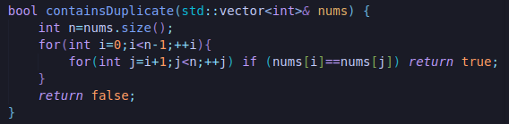
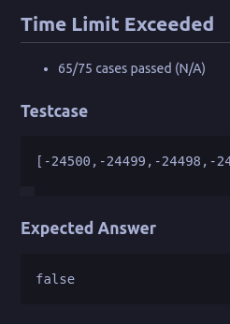
Naive approach: Code
Bad Time complexity
Time complexity: O(n²)

Slide 11
sorted approach
3 | 1 | 2 | 3 | 2 | 10
0 | 1 | 2 | 3 | 4 | 5
Sort
1 |  |  | 3 | 3 | 10
0 | 1 | 2 | 3 | 4 | 5
2
2
true

Slide 12
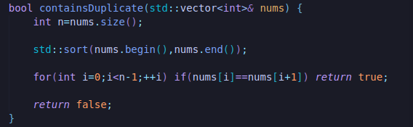
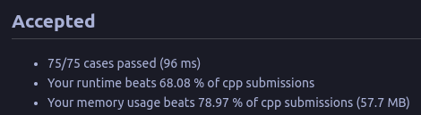
sorted approach
Time complexity
O(n log n)
O(n log n)
O(n)
max(O(n) , O(n log n)

Slide 13
Sets in C++
https://cplusplus.com/reference/unordered_set/unordered_set/
https://cplusplus.com/reference/set/set/
 | set | unordered_set
Insertion order | ASC order | No ordering
insert | O(log n) α(1) | Θ(1) O(n)
search | O(log n) | Θ(1) O(n)
delete | O(log n) α(1) | Θ(1) O(n)

Slide 14
set approach
4 | 1 | 2 | 3 | 2 | 10
0 | 1 | 2 | 3 | 4 | 5
4 | 3 | 6 | 8 | 2 | 1
0 | 1 | 2 | 3 | 4 | 5

Slide 15
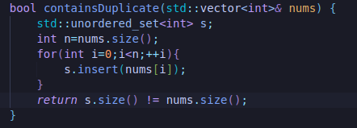
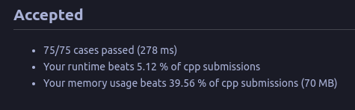
set approach
Time complexity:
Average case: Θ(n)
Worst case: O(n²)
Θ(1)
O(n)
O(1)
Θ(n)
O(n²)
Extra Space complexity:O(n)
O(1)
O(1)
https://cplusplus.com/reference/unordered_set/unordered_set/size/
https://cplusplus.com/reference/unordered_set/unordered_set/insert/
https://www.google.com/search?q=c%2B%2B+unordered_set+insert+time+complexity&sca_esv=594933686&sxsrf=AM9HkKmVTDxUeWxWCEsLGbnoe5es94U5Fg%3A1704131803421&ei=2_ySZZCtGbiRxc8P-6aysAo&oq=c%2B%2B+unordered_set+insert+time&gs_lp=Egxnd3Mtd2l6LXNlcnAiHWMrKyB1bm9yZGVyZWRfc2V0IGluc2VydCB0aW1lKgIIADIGEAAYFhgeMgsQABiABBiKBRiGA0i6E1B5WLgKcAB4ApABAJgBpQKgAd4HqgEFMC4zLjK4AQHIAQD4AQHCAgQQABhHwgIFEAAYgATiAwQYACBBiAYBkAYI&sclient=gws-wiz-serp

Slide 16
maps in C++
https://cplusplus.com/reference/unordered_map/unordered_map/
https://cplusplus.com/reference/map/map/
 | map | unordered_map
Insertion order | ASC order | No ordering
insert | O(log n) α(1) | Θ(1) O(n)
Search [] operator | O(log n) | Θ(1) O(n)
delete | O(log n) α(1) | Θ(1) O(n)

Slide 17
Unordered map approach
3 | 1 | 2 | 3 | 2 | 10
0 | 1 | 2 | 3 | 4 | 5
true
{}
{3:1}
{3:1,1:1}
{3:1,1:1,2:1}
{3:2,1:1,2:1}
4 | 3 | 6 | 8 | 2 | 1
0 | 1 | 2 | 3 | 4 | 5
false
{}
{4:1}
{4:1,3:1}
{4:1,3:1,6:1}
{4:1,3:1,6:1,8:1}
{4:1,3:1,6:1,8:1,2:1}
{4:1,3:1,6:1,8:1,2:1,5:1}

Slide 18
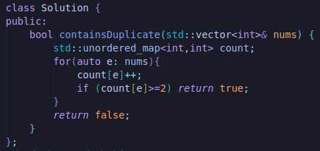
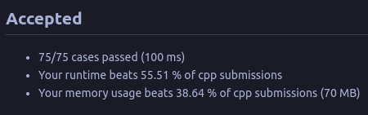
Unordered map approach
Time complexity:
Average case: Θ(n)
Worst case: O(n²)
Extra Space complexity:O(n)

