Slide 1
Problem statement: 979. Distribute Coins in Binary Tree

Slide 2

Understand the problem
Distribute Coins in Binary Tree, such that each node have one coin.
Compute the minimum number of moves required to make every node have exactly one coin
0
3
1
0
moves:
2
1
0
5
1
11
12
0
5
9
0
1
6
0
1
1

Slide 3
Observation
1
3
1
2
2
3
0
1
2
1
1
4
1
0
1
2
1
0
2
1
0
1
1
9 moves
0
1

Slide 4
Observation
9 moves
0 required
1
2
5 moves
2 required
2
0 move
2 excessive
0
3
1
4 moves
0 required
4
0
0 move
1 required
1 move
2 required
2
1
0
0
0 move
1 required
1
0 moves
1 required
0

Slide 5
Observation
prev_moves=1
We’d like to leave a coin, so, we subtract 1 from the actual number of coins in the the node (4-1) and we add/subtract the excessive/required coins (-2 and -1, both are required)
needed_moves=2+1=3
coins=-2-1+4-1=0
4 moves
0 required
4
1 move
2 required
2
1
0
0
0 move
1 required
1
0 moves
1 required
0

Slide 6
Logic
1
{moves,coins}
Negative coins means required.
0
3
4
0
0
0
{0,-1}
0

Slide 7
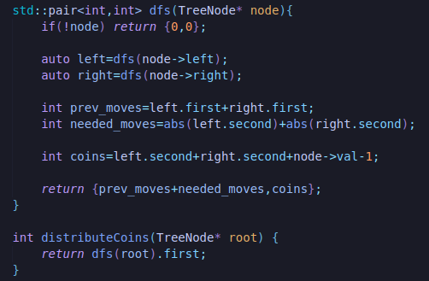
C++:

