Slide 1
Problem statement: 131. Palindrome Partitioning

Slide 2
Understand the problem

Slide 3
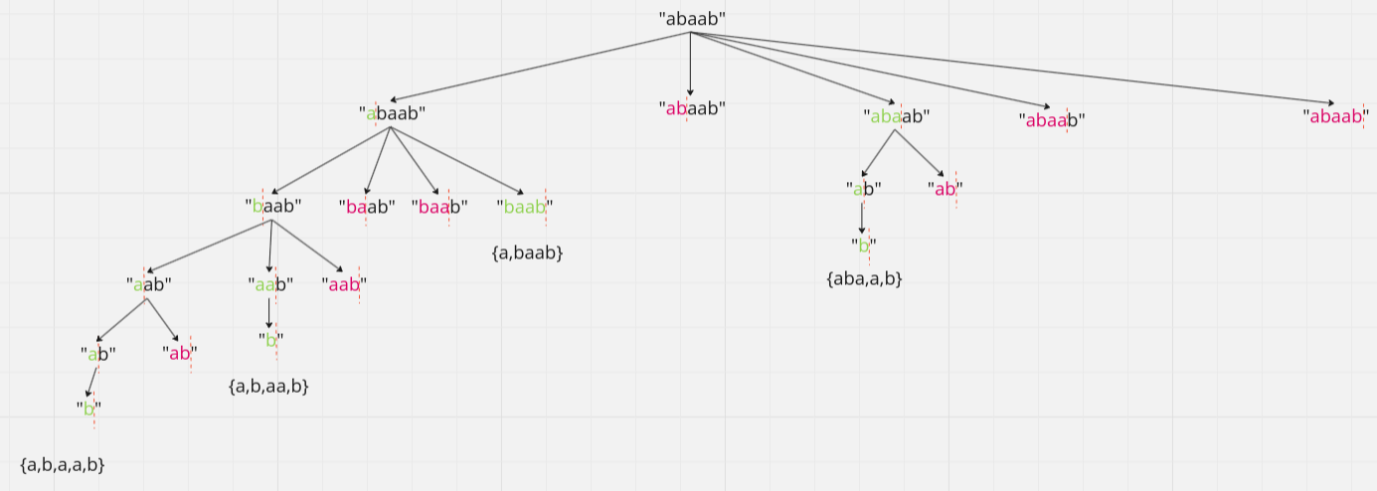
Logic

Slide 4
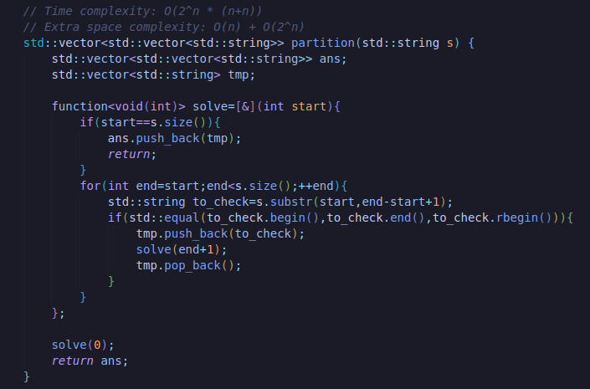
C++:

Slide 5
C++:

