Slide 1
Problem statement: 3068. Find the Maximum Sum of Node Values

Slide 2
Understand the problem

Slide 3
Logic

Slide 4
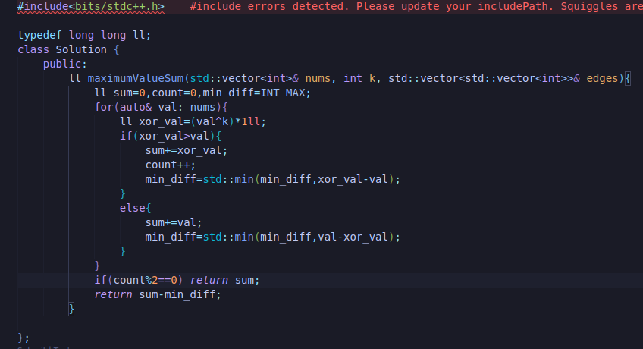
C++:

