Slide 1
Problem statement: 1863. Sum of All Subset XOR Totals

Slide 2
Understand the problem

Slide 3
Logic

Slide 4
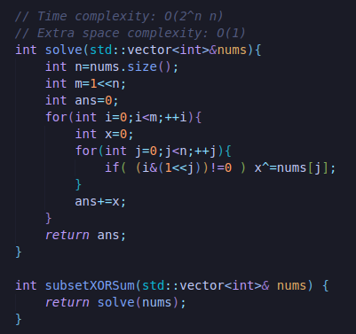
C++:

Slide 5
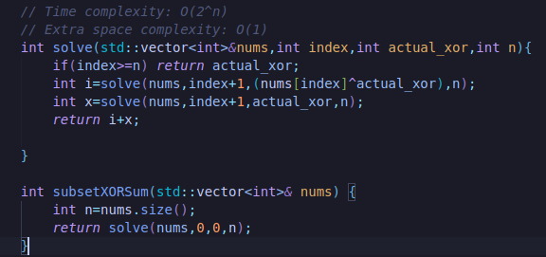
C++:

Slide 6
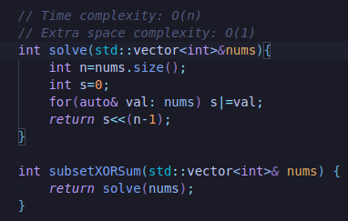
C++:

