Slide 1
Problem statement: 78. Subsets

Slide 2
Understand the problem

Slide 3
Logic

Slide 4
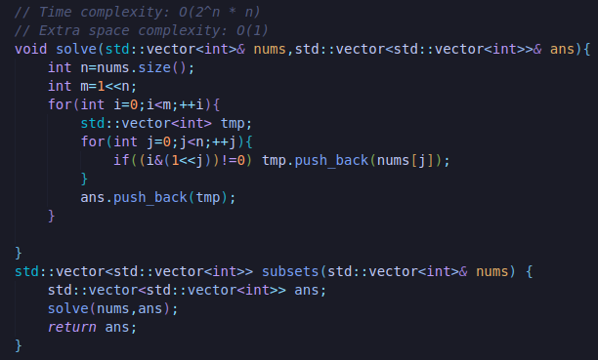
C++:

Slide 5
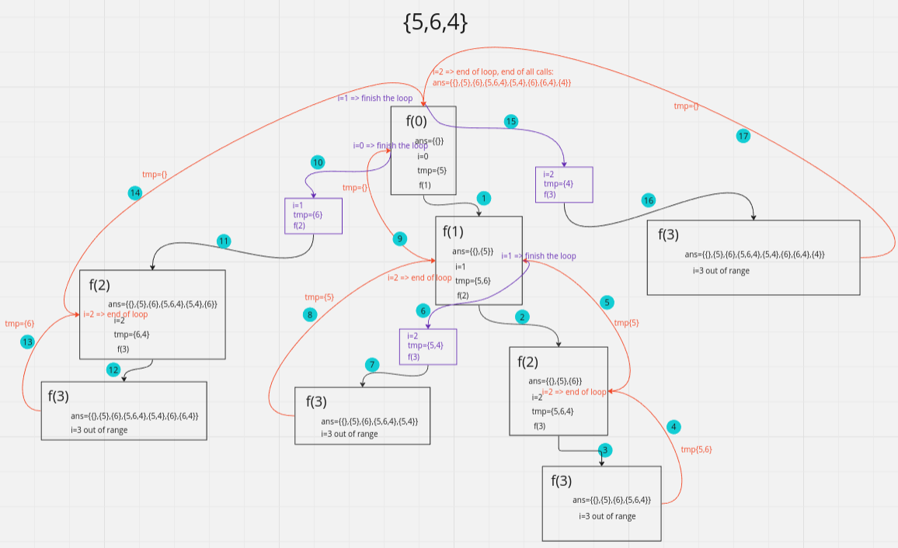
Logic: Backtracking

Slide 6
Logic: Backtracking
Link1

Slide 7
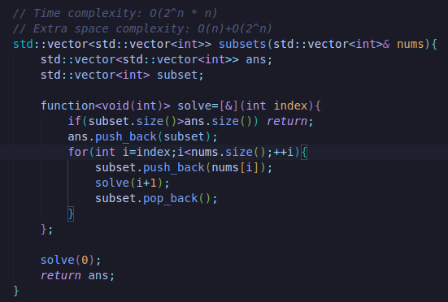
C++: Backtracking

Slide 8
C++:

