Slide 1

Workshop:Building &
Implementing an IOT application.

Slide 2


Slide 3
PLAN: simple Led blinking + serial communication
LED blinking using Arduino UNO R3
  The wiring
  Coding (Demo)
  LED Blink, based on commands, using serial monitor(Demo)
  LED Blink, based on commands using a client coded in Python (serial communication) (Demo)

Slide 4
Understanding our IOT project

Slide 5
PLAN:
Project description
Introduction to webhooks
How Facebook webhooks work ?
Building the Facebook app + webhook page (Demo)

Slide 6
PLAN: coding the server app.
Working on localhost
  Coding the app server and associated to the webhook(Demo)
  Coding the client and test it. (serial communication)(Demo)

Slide 7
PLAN: deploying to the cloud
Working on the cloud
  Deploy our server app. on Heroku.(Demo)
  Test all the staff. (serial communication)(Demo)
  Code the client to work on wireless (wifi)

Slide 8
Plan: Ideas to improve the project.

Slide 9
LED blinking using Arduino UNO R3

Slide 10
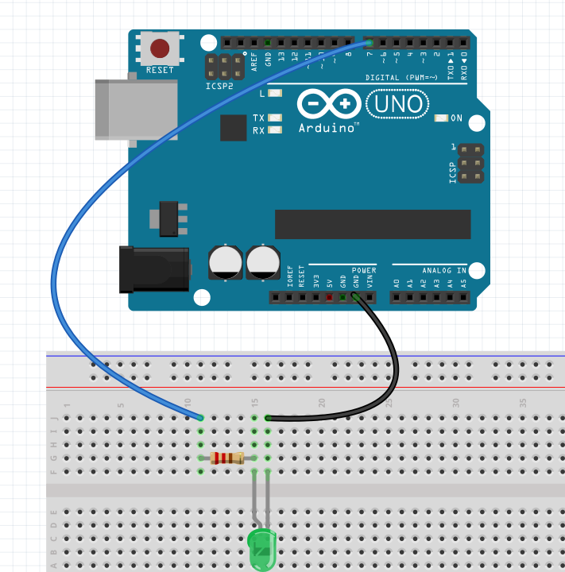
The wiring
Needed Hardware:
Arduino UNO R3 X 1
Micro USB cable x 1
LED x 1
200 ohm resistor x 1
Wire x 2
PC x 1

Slide 11
coding (Demo)
Needed softs:
  The Arduino IDE

Slide 12
LED Blink based, on commands, using serial monitor(Demo)
Needed softs:
  The Arduino IDE

Slide 13
LED Blink, based on commands using a client coded in Python (serial communication) (Demo)
Needed softs:
  The Arduino IDE
  Python >= 3.6

Slide 14
Understanding our project

Slide 15
Project description
A LED is on, when a number of comments is reached on a specific post on your FB page.
A LED is off, when that post is deleted.

Slide 16
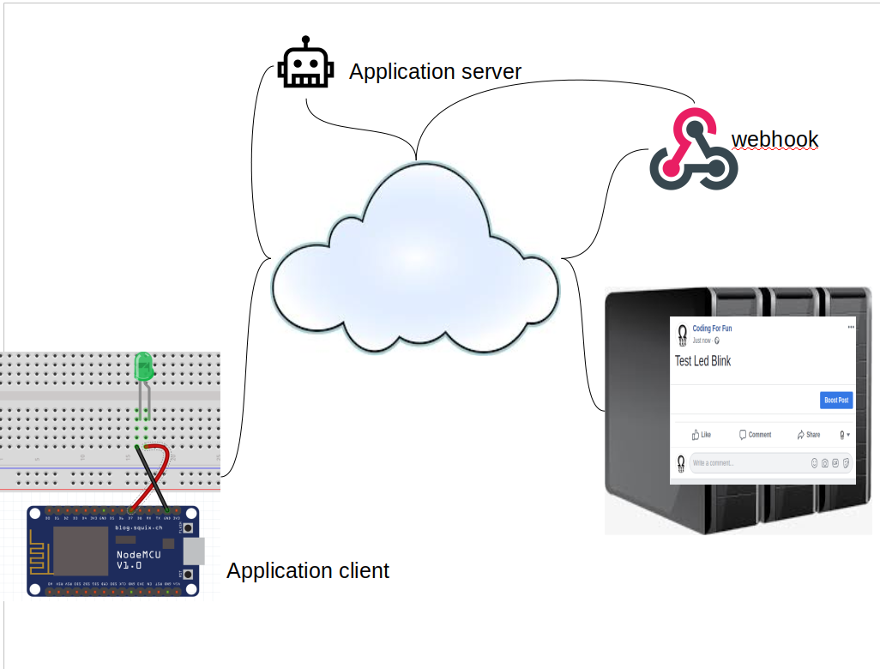


Slide 17
But in this presentation we gonna focus on the server side. That’s why, we will use an Arduino UNO with the serial communication for the client .

Slide 18
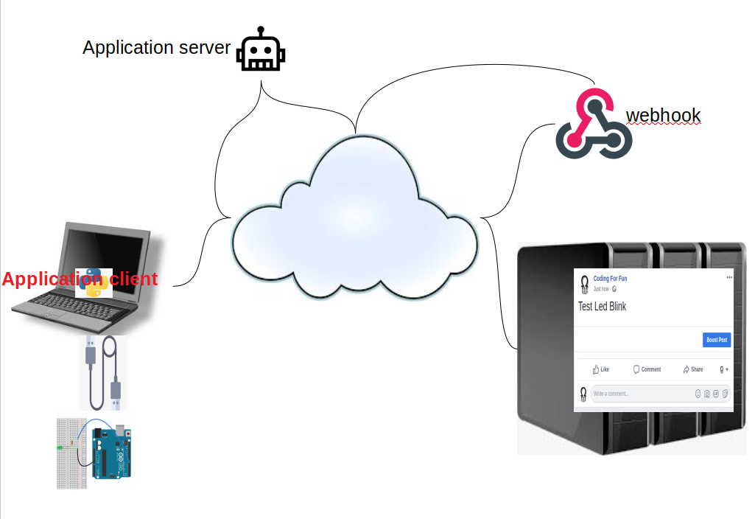

Slide 19
Introduction to webhooks

Slide 20
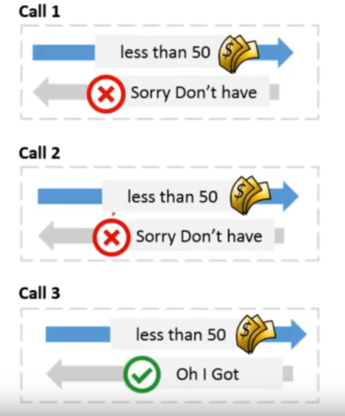


Polling the server: manual way
Client
server
https://www.youtube.com/watch?v=Nd6FbUWheAg&t=695s
hemant joshi

Slide 21

Polling the server: automatic way(hard to code)
Client
server
https://www.youtube.com/watch?v=Nd6FbUWheAg&t=695s
hemant joshi

Slide 22
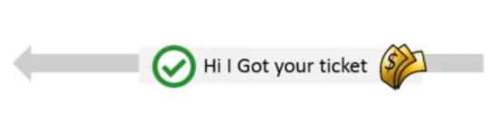

Using webhook
Client
webhook
server
https://www.youtube.com/watch?v=Nd6FbUWheAg&t=695s
hemant joshi

Slide 23
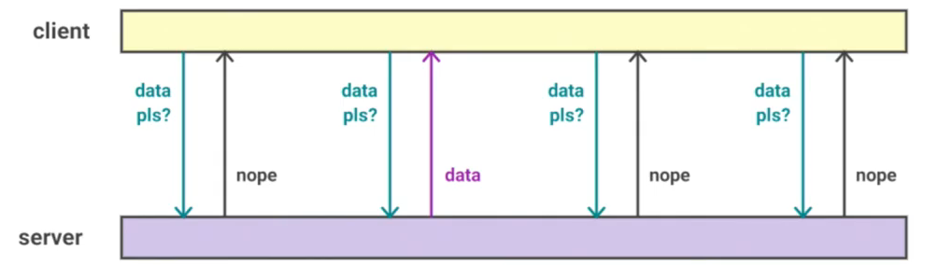
Server polling over time
API Polling
Time
https://www.youtube.com/watch?v=J7uENSm-w1g&t=492s
Lorna Mitchell | The Lead Developer UK 2016

Slide 24
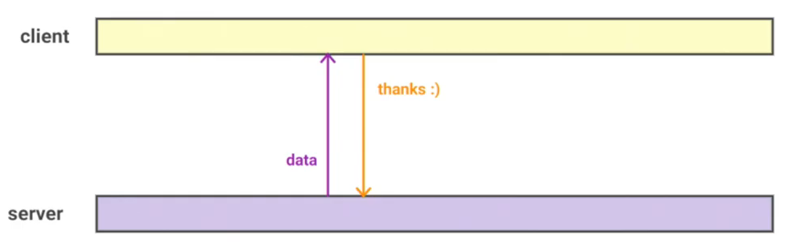
Webhooks
Webhooks over time
Time
https://www.youtube.com/watch?v=J7uENSm-w1g&t=492s
Lorna Mitchell | The Lead Developer UK 2016

Slide 25
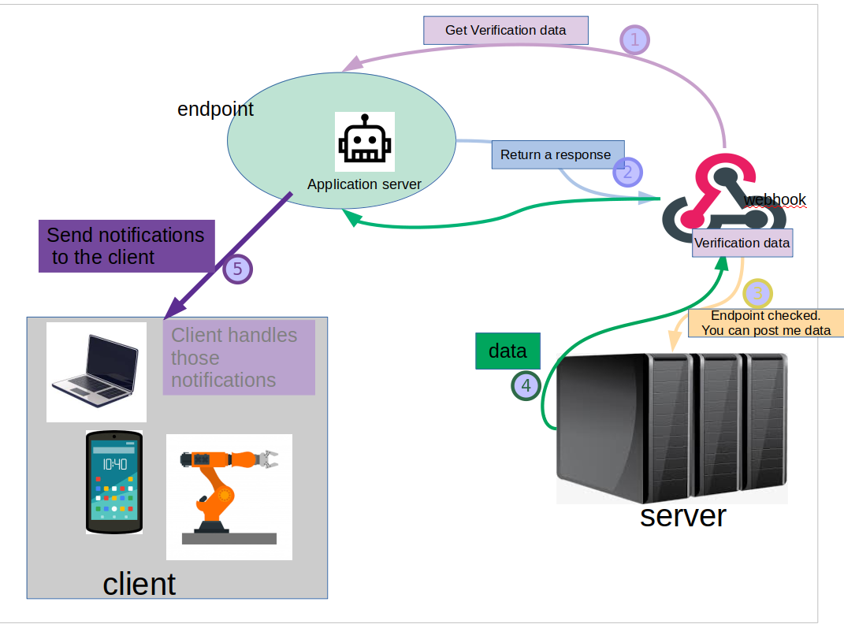
How webhooks works ?(1)

Slide 26
How webhooks works ?(2)
The endpoint receive a get from the webhook that contains all the data to verify.
The Server app. return back a response to the webhook.
If the data are verified…
...the server will be ready to post the asked data to the endpoint.
Once the data are posted to the endpoint, the app data sends them to the client app.

Slide 27
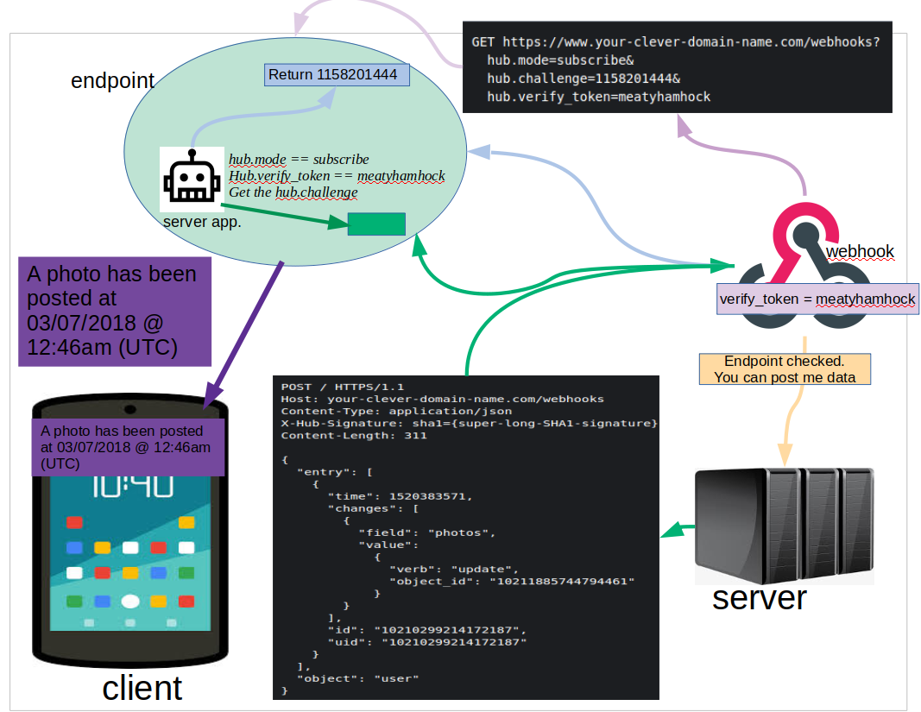
Understanding Facebook’s webhooks (March 2019)(1)

Slide 28
Understanding Facebook’s webhooks (March 2019) (2)
FB's webhooks in general: https://developers.facebook.com/docs/graph-api/webhooks/
FB's webhooks pages: https://developers.facebook.com/docs/pages/realtime/
Create FB webhooks: https://developers.facebook.com/docs/graph-api/webhooks/getting-started

Slide 29
Building the Facebook app + webhook page (Demo)

Slide 30
Working on localhost

Slide 31
Coding the server app. and associate the endpoint to the webhook(Demo)
Needed softs:
  Python
  A secure introspectable tunnels to localhost: ngrok, …
  https://directory.fsf.org/wiki/Ngrok
  https://ngrok.com/product

Slide 32
Coding the client app and test it. (remember, we still use the serial communication)(Demo)
Needed soft:
  python

Slide 33
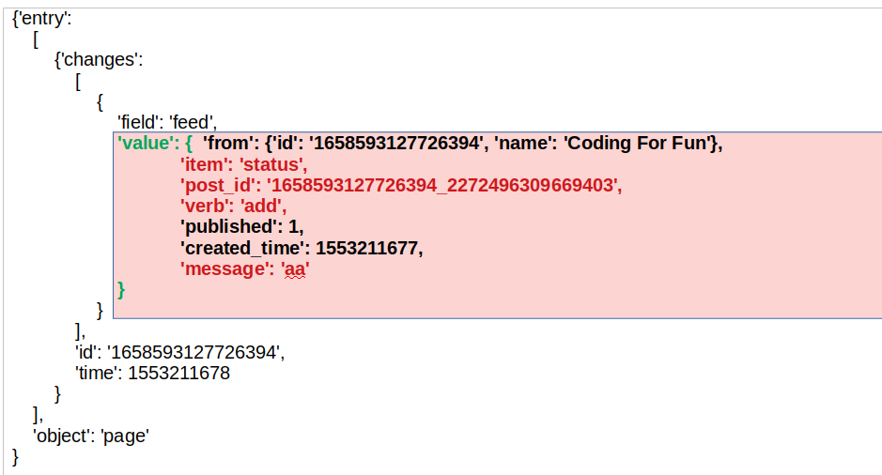
Add post JSON payload

Slide 34
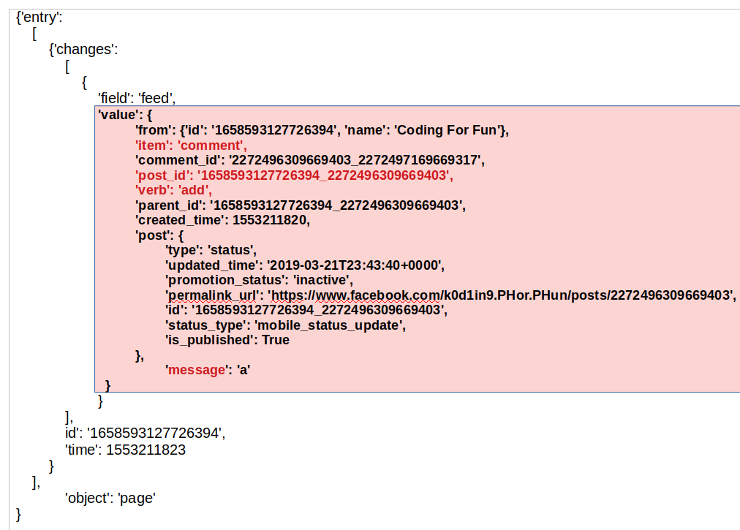
Comment JSON payload

Slide 35
{'entry': [{'changes': [{'field': 'feed', 'value': {'recipient_id': '1658593127726394', 'from': {'id': '1658593127726394', 'name': 'Coding For Fun'}, 'item': 'post', 'post_id': '1658593127726394_2272531812999186', 'verb': 'remove', 'created_time': 1553214793}}], 'id': '1658593127726394', 'time': 1553214803}], 'object': 'page'}

Slide 36
Working on the cloud

Slide 37
Deploy our app server on Heroku.(demo)
You need an account on Heroku
Install heroku CLI

Slide 38
Test all the staff. (serial communication)(Demo)

Slide 39
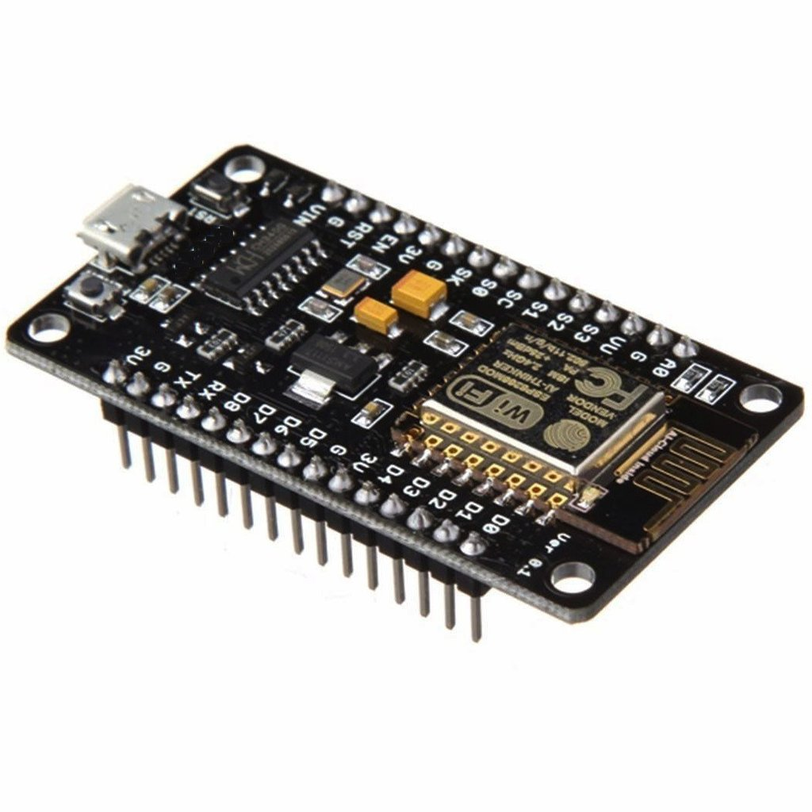
Code the client app to work on wireless (wifi)
Change the circuit to work with the NodeMCU ESP8266

Slide 40
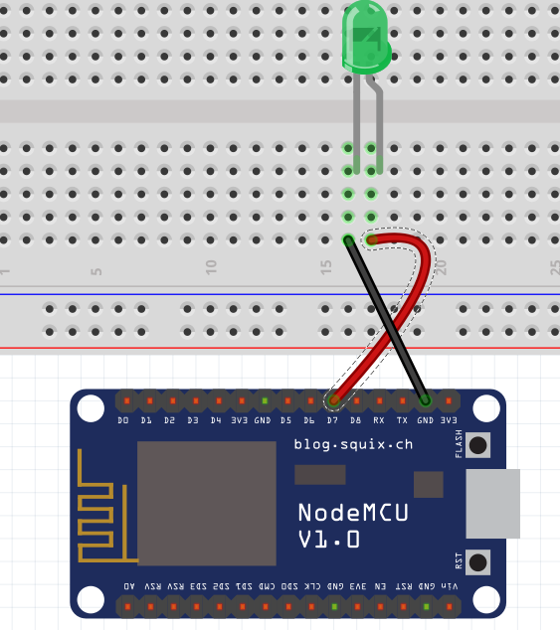
wiring

Slide 41
Before coding the code to the nodeMCU esp8266
Before uploading the coding, you have to install esp8266 into your Arduino IDE.
Additional board manager URL:http://arduino.esp8266.com/stable/package_esp8266com_index.json

Slide 42
Code the client app
Needed soft:
  Arduino IDE

Slide 43
Ideas to improve the project.

