Slide 1
Reinforcement Learning 101
Basics
chapter 04 - Dynamic programming
chapter 05 - Monte Carlo methods
chapter 06 - Temporal Difference Learning

Slide 2
Basics:
In Reinforcement learning problems we have an agent interacting with an environment.
At each time step, the agent performs an action which leads to :
changing the agent state
receiving a reward (or penalty) from the environment.
The goal of the agent is to discover an optimal policy (i.e. best actions in each state) such that it maximizes the total value of Rewards in response to these actions.
Markov Decision Process (MDP) is used to describe the agent/environment interaction settings in a formal way.
Why this name:
1- The Markov property: Once the current state in known, the history of information encountered so far may be thrown away
2- A process is a memory-less random process, i.e. a sequence of random states (chain or an episode) S1, S2, ….. with the Markov property.

Slide 3
Basics:
MDP consists of a tuple of 5 elements:
S : the set of states. At each t, the state of the environment s, s ∈ S.
A : the set of actions. At each t ,the agent choses an action a ∈ A to perform.
P(s_{t+1} | s_{t}, a_{t}) : State transition model that describes how the environment state changes when the agent in state s take action a
R(s_{t}, a_{t}) : describes the reward value that the agent receives from the environment after performing an action a in state s.
𝛾 : discount factor that controls the importance of future rewards.
The way by which the agent chooses which action to perform is named the agent policy: π (s) S →A
Environment = in most cases, means transition probabilities P(s_{t+1} | s_{t}, a_{t}) ( some times +rewards also)

Slide 4
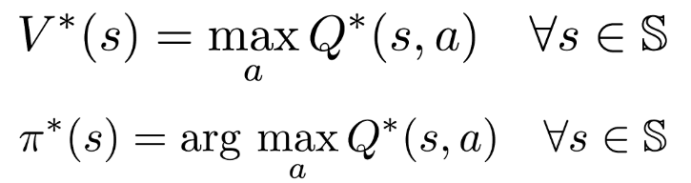
Def:
The Value-function ( State Value Function) [v_{π}(s)]: the expected total (future) reward for an agent starting from state s
( how good to be in this state s_{t+1} for that agent → this why is it important to get the v_{π} before finding optimal policy)
The Q-function [Q_{π}(s,a)]: the expected total reward received by an agent starting in state s and picking action a.
→ We use The Q-function to find the optimal policy when the model of the MDP is not available.

Slide 5
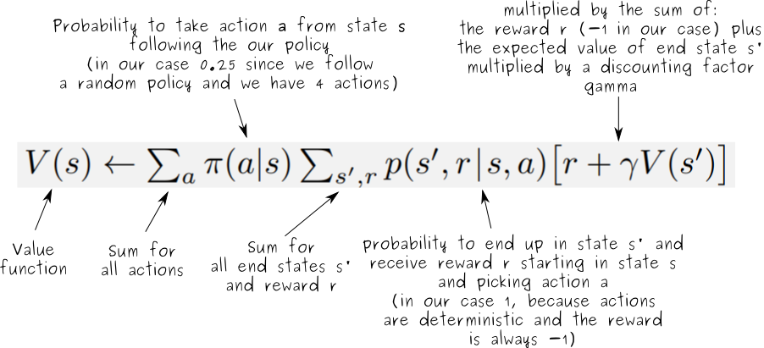
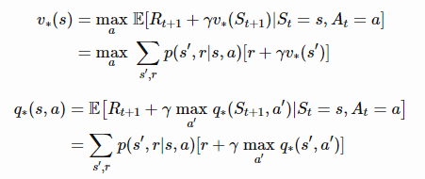

Def:
Bellman Expectation Equation: the value of the state is decomposed into immediate reward R(t) + the value of successor state v(S_{t+1}) with a discount factor 𝛾.
Bellman Expectation Equation: the value of a particular state subjected to some policy π.
How to find optimal Value function
How to the policy corresponding to a Value function

Slide 6
ALL RL problems may be decomposed into two steps:
Prediction (or policy evaluation): starting from a policy π, get value function v_{π} ( of optimal v_{π}*)
Control (or policy improvement): using the function v_{π,} From the 1st step, we get the optimal policy π∗ and optimal value function v∗
Expected vs Sampled methods :
We can use knowledge about the environment (transitions probabilities) to compute the expectation returns given all the next states probabilities (Expectation Methods: DP)
If our sample space is big enough, the expected update after each sample should tend to the optimal value function. Thus we don’t need to know the environment’s dynamics (Sampling Methods: MC, TD(0) and TD(λ))
bootstrapping : estimating the value function out of previous estimates of the value function. (DP and TD bootstraps, MC do NOT bootstraps).

Slide 7
Dynamic Programming (DP)
Dynamic Programming (DP) refers to a collection of algorithms that can be used to compute the optimal policies given a perfect MDP model.
Policy Iteration :
Step 1: compute v_{π}(k) iteratively, starting from an arbitrary value and the initial state v₀, perform iterative successive approximation using the Bellman equation as an update rule. ( iterative policy evaluation)
Step 2: For each state s , select action a the best action (could be the same as in the policy) according to the v_{π}(k)
Go to 1 and until the policy is stable
Value Iteration:
Step 1: compute v* iteratively, starting from an arbitrary value for the initial state v₀, perform iterative successive approximation using the Bellman equation as an update rule.
***However, Value update is updated wit the max over all actions.
***this step is perform multiple times until V converges ( or hits the max num of iteration).
Step 2: For each state s , select action a the best action according to the optimal value function founded before V*
Figure from [1] https://stackoverflow.com/questions/37370015/what-is-the-difference-between-value-iteration-and-policy-iteration

Slide 8
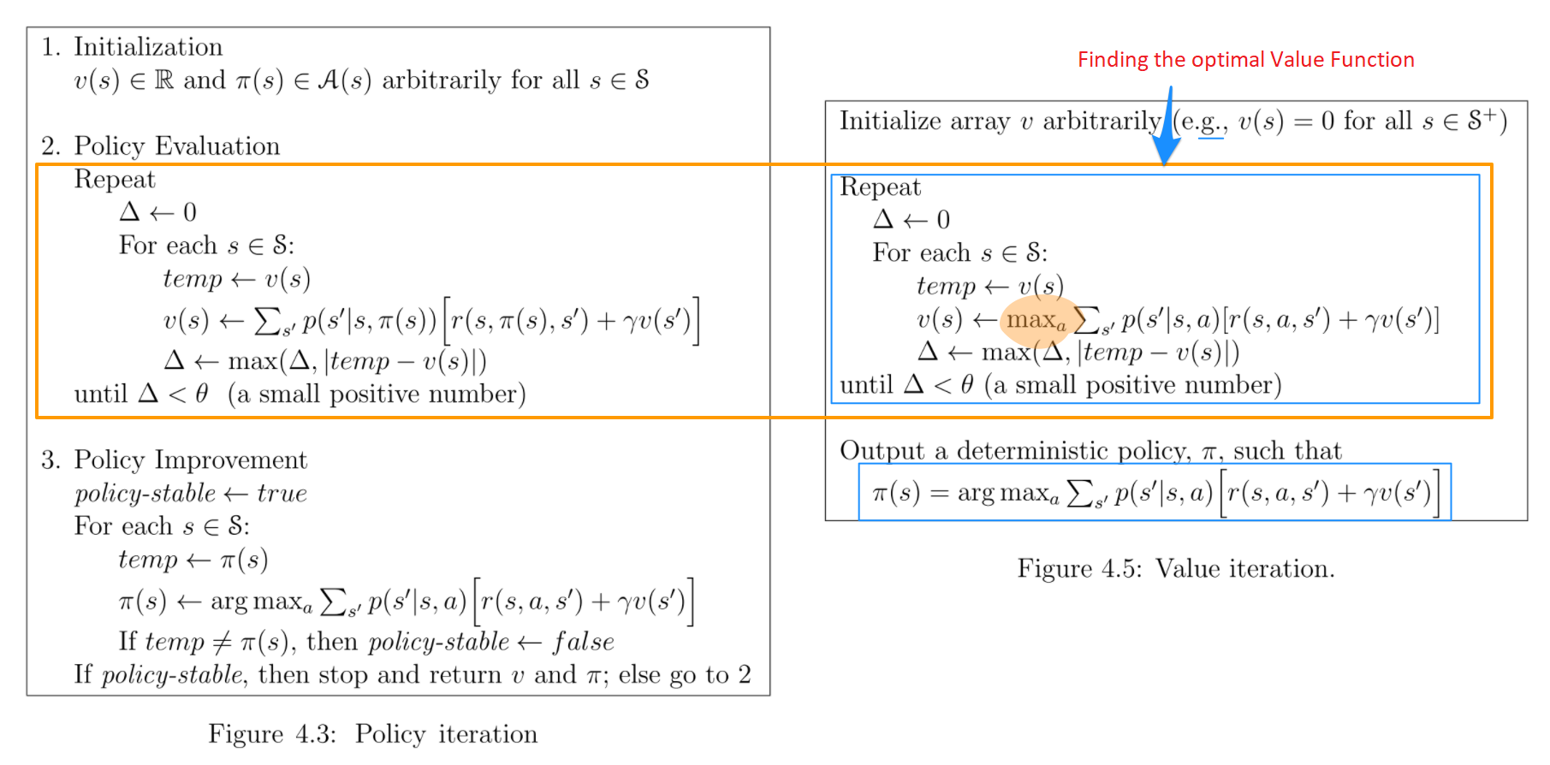
Dynamic Programming (DP)
Figure from [1] https://stackoverflow.com/questions/37370015/what-is-the-difference-between-value-iteration-and-policy-iteration

Slide 9
Ex: Simple Grid World
T
R(t) = -1 after each move
Actions: right, left, up, down
(0,0) and (3,3) game ends and R(t)=0
T

Slide 10
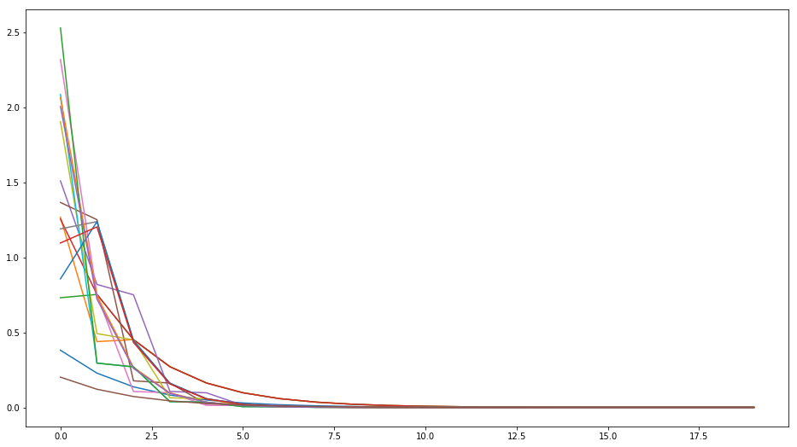
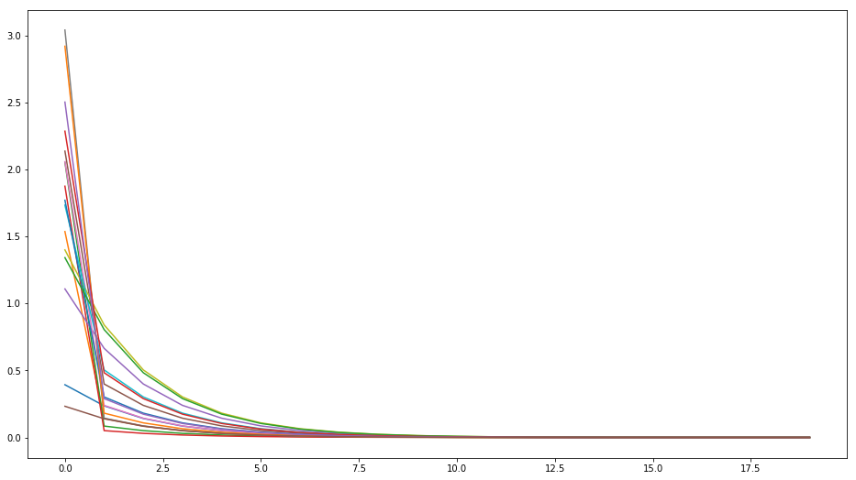
Policy Iteration
ΔV= V_{t+1}(s)-V_{t}(s)
indx of iteration
Value Iteration
ΔV= V_{t+1}(s)-V_{t}(s)
indx of iteration

Slide 11
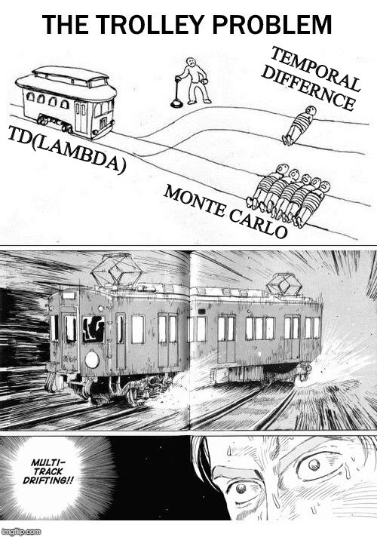
Monte Carlo Methods (MC)
Instead of computing the value function from our knowledge of the MDP, we learn it from sample returns.
We don’t have any knowledge of the environment dynamics, we learn only by experience.
MC are based on episodes and averaging sample returns R(t). (sampling method)
The estimate for each state in Monte Carlo methods is independent from estimates of other states (do not bootstrap).
MC methods are primarily used to find an estimate of q∗, since if we have the Q-function we don’t need the model P to find the policy.
Two types of MC:
- First visit MC method: averages the returns following first visit to s
- Every visit MC method: averages the returns after each visit to s
exploring starts: many state-action pairs may not be visited at all (for example if we have a deterministic policy).
- We must assure continual exploration.
- Use a stochastic policy with non-zero probability of selecting each a state-action pair

Slide 12
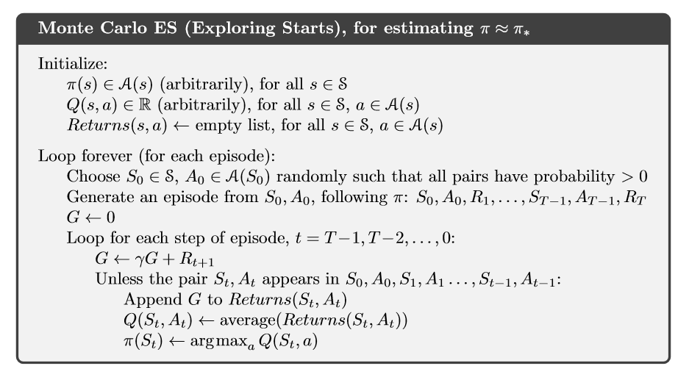
Monte Carlo Methods (MC)
Same Two steps :
Policy evaluation: many episodes are experienced, with the approximate action-value function approaching q∗ asymptotically. [We assume an infinite amount of episodes generated with exploring starts].
Policy improvement is done by making the current policy greedy with respect to the current Q function.
→ π*(s) = argmax q*(s,a)
Such a MC algorithm cannot converge to any suboptimal policy. Convergence has not yet been formally proved.

Slide 13
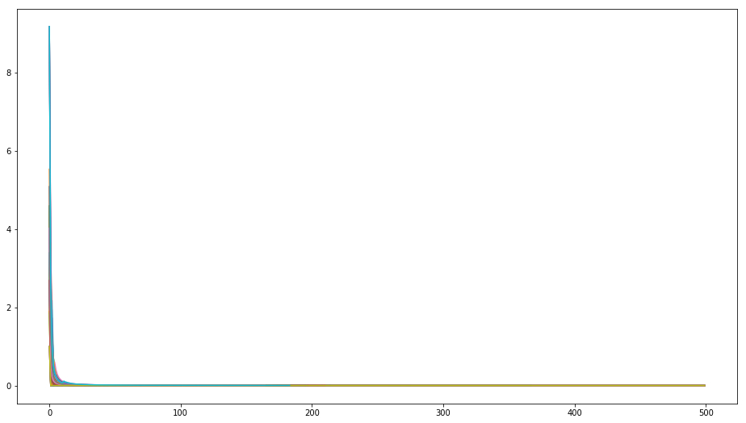
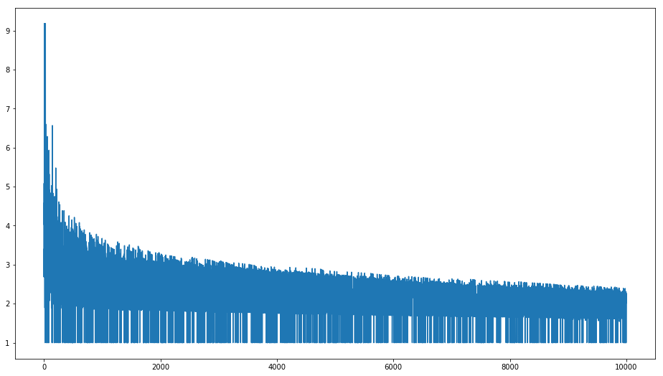
MC with exploring_starts
ΔQ= Q_{t+1}(s,a)-Q_{t}(s,a)
Time indx the state has been visited
bigestChangeInEpisode
indx of the episode

Slide 14
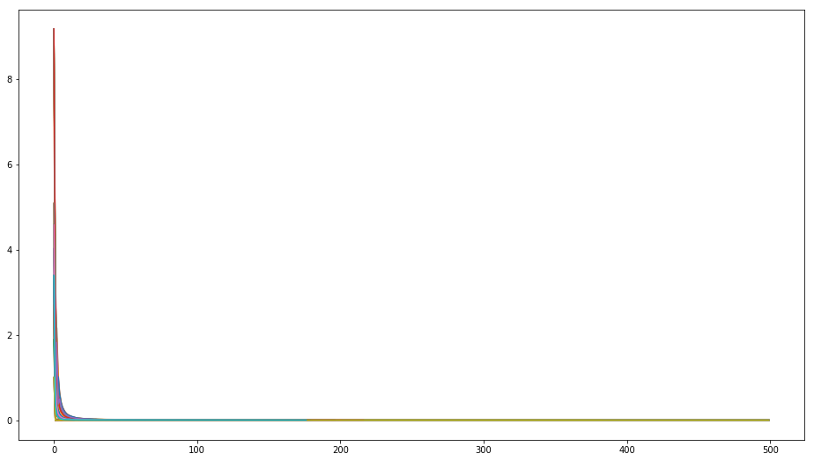

MC without exploring_starts
ΔQ= Q_{t+1}(s,a)-Q_{t}(s,a)
Time indx the state has been visited
bigestChangeInEpisode
indx of the episode

Slide 15
Monte Carlo Methods (MC)
How to ensure that all actions are selected infinitely often ?
on-policy methods: evaluate and improve the policy that is being used to make decisions.
off-policy methods: evaluate and improve a policy that is different from the one used to generate the samples.
In on-policy MC, We don’t make the policy greedy with respect to the current action-values because it would prevent exploration of non-greedy actions.
→ move it to eps-greedy policy
off-policy MC are based on importance sampling, that weight the return by the ratio of the probabilities of taking the observed action under the two policies, thereby transforming their expectations from the behavior policy to the target policy.

Slide 16
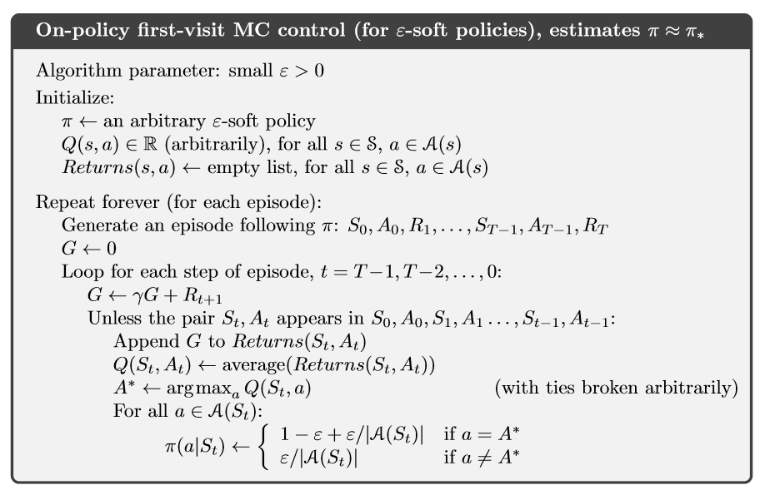
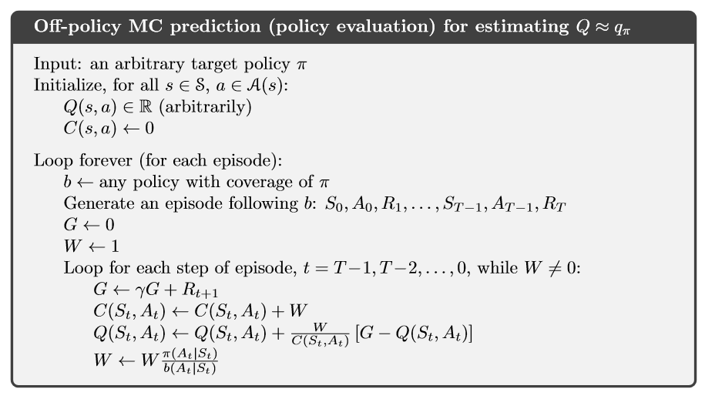
Monte Carlo Methods (MC)
- The fig below, MC with weighted importance sampling using a weighted average.
- A potential problem is that this method learns only from the tails of episodes, after the last non greedy action. If non greedy actions are frequent, then learning will be slow, particularly for states appearing in the early portions of long episodes

Slide 17
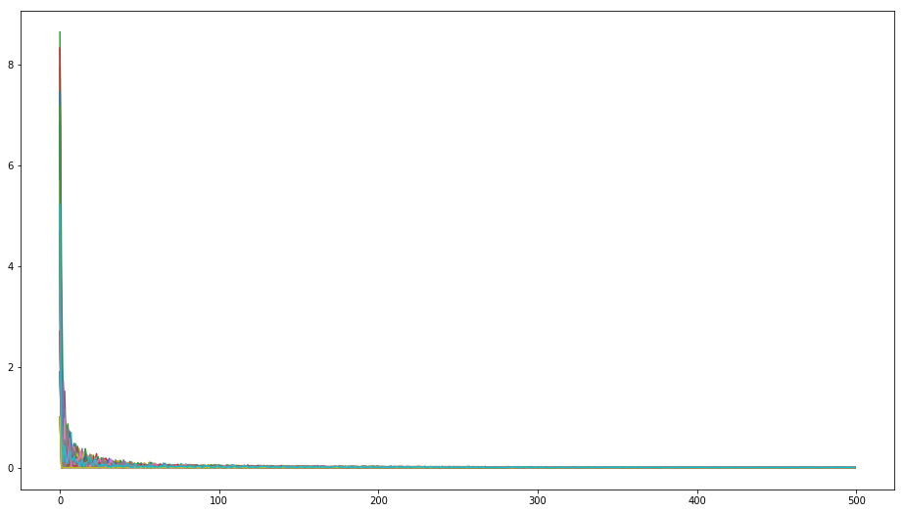
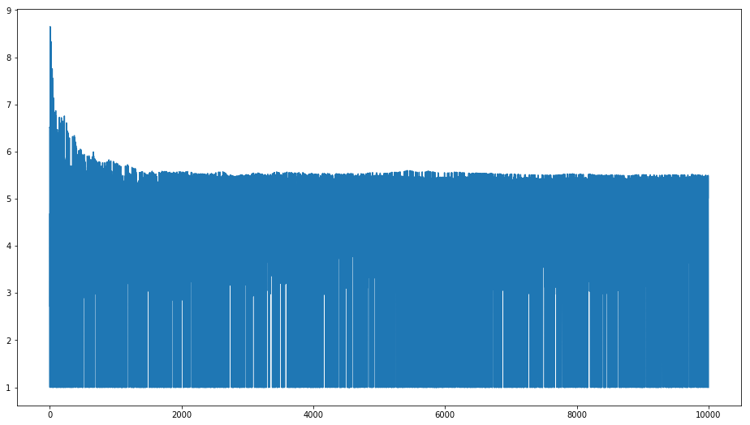
First-visit Epsilon-Greedy Monte Carlo control w/o exploring-Starts
ΔQ= Q_{t+1}(s,a)-Q_{t}(s,a)
Time indx the state has been visited
bigestChangeInEpisode
indx of the episode

Slide 18
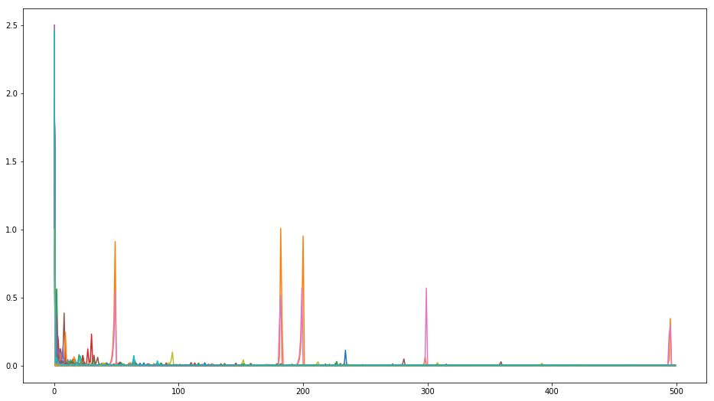
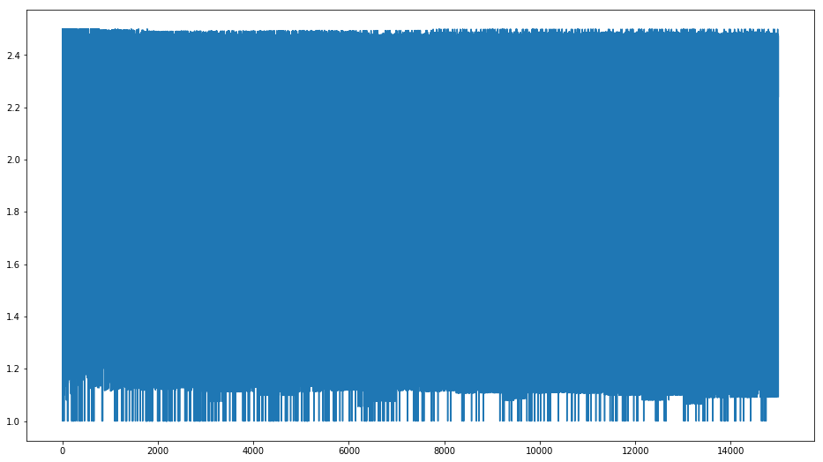
Off policy Monte Carlo control
ΔQ= Q_{t+1}(s,a)-Q_{t}(s,a)
Time indx the state has been visited
bigestChangeInEpisode
indx of the episode

Slide 19
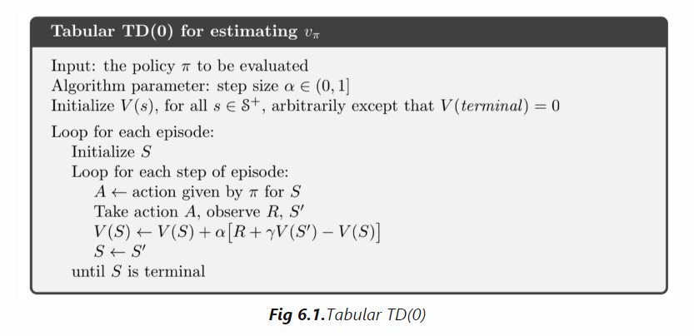
Temporal Difference (TD)
Temporal-Difference (TD) Learning is a combination of:
Monte Carlo methods→ sampling : can learn from experience without knowing the model
Dynamic programming → bootstrap: update estimate based on other learned estimates
but with advantages:
no waiting for the end of the episode like Monte Carlo
for a fixed policy π, TD(0) will converge to v_{π} certainly.
TD methods usually converge faster than MC methods
The difference between batch TD(0) and MC is that MC will always find the estimate that minimizes mean squared error on train data, whereas batch TD(0) always find the estimate that would be correct for the maximum likelihood model of the Markov process.

Slide 20
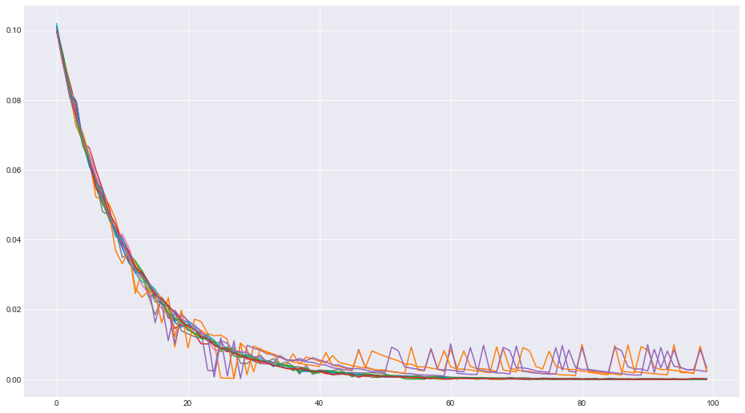
TD0 prediction
ΔV= V_{t+1}(s)-V_{t}(s)
Time indx the state has been visited

Slide 21
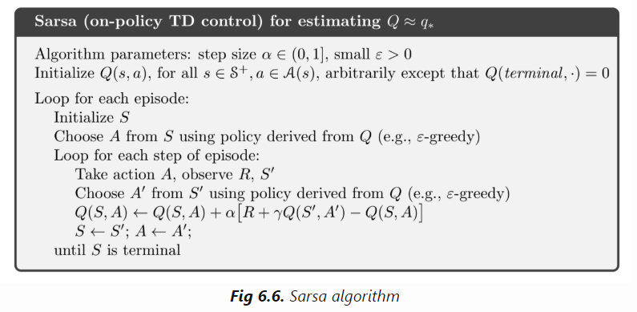
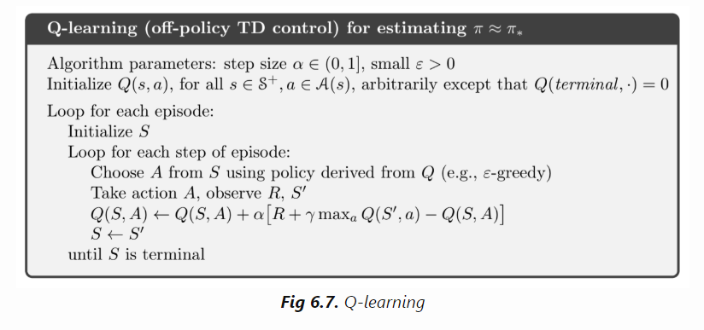
Temporal Difference (TD)
Sarsa: On-policy TD Control
The name came from s,a->r->s’,a’
For an on-policy method we must estimate q_{π}(s,a) for the current behavior policy π . We use the same TD method as for leaning v_{π}
Q-learning: Off-policy TD control: the learned value function Q directly approximates q∗, independent of the policy being followed.
Expected Sarsa: instead of taking the max over the next actions we use the expected value

Slide 22
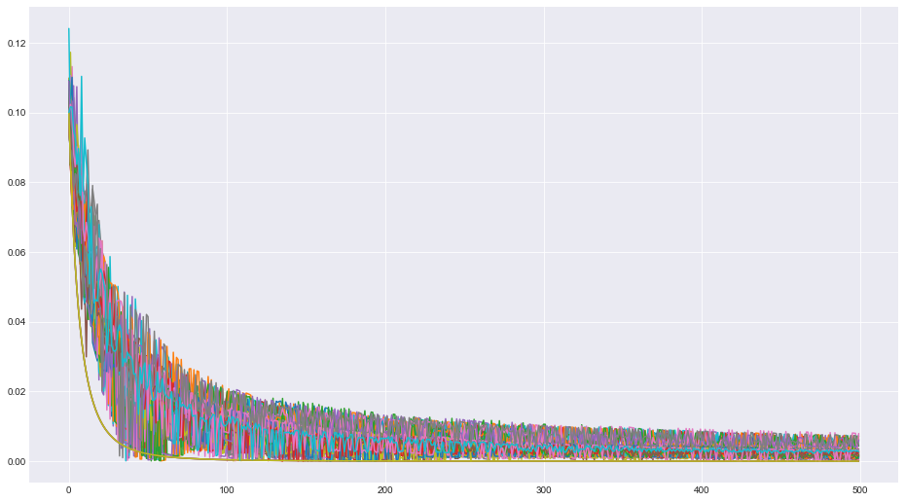
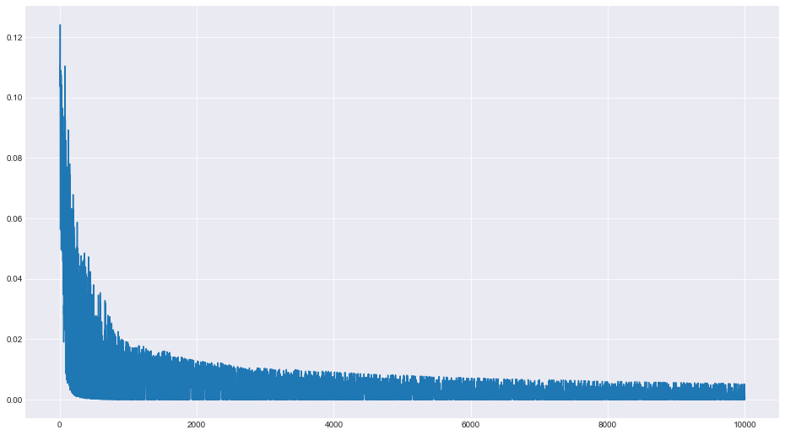
Sarsa
ΔQ= Q_{t+1}(s,a)-Q_{t}(s,a)
Time indx the state has been visited
bigestChangeInEpisode
indx of the episode

Slide 23
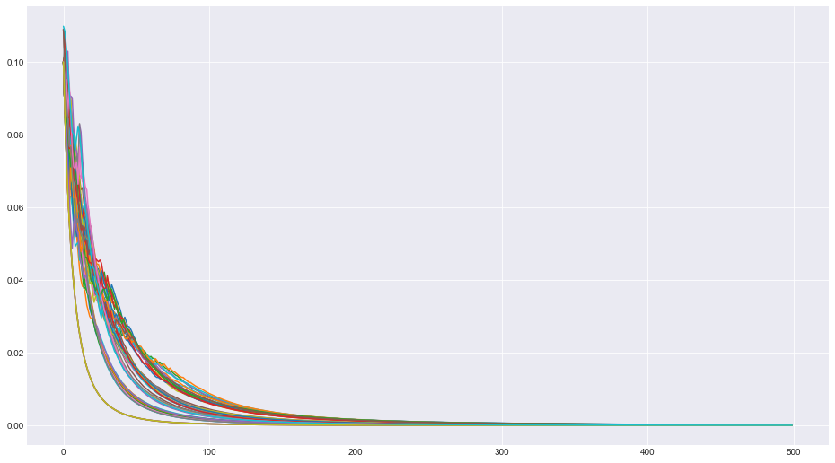
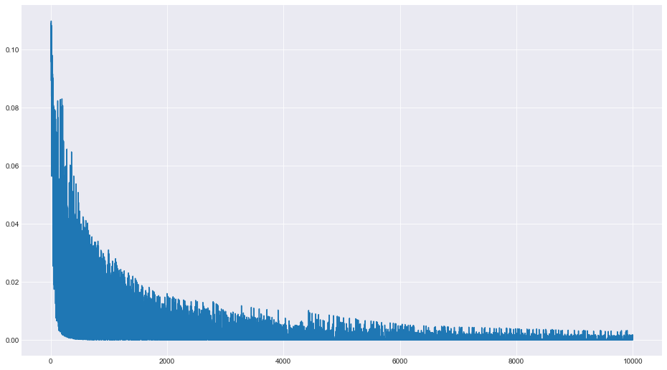
Q-learning
ΔQ= Q_{t+1}(s,a)-Q_{t}(s,a)
Time indx the state has been visited
bigestChangeInEpisode
indx of the episode

Slide 24
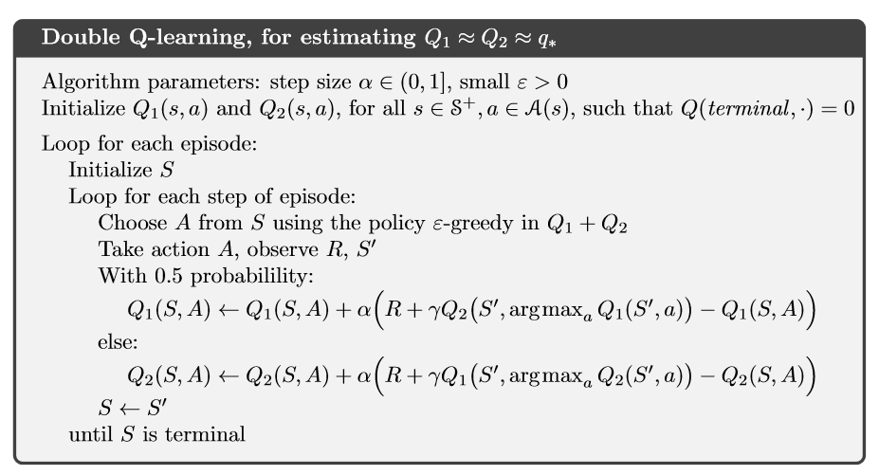
Temporal Difference (TD)
Double Q Learning :
the max used to estimated the Q functions, can lead to a significant positive bias.
We could then use one estimate, say Q1, to determine the maximizing action A* = argmaxa Q1(a), and the other, Q2, to provide the estimate of its value, Q2(A*)=Q2(argmaxa Q1(a)).

Slide 25
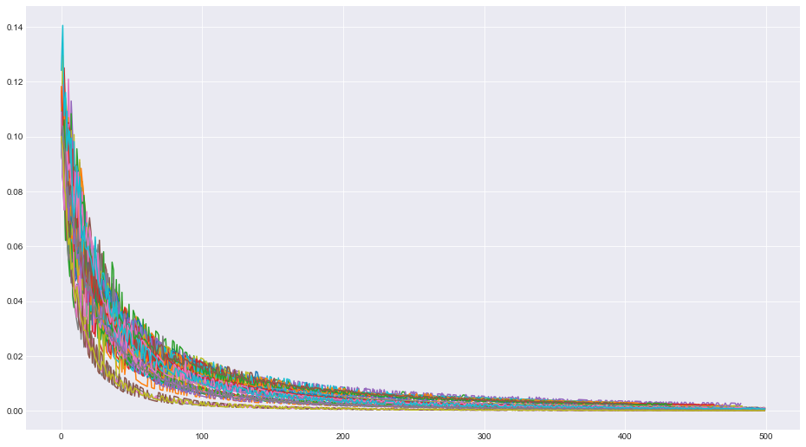
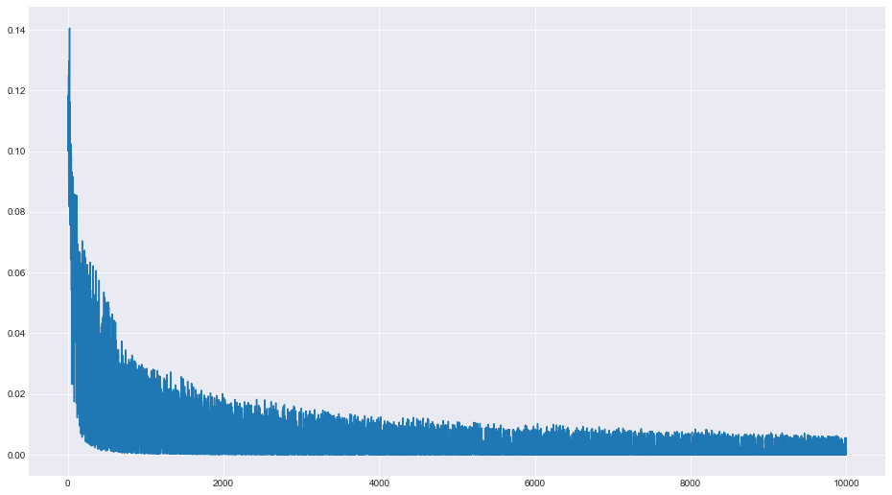
Double Q-learning
ΔQ= Q_{t+1}(s,a)-Q_{t}(s,a)
Time indx the state has been visited
bigestChangeInEpisode
indx of the episode

