Slide 1
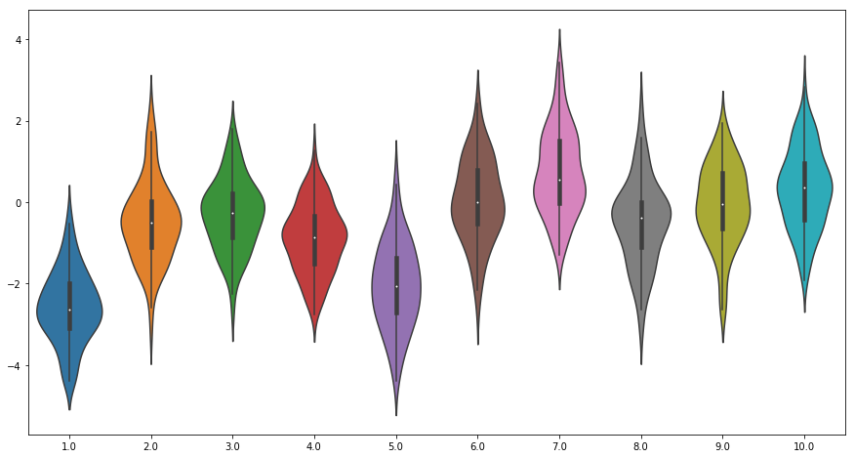
In python :
q ∗ (a) ∼ N (m (a), 1), a = 1, . . . , 10
Eps_greedy with learning rate= 1/N(a) VS Eps_greedy with cst learning rate =0.1

Slide 2
UBC VS Eps_greedy with cst learning rate =1/N(a)
Optimistic Init of Q VS Eps_greedy with cst learning rate =1/N(a)
UBC VS Eps_greedy with cst learning rate =0.1

Slide 3
Gradient baseline VS No baseline
Gradient VS UBC
% Selection of
optimal action

