Slide 1

MN910 – Advanced Compression
Project Presentation
Video encoder
M2R Multimedia networking 12/03/2018
Presented by :
Mourad AKLOUF
Maroua BAKOUR

Slide 2
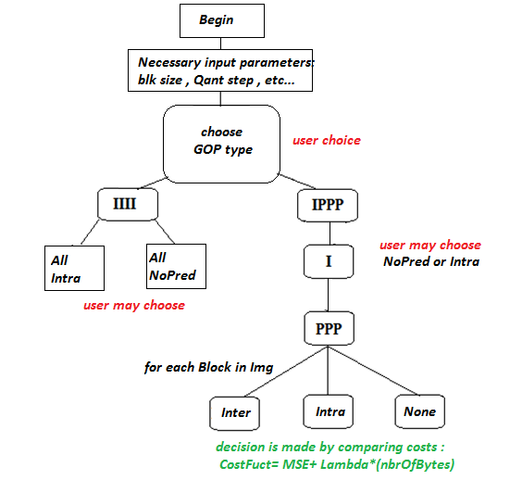
Main program
PROGRAM OVERVIEW IMPORTANT FUNCTIONS
RD CURVES
CONCLUSION
01
10/03/2018 Institut Mines-Telecom
MN910 – Advanced Compression

Slide 3
Main program
PROGRAM OVERVIEW IMPORTANT FUNCTIONS
RD CURVES
CONCLUSION
GetVideoSize();
readGOP();
getFrameI();
NoPrediction() → smallRLE(); → zigZagScan(); huffman_dc(); huffman_ac();
intra(); → smallRLE();
mod0(); mod1(); mod2();
getFrameP();
BestModeSelector();
NoPrediction(); → smallRLE();
inter(); → smallRLE();
intra(); →……
fullRLEforMV();
writeInfile();
02
10/03/2018 Institut Mines-Telecom
MN910 – Advanced Compression

Slide 4
Main program
PROGRAM OVERVIEW IMPORTANT FUNCTIONS
RD CURVES
CONCLUSION
Testing Parameters :
Video : Forman , CIF , Y only , dim : 288 ⤬ 352
2 Types of GOPs :
IIII (all none)
IIII (all intra)
IPPP (none then PPP )
IPPP ( intra then PPP)
Quantization steps : [ 10 30 70 120 180 200 ]
Block size : [4 8 16 32]
03
10/03/2018 Institut Mines-Telecom
MN910 – Advanced Compression

Slide 5
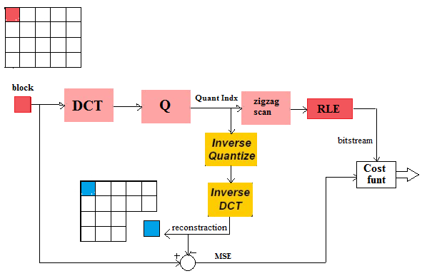
No Prediction Function
PROGRAM OVERVIEW IMPORTANT FUNCTIONS
RD CURVES
CONCLUSION
ZigZag
04
10/03/2018 Institut Mines-Telecom
MN910 – Advanced Compression

Slide 6
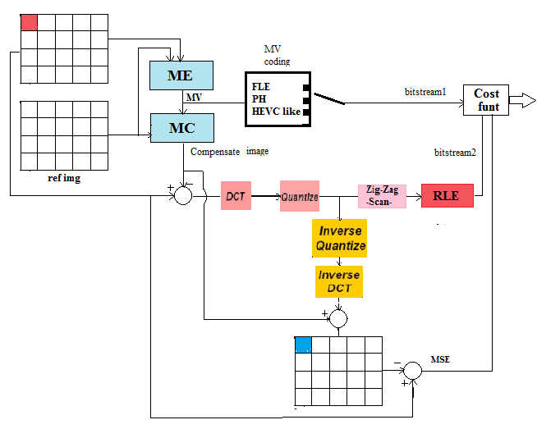
Inter Prediction Function
PROGRAM OVERVIEW IMPORTANT FUNCTIONS
RD CURVES
CONCLUSION
DCT
Q
ZigZag
05
10/03/2018 Institut Mines-Telecom
MN910 – Advanced Compression

Slide 7
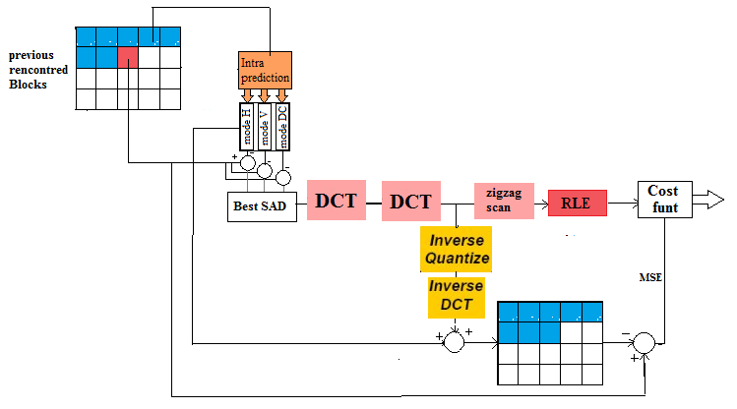
Intra Prediction Function
PROGRAM OVERVIEW IMPORTANT FUNCTIONS
RD CURVES
CONCLUSION
Quant
ZigZag
06
10/03/2018 Institut Mines-Telecom
MN910 – Advanced Compression

Slide 8
FUNCTIONS TEST
PROGRAM OVERVIEW IMPORTANT FUNCTIONS
RD CURVES
CONCLUSION
same image coded None with different Block sizes but constant quantization step:
07
10/03/2018 Institut Mines-Telecom
MN910 – Advanced Compression

Slide 9
FUNCTIONS TEST
PROGRAM OVERVIEW IMPORTANT FUNCTIONS
RD CURVES
CONCLUSION
same image coded Intra with different Block sizes but constant quantization step:
08
10/03/2018 Institut Mines-Telecom
MN910 – Advanced Compression

Slide 10
FUNCTIONS TEST
PROGRAM OVERVIEW IMPORTANT FUNCTIONS
RD CURVES
CONCLUSION
same image coded None with different quantization step but same Block sizes :
09
10/03/2018 Institut Mines-Telecom
MN910 – Advanced Compression

Slide 11
FUNCTIONS TEST
PROGRAM OVERVIEW IMPORTANT FUNCTIONS
RD CURVES
CONCLUSION
same image coded Intra with different quantization step but same Block sizes :
10
10/03/2018 Institut Mines-Telecom
MN910 – Advanced Compression

Slide 12
FUNCTIONS TEST
PROGRAM OVERVIEW IMPORTANT FUNCTIONS
RD CURVES
CONCLUSION
same image coded P with different Block sizes and a constant quantization step :
11
10/03/2018 Institut Mines-Telecom
MN910 – Advanced Compression

Slide 13
FUNCTIONS TEST
PROGRAM OVERVIEW IMPORTANT FUNCTIONS
RD CURVES
CONCLUSION
same image coded as P frame with constant Block size and a different quantization steps
12
10/03/2018 Institut Mines-Telecom
MN910 – Advanced Compression

Slide 14
RD curve for IIII GOP type
PROGRAM OVERVIEW IMPORTANT FUNCTIONS
RD CURVES
CONCLUSION
13
10/03/2018 Institut Mines-Telecom
MN910 – Advanced Compression

Slide 15
PROGRAM OVERVIEW IMPORTANT FUNCTIONS
RD CURVES
CONCLUSION
RD curve for IIII GOP type
14
10/03/2018 Institut Mines-Telecom
MN910 – Advanced Compression

Slide 16
PROGRAM OVERVIEW IMPORTANT FUNCTIONS
RD CURVES
CONCLUSION
RD curves : IIII vs IPPP
15
10/03/2018 Institut Mines-Telecom
MN910 – Advanced Compression

Slide 17
PROGRAM OVERVIEW IMPORTANT FUNCTIONS
RD CURVES
CONCLUSION
RD curves : IIII vs IPPP
16
10/03/2018 Institut Mines-Telecom
MN910 – Advanced Compression

Slide 18
RD curve for dif lambdas
PROGRAM OVERVIEW IMPORTANT FUNCTIONS
RD CURVES
CONCLUSION
17
10/03/2018 Institut Mines-Telecom
MN910 – Advanced Compression

Slide 19
PROGRAM OVERVIEW IMPORTANT FUNCTIONS
RD CURVES
CONCLUSION
RD curve
NoPred
Inter
Intra H
Intra V
Intra DC
18
10/03/2018 Institut Mines-Telecom
MN910 – Advanced Compression

Slide 20
CONCLUSION
PROGRAM OVERVIEW IMPORTANT FUNCTIONS
RD CURVES
CONCLUSION
We notice that :
For IIII GOP type bigger block size gives smaller BitRate , but better PSNR, not the case for smaller blocks
generally all none gives bigger BitRate and slightly better PSNR the all intra,
For both IIII & IPPP , smaller blocks gives bigger computation time , and it’s worse in P frames then the I frames
bigger quant steps gives bigger computation times
IPPP GOP type present less bitrate comparing to the III GOP type , but the PSNR slightly smaller,
lambda has an effect on the selecting mode for P frames : bigger lambdas gives more importance to the size of bit stream , witch is in favorer of the inter mode , Thus encoding with bigger lambda present lower bitrates,
19
10/03/2018 Institut Mines-Telecom
MN910 – Advanced Compression

