Slide 1
Introduction
Dr. Durga Prasad Mohapatra
Professor
Department of Computer Science & Engineering
NIT Rourkela.

Slide 2
What is Software Engineering?
Engineering approach to develop software.
Building Construction Analogy.
Systematic collection of past experience:
Techniques,
Methodologies,
Guidelines.

Slide 3
IEEE Definition
“Software engineering is the application of a systematic, disciplined, quantifiable approach to the development, operation, and maintenance of software; that is, the application of engineering to software.”

Slide 4
Software Crisis
It is often the case that software products:
Fail to meet user requirements.
Expensive.
Difficult to alter, debug, and enhance.
Often delivered late.
Use resources non-optimally.

Slide 5
Software Crisis (cont.)‏
Laptop or Desktop = Rs.45,000/-
Rational suite node locked = Rs.3,14,600/-
Rational suite floating license= Rs.6,03,200/-
Hw cost
Sw cost
1960
Year
2018
Relative Cost of Hardware and Software

Slide 6
Then why not have entirely hardware systems?...
A virtue of software:
Relatively easy and faster to develop and to change…
Consumes no space, weight, or power…
Otherwise all might as well be hardware.
The more is the complexity of software, the harder it is to change--why?
Further, the more the changes made to a program, the greater becomes its complexity.

Slide 7
28% Successful
49% Delayed or cost overrun
23% Cancelled
Standish Group Report

Slide 8
Which Factors are Contributing to the Software Crisis?
Larger problems,
Poor project management
Lack of adequate training in software engineering,
Increasing skill shortage,
Low productivity improvements.

Slide 9
Technology Development Pattern
Programming: an Art or Engineering?
Esoteric Past
Experience
Technology
Engineering
Craft
Systematic Use of Past
Experience and Scientific Basis
Unorganized Use of
Past Experience
Art
Time

Slide 10
Programming an Art or Engineering?
Heavy use of past experience:
Past experience is systematically arranged.
Theoretical basis and quantitative techniques provided.
Many are just thumb rules.
Tradeoff between alternatives.
Pragmatic approach to cost-effectiveness.

Slide 11
What is Exploratory Software Development?
Early programmers used exploratory (also called build and fix) style.
A `dirty' program is quickly developed.
The bugs are fixed as and when they are noticed.
Similar to how a junior student develops programs…

Slide 12
Exploratory Style
Fix
Initial
Coding
Test
Do Until Done
Does not work for nontrivial projects… Why?...

Slide 13
What is Wrong with the Exploratory Style?
Can successfully be used for developing only very small (toy) programs.
Software
Engineering
Exploratory
Effort, time, cost
Machine
Program Size

Slide 14
What is Wrong with the Exploratory Style? Cont…
Besides the exponential growth of effort, cost, and time with problem size:
Exploratory style usually results in unmaintainable code.
It becomes very difficult to use the exploratory style in team development environments…

Slide 15
What is Wrong with the Exploratory Style? Cont…
Why does the effort required to develop a software grow exponentially with size?
Why does the approach completely breaks down when the size of software becomes large?
Software
Engineering
Effort, time, cost
Exploratory
Machine
Program Size

Slide 16
An Interpretation Based on Human Cognition Mechanism
Human memory can be thought to be made up of two distinct parts [Miller 56]:
Short term memory and
Long term memory.

Slide 17

Human Cognition Mechanism
Suppose I ask: “It is 10:10AM now, how many hours are remaining today?"
10AM would be stored in the short-term memory.
“A day is 24 hours long.” would be fetched from the long term memory into short term memory.
The mental manipulation unit would compute the difference (24-10).

Slide 18
Schematic Representation of Brain
Short Term Memory
Processing Center
Long Term Memory
Brain

Slide 19
Short Term Memory
An item stored in the short term memory can get lost:
Either due to decay with time or
Displacement by newer information.
This restricts the time for which an item is stored in short term memory:
Typically few tens of seconds.
However, an item can be retained longer in the short term memory by recycling.

Slide 20
What is an Item?
An item is any set of related information.
A character such as `a' or a digit such as `5'.
A word, a sentence, a story, or even a picture.
Each item normally occupies one place in memory.
When you are able to relate several different items together (chunking):
The information that should normally occupy several places, takes only one place in memory.

Slide 21
Chunking
If I ask you to remember the number 110010101001
It may prove very hard for you to understand and remember.
But, the octal form of 6251 (110)(010)(101)(001) would be easier.
You have managed to create chunks of three items each.

Slide 22
Evidence of Short Term Memory
In many of our day-to-day experiences:
Short term memory is evident.
Suppose, you look up a number from the telephone directory and start dialling it.
If you find the number is busy, you can dial the number again after a few seconds without having to look up the number from directory.
But, after several days:
You may not remember the number at all
Would need to consult the directory again.

Slide 23
The Magical Number 7
If a person deals with seven or less number of items:
These would be accommodated in the short term memory.
So, he can easily understand it.
As the number of new information increases beyond seven:
It becomes exceedingly difficult to understand it.

Slide 24
What is the Implication in Program Development?
A small program having just a few variables:
Is within easy grasp of an individual.
As the number of independent variables in the program increases:
It quickly exceeds the grasping power of an individual…
Requires an unduly large effort to master the problem.

Slide 25
Implication in Program Development
Instead of a human, if a machine could be writing (generating) a program,
The slope of the curve would be linear.
But, how does use of software engineering principles helps hold down the effort-size curve to be almost linear?
Software engineering principles extensively use techniques specifically targeted to overcome the human cognitive limitations.

Slide 26
Which Principles are Deployed by Software Engineering Techniques to Overcome Human Cognitive Limitations?
Two important principles are profusely used:
Abstraction
Decomposition

Slide 27
Two Fundamental Techniques to Handle Complexity

Slide 28
What is Abstraction?
Simplify a problem by omitting unnecessary details.
Focus attention on only one aspect of the problem and ignore other aspects and irrelevant details.
Also called model building.

Slide 29
Abstraction Example
Suppose you are asked to develop an overall understanding of some country.
Would you:
Meet all the citizens of the country, visit every house, and examine every tree of the country?
You would possibly refer to various types of maps for that country only.

Slide 30
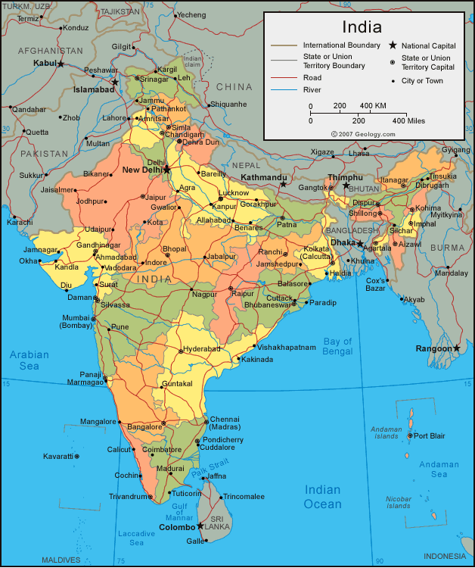
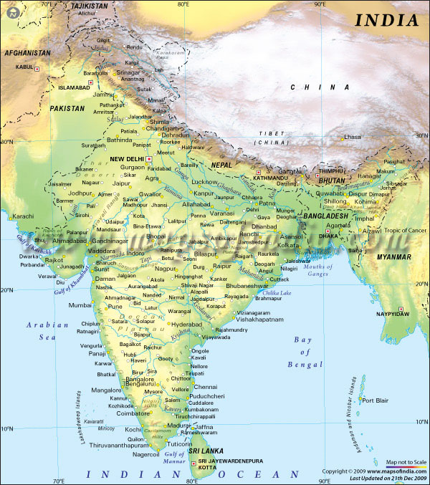
You would study an Abstraction…
A map is:
An abstract representation of a country.
Various types of maps (abstractions) possible.

Slide 31
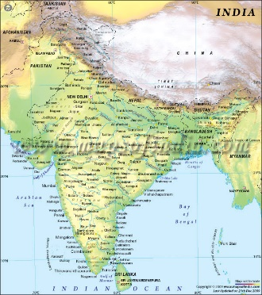
Does every Problem have a single Abstraction?
Several abstractions of the same problem can be created:
Focus on some specific aspect and ignore the rest.
Different types of models help understand different aspects of the problem.

Slide 32
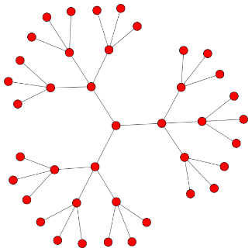
Abstractions of Complex Problems
For complex problems:
A single level of abstraction is inadequate.
A hierarchy of abstractions may have to be constructed.
Hierarchy of models:
A model in one layer is an abstraction of the lower layer model.
An implementation of the model at the higher layer.

Slide 33
Abstraction of Complex Problems -- An Example
Suppose you are asked to understand all life forms that inhabit the earth.
Would you start examining each living organism?
You will almost never complete it.
Also, get thoroughly confused.
Solution: Try to build an abstraction hierarchy.

Slide 34
Living Organisms
Kingdom
Animalia
Plantae
Fungae
Mollusca
Chordata
Ascomycota
Zygomycota
Phyllum
Homo Sapien
Solanum Tuberosum
Coprinus Comatus
Species

Slide 35
Quiz
What is a model?
Why develop a model? That is, how does constructing a model help?
Give some examples of models.

Slide 36

Decomposition
Decompose a problem into many small independent parts.
The small parts are then taken up one by one and solved separately.
The idea is that each small part would be easy to grasp and therefore can be easily solved.
The full problem is solved when all the parts are solved.

Slide 37


Decomposition
A popular example of decomposition principle:
Try to break a bunch of sticks tied together versus breaking them individually.
Any arbitrary decomposition of a problem may not help.
The decomposed parts must be more or less independent of each other.

Slide 38
Decomposition: Another Example
Example use of decomposition principle:
You understand a book better when the contents are organized into independent chapters.
Compared to when everything is mixed up.

Slide 39
Why Study Software Engineering? (1)‏
To acquire skills to develop large programs.
Handling exponential growth in complexity with size.
Systematic techniques based on abstraction (modelling) and decomposition.

Slide 40
Why Study Software Engineering? (2)‏
Learn systematic techniques of:
Specification, design, user interface development, testing, project management, maintenance, etc.
Appreciate issues that arise in team development.

Slide 41
Why Study Software Engineering? (3)‏
To acquire skills to be a better programmer:
Higher Productivity
Better Quality Programs

Slide 42
Jobs versus Projects
Uncertainty of outcome
Routine
Jobs
Projects
Exploration
Jobs – repetition of very well-defined and well understood tasks with very little uncertainty
Exploration – The outcome is very uncertain, e.g. finding a cure for cancer.
Projects – in the middle! Has challenge as well as routine…
Notes:
42
On the one hand there are repetitive jobs a similar task is carried out repeatedly, for example Kwikfit replacing a tyre on a car or a lecturer giving an introductory talk on project management. The task is well-defined and there is very little uncertainty. In some organizations, software development might tend to be like this – in these environments software process management might be more important than software project management
On the other hand some exploratory activities are very uncertain. Some research projects can be like this – we may not be sure what the outcome will be, but we hope that we will learn some things of importance. It may be very difficult to come up with precise plans, although we would probably have some idea of a general approach.
Projects seem to come somewhere between these two extremes. There are usually well-defined hoped-for outcomes but there are risks and uncertainties about achieving those outcomes.

Slide 43
Types of Software Projects
Two types of software projects:
Products (Generic software)‏
Services (custom software)‏
Total business – Several Trillions of US $
Half in products and half services
Services segment is growing fast!

Slide 44
Types of Software
Horizontal market software—meets needs of many companies
Packaged software —prewritten software available for purchase
Vertical market software—designed for particular industry
Custom software — software developed at some user’s requests-Usually developer tailors some generic solution

Slide 45
Thank You!!

