Slide 1
Life Cycle Models cont…

Slide 2
Unified Process
1/12/2019

Slide 3
Unified Process
The Unified Process is an extensible framework which needs to be customized for specific type of projects.
There are two characteristics of Unified Process
Use Case Driven
Iterative

Slide 4
Unified Process
Developed Ivar Jacobson, Grady Booch and James Rumbaugh
Incremental and iterative
Rational Unified Process (RUP) is version tailored by Rational Software:
Acquired by IBM in February 2003.

Slide 5
Four Phases --- and iterative Development at Every phase
Inception Phase
Elaboration Phase
Construction Phase
Transition Phase

Slide 6
Four Phases of Unified Process
Inception
In this phase, Scope of project is defined & prototypes may be developed about the project.
Elaboration
In this phase, Functional & Non-Functional requirements are captured.

Slide 7
Construction
During this phase, Analysis, Design & Implementation activities are carried out.
System features are implemented in iterations.
Each iteration results in executable release of the software.
Transition
In this phase, product is installed in the user’s environment and maintained.

Slide 8
Unified Process Iterations in Phases
The duration of and iteration may vary from two weeks or less.
Iterations
Iterations
Iterations
Iterations
Inception
Elaboration
Construction
Transition

Slide 9
Unified process work products
Inception phase
vision document
initial use-case model
initial business case
initial risk list
project plan
prototype(s)
...
Elaboration phase
use-case model
requirements
analysis model
preliminary model
revised risk list
preliminary manual
...
Construction phase
design model
SW components
test plan
test procedure
test cases
user manual
installation manual
...
Transition phase
SW increment
beta test reports
user feedback
...

Slide 10
Structure of RUP Process
Two dimensions.
Horizontal axis:
Represents time and shows the lifecycle aspects of the process.
Vertical axis:
Represents core process workflows.

Slide 11
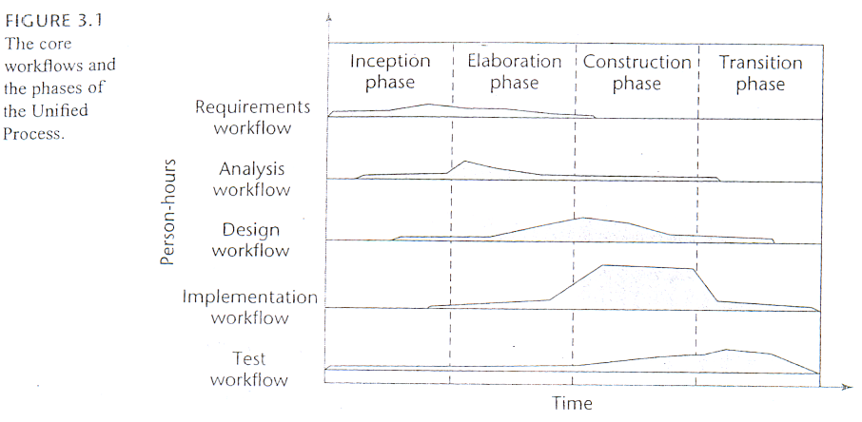
Phases of Unified Process

Slide 12
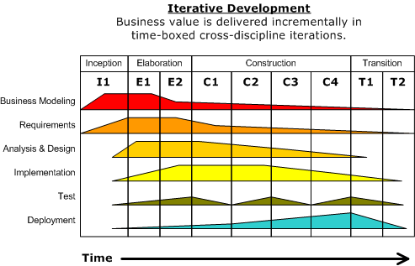
Two dimensions of Unified Process

Slide 13
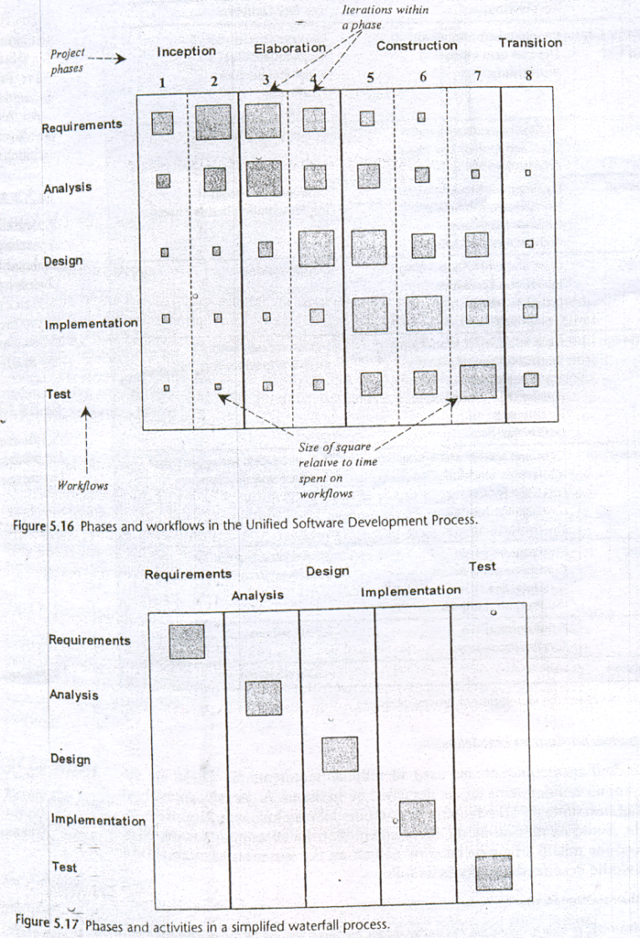

Slide 14
Inception activities
Formulate scope of project
Risk management, staffing, project plan
Synthesize a candidate architecture.

Slide 15
Outcome of Inception Phase
Initial requirements capture
Cost Benefit Analysis
Initial Risk Analysis
Project scope definition
Defining a candidate architecture
Development of a disposable prototype
Initial Use Case Model (10% - 20% complete)
First pass Domain Model

Slide 16
Spiral Model
Proposed by Boehm in 1988.
Each loop of the spiral represents a phase of the software process:
the innermost loop might be concerned with system feasibility,
the next loop with system requirements definition,
the next one with system design, and so on.
There are no fixed phases in this model, the phases shown in the figure are just examples.

Slide 17
Spiral Model (CONT.)‏
The team must decide:
how to structure the project into phases.
Start work using some generic model:
add extra phases
for specific projects or when problems are identified during a project.
Each loop in the spiral is split into four sectors (quadrants).

Slide 18
Spiral Model ‏
Determine Objectives
Identify & Resolve Risks
Customer Evaluation of Prototype
Develop Next Level of Product

Slide 19
Objective Setting (First Quadrant)‏
Identify objectives of the phase,
Examine the risks associated with these objectives.
Risk:
Any adverse circumstance that might hamper successful completion of a software project.
Find alternate solutions possible.

Slide 20
Risk Assessment and Reduction (Second Quadrant)‏
For each identified project risk,
a detailed analysis is carried out.
Steps are taken to reduce the risk.
For example, if there is a risk that requirements are inappropriate:
A prototype system may be developed.

Slide 21
Spiral Model (CONT.)‏
Development and Validation (Third quadrant):
develop and validate the next level of the product.
Review and Planning (Fourth quadrant):
review the results achieved so far with the customer and plan the next iteration around the spiral.
With each iteration around the spiral:
progressively more complete version of the software gets built.

Slide 22
Spiral Model as a Meta Model
Subsumes all discussed models:
a single loop spiral represents waterfall model.
uses an evolutionary approach --
iterations over the spiral are evolutionary levels.
enables understanding and reacting to risks during each iteration along the spiral.
Uses:
prototyping as a risk reduction mechanism
retains the step-wise approach of the waterfall model.

Slide 23
Agile Models
1/12/2019

Slide 24
What is Agile Software Development?
Agile: Easily moved, light, nimble, active software processes
How agility achieved?
Fitting the process to the project
Avoidance of things that waste time
Notes:
Agile SE -> Agile SD
How many have heard of Agile Software Development?
What does the word Agile mean? Anyone?
Latin word agilis, which means “easily moved, light, nimble, active”.
3. Agile Software development – defined as easily moved, light, nimble, and active software processes.
(Agile processes are not unique to software development. They appeared in mainstream business literature in 1991 in the form of Agile manufacturing.)
4. Fitting the process… Not project to the process.
Battlefield commanders plan extensively when going to war -> but realize that their plans are just the beginning. Creating and responding to change are very important.
Success is defined by accomplishing the mission (defeating the enemy) not conforming to the plan.
Can you image a commander saying, “We lost the battle but by golly we were successful because we followed our plan to the letter.”
Or “If we just plan this battle long and hard enough, and put repeatable processes in place, we can eliminate change early and not have to deal with it later.”
Pretty unreasonable.

Slide 25
Agile Model
To overcome the shortcomings of the waterfall model of development.
Proposed in mid-1990s
The agile model was primarily designed:
To help projects to adapt to change requests
In the agile model:
The requirements are decomposed into many small incremental parts that can be developed over one to four weeks each.

Slide 26
Ideology: Agile Manifesto
Individuals and interactions over
process and tools
Working Software over
comprehensive documentation
Customer collaboration over
contract negotiation
Responding to change over
following a plan
http://www.agilemanifesto.org
Notes:
Idealisms
Over instead of versus is because they are all good ideals
Rework vs. Reuse – everything should be production quality, but reworkable for flexibility. Don’t be afraid of partial solutions.
Military Adoption of the 80% solution.
Responding to Change – in line with Lucy Suchman’s Plans and Situated Actions, with the trukese and european navigators.

Slide 27
Agile Methodologies
XP
Scrum
Unified process
Crystal
DSDM
Lean

Slide 28
Agile Model: Principal Techniques
User stories:
Simpler than use cases.
Metaphors:
Based on user stories, developers propose a common vision of what is required.
Spike:
Simple program to explore potential solutions.
Refactor:
Restructure code without affecting behavior, improve efficiency, structure, etc.

Slide 29
Agile Model: Nitty Gritty
At a time, only one increment is planned, developed, deployed at the customer site.
No long-term plans are made.
An iteration may not add significant functionality,
But still a new release is invariably made at the end of each iteration
Delivered to the customer for regular use.

Slide 30
Methodology
Face-to-face communication favoured over written documents.
To facilitate face-to-face communication,
Development team to share a single office space.
Team size is deliberately kept small (5-9 people)
This makes the agile model most suited to the development of small projects.

Slide 31
Effectiveness of Communication Modes
Notes:
Software development is a communication game
Documentation is the worst way to communicate
Whatever your situation, use the most effective means at your disposal to communicate
http://www.agilemodeling.com/essays/communication.htm

Slide 32
Agile Model: Principles
The primary measure of progress:
Incremental release of working software
Important principles behind agile model:
Frequent delivery of versions --- once every few weeks.
Requirements change requests are easily accommodated.
Close cooperation between customers and developers.
Face-to-face communication among team members.

Slide 33
Agile Documentation
Travel light:
You need far less documentation than you think.
Agile documents:
Are concise
Describe information that is less likely to change
Describe “good things to know”
Are sufficiently accurate, consistent, and detailed
Valid reasons to document:
Project stakeholders require it
To define a contract model
To support communication with an external group
To think something through

Slide 34
Agile Software Requirements Management

Slide 35
Adoption Detractors
Sketchy definitions, make it possible to have
Inconsistent and diverse definitions
High quality people skills required
Short iterations inhibit long-term perspective
Higher risks due to feature creep:
Harder to manage feature creep and customer expectations
Difficult to quantify cost, time, quality.
Notes:
Why not more adoption (in SE? in corporate? In universities?)
Inconsistent and diverse defs – need more quality methodology not just quantity.
Lack of Theoretical Grounding – current concept of agility based on experience, not on underlying concepts like flexibility and leanness. Agile methods like SCRUM and XP are derived from subjective practical experience and not reliable systematic research.
But there is hope… Conboy et. Al. and their framework of agility for software development (based on underlying concepts);
Role changes – management role less prominent and active, more like a coach
Situational customization – no out of the box operation. Takes time to customize a process and get good at it.
Difficult to quantify – Agile practices are more philosophy based not activity based.
Risks – Making the customer understand the tradeoffs for following them down a rabbit hole can be difficult.
How do you budget a project if you can’t get the all/most requirements upfront?

Slide 36
Agile Model Shortcomings
Derives agility through developing tacit knowledge within the team, rather than any formal document:
Can be misinterpreted…
External review difficult to get…
When project is complete, and team disperses, maintenance becomes difficult…

Slide 37
Agile Model versus Waterfall Model
Steps of Waterfall model are a planned sequence:
Requirements-capture, analysis, design, coding, and testing .
Progress is measured in terms of delivered artefacts:
Requirement specifications, design documents, test plans, code reviews, etc.
In contrast agile model sequences:
Delivery of working versions of a product in several increments.

Slide 38
Agile Model versus Iterative Waterfall Model
As regards to similarity:
We can say that Agile teams use the waterfall model on a small scale.

Slide 39
Agile versus RAD Model
Agile model does not recommend developing prototypes:
Systematic development of each incremental feature is emphasized.
In contrast:
RAD is based on designing quick-and-dirty prototypes, which are then refined into production quality code.

Slide 40
Agile versus exploratory programming
Similarity:
Frequent re-evaluation of plans,
Emphasis on face-to-face communication,
Relatively sparse use of documents.
Agile teams, however, do follow defined and disciplined processes and carry out rigorous designs:
This is in contrast to chaotic coding in exploratory programming.

Slide 41
Extreme Programming (XP)

Slide 42
Extreme Programming Model
Extreme programming (XP) was proposed by Kent Beck in 1999.
The methodology got its name from the fact that:
Recommends taking the best practices to extreme levels.
If something is good, why not do it all the time.

Slide 43
Taking Good Practices to Extreme
If code review is good:
Always review --- pair programming
If testing is good:
Continually write and execute test cases --- test-driven development
If incremental development is good:
Come up with new increments every few days
If simplicity is good:
Create the simplest design that will support only the currently required functionality.

Slide 44
Taking to Extreme
If design is good,
everybody will design daily (refactoring)
If architecture is important,
everybody will work at defining and refining the architecture (metaphor)
If integration testing is important,
build and integrate test several times a day (continuous integration)

Slide 45
4 Values
Communication:
Enhance communication among team members and with the customers.
Simplicity:
Build something simple that will work today rather than something that takes time and yet never used
May not pay attention for tomorrow
Feedback:
System staying out of users is trouble waiting to happen
Courage:
Don’t hesitate to discard code

Slide 46
Best Practices
Coding:
without code it is not possible to have a working system.
Utmost attention needs to be placed on coding.
Testing:
Testing is the primary means for developing a fault-free product.
Listening:
Careful listening to the customers is essential to develop a good quality product.

Slide 47
Best Practices
Designing:
Without proper design, a system implementation becomes too complex
The dependencies within the system become too numerous to comprehend.
Feedback:
Feedback is important in learning customer requirements.

Slide 48
Extreme Programming Activities
XP Planning
Begins with the creation of “user stories”
Agile team assesses each story and assigns a cost
Stories are grouped to for a deliverable increment
A commitment is made on delivery date
XP Design
Follows the KIS principle
Encourage the use of CRC cards
For difficult design problems, suggests the creation of “spike solutions”—a design prototype
Encourages “refactoring”—an iterative refinement of the internal program design

Slide 49
Extreme Programming Activities
XP Coding
Recommends the construction of unit test cases before coding commences (test-driven development)
Encourages “pair programming”
XP Testing
All unit tests are executed daily
“Acceptance tests” are defined by the customer and executed to assess customer visible functionalities

Slide 50
Full List of XP Practices
Planning – determine scope of the next release by combining business priorities and technical estimates
Small releases – put a simple system into production, then release new versions in very short cycles
Metaphor – all development is guided by a simple shared story of how the whole system works
Simple design – system is to be designed as simple as possible
Testing – programmers continuously write and execute unit tests

Slide 51
Full List of XP Practices
Refactoring – programmers continuously restructure the system without changing its behavior to remove duplication and simplify
Pair-programming -- all production code is written with two programmers at one machine
Collective ownership – anyone can change any code anywhere in the system at any time.
Continuous integration – integrate and build the system many times a day – every time a task is completed.

Slide 52
Full List of XP Practices
40-hour week – work no more than 40 hours a week as a rule
On-site customer – a user is a part of the team and available full-time to answer questions
Coding standards – programmers write all code in accordance with rules emphasizing communication through the code

Slide 53
Emphasizes Test-Driven Development (TDD)
Based on user story develop test cases
Implement a quick and dirty feature every couple of days:
Get customer feedback
Alter if necessary
Refactor
Take up next feature

Slide 54
Project Characteristics that Suggest Suitability of Extreme Programming
Projects involving new technology or research projects.
In this case, the requirements change rapidly and unforeseen technical problems need to be resolved.
Small projects:
These are easily developed using extreme programming.

Slide 55
Thank You!!

