Slide 1

Mobile & Shuffle Network Project
GOTTIPATI MOURYA
This Photo by Unknown author is licensed under CC BYNCND.

Slide 2
Table of contents
Introduction
Project Description
Data Set
Mobile Network Architecture
Shuffle Network Architecture
Training Process
Testing and Evaluation
Results and Analysis
Conclusion
References

Slide 3
Introduction
Overview: Exploring this project focusing on Mobile and Shuffle Network architectures.
Structure: The presentation is organized to provide a stepbystep walkthrough of key project components.
Dataset Exploration: Understand the foundation of my work by examining the dataset that drove my experiments.
Network Architectures: Dive into the technical details of the Mobile Network and Shuffle Network structures.
Training Process: Uncover the methodologies and steps I employed during the training of my deep neural networks.
Testing and Evaluation: Gain insights into how my models were rigorously evaluated, emphasizing the testing phase.
Results and Analysis: Delve into the outcomes of my experiments and the subsequent analytical interpretation of these results.
Conclusion: Summarize my key findings and express concluding thoughts on the overall project.
References: Provide a list of sources and references that guided my exploration.

Slide 4
Project Description
Implemented and evaluated convolutional neural network architectures, MobileNet and Shuffle Net, for image classification.
Specifically, target the MNIST dataset for digit recognition.
Focus on two CNN architectures: MobileNet and Shuffle Net.
These architectures are known for their efficiency and suitability for mobile and edge devices.
Utilize the MNIST dataset for training and testing.
MNIST is a well-known dataset consisting of handwritten digits [0-9], commonly used for image classification tasks.
Train the MobileNet and Shuffle Net models on the MNIST dataset.
Evaluate the models' performance in terms of accuracy, precision, recall, average and F1score.

Slide 5
Project Description
The training process, including Adam optimization algorithms and loss functions.
hyperparameters such as the number of epochs and batch size.
Test the trained models on a separate dataset.
Evaluate and compare the performance metrics of MobileNet and Shuffle Net.
Assess the models based on accuracy, precision, recall, and F1score.
These metrics provide insights into the models' ability to correctly classify digits.
Conduct a comparative analysis of MobileNet and Shuffle Net.
Highlight strengths and weaknesses of each architecture based on the evaluation metrics.

Slide 6
Data Set
Data Overview:
The dataset comprises handdrawn digits from zero through nine.
Images are in grayscale and have a resolution of 28x28 pixels.
Pixel Information:
Each image is represented by 784 pixels, with a single pixelvalue indicating lightness or darkness.
Pixelvalues range from 0 to 255, where higher values signify intensity pixels.
File Descriptions:
The training dataset (train.csv) contains 785 columns.
The first column, "label," represents the digit drawn by the user (target variable).
The remaining columns represent pixelvalues of the associated image.
Pixel Naming Convention:
Pixels in the training set are named pixel x, where x is an integer from 0 to 783.
The decomposition x = i * 28 j maps the pixel to a 28x28 matrix, with i and j in the range [0, 27].

Slide 7
Data Set
Image Location in Matrix:
Pixelx, decomposed as x = i * 28 j, is located at row i and column j in the 28x28 matrix (zerobased indexing).
Test Data Set:
The test dataset (test.csv) is identical to the training set .
Sample Size:
The Train dataset has 32000 samples and Test dataset has 10000 samples
PreProcessing Data:
Normalized the gray scale data in [0,1] which can help in preventing from Overfitting, Numerical Stability, improved convergence.
Data Augmentation:
The Train dataset has 32000 samples, and the same data is augmented and added into original train dataset to make it more robust.
The Test dataset is augmented to make it robust and perform metrics on the outcomes.

Slide 8
Mobile Network Architecture
Input Layer:
Shape: (28, 28, 1)
Description: Accepts 28x28 grayscale images representing handdrawn digits.
Convolution Blocks:
Conv2D (3x3 kernel, 32 filters, strides=2)
Batch Normalization
ReLU activation
Description: This convolutional block applies a 3x3 kernel with 32 filters and a stride of 2 to reduce spatial dimensions. Batch normalization and ReLU activation follow to introduce nonlinearity.
Depthwise Separable Convolution Blocks(x6):
Depthwise Conv2D (3x3 kernel, strides=1)
Batch Normalization
ReLU activation
Pointwise Conv2D (1x1 kernel, 64 filters, strides=1)
Batch Normalization
ReLU activation

Slide 9
Mobile Network Architecture
Description: Depthwise separable convolutions are used for their efficiency. The depthwise convolution is followed by batch normalization and ReLU activation. Then, a pointwise convolution with 64 filters is applied with subsequent batch normalization and ReLU activation. Similarly, it is performed on 5 other layers with various strides, kernel sizes, and numbers of filters.
Global Average Pooling:
Description: Reduces spatial dimensions to (1, 1, 512) by taking the average of each channel across the spatial dimensions. This operation is commonly used to reduce the spatial dimensions before the fully connected layers.
Fully Connected Layers:
Dense layer (1024 units, ReLU activation)
Dropout layer (50% dropout rate)
Dense layer (10 units, softmax activation)
Description: The global averagepooled output is fed into a fully connected layer with 1024 units and ReLU activation. A dropout layer is introduced to prevent overfitting, and finally, a dense layer with 10 units and softmax activation produces the output probabilities for each digit class (09).

Slide 10
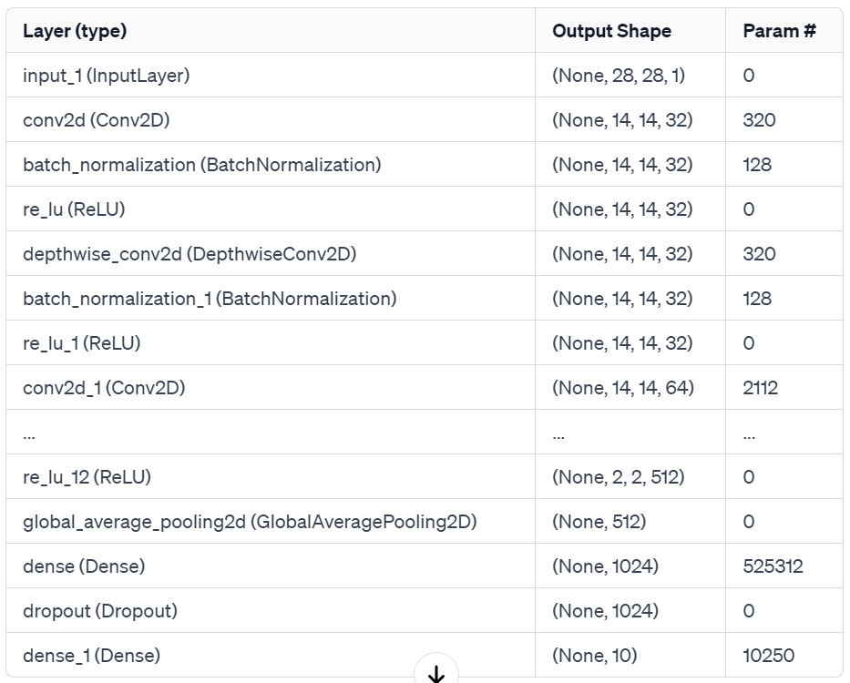
Mobile Network Architecture: Total Parameters- 810826

Slide 11
Shuffle Network Architecture
Input Layer:
Shape: (28, 28, 1)
Input: Grayscale images representing handdrawn digits.
Convolution Block:
Conv2D (3x3 kernel, 24 filters, strides=1, padding=same)
Batch Normalization
ReLU activation
Depthwise Separable Convolution Blocks (x3):
Depthwise Conv2D (3x3 kernel, strides=1, padding=same)
Batch Normalization
ReLU activation
Pointwise Conv2D (1x1 kernel, 24 filters, strides=1, padding=same)
Batch Normalization
ReLU activation

Slide 12
Shuffle Network Architecture
Channel Shuffle Operation:
Shuffle channels within groups to enhance feature diversity.
Global Average Pooling:
Reduces spatial dimensions to (1, 1, 24).
Fully Connected Layer:
Dense layer (1024 units, ReLU activation)
Dropout layer (50% dropout rate)
Output Layer:
Dense layer (10 units, softmax activation) for classification.

Slide 13
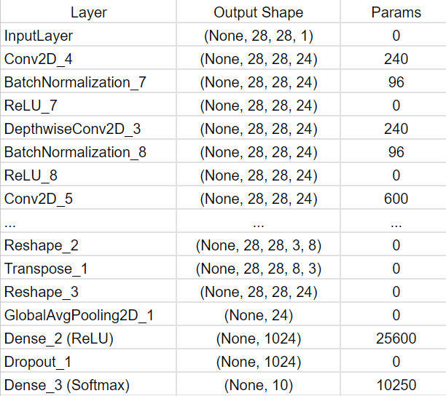
Shuffle Network Architecture: Total Parameters-39282

Slide 14
Training Process
1. Model Compilation:
Optimizer: Adam optimizer is employed for efficient weight updates during training.
Loss Function: Sparse categorical crossentropy is chosen as the loss function, suitable for multiclass classification tasks.
Metric: Accuracy is selected as the evaluation metric to measure the model's performance during training.
2. Train Function Parameters:
Model: The architecture, optimizer, loss function, and metric are encapsulated in the model.
Training Data: The input data (`x_train`) and corresponding labels (`y_train`) are provided to the model for learning.
Epochs: The number of epochs determines how many times the model iterates over the entire training dataset.
Batch Size: Training data is divided into batches, and the model's weights are updated after processing each batch.
3. Performance Monitoring:
The training process is monitored using the specified metric (accuracy), providing insights into the model's accuracy on the training dataset.

Slide 15
Testing and Evaluation
Predicted Labels:
The model predicts class labels for the test data, obtaining one-hot encoded predictions.
Argmax:
Argmax operation is applied to convert the one-hot encoded predictions into integer labels.
Evaluation:
Performance Metrics:
The model's performance is evaluated using metrics such as accuracy, precision, recall, f1-score, average and running time.

Slide 16
Results and Analysis-1
Mobile net Train accuracy after 15 epochs-0.9942
Shuffle net Train accuracy after 15 epochs-0.9631
Metrics:
Mobile Net | Shuffle Net
Accuracy: MobileNet-0.837 Precision: MobileNet-0.9623188405797102 Recall: MobileNet-0.9940119760479041 F1-score: MobileNet-0.9779086892488954 Average: MobileNet-0.9428098764691275 Running time: MobileNet-1548.18 seconds | Accuracy: ShuffleNet-0.9149 Precision: ShuffleNet-0.9982142857142857 Recall: ShuffleNet-1.0 F1-score: SuffleNet-0.9991063449508489 Average: ShuffleNet-0.9780551576662837 Running time: ShuffleNet-1309.48 seconds

Slide 17
Results and Analysis-2
Mobile net Train accuracy after 20 epochs-0.9954
Shuffle net Train accuracy after 20 epochs-0.9713
Metrics:
Mobile Net | Shuffle Net
Accuracy: MobileNet-0.8253 Precision: MobileNet-0.9578577699736611 Recall: MobileNet-0.9954379562043796 F1-score: MobileNet-0.9762863534675617 Average: MobileNet-0.9387205199114006 Running time: MobileNet-3988.45 seconds | Accuracy: ShuffleNet-0.8531 Precision: ShuffleNet-1.0 Recall: ShuffleNet-1.0 F1-score: SuffleNet-1.0 Average: ShuffleNet-0.963275 Running time: ShuffleNet-3449.58 seconds

Slide 18
Results and Analysis-3
Mobile net Train accuracy after 30 epochs-0.9971
Shuffle net Train accuracy after 30 epochs-0.9730
Metrics:
Mobile Net | Shuffle Net
Accuracy: MobileNet-0.8418 Precision: MobileNet-0.8302193338748984 Recall: MobileNet-0.9742612011439467 F1-score: MobileNet-0.8964912280701754 Average: MobileNet-0.8856929407722551 Running time: MobileNet-5700.63 seconds | Accuracy: ShuffleNet-0.5646 Precision: ShuffleNet-1.0 Recall: ShuffleNet-1.0 F1-score: SuffleNet-1.0 Average: ShuffleNet-0.89115 Running time: ShuffleNet-4927.34 seconds

Slide 19
Conclusion
Mobile-Friendly CNN Exploration:
Explored the development of convolutional neural networks optimized for mobile and edge devices.
Efficient Model Building:
Implemented models inspired by MobileNet and ShuffleNet architectures.
Leveraged depthwise separable convolutions and channel shuffling for efficiency.
Promising Results:
The models showcased promising results in image classification tasks.
Successfully applied optimization techniques for performance enhancement.
Guiding Future Projects:
The lessons and experiences gained from this project will serve as a guide.

Slide 20
References
Mobile Net- https://arxiv.org/pdf/1704.04861.pdf
Shuffle Net- https://arxiv.org/pdf/1707.01083.pdf

Slide 21
Question & Answers

Slide 22
Thank You

