Slide 1
Information Retrieval
Adapted from Lectures by
Berthier Ribeiro-Neto (Brazil),
Prabhakar Raghavan (Google and Stanford) and Christopher Manning (Stanford)
Prasad
L1IntroIR
Notes:
Scope of IR: Essentially about search engine under the hood
Personal Experience (Context):
(1) IR from Matl. Process Specs (NSF-SBIR)
(2) XML Search (R&D)
(3) IR from News Dataset (Lexis-Nexis)
(4) IR from SW+HW (Ph.D. diss.)
------------------------------------
Document Analytics: Medical literature IR/IE
------------------------------------
Social media analytics : crisis response, monitoring extremists,
mental health/depression, harassment and social harm

Slide 2
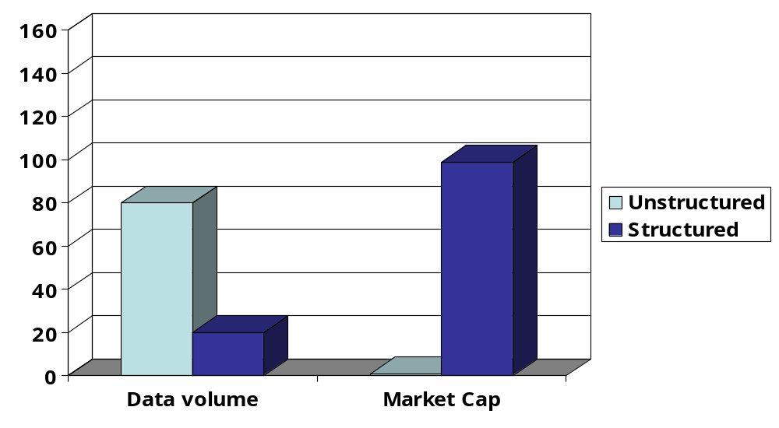
Unstructured (text) vs. structured (database) data in 1996
Prasad
L1IntroIR
Notes:
4:1
80%-20% to 1%-99%
----------------------------
Structured => Relational systems (RDBMS)

Slide 3
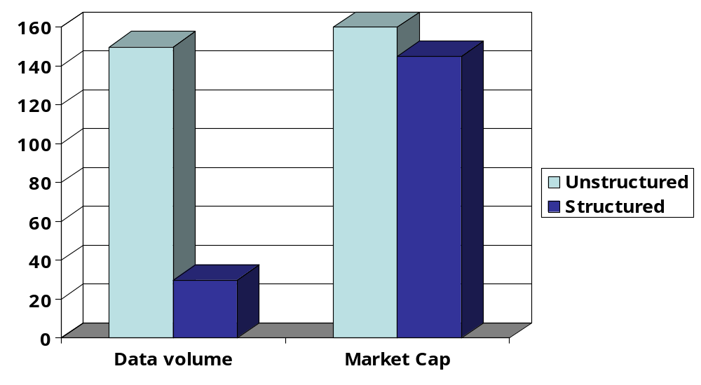




Unstructured (text) vs. structured (database) data in 2006
Prasad
L1IntroIR
Notes:
6 :: 1 vs 1:1
150-25
Search engines promoted this growth

Slide 4
Structured vs unstructured data
Structured data : information in “tables”
Employee
Manager
Salary
Smith
Jones
50000
Chang
Smith
60000
Ivy
Smith
50000
Typically allows numerical range and exact match
(for text) queries, e.g.,
Salary < 60000 AND Manager = Smith.
Prasad
L1IntroIR
Notes:
Integration requires introduction of partial matching
(range query is the partial match equivalent for numeric data)
Relational Database revolution : Simple conceptual model of data and queries
– Declarative (Codd’s contribution Relational Algebra and Calculus that founds SQL)
---------------------------
Simple conceptual model – sophisticated, efficient implementations

Slide 5
Unstructured data
Typically refers to free text
  Data which does not have clear, semantically overt, easy-for-a-computer structure
  Low barrier for creation; Widely available and easily accessible on the Web
Allows
  Keyword-based queries including operators
  More sophisticated “concept” queries, e.g.,
    find all web pages dealing with drug abuse (SUD)
Prasad
L1IntroIR
Notes:
Research prototypes: use of metadata – RDFa / Semantic Web technologies to
improve computer comprehension
NLP and domain knowledge can improve effectiveness : Semantic Web and ontologies
(Use linguistic and domain resources to glean semantics and use formalisms to make it
Machine accessible both syntactically and semantically)
Schema.org, Google graphs, etc. :: Improve informativeness using Freebase, Wikipedia info (curated resources)
[[[[APPROXIMATION TO OVERT SEMANTICS : highlight entities + lookup more info ➔ to bridge the gap]]]]
Concept queries = Query Expansion, LSA (cf. web of concepts)
Queries easy to formulate – but “good” results hard to generate, in general
(because accuracy is in the eye of the beholder)
------------------------------------
Grammatical text (NLP-lite parsing / POS tagging) vs user-generated content (n-gram-based approaches)
E.g., News articles vs tweets/blogs
=====================
Onus of interpretation and scalability on machine (enter knowledge-based techniques for annotation) => semantic web

Slide 6
Semi-structured data
In fact almost no data is “unstructured”
  E.g., this slide has distinctly identified zones such as the Title and Bullets
Facilitates “semi-structured” search such as
  Title contains data AND Bullets contain search
    … to say nothing of linguistic structure
Prasad
L1IntroIR
Notes:
More expressive (hence effective) queries
Fielded search: Different matching criteria for different fields
ORIGINAL BRIN/PAGE PROPOSAL: exploits anchor text, fonts info
---------------
Richer annotations – metadata using background knowledge
--------
XML search

Slide 7
Sampling of Current Trends
Semantic Web: Use of metadata to make semantics explicit and machine processable
  Translation to RDF (or OWL, a logic-based formalism)
  Embedding tags using RDFa (for traceability) and then extracting RDF triples (via GRRDL)
Linked Open Data : Structured representation of unstructured data (E.g., Dbpedia vs Wikipedia)
Google Fusion Tables : E.g., Information about places of interests and geo-mashups
Prasad
L1IntroIR
Notes:
Semantics made explicit using standard, community agreed domain ontologies
-------------
Technology and techniques SW => Practice LOD => Ultimate applications GFT

Slide 8
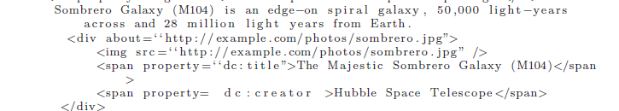

Annotated Document and Extracted Triples
Prasad
L1IntroIR
Notes:
Both human and machine accessible format => Hybridizing structured and unstructured information

Slide 9
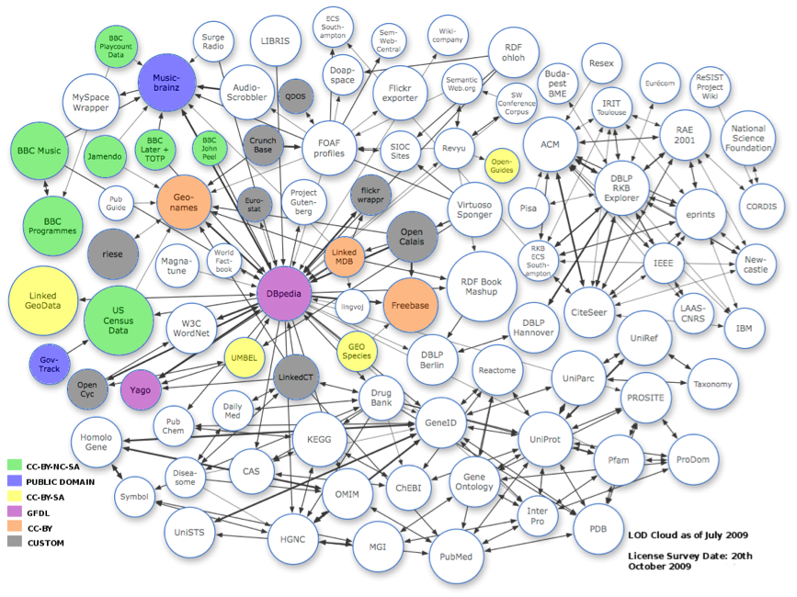
Linked Open Data
Prasad
L1IntroIR
Notes:
Census data, medical data (NCBO), Geonames, NYT, BBC, …, Freebase, Dbpedia, …,Music Brainz
-------------
Structured and standardized representation of certain domains (ontologies/instances)
=> Facilitates reasoning (“intelligent behavior”)

Slide 10
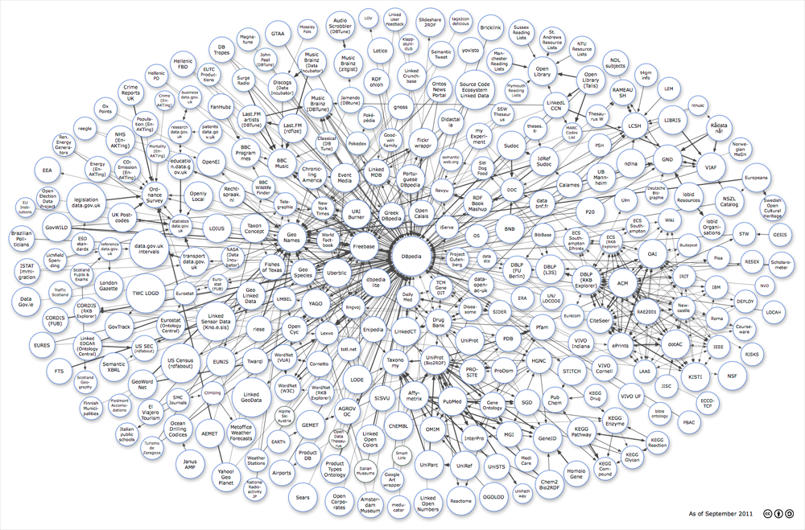
295+ datasets
31+ million triples
Prasad
L1IntroIR
Notes:
http://richard.cyganiak.de/2007/10/lod/
295+ datasets – 31+ billion triples as of 9/2011
Kno.e.sis has sensor data

Slide 11
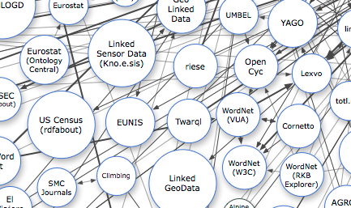
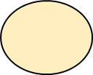
Kno.e.sis on LOD:
Linked Sensor Data and Twarql
Prasad
L1IntroIR

Slide 12
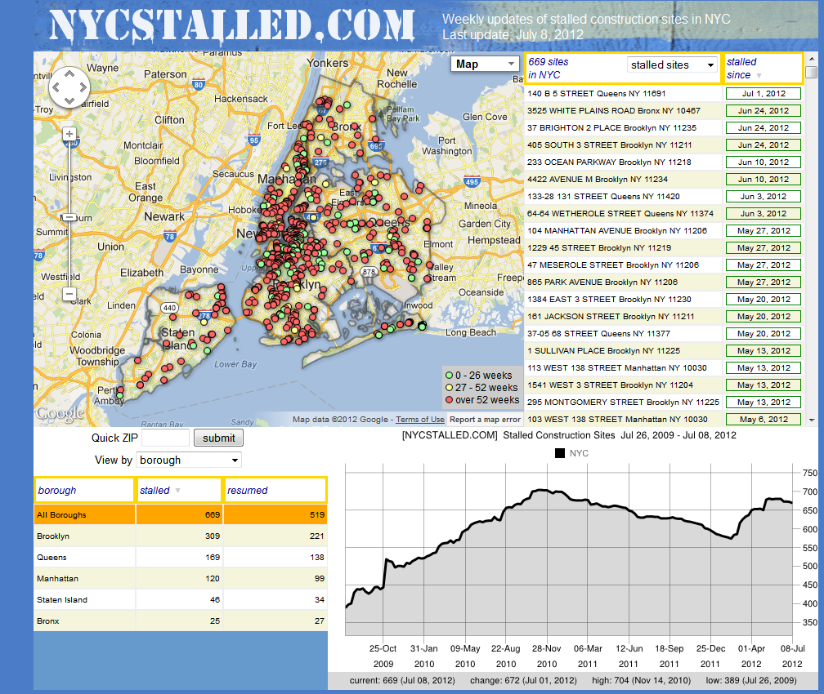

Prasad
L1IntroIR
Notes:
Dashboards

Slide 13
What is IR?
Representation / Conceptual Model
    Keywords/Phrases, Structure/Fonts, Counts, etc
Organization and Storage
    Inverted File Index, Compressed, etc
    Hardware Architecture and Memory Hierarchy
Access to information items
    Interface : Spell-checker to tree-structured display
    Visualization : Labeled Clusters, Timelines, Spring graphs, etc.
Prasad
L1IntroIR
Notes:
Above lists concrete activities/facets …
MODEL and QUERIES (conceptual view/semantics)(designer): Abstract the meaning via semantic and syntactic (for emphasis) cues.
What aspects of a document are significant?
IMPLEMENTATION(data structures/algorithms)(developer): Structuring data/algorithms (software) and hardware
INTERFACE/USABILITY(pragmatics/palatability)(end users): Improved querying to presentation/navigation of result-sets
(e.g. Spring graphs in Twitris)

Slide 14
Ultimate Focus of IR
Satisfying user information need
  Emphasis is on retrieval of information deemed useful by the user (not data) => “eye of the beholder”-problem
User information need : Examples
  Printer specs and reviews
  Printer prices and availability
  Words in which all vowels appear
  Flight status; UPS/FedEx/USPS Tracking
Predicting which documents are relevant, and linearly ranking them (to overcome information overload).
Prasad
L1IntroIR
Notes:
Abstractly IR is about gleaning user intent …
facetious -- information (data + “user’s” semantics)
Anagram/Permutations of art
diversity of user information need -→ conflicting demands
on the nature of query language and result set to be constructed
(printer name – (N1) reviews (N2) price (N3) details)
:: Information Need Highly Subjective ::
Understanding these issues is critical/central to evaluating IR systems
=================
Flight number search => providing my itinerary in email
Federal Exp. / UPS id => Tracking information

Slide 15
Information Need : Query, Relevancy
An information need is the topic about which the user desires to know more, and is differentiated from a query, which is what the user conveys to the computer in an attempt to communicate the information need.
A document is relevant if it is one that the user perceives as containing information of value with respect to their personal information need.
Prasad
L1IntroIR
Notes:
Role of query language : Subjectivity

Slide 16
DIKW Hierarchy
Data: Symbolic units
  E.g., Records of customer.
  E.g., Bytes from sensors.
Information : Data with an interpretation (Who?, What?, When?, Where?).
  E.g., Records of current/new customer grouped by their ages.
  E.g., Variation in temperature readings.
Prasad
L1IntroIR
Notes:
No strict demarcation
Information: Focus on relationship
Knowledge: Intends to be useful (usually implicit)
-----------------
-> Data Integer -> Information age => adult -> Knowledge : possible range, driving license, insurance, …
-------------------
DATA – isolated (syntactic) INFO – related pieces of data (somewhat semantic)
KNOWLEDGE – reasoning using background knowledge
WISDOM – the good and the bad for humanity …

Slide 17
DIKW Hierarchy
Knowledge : Information organized with theoretical concepts or abstract ideas (How?)
  E.g., How many customers have cancelled the accounts in current fiscal year?
  E.g., Analysis of temperature variation over the years and their causes.
Wisdom : Understanding of fundamental principles + Human Judgement
  E.g., What strategies can be employed to retain customers in the face of cheaper alternatives?
  E.g., Global warming issues and the future of Earth.
Prasad
L1IntroIR
Notes:
Knowledge: Summarizes patterns, enables reasoning
Wisdom: Extrapolative, the process by which we discern, or judge, between right and wrong, good and bad.
Dictates future course of action.
Knowledge is of two kinds. We know a subject ourselves, or we know where we can find information upon it.
Samuel Johnson
I never waste memory on things that can easily be stored and retrieved from elsewhere.
A. Einstein

Slide 18
DIKW hierarchy: Clark 2004
Wisdom
Joining of
wholes
Formation
of a whole
Connection
of parts
Gathering
of parts
Context
Knowledge
Future
Novelty
Information
Data
Past
Experience
Understanding
Researching Absorbing Doing Interacting Reflecting
Prasad
L1IntroIR
Notes:
Data: It is raining.
Information: The temperature dropped 15 degrees and then it started raining.
Knowledge: If the humidity is very high and the temperature drops substantially,
the atmospheres is often unlikely to be able to hold the moisture so it rains.
Wisdom: An understanding of all the interactions between raining, evaporation,
air currents, temperature gradients, changes, and raining.

Slide 19
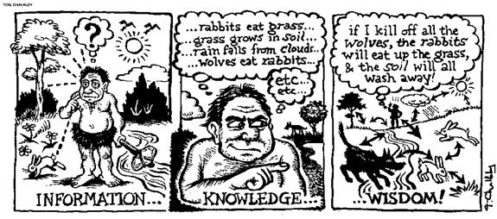
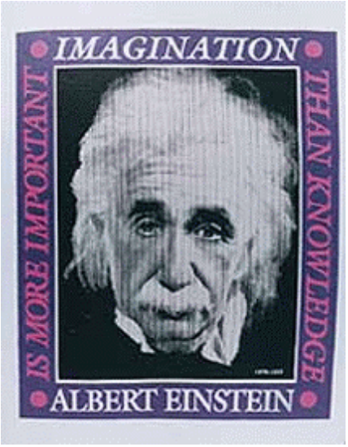
You see things; and you say "Why?"
But I dream things that never were;
and I say "Why not?"
George Bernard Shaw
Prasad
L1IntroIR
Notes:
First cartoon: DIK or IKW?
J. K. Rowlings Graudation/Convocation Speech at Harvard :
“The fringe benefits of failures and the importance of imagination”

Slide 20
Information Retrieval vs Data Retrieval
DATA:
QUERY :
QUALITY OF RESULTS:
FOUNDATIONS:
APPLICATION:
Unstructured : open to interpretation
Usually incomplete or ambiguous (w.r.t. information need)
Partial match allowed, relevance-based ranking
Probabilistic underpinnings
Library
Structured with well-defined semantics
Well-defined semantics
Exact match required - no or many results
Foundations: Algebra/Logic
Accounting
Prasad
L1IntroIR
Notes:
Matching between the document and the query in the abstracted space of the set of index words is very imprecise.
Relational Databases and Query language exemplify data retrieval due to semantic clarity and precision. (Tables)
Document querying can be transitioned to data retrieval if only we could re-author all the docs so as to provide formal semantics to them and implement sufficiently powerful query language.
Semantic Web (RDF and SPARQL) is a step in that direction. => Straddling the extremes

Slide 21
User Task
  Retrieval
    Purposeful – HP Multifunction Printer Information
  Browsing
    Casual – Big Bang, CBR, Element Genesis, Supernova, ...
    Hyperlink-based
  Filtering by Agents
    Push – Podcasts from B.B.C.’s Naked Science
Retrieval
Database
Browsing
Prasad
L1IntroIR
Notes:
Creation of Universe, Relativity

Slide 22
Logical View of Documents
Abstraction (essentials)
  Structure, fonts, proximity, repetitions, etc
Accents
spacing
Noun
groups
Manual
indexing
Docs
stopwords
stemming
structure
structure
Full text
Index
terms
Prasad
L1IntroIR
Notes:
“Features” that enable gleaning the semantics/intent better
Cf., Topic sentence in a News article for summarization or abstract of a paper

Slide 23
The Retrieval Process
User
Interface
Text
user need
4, 10
Text
Text Operations
6, 7
logical view
logical view
Query
Operations
DB Manager
Module
Indexing
user feedback
5
8
query
inverted file
Searching
Index
8
retrieved docs
Text
Database
Ranking
ranked docs
2
Prasad
L1IntroIR
Notes:
Text operations generate a logical view of the query and the documents (after stopword elimination, stemming, etc).
Query operations may formulate or modify the query and can involve query expansion, relevance feedback, etc.
Ranking based on the likelihood of retrieved docs satisfying the information need.

Slide 24
Personal Experience
(Document Analysis)
Computer-Assisted Document Interpretation and Content Extraction from legacy Materials and Process Specs (Tables) (NSF-SBIR; AFRL)
XML Search Engine based on Lucene (AFRL)
Information Retrieval from News Documents Dataset using Timelines (Events) (Lexis-Nexis)
Hybrid Retrieval from Unified Web (Ph.D. diss.)
  Combining Web of Documents and Web of Data and providing expressive [exploiting term hierarchy] and flexible [a la keyword-based] query language
Prasad
L1IntroIR
Notes:
Extract info to make and test a particular alloy to be created in a certain shape - processing tables
More News documents on a certain day talking about a company – salient event to focus
HTML Web and Semantic Web [[Bringing data retrieval to HTML pages and retrieving HTML pages
using richer semantic queries]]

Slide 25
Personal Experience
(Sensor and Social Media Analysis)
Crisis / Disaster Data (NSF)
  Flood Data (Chennai, Houston, Louisiana)
  Location Extraction and Spatio-Temporal analysis
Mental Health / Depression (NIH)
  PHQ-9 vs self-volunteered information
  Suicidality (individual vs community level)
Harassment on Social Media (NSF)
  Extremism and Hate Speech
Asthma (NSF/NIH)
  Environmental and Physiological sensor data
Prasad
L1IntroIR

Slide 26
IR Basics
Models and retrieval evaluation
Query languages and operations
    Improve inferring query context
      (query expansion, relevance feedback)
Text operations
    Improve gleaning of document semantics
      (stemming keywords)
Efficient Access: Index and Search
  Visualization, Multimedia, Applications, …
Prasad
L1IntroIR

Slide 27
Clustering and classification
Given a set of docs, group them into clusters based on the similarity of their content.
Given a set of topics, plus a new doc D, decide which topic(s) D belongs to.
Prasad
L1IntroIR
Notes:
OTHER EXAMPLES:
CLUSTERING: generate groups which are similar
• homogeneous within the group and as much as possible heterogeneous to other groups
(e.g., Google NEWS)
E.g., Clustering is used in marketing to segment consumer market.
CLASSIFICATION: Pattern recognition : determining whether ECG, X-Rays, …
corresponds to normal from abnormal condiition
(e.g., New document / blog labelling)

Slide 28
The web and its challenges
Unusual and diverse documents
Unusual and diverse users, queries, information needs
Beyond terms, exploit ideas from social networks
  link analysis, clickstreams, ...
How do search engines work? And how can we make them better?
Prasad
L1IntroIR
Notes:
To deal with sever information overload …

Slide 29
More sophisticated semi-structured search
Title is about Object Oriented Programming AND Author something like stro*rup
  where * is the wild-card operator
Issues:
  how do you process “about”?
  how do you rank results?
The focus of XML search.
Prasad
L1IntroIR

Slide 30
More sophisticated information retrieval
Cross-language information retrieval
Question answering
Summarization
Text mining
…
Prasad
L1IntroIR
Notes:
Europe; India
User information need-oriented : synthesized information as opposed to relevant data
IBM WATSON
(3) Summarization of sorts: Consumer Electronics Show 2014 : Yahoo News Digest
(4) Correlationships

Slide 31
Future Progress: Factors/Trends
Large, uncontrolled publishing media
  Quality and trust issues
Cheap, fast and wide access
  Ease of use (query formulation) and diverse users
Variety and flexibility
  Navigational and Visualization aids
  Directory-based (Table of contents) vs Keywords-based (Inverted File Index)
    Index terms (automatic/human-created) vs Full-text
Privacy, Security, Copyright
Prasad
L1IntroIR
Notes:
Google: Full-text
Lexis-Nexis : Also has SmartIndexing terms-based

