Slide 1
Models for IR
Adapted from Lectures by
Berthier Ribeiro-Neto (Brazil), Prabhakar Raghavan (Google) and Christopher Manning (Stanford)
Prasad
L2IRModels
Notes:
Automating search: Machine processable analog for semantic matching for relevance
How do we conceptualize and concretize IR task?

Slide 2
Information Retrieval
Document Corpus, Query => Relevant Documents
  ME: English corpus and query
    E.g., Understand English
    E.g., Can manage Hindi, Gujarati, Tamil, Kannada
  ME: Telugu/Chinese corpus and query
    E.g., Guess using surface syntax / patterns
  Machine: English corpus and query
    E.g., Guess using surface syntax / patterns
Prasad
L2IRModels

Slide 3

Introduction
Docs DB
Index Terms
Doc
abstract
match
Information Need
Ranked
List of
Docs
Query
Prasad
L2IRModels
Notes:
Machine sees doc and query as one long string!
------------
Terms = concepts (as opposed to words) E.g., I-9, Hong Kong, etc
How do we abstract and compare document semantics with query expectation.
---------------
We are not teaching language semantics – we are hacking syntax!
The same “English” search engine techniques can be used for “Hindi”!
Contrast this task with machine translation …
------------
Syntactic manipulations should come across as if the m/c is understanding the document …

Slide 4
Introduction
Premise: Semantics of documents and user information need is expressible naturally through sets of index terms
  Unfortunately, in general, matching at index term level is quite imprecise
Critical Issue: Ranking
  Ordering of retrieved documents that (hopefully) reflects their relevance to the query
Prasad
L2IRModels
Notes:
“machine opinion overseen by user”
Word sequencing information is being abstracted …
So failures attributable to it are expected …
Later on we will see how to reinstate sequencing
information in a limited way using phrasal queries
(down side : scalability) (expressive power vs efficiency trade-off)
-------------
Absolute understanding less critical than relative ordering of relevance
in practice

Slide 5
Fundamental premisses regarding relevance determines an IR Model
  common sets of index terms
  sharing of weighted terms
  likelihood of relevance
IR Model (boolean, vector, probabilistic, etc), logical view of the documents (full text, index terms, etc) and the user task (retrieval, browsing, etc) are all orthogonal aspects of an IR system.
Prasad
L2IRModels
Notes:
Logical view: What aspects do you think are significant and what aspects do you choose to ignore?
IR Model: How do you choose to abstract the meaning (presence/absence, counts, etc) and how do you compare the meaning?
E.g., LOGICAL VIEW: single word vs phrases, to stem or not to stem, etc
E.g., IR MODEL: existence vs counts
---------
For search engine, we will see Boolean and Vector-space models
For classification, we will consider Probabilistic approach

Slide 6
IR Models
Set Theoretic
Fuzzy
Extended Boolean
Classic Models
boolean
vector
probabilistic
Algebraic
U
s
e
r
T
a
s
k
Generalized Vector
Lat. Semantic Index
Neural Networks
Retrieval:
Adhoc
Filtering
Structured Models
Probabilistic
Non-Overlapping Lists
Proximal Nodes
Inference Network
Belief Network
Browsing
Browsing
Flat
Structure Guided
Hypertext
Prasad
L2IRModels

Slide 7
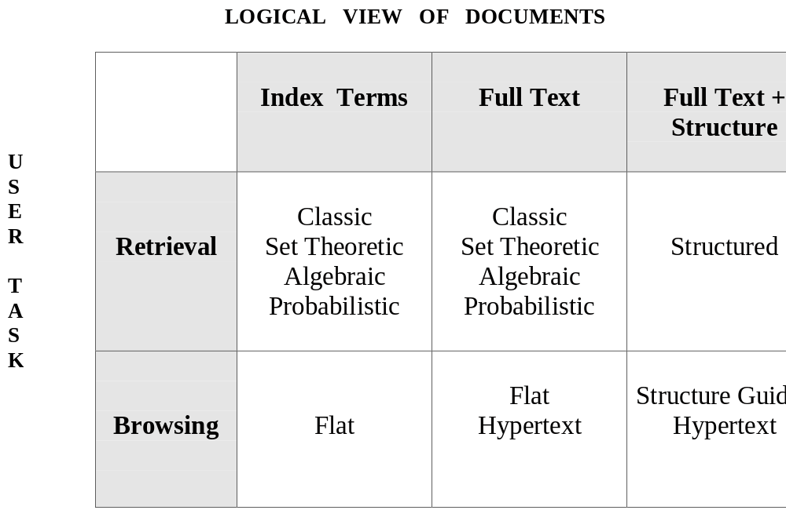
IR Models
The IR model, the logical view of the docs, and the retrieval task are distinct aspects of the system
Prasad
L2IRModels

Slide 8
Retrieval: Ad Hoc vs Filtering
Ad hoc retrieval:
Q1
Q2
Q3
Collection
“Fixed Size”
Q4
Q5
Prasad
L2IRModels

Slide 9
Retrieval: Ad Hoc vs Filtering
Filtering:
User 2
Profile
Docs Filtered
for User 2
User 1
Profile
Docs for
User 1
Documents Stream
Prasad
L2IRModels

Slide 10
Retrieval : Ad hoc vs Filtering
Docs collection relatively static while queries vary
Ranking for determining relevance to user information need
  Cf. String matching problem where the text is given and the pattern to be searched varies.
    E.g., use indexing techniques, suffix trees, etc.
Queries relatively static while new docs are added to the collection
Construction of user profile to reflect user preferences
  Cf. String matching problem where pattern is given and the text varies.
    E.g., use automata-based techniques
Prasad
L2IRModels
Notes:
http://www-igm.univ-mlv.fr/~lecroq/

Slide 11
Specifying an IR Model
Structure Quadruple [D, Q, F, R(q_{i}, d_{j})]
  D = Representation of documents
  Q = Representation of queries
  F = Framework for modeling representations and their relationships
    Standard language/algebra/impl. type for translation to provide semantics
    Evaluation w.r.t. “direct” semantics through benchmarks
  R = Ranking function that associates a real number with a query-doc pair
Prasad
L2IRModels
Notes:
Most important conceptual slide for understanding what is going on in IR field
----------------------------------------------------------------------------------------------
Boolean : sets and boolean operations
Vector : vector algebra
Probabilistic
-------------------------------------------------
There is no oracle that tells us when a document is relevant to a query
So we decide on an abstract representation and use some familiar
algebraic structure to help us gauge and approximate similarity function (Translation Model).
In the absence of “direct semantics oracle” we fall back on benchmarks for “correctness” spec.
Explain interpolation idea => proxy for semantic similarity

Slide 12

Automation / Machine Learning as
Interpolation / Extrapolation
Behavior of the
General Algorithm
Training Examples
Benchmark
Query ->
Prasad
L2IRModels

Slide 13
Classic IR Models - Basic Concepts
Each document represented by a set of representative keywords or index terms
  Index terms meant to capture document’s main themes or semantics.
    Usually, index terms are nouns because nouns have meaning by themselves.
    However, search engines assume that all words are index terms (full text representation)
Prasad
L2IRModels
Notes:
Adjectives, adverbs, conjunction, etc not useful. What about verbs?
Choice of index terms non-trivial because of context-sensitivity.
E.g., “The” is a non-stop word in articles dealing with article!
Similarly, reference to “To be or not to be”-author or speaker may
signify Shakespeare or Hamlet or the play …
-----------------------------------------------------------------------------
Many names used these days come from common nouns (APPLE,
WINGS) or are not found in the dictionary (EBAY).

Slide 14
Classic IR Models - Basic Concepts
Not all terms are equally useful for representing the document’s content
Let
  ki be an index term
  dj be a document
  wij be the weight associated with (ki,dj)
The weight wij quantifies the importance of the index term for describing the document content
Prasad
L2IRModels
Notes:
More frequent intra-document terms => relevant => formation of cluster
(e.g., affix removal)
Less frequent inter-document terms => charaterize narrower set of docs => distinguish cluster
(e.g., stop words extreme)

Slide 15
Notations/Conventions
  ki is an index term
  dj is a document
  t is the total number of terms
  K = (k1, k2, …, kt) is the set of all index terms
  wij >= 0 is the weight associated with (ki,dj)
    wij = 0 if the term is not in the doc
  vec(dj) = (w1j, w2j, …, wtj) is the weight vector associated with the document dj
  gi(vec(dj)) = wij is the function which returns the weight associated with the pair (ki,dj)
Prasad
L2IRModels

Slide 16
Boolean Model
Prasad
L2IRModels

Slide 17
The Boolean Model
Simple model based on set theory
Queries and documents specified as boolean expressions
  precise semantics
  E.g., q = ka ∧ (kb ∨ ¬kc)
Terms are either present or absent. Thus, wij ε {0,1}
Prasad
L2IRModels
Notes:
As we will see, this is precise but does not allow “accurate” description of
document semantics or user information need because of lack of expressive power

Slide 18
Example
  q = ka ∧ (kb ∨ ¬kc)
  vec(qdnf) = (1,1,1) ∨ (1,1,0) ∨ (1,0,0)
        Disjunctive Normal Form
  vec(qcc) = (1,1,0)
        Conjunctive component
Similar/Matching documents
    md1 = [ka ka d e] => (1,0,0)
    md2 = [ka kb kc] => (1,1,1)
Unmatched documents
    ud1 = [ka kc] => (1,0,1)
    ud2 = [d] => (0,0,0)
Prasad
L2IRModels

Slide 19
Similarity/Matching function
  sim(q,dj) = 1 if vec(dj) ε vec(qdnf)
  0 otherwise
        Requires coercion for accuracy
Prasad
L2IRModels
Notes:
In practice, AND and OR queries are integrated into phrasal queries with fuzzy Boolean interpretation.
E.g., in Google, documents are ranked based on the amount of match wrt the phrase and
NOT corresponds to penalizing the document.

Slide 20
Venn Diagram
Ka
Kb
(1,1,0)
(1,0,0)
(1,1,1)
Kc
q = ka ∧ (kb ∨ ¬kc)
Prasad
L2IRModels

Slide 21
Drawbacks of the Boolean Model
  Expressive power of boolean expressions to capture information need and document semantics inadequate
    Retrieval based on binary decision criteria (with no partial match) does not reflect our intuitions behind relevance adequately
As a result
  Answer set contains either too few or too many documents in response to a user query
  No ranking of documents
Prasad
L2IRModels
Notes:
WSU doc containing a reference to one student who went to Cambridge Univ
Should this doc be returned in response to Cambridge Univ?
Does reference to Oxford and Univ on Miami Univ page make it be valid response to
Oxford Univ query?
-------------------------------------------------------------------------------------------
Wrt multi-word query example
Query-related: Synonyms, affixes (syntax match vs semantic match)
Document-related: Casual reference to a word vs emphatic repeated reference
Ordering documents helps with information overload (high recall)
-----------------------------------------------------------------------------------------------
Clarity of the formalism is a means to an end, but cannot be an end in itself.
-----------------------------------------------------------------------------------------------
Too few documents: If all the query words not found, a document may be completely dropped.
Too many documents: Casual occurrence vs emphatic occurrence not distinguished causing
higher recall
Finding a document that has 3 words of a 4 word query is generally better than finding just one word.
(Author-publisher-year match better than author match)
====================================================
****FRAGILE****

Slide 22
Vector Model
Prasad
L2IRModels

Slide 23
Documents as vectors
Not all index terms are equally useful in representing document content
Word sequencing information in the original document ignored for approximation
Each doc j can be viewed as a vector of non-boolean weights, one component for each term
  terms are axes of vector space
  docs are points in this vector space
    even with stemming, the vector space may have 20,000+ dimensions
Prasad
L2IRModels

Slide 24
Intuition
t₃
d₂
d₃
d₁
θ
φ
t₁
d₅
t₂
d₄
Postulate: Documents that are “close together”
in the vector space talk about the same things.
Prasad
L2IRModels

Slide 25
Desiderata for proximity
If d₁ is near d₂, then d₂ is near d₁.
If d₁ near d₂, and d₂ near d₃, then d₁ is not far from d₃.
No doc is closer to d than d itself.
Prasad
L2IRModels

Slide 26
First cut
Idea: Distance between d₁ and d₂ is the length of the vector |d₁ – d₂|.
  Euclidean distance
Why is this not a great idea?
We still haven’t dealt with the issue of length normalization
  Short documents would be more similar to each other by virtue of length, not topic
However, we can implicitly normalize by looking at angles instead
  “Proportional content”
Prasad
L2IRModels
Notes:
Similarity measure
Euclidean Distance: abstract, summary of a document not close to the original
Near docs may be related but far away docs may be more related
if the proportions of the words are similar.
--------------
Two five line documents vs
one five line document and another with 100 copies of the same five lines

Slide 27
Cosine similarity
Distance between vectors d₁ and d₂ captured by the cosine of the angle x between them.
t ₃
d ₂
d ₁
θ
t ₁
t ₂
Prasad
L2IRModels
Notes:
Note – this is similarity, not distance
No triangle inequality for similarity.
============
Easy to show violates English semantic similarity using counter example:
“A wins over B” vs “B wins over A”.
However, our goal is to evaluate over benchmarks containing natural documents.
--------
“A is younger than B” vs “B is younger than A”.
are responses to the same query “A younger B”
Implying it has some relevant information.

Slide 28
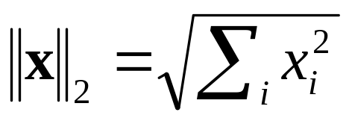
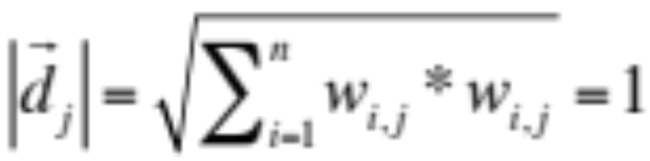
Cosine Similarity and its Relationship to Euclidean Distance Metric
A vector can be normalized (given a length of 1) by dividing each of its components by its length – here we use the L₂ norm
This maps vectors onto the unit sphere:
Then,
Longer documents don’t get more weight.
Prasad
L2IRModels
Notes:
Cosine similarity ~ Euclidean distance on normalized documents

Slide 29
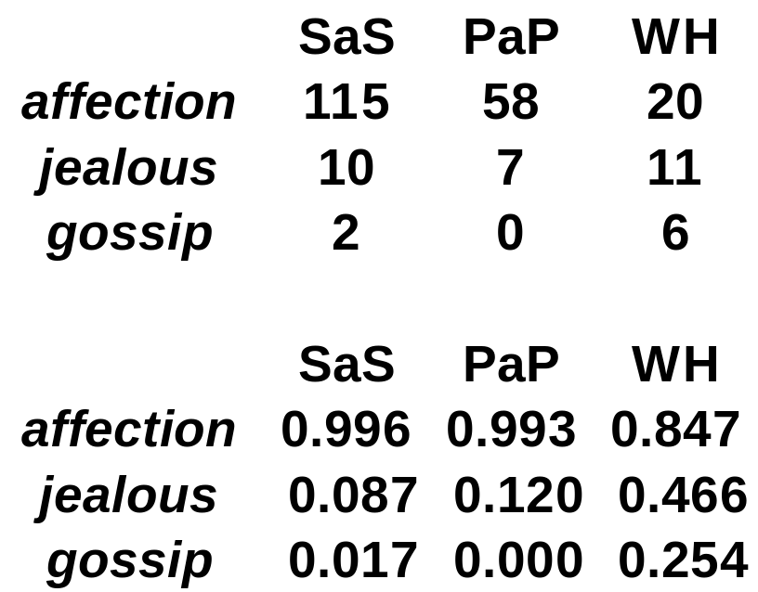
Example
Docs: Austen's Sense and Sensibility, Pride and Prejudice; Bronte's Wuthering Heights. tf weights
Normalized
weights
Prasad
L2IRModels

Slide 30

Normalized
weights
cos(SAS, PAP) = .996 x .993 + .087 x .120 + .017 x 0.0 = 0.999
cos(SAS, WH) = .996 x .847 + .087 x .466 + .017 x .254 = 0.889
Prasad
L2IRModels
Notes:
Dot product on normalized vector = cosine similarity

Slide 31
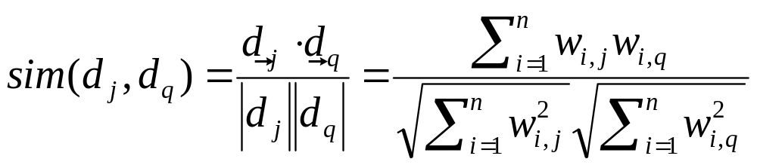
Queries in the vector space model
Central idea: the query as a vector:
We regard the query as short document
  Note that d_{q} is very sparse!
We return the documents ranked by the closeness of their vectors to the query, also represented as a vector.
Prasad
L2IRModels
Notes:
Basis for query answering and ranking

Slide 32

Cosine similarity
Cosine of angle between two vectors
The denominator involves the lengths of the vectors.
Normalization
Prasad
L2IRModels
Notes:
Basis for document clustering

Slide 33
Triangle Inequality
W1 = Theater
W2 = Play
W3 = Soccer
cos(W1,W2) >
cos(W1,W3) + cos(W2,W3)
Euclidean distance:
AC ≤ AB + BC
w₁
AC
AB
BC
w₂
w₃
The above triangle inequality can be violated in Semantic Spaces (cosine similarity) .
Prasad
L2IRModels
Notes:
Cosine similarity is not a distance metric …
Similarities can often be asymmetric
“North-Korea” is more similar to “China” than vice versa

Slide 34
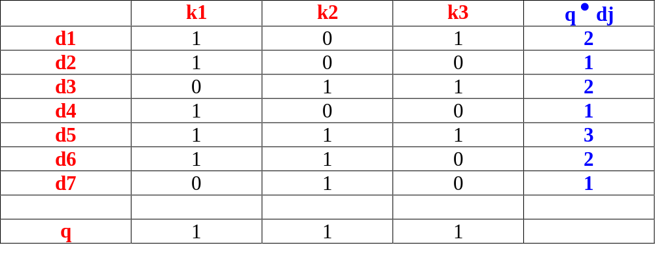
k2
k1
The Vector Model: Example I
d7
d2
d6
d4
d5
d3
d1
k3
Prasad
L2IRModels

Slide 35
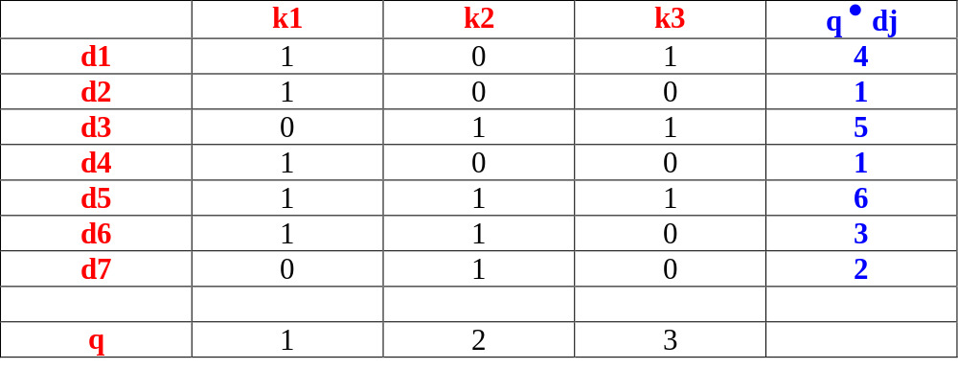
k2
k1
The Vector Model: Example II
d7
d2
d6
d4
d5
d3
d1
k3
Prasad
L2IRModels

Slide 36
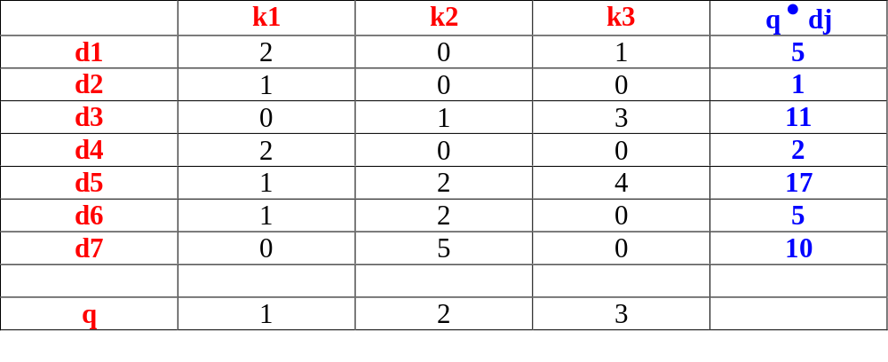
k2
k1
d7
The Vector Model: Example III
d2
d6
d4
d5
d3
d1
k3
Prasad
L2IRModels

Slide 37
Summary: What’s the point of using vector spaces?
A well-formed algebraic space for retrieval
Query becomes a vector in the same space as the docs.
  Can measure each doc’s proximity to it.
Natural measure of scores/ranking – no longer Boolean.
  Documents and queries are expressed as bags of words
Prasad
L2IRModels
Notes:
Downside: ignores sequencing information “A loses B” vs “B loses to A”.
Downside: ignores synonymy information “A loses B” vs “Asym loses to Bsym”.
Downside: ignores polysymy information “Pink is my favorite” vs “Pink is my favorite”. (singer vs color vs …)

Slide 38
The Vector Model
Non-binary (numeric) term weights used to compute degree of similarity between a query and each of the documents.
Enables
  partial matches
    to deal with incompleteness
  answer set ranking
    to deal with information overload
Prasad
L2IRModels
Notes:
Overcomes fragility of boolean model
Overcomes information overload problem

Slide 39
Define:
  wij > 0 whenever ki ∈ dj
  wiq >= 0 associated with the pair (ki,q)
  vec(dj) = (w1j, w2j, ..., wtj) vec(q) = (w1q, w2q, ..., wtq)
  To each term ki, associate a unit vector vec(i)
  The t unit vectors, vec(1), ..., vec(t) form an orthonormal basis (embodying independence assumption) for the t-dimensional space for representing queries and documents
Prasad
L2IRModels
Notes:
Assumes orthogonality of term meanings!
--------
To determine weights: (1) give informal rationale (2) how concretized

Slide 40
The Vector Model
How to compute the weights wij and wiq?
  quantification of intra-document content (similarity/semantic emphasis)
    tf factor, the term frequency within a document
  quantification of inter-document separation (dis-similarity/significant discriminant)
    idf factor, the inverse document frequency
  wij = tf(i,j) * idf(i)
Prasad
L2IRModels
Notes:
TF: Downside: ignores synonymy information “A defeated by B” vs “Asym loses to Bsym”.
TF: Downside: ignores polysymy information “Pink is my favorite” vs “Pink is my favorite”. (singer vs color vs …)
------------------
IDF:Upside: needed to get relative emphasis on multi-word queries
--------
TF: Query – document relevance (emphatic vs casual reference)
IDF: Query – multiple document discrimination (rare words vs common words)

Slide 41
Let,
  N be the total number of docs in the collection
  ni be the number of docs which contain ki
  freq(i,j) raw frequency of ki within dj
A normalized tf factor is given by
  f(i,j) = freq(i,j) / max_{l}(freq(l,j))
    where the maximum is computed over all terms l which occur within the document dj
The idf factor is computed as
  idf(i) = log (N/ni)
    the log makes the values of tf and idf comparable.
Prasad
L2IRModels
Notes:
TF: This approach will fail to the extent that there are (syntactically dissimilar) coreferences
IDF: It can also be interpreted as the amount of information associated with the term ki. (a la Shannon?)
Stop-words can be defined in terms of IDF() for a domain specific dataset
Empherically determined functions – comparable order
(Significant improvement obtained by using other query processing techniques rather than
tweaking weights.)

Slide 42
Digression: terminology
WARNING: In a lot of IR literature, “frequency” is used to mean “count”
  Thus term frequency in IR literature is used to mean number of occurrences in a doc
  Not divided by document length (which would actually make it a frequency)
Prasad
L2IRModels

Slide 43
The best term-weighting schemes use weights which are given by
  wij = f(i,j) * log(N/ni)
  this strategy is called a tf-idf weighting scheme
For the query term weights, use
  wiq = (0.5 + [0.5 * freq(i,q) / max(freq(l,q))]) * log(N/ni)
The vector model with tf-idf weights is a good ranking strategy for general collections.
  It is also simple and fast to compute.
Prasad
L2IRModels
Notes:
Empirical basis: query treated a bit differently than an ordinary document
For ranking:
A term that appears relatively more frequently in a document is given higher weight
(the document is more relevant to the term)
A term that appears in fewer documents is given higher weight
(skew the retrieval towards rarer content terms)
ANALYSIS: “invisible” keyword stuffing (Search Engine Optimization),
synonyms or ambiguous words may lead it astray
(mismatch between syntax ans semantics)

Slide 44
The Vector Model : Pros and Cons
Advantages:
  term-weighting improves answer set quality
  partial matching allows retrieval of docs that approximate the query conditions
  cosine ranking formula sorts documents according to degree of similarity to the query
Disadvantages:
  assumes independence of index terms; not clear that this is bad though
Prasad
L2IRModels

