Slide 1
Inverted Index Construction
Adapted from Lectures by
Prabhakar Raghavan (Google) and Christopher Manning (Stanford)
Prasad
L3InvertedIndex

Slide 2
Unstructured data in 1650
Which plays of Shakespeare contain the words Brutus AND Caesar but NOT Calpurnia ?
One could grep all of Shakespeare’s plays for Brutus and Caesar, then strip out plays containing Calpurnia ?
  Slow (for large corpora)
  Other operations (e.g., find the word Romans near countrymen) not feasible
Prasad
L3InvertedIndex
Notes:
NOT Calpurnia is non-trivial
=============
Not efficient – Not expressive

Slide 3
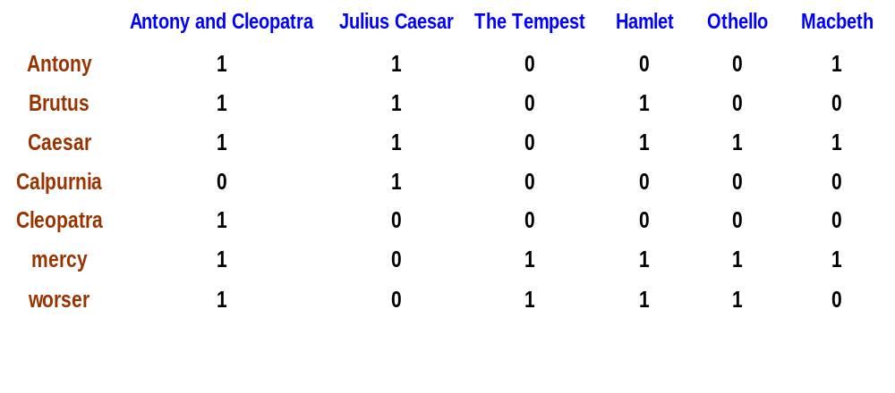
Term-document incidence
Brutus AND Caesar but NOT Calpurnia
1 if play contains word, 0 otherwise
Prasad
L3InvertedIndex
Notes:
Grep is “dynamic” and hence expensive at run-time.
If the document corpus is static, it can be pre-processed.
TD-incidence matrix enables offline pre-computation.

Slide 4
Incidence vectors
So we have a 0/1 vector for each term.
To answer query:
take the vectors for Brutus, Caesar and Calpurnia (complemented) ➔ bitwise AND.
110100 AND 110111 AND 101111 = 100100.
Prasad
L3InvertedIndex
Notes:
Linear in the size of document datasets [= number of documents]
rather than the total storage [= number of words in the dataset].
The latter is several orders larger.

Slide 5
Answers to query
Antony and Cleopatra, Act III, Scene ii
Agrippa [Aside to DOMITIUS ENOBARBUS]: Why, Enobarbus,
When Antony found Julius Caesar dead,
He cried almost to roaring; and he wept
When at Philippi he found Brutus slain.
Hamlet, Act III, Scene ii
Lord Polonius: I did enact Julius Caesar I was killed i' the
Capitol; Brutus killed me.
Prasad
L3InvertedIndex

Slide 6
Basic assumptions of
Information Retrieval
Collection: Fixed set of documents
Goal: Retrieve documents with information that is relevant to user’s information need and helps him complete a task
Prasad
L3InvertedIndex

Slide 7

The classic search model
TASK
Get rid of mice in a politically correct way
Mis-conception
Info Need
Info about removing mice
without killing them
Mis-translation
Verbal form
How do I trap mice alive?
Mis-formulation
Query
mouse trap
SEARCH
ENGINE
Query
Refinement
Results
Corpus
Prasad
L3InvertedIndex

Slide 8
How good are the retrieved docs?
Precision : Fraction of retrieved docs that are relevant to user’s information need
Recall : Fraction of relevant docs in collection that are retrieved
More precise definitions and measurements to follow in later lectures
Prasad
L3InvertedIndex

Slide 9
Bigger corpora
Consider N = 1M documents, each with about 1K terms.
Avg 6 bytes/term including spaces/punctuation
  6GB of data in the documents.
Say there are m = 500K distinct terms among these.
Prasad
L3InvertedIndex
Notes:
Heap’s Law divergence: sqrt(10^9) = 32K (Culprit: stop words?)

Slide 10
Can’t build the matrix
500K x 1M matrix has half-a-trillion 0’s and 1’s.
But it has no more than one billion 1’s.
  matrix is extremely sparse.
What’s a better representation?
  We only record the 1 positions.
Why?
Prasad
L3InvertedIndex
Notes:
500 G bits
1 M docs each with 1K terms = 1 G bits

Slide 11
Inverted index
For each term T, we must store a list of all documents that contain T.
Do we use an array or a list for this?
Brutus
2
4
8
16
32
64
128
Calpurnia
1
2
3
5
8
13
21
34
Caesar
13
16
What happens if the word Caesar is added to document 14?
Prasad
L3InvertedIndex
Notes:
An index always maps back from terms to the parts of a document where they occur.
Inverted index construction is a special case of sparse matrix representation

Slide 12
Inverted index
Linked lists generally preferred to arrays
  Dynamic space allocation
  Insertion of terms into documents easy
  Space overhead of pointers
Posting
Brutus
2
4
8
16
32
64
128
Calpurnia
1
2
3
5
8
13
21
34
Caesar
13
16
Dictionary
Postings lists
Prasad
L3InvertedIndex
Sorted by docID (more later on why).
Notes:
Observe Tradeoffs
In Java, arrays need not be rectangular. Each row can have different length.
So, it is possible to use arrays in an efficient way if the dataset is static.
Programming Statistics: Average length of posting list?

Slide 13





Inverted index construction
Documents to
be indexed.
Friends, Romans, countrymen.
Tokenizer
Token stream.
Friends
Romans
Countrymen
More on
these later.
Linguistic modules
Modified tokens.
friend
roman
countryman
Indexer
friend
2
4
roman
1
2
Inverted index.
Prasad
countryman
13
16
Notes:
Tokenize file 1 and initialize inverted index.
For subsequent files, add new tokens or update postings for old tokens.
Tokenizer: char seq to token seq
linguistic modules: case conversion, stemming, etc

Slide 14
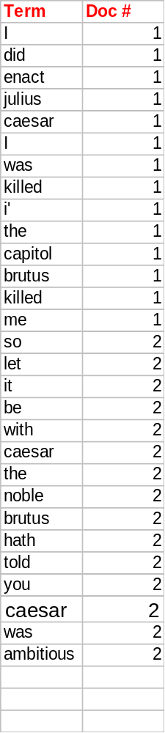
Indexer steps
Sequence of (Modified token, Document ID) pairs.
Doc 1
Doc 2
I did enact Julius
Caesar I was killed
i' the Capitol;
Brutus killed me.
So let it be with
Caesar. The noble
Brutus hath told you
Caesar was ambitious
Prasad
L3InvertedIndex
Notes:
Map-step (II obtained thro reduce?)

Slide 15
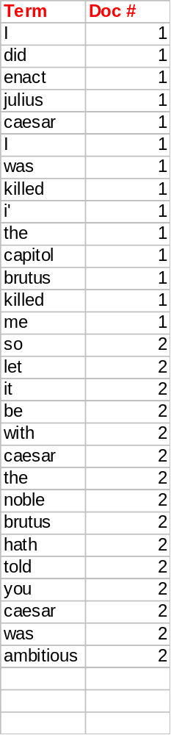
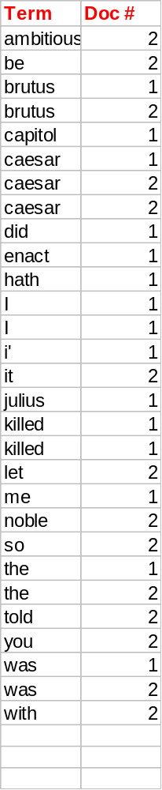
Sort by terms.
Core indexing step.
Prasad
L3InvertedIndex

Slide 16
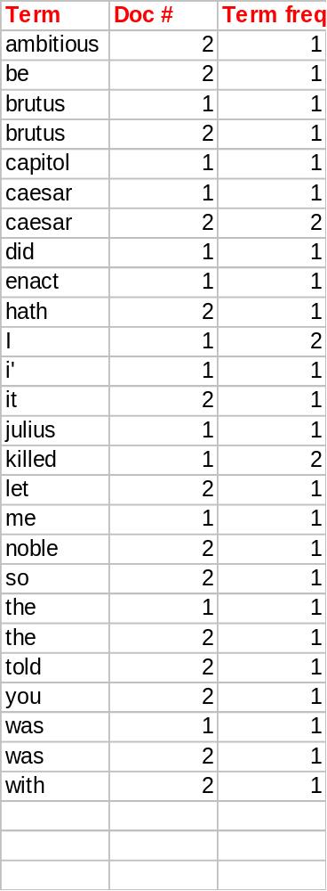
Multiple term entries in a single document are merged.
Frequency information is added.
Why frequency?
Will discuss later.
Prasad
Notes:
Number of documents vs Document number
Cumulative frequency vs frequency within a document
In practice, positions of the hits may be retained separately (for proximity search)

Slide 17
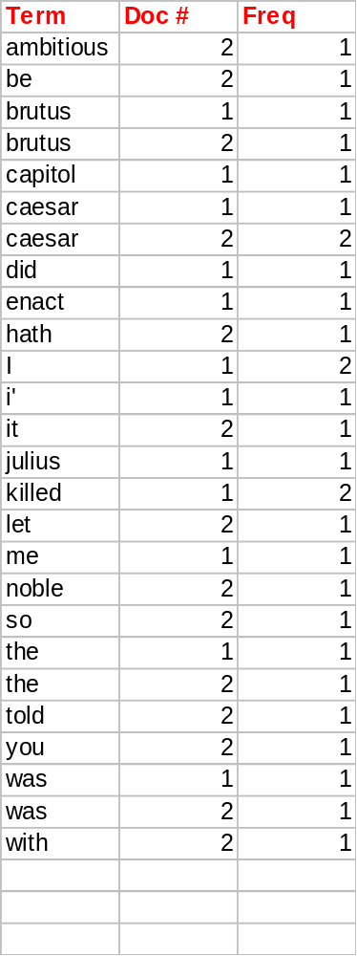
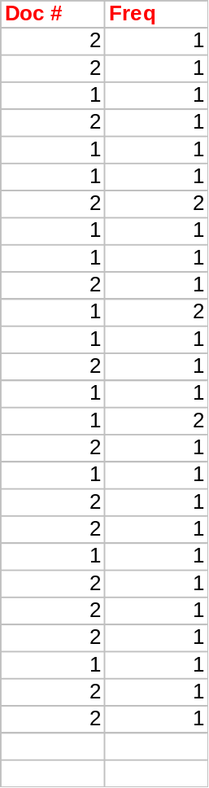
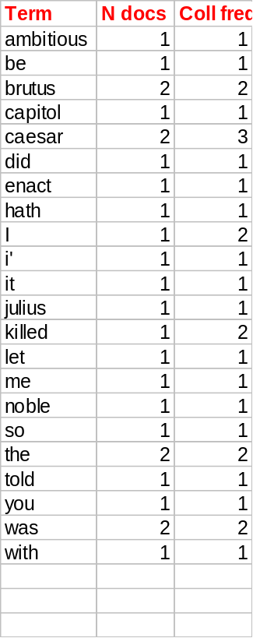
The result is split into a Dictionary file and a Postings file.
L3InvertedIndex
Notes:
Observe tradeoffs: Split to enable exploiting memory hierarchy – extra pointer storage required
N docs = “number of rows with the same term”
Collection Frequency = sum of the last column of the rows associated with the same term
All this information feeds into vector space model
(Departure from reality: Only freq count of hits shown here,
while in practice, one keeps positions of hits too.)
Dictionary file searched using binary serach?

Slide 18
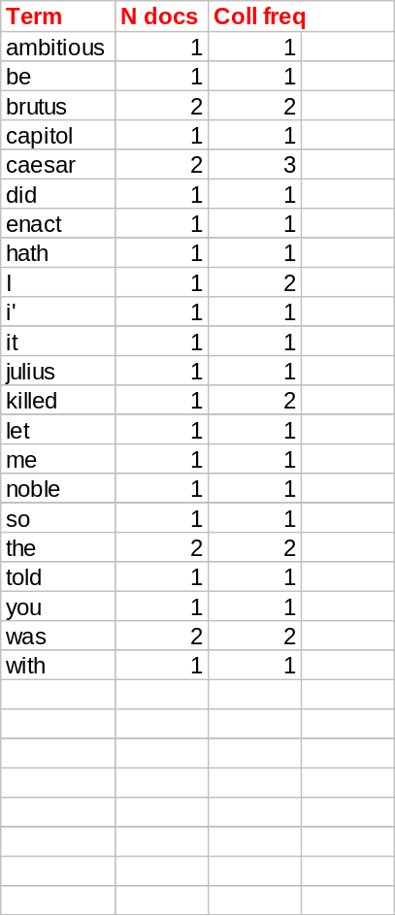
Where do we pay in storage?
Will quantify the storage, later.
Terms
Pointers
Prasad
Notes:
Dictionary size: Number of distinct index terms
Postings size: Number of occurrences of term in distinct documents
In practice, total number of occurrences in all documents.

Slide 19
Query Processing
What?
How?
Prasad
L3InvertedIndex

Slide 20
Query processing: AND
Consider processing the query:
  Brutus AND Caesar
  Locate Brutus in the Dictionary;
    Retrieve its postings.
  Locate Caesar in the Dictionary;
    Retrieve its postings.
  “Merge” the two postings:
2
4
8
16
32
64
128
Brutus
1
2
3
5
8
13
21
34
Caesar
Prasad
L3InvertedIndex
Notes:
AND, OR, NOT : intersection, union, set-difference

Slide 21
The merge
Walk through the two postings simultaneously, in time linear in the total number of postings entries
2
2
4
4
8
8
16
16
32
64
128
32
64
128
Brutus
2
8
1
Caesar
1
2
2
3
5
5
8
8
13
13
21
21
34
3
34
If the list lengths are x and y, the merge takes O(x+y)
operations.
Crucial: postings sorted by docID.
Prasad
L3InvertedIndex

Slide 22
Boolean queries: Exact match
Boolean Queries are queries using AND, OR and NOT to join query terms
    Views each document as a set of words
    Is precise: document matches or not.
Primary commercial retrieval tool for 3 decades.
Professional searchers (e.g., lawyers) still like Boolean queries:
  You know exactly what you’re getting.
Prasad
L3InvertedIndex

Slide 23
Example: WestLaw http://www.westlaw.com/
Largest commercial (paying subscribers) legal search service (started 1975; ranking added 1992)
Tens of terabytes of data; 700,000 users
Majority of users still use boolean queries
Example query:
  What is the statute of limitations in cases involving the federal tort claims act?
  LIMIT! /3 STATUTE ACTION /S FEDERAL /2 TORT /3 CLAIM
/3 = within 3 words, /S = in same sentence
Prasad
L3InvertedIndex
Notes:
LexisNexis locally

Slide 24
Example: WestLaw http://www.westlaw.com/
Another example query:
  Requirements for disabled people to be able to access a workplace
  disabl! /p access! /s work-site work-place (employment /3 place)
Note that SPACE is disjunction, not conjunction!
Long, precise queries; proximity operators; incrementally developed; not like web search
Professional searchers often like Boolean search:
  Precision, transparency and control
But that doesn’t mean they actually work better ...
Prasad
L3InvertedIndex
Notes:
Information need: Cases about a host's responsibility for drunk guests.
Query: host! /p (responsib! liab!) /p (intoxicat! drunk!) /p guest

Slide 25
Example: Using Search Connectors and Commands on LexisNexis
Sample Commands
Example Queries
AND/OR Connector
ATLEAST n Command
COMPANY Command
HEADLINE Command
LENGTH Command
NOCAPS Command
PRE/n (Preceded by n Words) Connector
W/n (Within n Words) Connector
W/p (Within Paragraph) Connector
W/s (Within Sentence) Connector
…
election AND opinion poll
ATLEAST5(free)
COMPANY(Tivoli NOT IBM)
gore vidal AND LENGTH(>1000)
NOCAPS(aid)
digital PRE/3 television
airport W/5 noise W/5 nuisance
olympic W/s bid
…
Prasad
L3InvertedIndex
Notes:
http://help.lexisnexis.com/tabula-rasa/rosetta/connectors_group_ref-reference?lbu=GB&locale=en_GB&audience=business
Implementation requires richer inverted index with position information
(In practice, position information (byte offset from the beginning) is used to present teaser text)

Slide 26
Query optimization
Consider a query that is an AND of t terms.
For each of the t terms, get its postings, then AND them together.
What is the best order for query processing?
Brutus
2
4
8
16
32
64
128
Calpurnia
1
2
3
5
8
16
21
34
Caesar
13
16
Query: Brutus AND Calpurnia AND Caesar
Prasad
L3InvertedIndex

Slide 27
Query optimization example
Process in order of increasing frequency:
  start with smallest set, then keep cutting further.
This is why we kept
freq in dictionary
Brutus
2
4
8
16
32
64
128
Calpurnia
1
2
3
5
8
13
21
34
Caesar
13
16
Execute the query as (Caesar AND Brutus) AND Calpurnia.
Prasad
L3InvertedIndex

Slide 28
More general optimization
e.g., (madding OR crowd) AND (ignoble OR strife)
Get freq’s for all terms.
Estimate the size of each OR by the sum of its freq’s (conservative).
Process in increasing order of OR sizes.
Prasad
L3InvertedIndex

Slide 29
Space Requirements
The space required for the vocabulary is rather small. According to Heaps’ law the vocabulary grows as O(n^{β}), where β is a constant between 0.4 and 0.6 in practice.
Size of inverted file as a percentage of text (all words, non-stop words)
Index
Small collection
(1Mb)
Medium collection
(200Mb)
Large collection
(2Gb)
Addressing words
Addressing documents
Addressing 256 blocks
45%
19%
18%
73%
26%
25%
36%
18%
1.7%
64%
32%
2.4%
35%
26%
0.5%
63%
47%
0.7%
Prasad
L3InvertedIndex
Notes:
N^0.5 is square root of N.
How does vocabulary size relate to document size?
Space for words falls but for doc info increases
==================================
Positional addressing, Document Id addressing, In-between
----------------------------------------------------------------------
MORAL: Size of the index is of the same order as the dataset

Slide 30
Space Requirements
To reduce space requirements, a technique called block addressing can be used
  Advantages:
    the number of pointers is smaller than positions
    all the occurrences of a word inside a single block are collapsed to one reference
  Disadvantages:
    online (dynamic) search over the qualifying blocks necessary if exact positions are required
Prasad
L3InvertedIndex
Notes:
Cf. memory management (garbage collection), page fragmentation

Slide 31
What’s ahead in IR?
Beyond term search
What about phrases?
  Stanford University
Proximity: Find Gates NEAR Microsoft.
  Need index to capture position information in docs.
Zones in documents: Find documents with (author = Ullman) AND (text contains automata).
Prasad
L3InvertedIndex

Slide 32
Other Indexing Techniques
Even though Inverted Files is the method of choice, in the face of phrase and proximity queries, the following approaches were also developed:
  Suffix arrays
  Signature files
Prasad
L3InvertedIndex

