Slide 1
Index Construction
Adapted from Lectures by
Prabhakar Raghavan (Google) and
Christopher Manning (Stanford)
Prasad
L06IndexConstruction
Notes:
DONE SO FAR
========
Token -> Term => Postings Lists (Doc Ids ::REFINED TO:: DocIds to Hit Positions)
(Also maintain: cumulative freq in dataset, doc occurrence count, term freq in each doc)
-----------
Large Dictionary structure for efficient search : B-Trees
Tolerant IR: Map queries to sets of terms TO postings lists
(robust wrt spelling errors (caused by typing error to sound-based verbalization)
+ flexible expression of (alternative) multiple terms)

Slide 2
Plan
Last lectures:
  Dictionary data structures
  Tolerant retrieval
    Wildcards
    Spell correction
    Soundex
This time:
  Index construction
a-hu
hy-m
n-z
$m
mace
madden
mo
among
amortize
on
abandon
among
Prasad
L06IndexConstruction
Notes:
Scalability Issues:
Single Machine (Main memory – Hard Disk) – Multi-machine (Distributed System)

Slide 3
Index construction
How do we construct an index?
What strategies can we use with limited main memory? Limited CPU?
  Hardware Basics
    Many design decisions in information retrieval are based on the characteristics of hardware
    We begin by reviewing hardware basics
Prasad
L06IndexConstruction

Slide 4
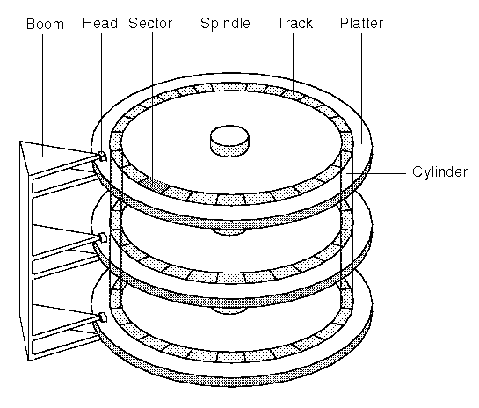
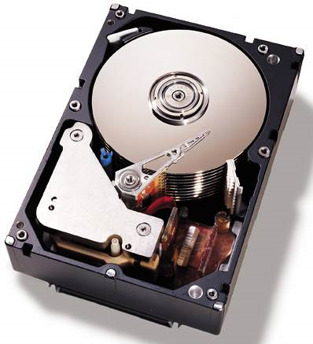
Hard disk geometry and terminology:
Structure and Behavior
Prasad
L06IndexConstruction
Notes:
Seek time is one of the three delays associated with reading or writing data on a computer's disk drive, and somewhat similar for CD or DVD drives. The others are rotational delay and transfer time.
Solid State Disks (SSDs) do not have what we classically mean by seek time because data is accessed without the use of moving parts, however there is a delay from hardware signal relay (and buffering) that is sometimes described as 'seek time' with a magnitude of ~0.1 ms.
SEEK TIME -> The time required for the access mechanism of a random-access storage device to be properly positioned.
The time it takes for a disk drive to move its head(s) from one track to another depends on the power of the servo, the mass of the heads, the number of tracks traversed and the time taken to position the heads over the target track accurately enough to start data transfer.
7200 rpm (30MBps-40MBps) / 5400 rpm disk speeds

Slide 5
Hardware basics
Access to data in memory is much faster than access to data on disk. (prefer caching)
Disk seeks: No data is transferred from disk while the disk head is being positioned.
  Therefore: Transferring one large chunk of data from disk to memory is faster than transferring many small chunks.
Disk I/O is block-based: Reading and writing of entire blocks (as opposed to smaller chunks).
  Block sizes: 8KB to 256 KB.
Prasad
L06IndexConstruction
Notes:
Memory transfer: 5 ns / byte Disk transfer: 20 ns / byte (because disk is not random access device)
Seek time: 5 ms

Slide 6
Hardware basics
Servers used in IR systems now typically have several GBs of main memory, sometimes tens of GBs.
Available disk space is several (2–3)orders of magnitude larger (TBs).
Fault tolerance is very expensive: It’s much cheaper to use many regular machines rather than one fault tolerant machine.
Prasad
L06IndexConstruction
Notes:
Come up with distributed architecture, programming model and software infrastructure
that enables exploiting commodity PCs (as opposed to special hardware) that is
potentially crash prone through redundant storage and computations

Slide 7
Hardware assumptions
symbol statistic value
s average seek time 5 ms = 5 x 10⁻³ s
b transfer time per byte 0.02 μs = 2 x 10⁻⁸ s
processor’s clock rate 10⁹ s⁻¹
p low-level operation 0.01 μs = 10⁻⁸ s
  (e.g., compare & swap a word)
size of main memory several GBs
size of disk space 1 TBs or more
Memory transfer: 5 ns / byte
(cf. 20ns / byte for disk)
Prasad
Notes:
5ms 20ns GHz 10ns
In the original: Mem. trans. time per byte 5 ns

Slide 8
RCV1: Our corpus for this lecture
Shakespeare’s collected works definitely aren’t large enough.
The corpus we’ll use isn’t really large enough either, but it’s publicly available and is at least a more plausible example.
As an example for applying scalable index construction algorithms, we will use the Reuters RCV1 collection (Approx. 1GB).
    This is one year of Reuters newswire (part of 1996 and 1997)
Prasad
L06IndexConstruction
Notes:
Typical corpus two order of magnitudes larger (Lexis Nexis CurrNews 2005 Datasets = 150GB)

Slide 9

A Reuters RCV1 document
Prasad
L06IndexConstruction
Notes:
Ignore multi-media aspects for our purposes

Slide 10
Type/token distinction
  Token – an instance of a word occurring in a document
  Type (term) – an equivalence class of tokens
  In June, the dog likes to chase the cat in the barn.
  12 word tokens, 8 word types
    Tokens – {the, in} = Types (terms)
Prasad
L06IndexConstruction
Notes:
12 word tokens, 9 word types?

Slide 11
Reuters RCV1 statistics
symbol statistic value
N documents 800,000
L avg. # tokens per doc 200
M terms (~ word types) 400,000
avg. # bytes per token 6
  (incl. spaces/punct.)
avg. # bytes per token 4.5
    (without spaces/punct.)
avg. # bytes per term 7.5
non-positional postings = term occurrences 100M
4.5 bytes per word token vs. 7.5 bytes per word type/term: why?
Notes:
Token : sequence of char in the input doc to be treated as a semantic unit
Term : Transformed/normalized token that is stored in a dictionary
Total tokens = 160 M (non-positional postings: 100 M) [[ slack stop words??]]
Total terms = 0.4 M
Total dataset size = 1GB
-------------------------------------------------------------------------------------------
CONFLICT: The IR book also says # of tokens = 800K * 200 =/= Number of terms = 100M
[[ slack stop words??]]
Then the size of the (tokenId-DocId list) = (4 bytes + 4 bytes) * 100 MB = 0.8GB
Is not non-positional posting (termId, docId, count)?
Is avg. term size higher because stop words filtered out?

Slide 12
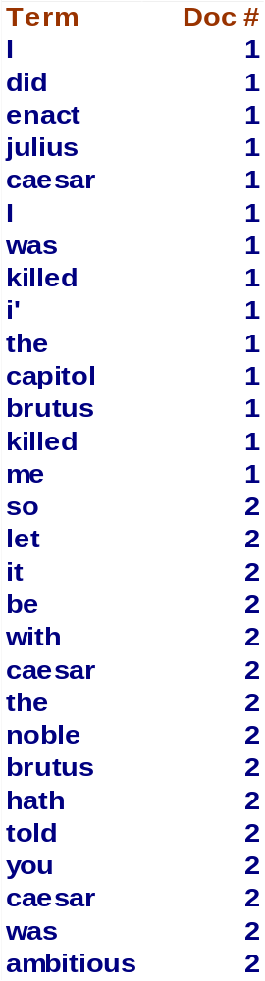
Recall IIR1 index construction
Documents are parsed to extract words and these are saved with the Document ID.
Doc 1
Doc 2
I did enact Julius
Caesar I was killed
i' the Capitol;
Brutus killed me.
So let it be with
Caesar. The noble
Brutus hath told you
Caesar was ambitious
Prasad
L06IndexConstruction

Slide 13
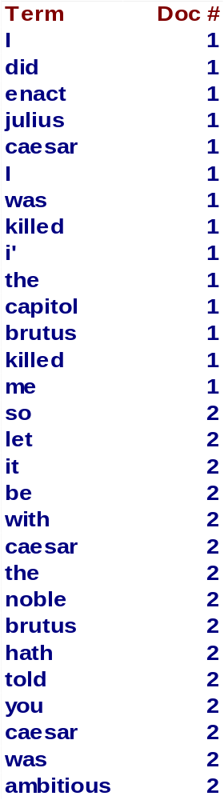
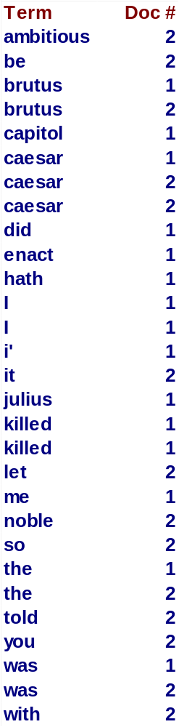
Key step
After all documents have been parsed, the inverted file is sorted by terms.
We focus on this sort step.
We have 100M items to sort.
Prasad
L06IndexConstruction

Slide 14
Scaling index construction
In-memory index construction does not scale.
How can we construct an index for very large collections?
Taking into account the hardware constraints we just learned about . . .
Memory, disk, speed etc.
Prasad
L06IndexConstruction
Notes:
Earlier sample corpus:
Number of docs = n = 1M Each doc has 1K terms
Number of distinct terms = m = 500K 667 million postings entries
Distinct terms = non-stop, normalized tokens (words)
Postings entries = terms + doc-ids + doc-freq-cnt
1000 words = 4 pages (Times new roman font, double spaced, one inch margins)

Slide 15
Bottleneck
Parse and build postings entries one doc at a time
Now sort postings entries by term (then by doc within each term)
Doing this with random disk seeks would be too slow – must sort T=100M records
If every comparison took 2 disk seeks, and N items could be
sorted with N log₂N comparisons, how long would this take?
Prasad
L06IndexConstruction
Notes:
Access to non-contiguous blocks adds seek time.
Cumulative term count useful for determining stop words? => Eventually used for ranking
Stable-sort w.r.t doc within each term to obtain term-freq and term hit list
Approx. 2 * 5 milliseconds * 100M * 27 = 27000000 seconds = 7500 hours (= 10 months)
log 10 = 3.32 (log 2 = 0.301)
8 * 3.32 = 26.5
(Reasonableness: 1M docs x 100 terms per doc)
[If we sort this in memory, total time = 27 sec] [should it not be 2*20ns*100M*27 ~ 100 sec?]
[If we sort this using disk when all information is in 10 contiguous blocks = 27 * 4 sec
+ 100M * 20ns * number of merge passes + 10 * 5ms (seek)]

Slide 16
Use the same algorithm for disk?
Can we use the same index construction algorithm (internal sorting algorithms) for larger collections, but by using disk instead of memory?
No: Sorting T = 100,000,000 records on disk is too slow – too many disk seeks.
We need an external sorting algorithm.
If every comparison took 2 disk seeks, and N items could be
sorted with N log₂N comparisons, how long would this take?
Prasad
L06IndexConstruction
Notes:
Access to non-contiguous blocks adds seek time.
Cumulative term count useful for determining stop words? => Eventually used for ranking
Stable-sort w.r.t doc within each term to obtain term-freq and term hit list
Approx. 2 * 5 milliseconds * 100M * 27 = 27000000 seconds = 7500 hours (= 10 months)
log 10 = 3.32 (log 2 = 0.301)
8 * 3.32 = 26.5
(Reasonableness: 1M docs x 100 terms per doc)
[If we sort this in memory, total time = 27 sec] [should it not be 2*20ns*100M*27 ~ 100 sec?]
[If we sort this using disk when all information is in 10 contiguous blocks = 27 * 4 sec
+ 100M * 20ns * number of merge passes + 10 * 5ms (seek)]

Slide 17
Disk Sorting Time Estimate
Approx. 2 * 5 milliseconds * 100M * log₂ 100M
= 2 * 5 milliseconds * 100M * 27
as log₂ 10 = 3.32 (log₁₀ 2 = 0.301)
= 27000000 seconds
= 7500 hours
(= 10 months)
Prasad
L06IndexConstruction
Notes:
Four stages: (1) In-memory index [e.g., Reuters RCV1 1GB]
(2) Dictionary in memory – Postings list in Disk [e.g., Lexis Nexis CurrNews 150GB]
(3) Dictionary– Postings list in Disk on single machine
(4) Dictionary– Postings list in cluster of machines (Distributed indexing) [e.g., Web]

Slide 18
BSBI: Blocked sort-based Indexing (Sorting with fewer disk seeks)
Assume that the entire dictionary can fit into the memory
Parse documents into (termId, docId) pairs to conserve space, maintaining (term -> termId) universal mapping in the main memory.
Eventually 12-byte (4+4+4) records of the form (termId, doc, freq) are generated as we parse docs.
  term requires more space than termId
Notes:
High Main Memory requirement for current machines (0.1G entries x 3 plus constant factor matters!)
1 block = 10M * 12 bytes = 120 MB (or 3 M Words)
10 blocks = 1.2 GB
==========
Sort on termIds and docIds to get dictionary and the posting lists in sorted form?

Slide 19
(cont’d)
As we build the index, we parse docs one at a time.
  While building the index, we cannot easily exploit compression tricks (you can, but much more complex)
The final postings for any term are incomplete until the end.
At 12 bytes per postings entry, demands a lot of space for large collections.
In general, need to store intermediate results on disk.
  However, T = 100,000,000 in the case of RCV1
  So … we can do this in memory in 2008, but typical collections are much larger. E.g. New York Times provides index of >150 years of newswire
Notes:
100 M terms * 12 bytes = 1.2 GB

Slide 20
BSBI: Blocked sort-based Indexing (Sorting with fewer disk seeks)
Must now sort 100M such 12-byte records by term.
Define a Block ~ 10M of such records
  Can easily fit a couple into memory.
  Will have 10 such blocks to start with.
Basic idea of algorithm:
  Accumulate postings for each block, sort, write to disk.
  Then merge the blocks into one long sorted order.
Notes:
High Main Memory requirement for current machines (0.1G entries x 3 plus constant factor matters!)
1 block = 10M * 12 bytes = 120 MB (or 3 M Words)
10 blocks = 1.2 GB

Slide 21
On-disk sorting
  Break up list into chunks. Sort chunks, then merge chunks
    We can pick the chunk size so that we can sort it in memory
sort
chunks
merge
chunks
split

Slide 22
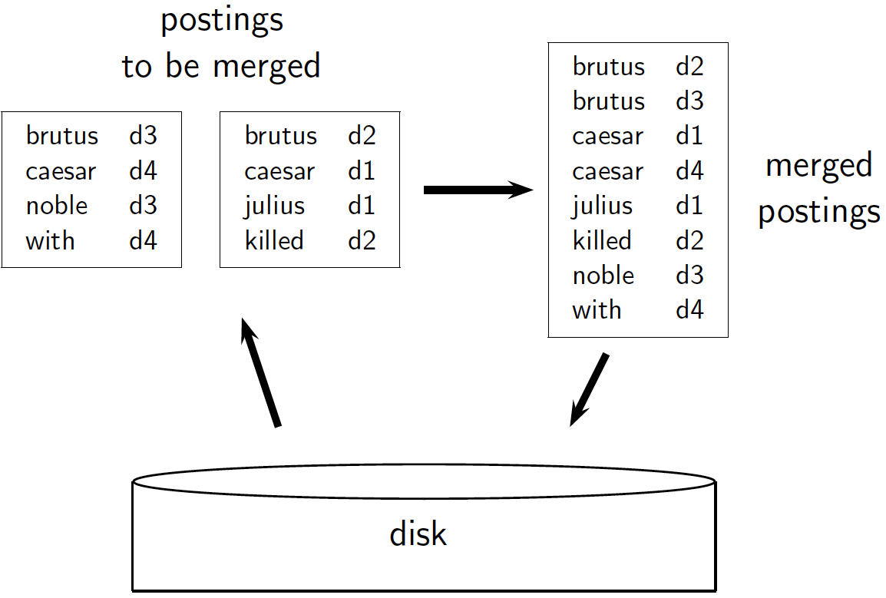
Prasad
L06IndexConstruction

Slide 23
Sorting 10 blocks of 10M records
First, read each block and sort within:
  Quicksort takes 2N log N expected steps
  In our case 2 x (10M log 10M) steps
Exercise: estimate total time to read each block from disk and quicksort it.
10 times this estimate - gives us 10 sorted runs of 10M records each.
Merge sorted records which if done straightforwardly needs 2 copies of data on disk
  But can be optimized
Prasad
L06IndexConstruction
Notes:
Estimated time:
Reading 10 blocks:
0.02 microsecond * 12 bytes / record x 10 blocks x 10 M records per block = 24 seconds
(seek time ignored – if separate seek for each 512K quantum access
then cumulative seek time 10 x 10M x 2 quantum/M x 5ms = 1s)
Sorting a block: 2 x 10M * 23 (approx => log base 2) * 0.01 microseconds = 4.6 seconds
(arithmetic operation : 10 ns) (log 10^7 = 23 given log 2 = 0.301 log 10 = 3.32)
Sorting 10 blocks: 46 seconds
Need two copies of data because merge is not in-place

Slide 24
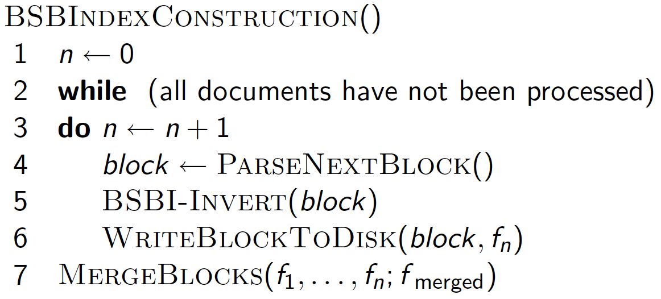
Prasad
L06IndexConstruction
Notes:
BSBI: Block Sort Based Indexing --- Global Dictionary
While merging, use all n-blocks simultaneously using in-memory buffers
Complexity = O(T log T) because of sorting step
================
PARSENEXTBLOCK (time intensive): The algorithm parses documents into termID-docID pairs and accumulates the pairs in memory until a block of a fixed size is full.
************: We choose the block size to fit comfortably into memory to permit a fast in-memory sort. The block is then inverted and written to disk.
BSBI-INVERT (sorting complexity not dominant): Inversion involves two steps. First, we sort the termID-docID pairs. Next, we collect all termID-docID pairs with the same termID into a postings list, where a posting is simply a docID.
MERGING: To do the merging, we open all block files simultaneously, and maintain small read buffers

Slide 25
How to merge the sorted runs?
Can do binary merges, with a merge tree of height log₂n (e.g., log₂10 = 4 layers).
During each layer, read into memory runs in blocks of 10M, merge, write back.
1
1
2
2
Merged run.
3
4
3
4
Runs being
merged.
Disk
Prasad
Notes:
For n chunks, how many levels will there be? log(n)

Slide 26
How to merge the sorted runs?
But it is more efficient to do a n-way merge, where you are reading from all blocks simultaneously.
Providing you read decent-sized chunks of each block into memory, you’re not killed by disk seeks.
Binary Merge
N-way Merge
Prasad
L06IndexConstruction

Slide 27
Remaining problem with sort-based algorithm
Our assumption was: we can keep the dictionary in memory.
We need the dictionary (which grows dynamically) to map a term to termID.
Actually, we could work with term,docID postings instead of termID,docID postings . . .
. . . but then intermediate files become very large. (We would end up with a scalable, but very slow index construction method.)
Prasad
L06IndexConstruction
Notes:
Encoding term using termed will compress postings somewhat but will have to be decoded while merging.

Slide 28
SPIMI:
Single-pass in-memory indexing
Key idea 1: Generate separate dictionaries for each block – no need to maintain term-termID mapping across blocks.
Key idea 2: Don’t sort. Accumulate postings in postings lists as they occur.
With these two ideas we can generate a complete inverted index for each block.
These separate indexes can then be merged into one big index.
Prasad
L06IndexConstruction
Notes:
Literally what we discussed using in-memory indexing + mega-merges at the end
=========

Slide 29
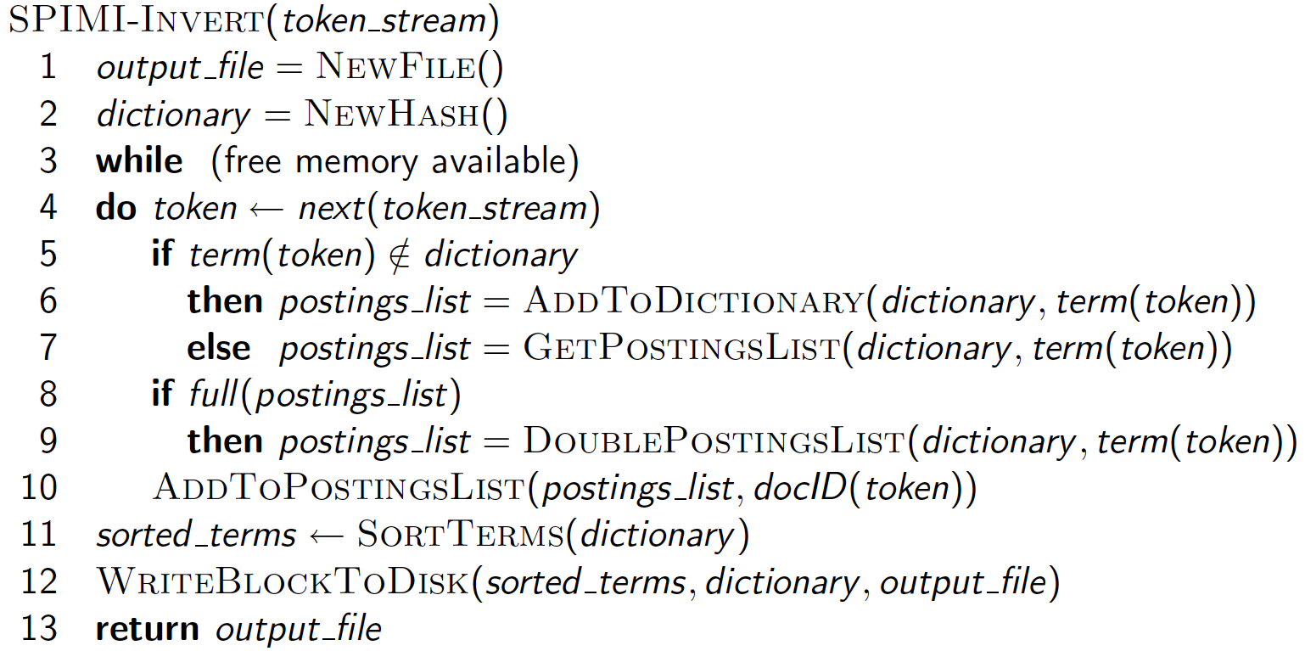
SPIMI-Invert
Merging of blocks is analogous to BSBI but what about sorted postings?
Notes:
Why is the complexity O(T) in spite of sorting step?
We are only sorting terms and not postings list.
Finally merging different dictionaries (not shown in code).
---------
Should ‘dictionary’ in line 12 be ‘postings_list’? :: we write the index of the block (which consists of the dictionary and the postings lists) to disk. We have to sort the terms (line 11) before doing this because we want to write postings lists in lexicographic order to facilitate the final merging step.
----------
Using HashTable because it is in-memory operation.
=========
A difference between BSBI and SPIMI is that SPIMI adds a posting directly to its postings list (line 10). Instead of first collecting all termID-docID pairs and then sorting them (as we did in BSBI),

Slide 30
SPIMI: Compression
Compression makes SPIMI even more efficient.
  Compression of terms
  Compression of postings
    Requires sorted postings?
See next lecture
Prasad
L06IndexConstruction

Slide 31
Distributed indexing
For web-scale indexing:
  must use a distributed computing cluster
Individual machines (stock hardware) are fault-prone
  Can unpredictably slow down or fail
Can we exploit a pool of machines?
  ‘Embarrassing parallelism’ in the data and computation to rescue
How do we exploit such a pool of machines?
  Convenient programming model and middleware
Prasad
L06IndexConstruction
Notes:
Middleware manages resource allocation : both data and computation redundancy
Parallel algorithms vs inherent parallism

Slide 32
Google data centers
Google data centers mainly contain commodity machines and are distributed around the world.
Estimate: a total of 2.5 million servers (2016) (earlier: 3 million processors/cores (Gartner 2007))
Estimate: Google installs 100,000 servers each quarter.
  Based on expenditures of 200–250 million dollars per year
This would be 10% of the computing capacity of the world!?!
2021 Storage Capacity : 15 exabytes (15 * 10^18 bytes)
Prasad
L06IndexConstruction

Slide 33
Google data centers
If in a non-fault-tolerant system with 1000 nodes, each node has 99.9% uptime, what is the uptime of the system?
Answer: 36%
  Note, (1 – 0.999¹⁰⁰⁰⁾ = 0.63
  Probability that at least one will fail.
Prasad
L06IndexConstruction
Notes:
Calculate the number of servers failing per minute for an installation of 1 million servers.
Failures common unless we recover using redundancies
0.36 = 0.999¹⁰⁰⁰

Slide 34
Distributed indexing
Maintain a master machine directing the indexing job – considered “safe”.
Break up indexing into sets of (parallel) tasks.
Master machine assigns each task to an idle machine from a pool.
  Also manages faults and scheduling redundant data / computations automatically
Prasad
L06IndexConstruction
Notes:
Middleware manages redundancy and fault tolerance using cheap hardware so that application can run smoothly.
Cheap hardware issues transparent to the application. Embarrassing parallelism is critical for its success.
--------------
Fault tolerance through redundancy/duplication:
3 copies of each data file on different machine (data redundancy)
3 computations run or reinitiating a computation if a m/c is slow or fails (computation redundancy)

Slide 35
Parallel tasks
We will use two sets of parallel tasks
  Parsers
  Inverters
Break the input document corpus into splits
Each split is a subset of documents (corresponding to blocks in BSBI/SPIMI)
Prasad
L06IndexConstruction

Slide 36
Parsers
Master assigns a split to an idle parser machine
Parser reads a document at a time and emits (term, doc) pairs
Parser writes pairs into j partitions
Each partition is for a range of terms’ first letters
  (e.g., a-f, g-p, q-z) – here j=3.
Now to complete the index inversion
Prasad
L06IndexConstruction

Slide 37
Inverters
An inverter collects all (term,doc) pairs (= postings) for one term-partition.
Sorts and writes to postings lists
Prasad
L06IndexConstruction

Slide 38
Data flow
assign
Master
assign
Postings
Parser
a-f
g-p
q-z
Inverter
a-f
Parser
a-f
g-p
q-z
Inverter
g-p
splits
Inverter
q-z
Parser
a-f
g-p
q-z
Map
phase
Reduce
phase
Segment files
Notes:
Parser (map) and Inverter (reduce) are problem specific.
Fault tolerance through redudant data storage and Repeated computation, and
Splitting and “hashed merge”
are implicit in the map-reduce computational framework
And distributed file system.
-------Middleware manages redundancy transparently--------------
MAP and REDUCE are building blocks;
machine code for compile cloud computations.
Hive, PIG, etc. compile relational queries into a graph of
map and reduce blocks.

Slide 39
MapReduce
The index construction algorithm we just described is an instance of MapReduce.
MapReduce (Dean and Ghemawat 2004) is a robust and conceptually simple framework for
  distributed computing …
  … without having to write code for the distribution part.
They describe the Google indexing system (ca. 2002) as consisting of a number of phases, each implemented in MapReduce.
Prasad
L06IndexConstruction
Notes:
MapReduce architecture provides the hardware and the middleware.
MapReduce as querying primitives.
End-user programming: searches using HIVE and PIG.

Slide 40
MapReduce
Index construction was just one phase.
Another phase: transforming a term-partitioned index into document-partitioned index.
  Term-partitioned: one machine handles a subrange of terms
  Document-partitioned: one machine handles a subrange of documents
(As we discuss in the web part of the course) most search engines use a document-partitioned index … better load balancing, etc.)
Prasad
L06IndexConstruction

Slide 41
Schema for index construction in MapReduce
Schema of map and reduce functions
map: input → list(k, v) reduce: (k,list(v)) → output
Instantiation of the schema for index construction
map: web collection → list(termID, docID)
reduce: (<termID1, list(docID)>, <termID2, list(docID)>, …) → (postings list1, postings list2, …)
Example for index construction
map: d2 : C died. d1 : C came, C c’ed. → (<C, d2>, <died,d2>, <C,d1>, <came,d1>, <C,d1>, <c’ed, d1>
reduce: (<C,(d2,d1,d1)>, <died,(d2)>, <came,(d1)>, <c’ed,(d1)>) → (<C,(d1:2,d2:1)>, <died,(d2:1)>, <came,(d1:1)>, <c’ed,(d1:1)>)
Prasad
L06IndexConstruction

Slide 42
Dynamic indexing
Up to now, we have assumed that collections are static.
They rarely are:
  Documents come in over time and need to be inserted.
  Documents are deleted and modified.
This means that the dictionary and postings lists have to be modified:
  Postings updates for terms already in dictionary
  New terms added to dictionary
Prasad
L06IndexConstruction
Notes:
Two approaches:
Maintain main index and auxiliary index
Reindex periodically

Slide 43
Simplest approach
Maintain “big” main index
New docs go into “small” auxiliary index
Search across both, merge results
Deletions
  Invalidation bit-vector for deleted docs
  Filter docs output on a search result by this invalidation bit-vector
Periodically, re-index into one main index
Prasad
L06IndexConstruction

Slide 44
Merging
Aux:
Main:

Slide 45
Merging
Aux:
Main:

Slide 46
Merging
Aux:
Main:

Slide 47
Merging
Aux:
Main:
Every time we merge we use the entire index.
Can we do better?

Slide 48
Issues with main and auxiliary indexes
Problem of frequent merges – you touch stuff a lot
Poor performance during merge
Actually:
  Merging of the auxiliary index into the main index is efficient if we keep a separate file for each postings list.
  Merge is the same as a simple append.
  But then we would need a lot of files – inefficient for O/S.
Assumption for the rest of the lecture: The index is one big file.
In reality: Use a scheme somewhere in between (e.g., split very large postings lists, collect postings lists of length 1 in one file etc.)

Slide 49
Logarithmic merge
main memory

Slide 50
Logarithmic merge
main memory
1
2
3
4
5
…

Slide 51
Logarithmic merge
main memory
1
2
3
4
5
…

Slide 52
Logarithmic merge
main memory
1
2
3
4
5
…

Slide 53
Logarithmic merge
main memory
1
2
3
4
5
…

Slide 54
Logarithmic merge
main memory
1
2
3
4
5
…

Slide 55
Logarithmic merge
main memory
1
2
3
4
5
…

Slide 56
Logarithmic merge
main memory
1
2
3
4
5
…

Slide 57
Logarithmic merge
main memory
1
2
3
4
5
…

Slide 58
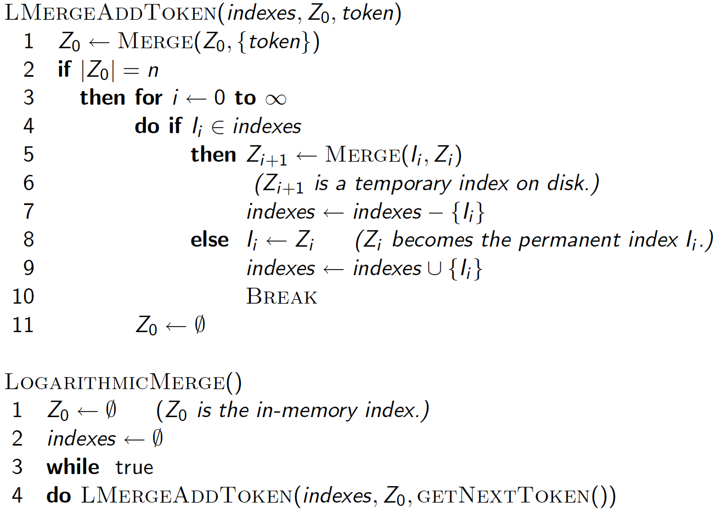
Logarithmic merge
Notes:
Net effect of adding each new block is the same as counting up with
Each 1 signifying the size of the block created
0
1
10
11
100
=> after consuming five Z0 blocks
we have an I3 (of size 4) and an I1 (of size 1)
…
1000=>=> after consuming eight Z0 blocks
we have an I4 (of size 8)
****I_n has size 2^(n-1) ***

Slide 59
Logarithmic merge
Maintain a series of indexes, each twice as large as the previous one.
Keep smallest (Z₀) in memory
Larger ones (I₀, I₁, …) on disk
If Z₀ gets too big (> n), write to disk as I₀
or merge with I₀ (if I₀ already exists) as Z₁
Either write merged Z₁ to disk as I₁ (if no I₁)
Or merge with I₁ to form Z₂
etc.
Prasad
L06IndexConstruction
Notes:
Instead of merging a fixed size (n) index Z0 with varying sized one index and get quadratic complexity T^2 /n,
(n + 2n + 3n + …)
Maintain several indices of different sizes n, 2n, 4n, … to reduce the complexity of merge to T lgT/n
(n + 2n + 4n + …)
-----------------------------------------------
Z0 -> =>
0 -> I0
Z0 -> I0 =>
0 -> I1
Z0 -> I1 =>
0 -> I0, I1
Z0 -> I0, I1 =>
0 -> 0, 0, I2
…
(follow the counting pattern … with capacities 1:2:4:…)

Slide 60
Logarithmic merge
Auxiliary and main index: index construction time is O(T²) as each posting is touched in each merge.
Logarithmic merge: Each posting is merged O(log T) times, so complexity is O(T log T)
So logarithmic merge is much more efficient for index construction
But query processing now requires the merging of O(log T) indexes
  Whereas it is O(1) if you just have a main and auxiliary index
Prasad
L06IndexConstruction

Slide 61
Further issues with multiple indexes
Corpus-wide statistics are hard to maintain
E.g., when we spoke of spell-correction: which of several corrected alternatives do we present to the user?
  We said, pick the one with the most hits
How do we maintain the top ones with multiple indexes and invalidation bit vectors?
  One possibility: ignore everything but the main index for such ordering
Will see how such statistics used in results ranking
Prasad
L06IndexConstruction

Slide 62
Dynamic indexing at search engines
All the large search engines now do dynamic indexing
Their indices have frequent incremental changes
  News items, new topical web pages
    Joe Biden, COVID-19,…
But (sometimes/typically) they also periodically reconstruct the index from scratch
  Query processing is then switched to the new index, and the old index is then deleted
Prasad
L06IndexConstruction

Slide 63

Prasad
L06IndexConstruction
Notes:
Webmasterworld. Search Engine watch.

Slide 64
Other sorts of indexes
Positional indexes
  Same sort of sorting problem … just larger
Building character n-gram indexes:
  As text is parsed, enumerate n-grams.
  For each n-gram, need pointers to all dictionary terms containing it – the “postings”.
  Note that the same “postings entry” will arise repeatedly in parsing the docs – need efficient hashing to keep track of this.
    E.g., that the trigram uou occurs in the term deciduous will be discovered on each text occurrence of deciduous
    Only need to process each term once
Why?

