Slide 1
Adimulam Mourya
Final Project
14/6/2024 Annual Review

Slide 2


Keylogger and Security
3/21/2024 Annual Review

Slide 3

AGENDA
Introduction
Problem Statement
Project Overview
Who Are The End Users
Solution and Value Proposition
The "Wow" Factor in Our Solution
Modelling
Results
Conclusion and Q&A
14/06/2024 Annual Review

Slide 4
Introduction
Key loggers also known as keystroke loggers, may be defined as the recording of the key pressed on a system and saved it to a file, and the that file is accessed by the person using this malware. Key logger can be software or can be hardware.
Working: Mainly key-loggers are used to steal password or confidential details such as bank information etc.

Slide 5

PROBLEM STATEMENT
Keyloggers are a significant threat to cybersecurity, leading to unauthorized access to sensitive information , identity theft, and financial fraud.
Affects individuals, businesses, and organizations by compromising data privacy and security.
14/06/2024 Annual Review

Slide 6

PROJECT OVERVIEW
Objective: The goal of this project is to create a software tool that records keystrokes on a computer, primarily for monitoring purposes. This can include parental control, employee monitoring, or user behavior research. The project emphasizes ethical use, requiring user consent and adherence to legal standards.
3/21/2024 Annual Review

Slide 7
FEATURES OF THE KEYLOGGER
Keystroke Logging: Capture and log all keystrokes made by the user.
Data Storage: Store logged keystrokes in both text and JSON format.
Stealth Mode: Operate unobtrusively in the background.
User Interface: Provide a simple GUI for starting and stopping the keylogger
.

Slide 8
Technologies Used
Programming Language: Python
Libraries :
‘tkinter’ for the graphical user interface.
‘pynput ‘for capturing keyboard events.
‘json’ for managing JSON data storage.

Slide 9




WHO ARE THE END USERS?
IT Professionals
Business Leaders
Individual Users
Keylogger-based security solutions are invaluable for IT professionals responsible for safeguarding organizational data and systems. These tools provide critical insights into user behavior and potential security breaches, enabling them to proactively address vulnerabilities and mitigate risks
Business leaders, concerned with the protection of sensitive information and the continuity of their operations, will find keyloggers to be a powerful asset in their cybersecurity arsenal. These tools can help them make informed decisions and implement effective security measures to safeguard their organization's assets.
Individual users, such as employees or consumers, may also benefit from the use of keyloggers to protect their personal devices and sensitive data. However, the use of these tools by individuals must be carefully considered and balanced with privacy concerns.
3/21/2024 Annual Review

Slide 10
YOUR SOLUTION AND ITS VALUE PROPOSITION
Anti-Key-logger – As the name suggest these are the software which are anti / against key loggers and main task is to detect key-logger from a computer system.
Anti-Virus – Many anti-virus software also detect key loggers and delete them from the computer system. These are software anti-software so these can not get rid from the hardware key-loggers.
Automatic form filler – This technique can be used by the user to not fill forms on regular bases instead use automatic form filler which will give a shield against key-loggers as keys will not be pressed .
One-Time-Passwords – Using OTP’s as password may be safe as every time we login we have to use a new password.
Patterns or mouse-recognition – On android devices used pattern as a password of applications and on PC use mouse recognition, mouse program uses mouse gestures instead of stylus.
Voice to Text Converter – This software helps to prevent Keylogging which targets a specific part of our keyboard.
14/05/2024 Annual Review

Slide 11

THE WOW IN YOUR SOLUTION
Innovative Approach: Combining technical measures with user education for comprehensive protection.
Demonstration: Real-time demonstration of a simple keylogger to illustrate the threat and the effectiveness of security measures.
Impact: Significant reduction in the likelihood of keylogging attacks through proactive measures.
3/21/2024 Annual Review
11

Slide 12
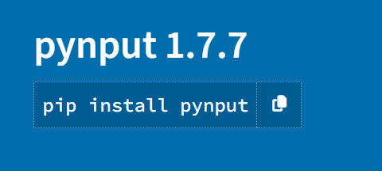
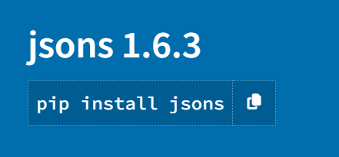
MODELLING
Installing Required Libraries
Before we begin, we need to install a particular library, which we can do with the pip command: pip install pynput and pip install jsonlib.
3/21/2024 Annual Review
12

Slide 13
Importing Required Libraries
pynput: This will help us read the keystrokes as the user types in stuff
JSON is a lightweight data-interchange format. It is often used for exchanging data between a web server and user agent

Slide 14
Initialization:
Set up the main GUI window.
Initialize global variables for key logging.
Event Capture:
Start capturing key events when the "Start" button is pressed. Log key press and release events.
Data Logging:
Continuously update text and JSON log files with captured key events.
Stop Logging:
Stop capturing key events when the "Stop" button is pressed. Update the GUI status to indicate the keylogger is stopped.

Slide 15
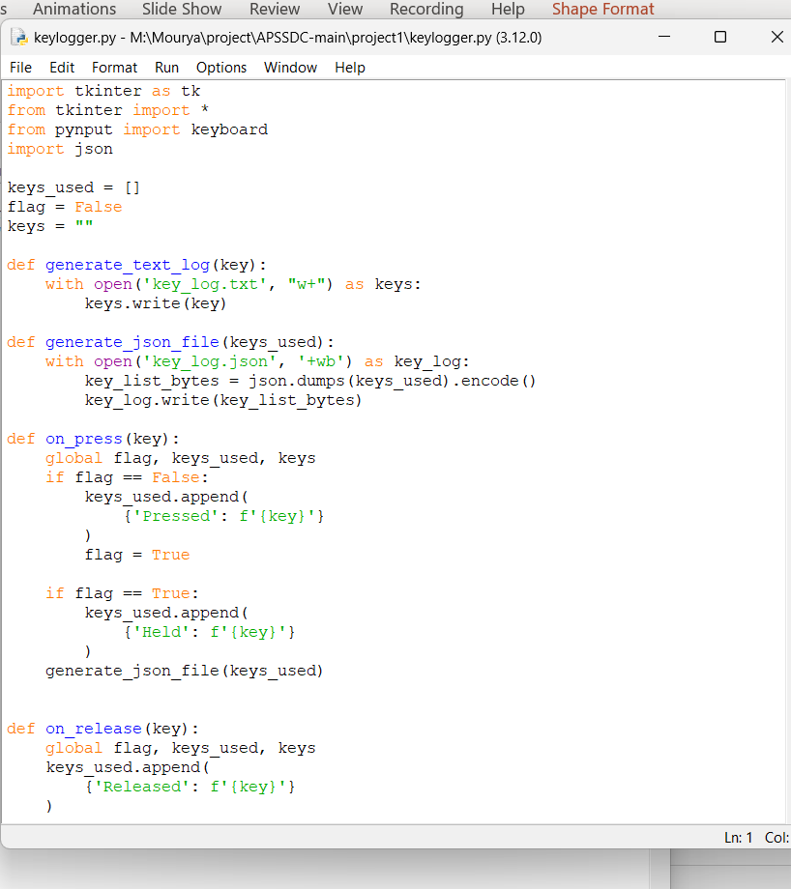
Program

Slide 16
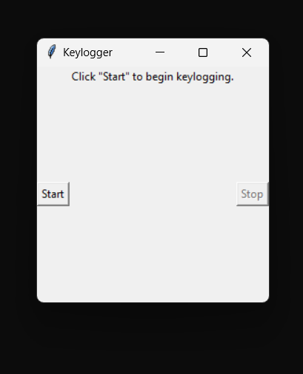
RESULTS
After Execution :
The code generates the keylogger application
14/06/2024 Annual Review
16

Slide 17
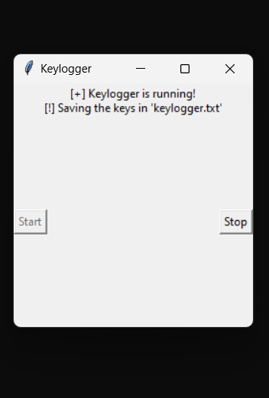
OUTPUT
* Hit the Start to capturing key events when the "Start" button is pressed

Slide 18
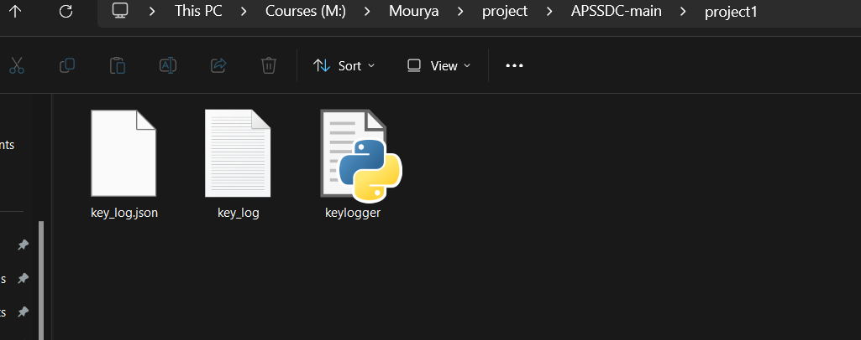
OUTPUT:
It generates two files until Continuously update text and JSON log files with captured key events

Slide 19
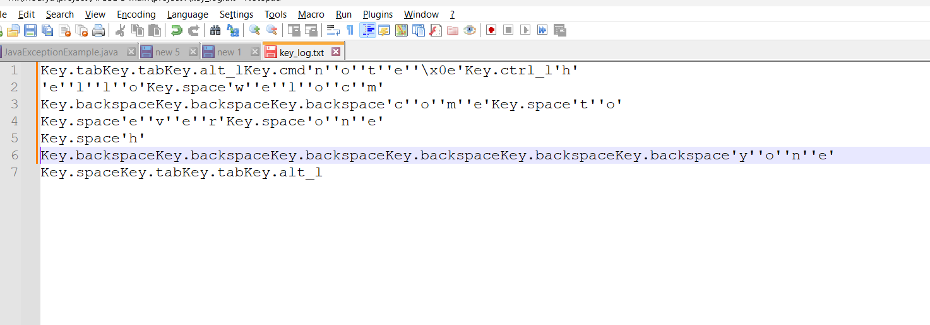
The Stores all the key Strokes in the key_log.txt file

Slide 20
RESULT
Successfully implemented a keylogger that captures keystrokes and records them into both text and JSON files.
Real-time keylogging with start and stop functionality controlled via a simple GUI.
The keylogger project demonstrated the capability to effectively capture and log keystrokes in real-time.
The GUI provided a user-friendly way to control the keylogger, making it accessible and easy to use.
Emphasized the ethical use of keyloggers and the importance of implementing security measures to protect against malicious use

Slide 21
PROJECT GITHUB LINK
https://github.com/MouryaSagar17/KeyLogger

