Slide 1

CampusNLP: An Intelligent Semantic Retrieval System for College Knowledge Discovery
Team Leader:
Mouryagna Baindla - BT24CSA015
Team Members:
Shashank Reddy - BT24CSA014
Rishikesh Reddy - BT24CSA058
Department: CSA
IIIT Nagpur

Slide 2
Problem Statement & Motivation
The Problem
IIIT Nagpur's information is spread across web pages, PDFs, DOCX files, spreadsheets, and images.
Much of the website content is loaded dynamically, so normal web crawlers can miss important information.
Finding the right information is difficult because important details and their context can get lost.
Simple keyword search may miss the meaning of a query, while vector search may miss exact terms like course codes, faculty names, or department names.
Why Intelligent Retrieval?
Bring information from different sources into one searchable system.
Make it easier for students to find the information they actually need.
Understand the meaning of the query while still matching important exact terms.
Objective
Build an intelligent retrieval system that lets students easily search IIIT Nagpur's scattered information and get relevant, accurate results — combining semantic understanding with exact keyword matching.

Slide 3
Existing Solutions & Research Gap
Existing Research
Commonly used Data
Static web pages
PDF documents
Plain-text web content
Documents in a single format
Existing Approaches
Keyword search using BM25 / TF-IDF
Vector search using embeddings
Basic text chunking
Retrieving results based only on similarity scores
Research Gap
Most existing systems work with clean, static text, rather than information spread across dynamic websites and different document formats.
They often don't keep enough metadata and context while processing the data.
There is limited work on handling IIIT Nagpur's dynamic React website + documents + images together.
Keyword search can miss meaning, while vector search can miss exact terms such as course codes and faculty names.
Our Direction
Build an IIIT Nagpur-specific intelligent retrieval system that combines keyword search + semantic search + cross-encoder re-ranking to provide more accurate and relevant results.

Slide 4
Research Papers Reviewed
LearnForge: An AI-Powered Intelligent Learning Assistant with RAG-Based Document Intelligence— IEEE Xplore
Ontology-Guided Semantic Retrieval in Virtual University Information Systems: An Empirical Benchmark Study— SCIRP
From Retrieval to Comprehension (R2C): A Collaborative Architecture for Campus Policy QA
A Retrieval-Augmented Multilingual Chatbot for Intelligent College Information Services— IRO Journals
From BM25 to Corrective RAG: Benchmarking Retrieval Strategies for Text-and-Table Documents — alphaXiv
Advisely: AI-Powered Academic Advising Using Large Language Models (LLMs) — ResearchGate
A Comparative Study of Information Retrieval Models: BM25 versus Hybrid Retrieval on the Cranfield Collection — ResearchGate
A Study on a Multimodal Agentic RAG Framework for Integrating Multi-Source Heterogeneous Information in Higher Education Institutions— MDPI
Benchmarking Retrieval Strategies for Curriculum-Aligned Retrieval-Augmented Generation Using NCERT-RAG-Eval STEM Textbooks — Nature
Enhancing Educational Semantic Retrieval Through Dual Objective Fine-Tuning of Open Source Embedding Models — Springer

Slide 5
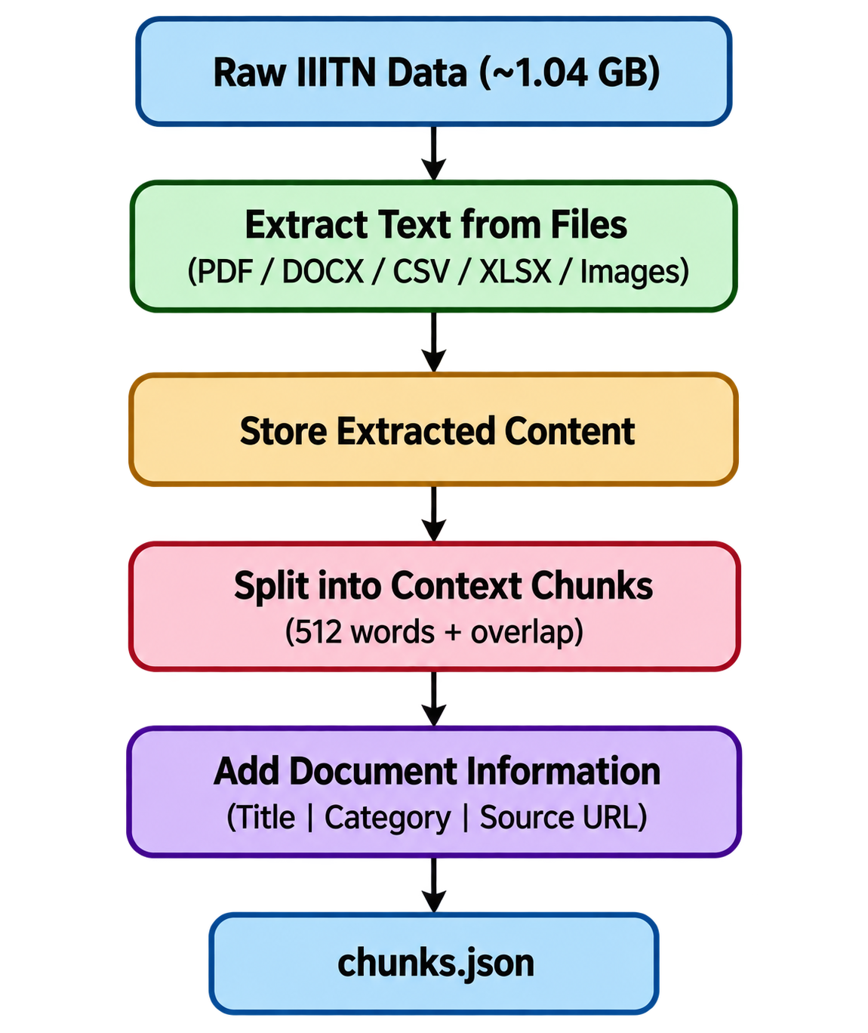
Dataset & Data Preparation
Dataset
Collected 72 important IIIT Nagpur URLs covering academics, placements, governance, and facilities.
Used Playwright to extract content from the dynamic React/Vite website.
Collected different types of data: PDFs, DOCX files, CSV/XLSX sheets, and images.
Used Tesseract OCR to extract text from placement images and recruiter information.
Used MD5 hashing to remove duplicate files.
In total, we collected around 1.04 GB of institutional data
Data Preparation
Why Metadata Matters
Each chunk keeps information about where it came from, such as the document title, category, and source URL.
This helps the system return not just relevant text, but also the right context and source behind that information.
72 URLs → ~1.04 GB of raw data → extracted text → context-aware chunks → metadata-rich dataset ready for retrieval

Slide 6
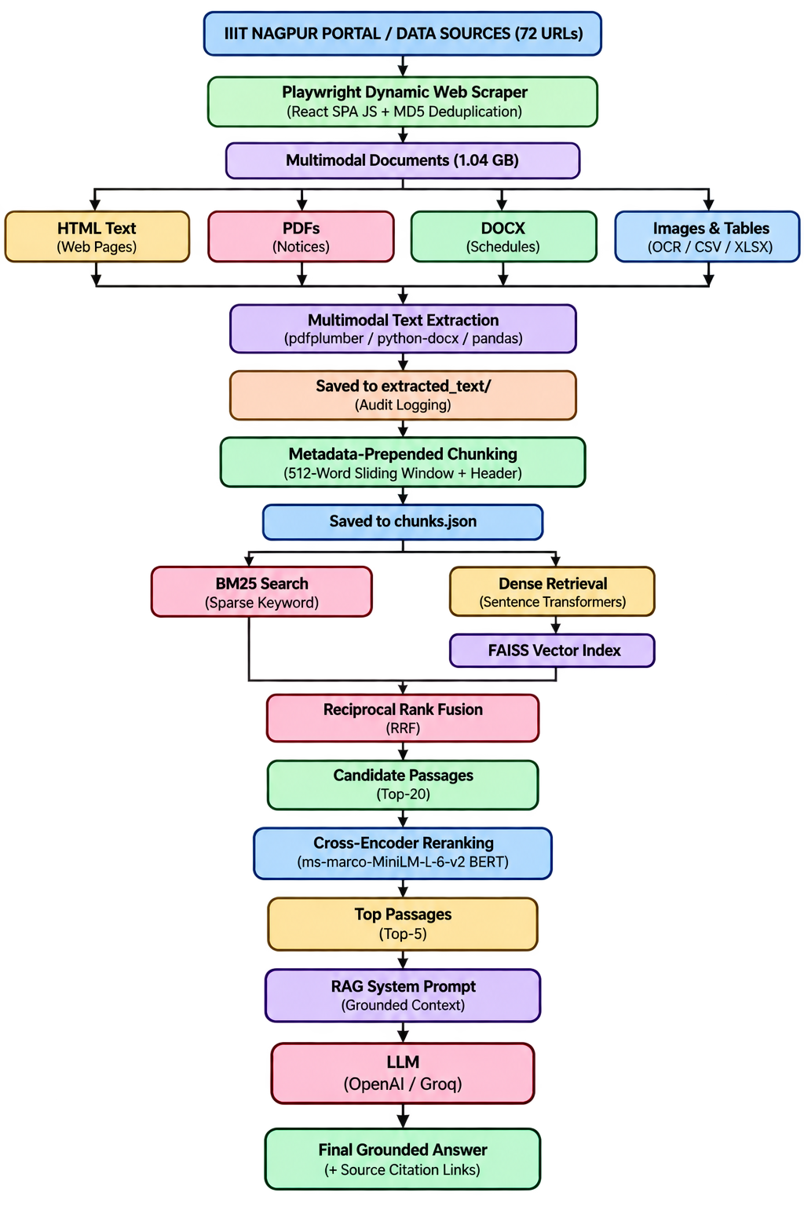
Overall Workflow

Slide 7
Model Specifications & Architecture
Dense Retrieval - Semantic Search
Model: sentence-transformers/all-MiniLM-L6-V2
Architecture: 6-layer Transformer encoder with ~22.7M parameters.
Embedding Size: 384 dimensions.
Context: Up to 256 tokens.
Purpose: Converts queries and documents into vectors so we can find passages with similar meaning.
Retrieval: FAISS is used for fast similarity search.
Example
Query: “Who teaches Machine Learning?”
→ Can retrieve a passage containing “Faculty handling CSL-422 Machine Learning” even if the exact words don't match.
Sparse Retrieval -Keyword Search
Algorithm: BM25Okapi
Uses term frequency, inverse document frequency, and document length to score passages.
Good at finding exact words and terms.
Particularly useful for course codes, faculty names, room numbers, etc.
Example
Query: "CSL-422"
→ BM25 can directly match passages containing CSL-422.
Cross-Encoder - Final Re-Ranking
Model: cross-encoder/ms-marco-MiniLM-L-6-v2
Takes the query and passage together as input.
Uses attention between the query and passage to understand their relevance.
Receives the Top-20 candidates from BM25 + dense retrieval.
Re-scores them and selects the Top-5 most relevant passages.

Slide 8
System Evaluation Metrics
Retrieval Quality
Recall@K (5, 10, 20) - How many relevant passages are successfully retrieved in the top-K results.
Precision@K - How many of the retrieved passages are actually relevant.
MRR - Measures how high the first relevant result appears in the ranking.
NDCG@K - Measures how well the most relevant passages are ordered near the top.
Answer Quality
Faithfulness / Groundedness - Checks whether the answer is supported by the retrieved information.
Answer Relevance - Checks whether the answer actually addresses the user's question.
Citation Accuracy - Checks whether the provided source links and document references point to the information used in the answer.
System Performance
Retrieval Latency — Time required to retrieve candidate passages using BM25 and FAISS.
Re-ranking Latency — Time required by the Cross-Encoder to rank the Top-20 candidates.
End-to-End Latency — Total time from the user query to the final answer.

Slide 9
Baseline Analysis & Future Scope
Initial Baseline — Dense Retrieval
We initially tested dense retrieval using FAISS and all-MiniLM-L6-v2.
It performed well for queries based on meaning and context.
During testing, we noticed that some exact terms were not retrieved reliably.
Queries involving course codes, faculty names, room numbers, and other specific identifiers could be missed or ranked lower.
This showed that dense retrieval alone was not sufficient for our institutional data.
Future Scope — Hybrid Retrieval
Add BM25 to handle exact keyword and identifier matching.
Combine dense and sparse results using Reciprocal Rank Fusion (RRF).
Use a Cross-Encoder to improve the ranking of retrieved passages.
Compare the hybrid system against the dense-only baseline using Recall@K, MRR, and NDCG.
Evaluate the final RAG system for faithfulness, answer relevance, and citation accuracy
Goal
Build a reliable retrieval system for IIIT Nagpur that understands the meaning of a query while also accurately finding exact terms such as course codes, faculty names, and other institutional information — with grounded answers and proper source citations.

