Slide 1

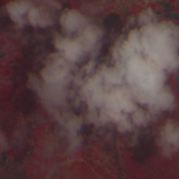
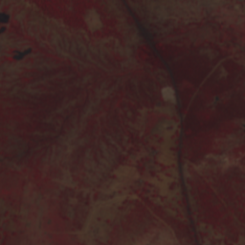
Generative AI-Based Cloud Removal & Reconstruction for LISS-IV Satellite Imagery
Using Deep Learning for Image-to-Image Reconstruction
Team Members
Shashank Reddy , Mouryagna Baindla, Rishikesh Reddy
BT24CSA014, BT24CSA015, BT24CSA058
Supervisor: Dr. Santosh Kumar Sahu
Cloudy
Clear
Department: CSA,
IIIT Nagpur

Slide 2
Problem Statement & Motivation
The Problem
• Clouds obscure the Earth's surface in optical satellite imagery.
• Cloud-covered regions lose important spatial information.
• Cloud contamination affects spectral information.
• This limits reliable analysis of the Earth's surface.
Why Cloud Removal?
• Recover information hidden beneath clouds.
• Improve the usability of optical satellite imagery.
• Preserve both spatial details and spectral characteristics.
Objective
Reconstruct a cloud-free LISS-IV image from a cloudy observation while preserving spatial details and spectral information.

Slide 3
Existing Solutions & Research Gap
Existing Research
Commonly used Data
Sentinel-2
Sentinel-1 + Sentinel-2
Landsat
Multi-sensor datasets
Existing Approaches
CNN / Encoder–Decoder
Residual networks
GAN-based reconstruction
SAR–optical fusion
Research Gap
Deep-learning cloud-removal research is strongly represented by Sentinel-2 and multi-sensor datasets.
LISS-IV-specific cloud-removal research and benchmark datasets are comparatively less explored.
Our Direction
Develop and evaluate a native LISS-IV cloud-removal pipeline using paired cloudy and cloud-free imagery.

Slide 4
Why LISS-IV?
Feature | Sentinel-2 | LISS-IV
Programme | Copernicus / ESA | Resource sat / ISRO
Multispectral bands | 13 | 3
Highest spatial resolution | 10 m | 5.8 m
Representation | — | B4–B3–B2 FCC
Research maturity | Extensive | Comparatively less explored
01 — Higher spatial resolution
LISS-IV: 5.8 m
vs Sentinel-2: 10 m
02 — Indian Earth-observation context
LISS-IV belongs to India's
Resourcesat programme.
03 — Research opportunity
Investigate cloud removal specifically for
high-resolution LISS-IV imagery.

Slide 5
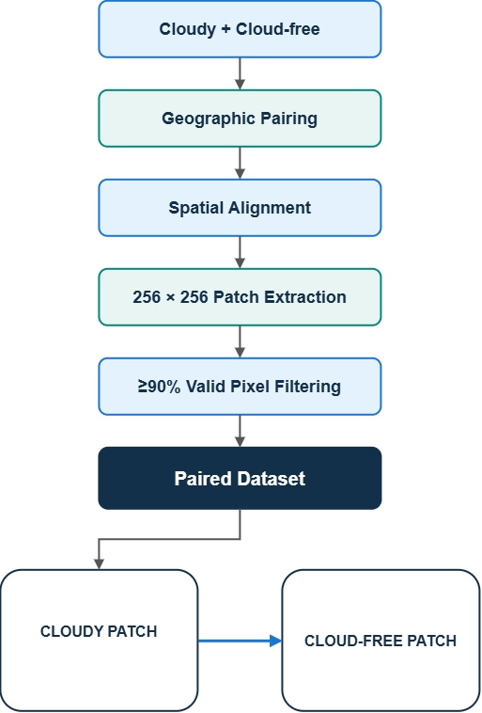
Dataset & Data Preparation
Dataset
LISS-IV
Resourcesat-2/2A
B2 — Green
B3 — Red
B4 — NIR
FCC: [B4, B3, B2]
~5.8 m spatial resolution
Data Preparation
235,001 Paired Patches
Scene-level split → reduces spatial leakage
Train: 185,001 | Validation: 25,000 | Test: 25,000

Slide 6
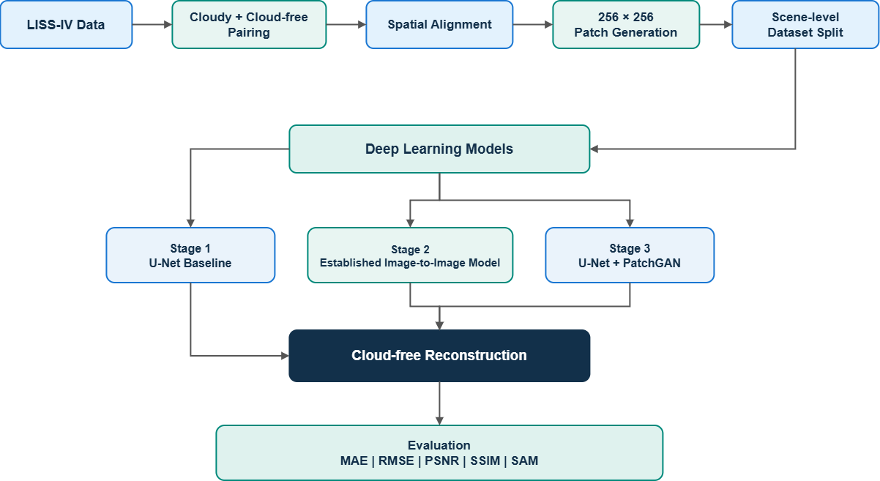
Overall Workflow

Slide 7
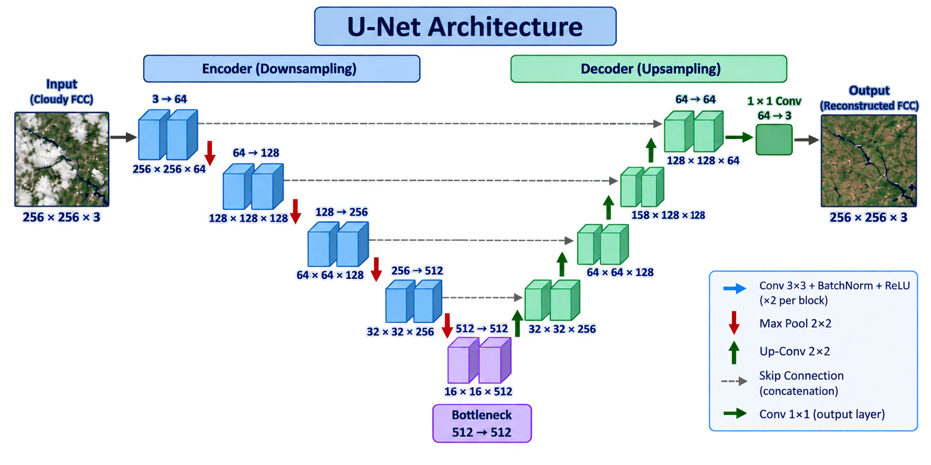
Baseline Model – U-Net
Model Configuration
Input : Cloudy FCC - 256 × 256 × 3
Encoder : 3 → 64 → 128 → 256 → 512
Bottleneck : 512 → 512
Decoder : Upsampling + Skip Connections
Output :Reconstructed Clear FCC
256 × 256 × 3
Training Configuration | L1 Loss | Adam | Learning Rate: 2 × 10⁻⁴ | 5 Epochs

Slide 8
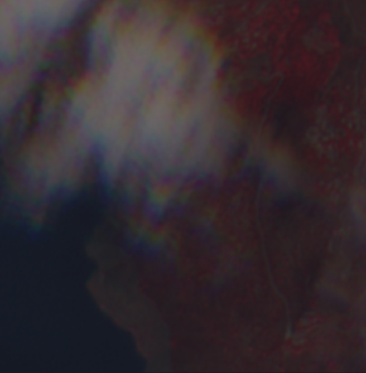

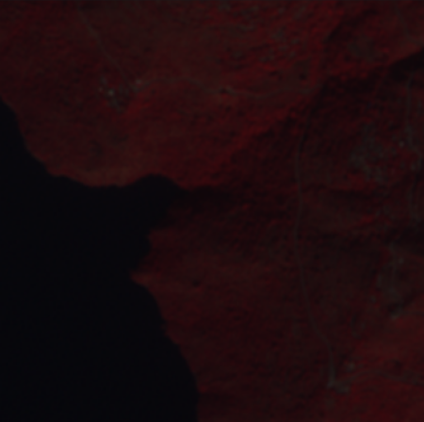
Evaluation Metrics & Baseline Results
Evaluation Metrics
U-Net Baseline Results
Metric | Meaning | Goal
MAE | Absolute pixel difference | ↓
RMSE | Squared reconstruction error | ↓
PSNR | Reconstruction quality | ↑
SSIM | Structural similarity | ↑
SAM | Spectral similarity | ↓
Metric | Result
MAE ↓ | 0.043772
RMSE ↓ | 0.067446
PSNR ↑ | 23.4209 dB
SSIM ↑ | 0.808675
SAM ↓ | 9.9696°
Cloudy Input
U-Net Output
Ground Truth

Slide 9
Baseline Analysis, Limitations & Future Scope
Baseline Analysis
What worked
U-Net learned cloudy-to-clear reconstruction.
SSIM: 0.8087
Cloud appearance was reduced.
General scene structure was reconstructed.
Limitations
Output is noticeably smoother than the ground truth.
Fine spatial details are lost.
Spectral variation is not fully recovered.
Radiometric distribution is not reproduced perfectly.
Future Scope
Stage 1 — U-Net + L1
✓ Completed
↓
Stage 2 — Stronger Image-to-Image Model
↓
Stage 3 — U-Net + PatchGAN
↓
Final Comparison
MAE | RMSE | PSNR | SSIM | SAM
Goal Box
Improve spatial detail and spectral fidelity while maintaining or improving quantitative reconstruction performance.

Slide 10
References
[1] Cloud Removal Advances: A Comprehensive Review and Analysis for Optical Remote Sensing Images.
[2] Meraner, A., Ebel, P., Schmitt, M., & Zhu, X. X. (2020). Cloud removal in Sentinel-2 imagery using a deep residual neural network and SAR-optical data fusion. ISPRS Journal of Photogrammetry and Remote Sensing.
[3] Li, Y., et al. (2020). Thin cloud removal in optical remote sensing images based on generative adversarial networks and physical model of cloud distortion.
[4] Zhou, X., et al. (2024). AllClear: A Comprehensive Dataset and Benchmark for Cloud Removal in Satellite Imagery. NeurIPS 2024.
[5] ESA. Copernicus Sentinel-2 Mission and Multispectral Instrument documentation.
[6] Ronneberger, O., Fischer, P., & Brox, T. (2015). U-Net: Convolutional Networks for Biomedical Image Segmentation. MICCAI.

