Slide 1

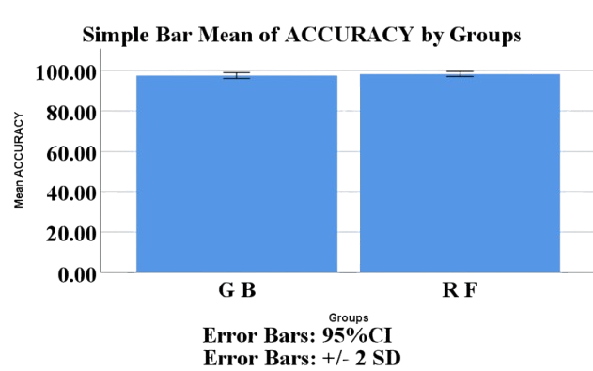
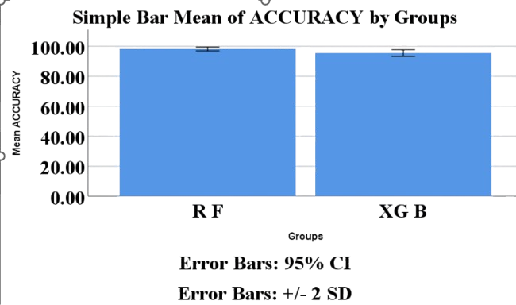
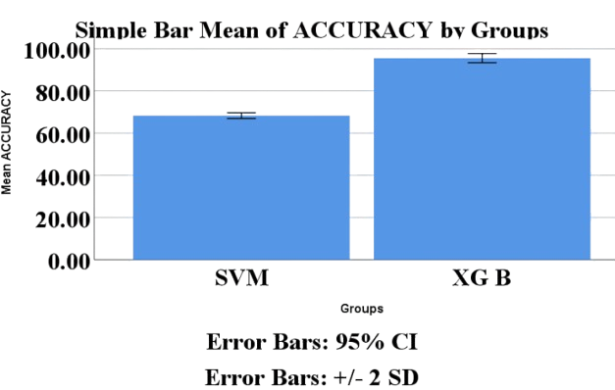
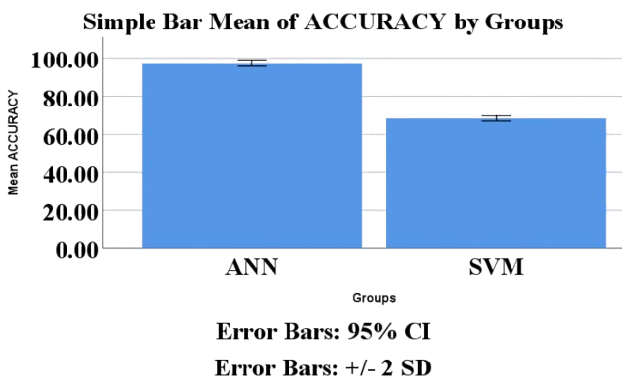
Register No: 192211771
Students Name: Mourya.P
Guided By Ms. Radhika Sethuraman
Hybrid ML Framework For SSD and HDD Using Random Forest Comparing over Gradient Boosting For Improved Accuracy
Hybrid Framework For SSD and HDD performance using Random Forest comparing over XGBoost for Improved Accuracy.
INTRODUCTION
INTRODUCTION
This research aims to analyze and compare the performance characteristics of Solid-State Drives (SSD) and Hard Disk Drives (HDD) using real-world data.
Random Forest and Gradient Boosting are applied to classify drive types and measure predictive accuracy.
Using commodity SSD and HDD drives, we have developed, structured and carefully evaluated GreenDM with some workloads.
It all depends on specific requirement,SSDs is better than HDD.
Disk capacity, benchmark scores, and use samples are real-world measures used in the study to compare the performance of SSDs and. HDDs.
Multiple ML algorithms are compared to highlight how different models interpret the same dataset, revealing strengths and weaknesses.
Random Forest and XG Boosting are applied to classify drive types and measure predictive accuracy.
The system is adaptable, allowing users to tune parameters.
MATERIALS AND METHODS
MATERIALS AND METHODS
ML Model
Evaluation
Training
Set
Learning
Dataset
Acquisition
Dataset
Processing
ML Model
Training
Dataset
(SSD & HDD)
Testing
Set
ML Model
Using Random
Forest
Values
Hyperparameter
Tuning
Feature
engineering
Deployment
Testing
Fig:1 Flowchart Of Random Forest Algorithm
Fig:1 Flowchart Of Random Forest Algorithm
RESULTS
Table.1. Comparison of The Random Forest vs Gradient Boosting.
RESULTS
Table.1. Comparison of The Random Forest vs XG -Boost.
 | Group Statistics
 | Groups | N | Mean | Std. Deviation | Std. Error Mean
Accuracy | R F | 10 | 98.1000 | .73786 | .23333
 | G B | 10 | 97.0000 | .81650 | .25820
 | Group Statistics
 | Groups | N | Mean | Std. Deviation | Std. Error Mean
Accuracy | R F | 10 | 98.1000 | . 73786 | . 23333
 | XGBoost | 10 | 95.1000 | . 87560 | . 27689
Fig:2 Comparison on the accuracy of RF with GB.
Fig:2 Comparison on the accuracy of RF with XGB.
DISCUSSION AND CONCLUSION
DISCUSSION AND CONCLUSION
Based on Independent T-test analysis, the difference in mean accuracy is P=0.001 statistically significant (p < 0.05).
In conclusion, the study demonstrates that Random Forest outperforms the Gradient Boosting algorithm for person detection in restricted zones.
The Mean Value Accuracy of Random Forest is 98.19%
The Mean Value Accuracy of Gradient Boosting is 97.00%
Based on Independent T-test analysis, the difference in mean accuracy is P=0.001 statistically significant (p < 0.05).
In conclusion, the study demonstrates that Random Forest outperforms the XGBoost algorithm for person detection in restricted zones.
The Mean Value Accuracy of Random Forest is 98.1000%
The Mean Value Accuracy of XG Boost is 95.1000%
BIBLIOGRAPHY
BIBLIOGRAPHY
Kumar, A., & Singh, M. (2023). Machine Learning Models for Predicting Storage Performance in SSDs and HDDs. 18(2), 145–159.
Zhao, H., & Liu, F. (2024). Data-Driven Classification of Storage Devices Using Supervised Learning Algorithms. 23(1).
Cheng, Y., & Gupta, R. (2023). Performance Prediction of Storage Devices Using Ensemble Learning Methods. IEEE Transactions on Computers, 72(4), 812–821.
Cheng, Y., & Gupta, R. (2023). Performance Prediction of Storage Devices Using Ensemble Learning Methods. IEEE Transactions on Computers, 72(4), 812–821.
Ramirez, D., & Okafor, T. (2024). Comparing Classification Algorithms for Storage Device Identification Using Hardware Metrics. 229, 120685.
Google Research Team. (2025. ). Storage Performance Dataset: SSD and HDD Comparison Benchmarks. Google AI Blog
Optimization Of SSD And HDD Performance Using XG Boost Comparing Over SVM For Improved Accuracy.
Hybrid Machine Learning Framework For SSD And HDD Using SVM Comparing Over ANN For Improve Accuracy.
INTRODUCTION
INTRODUCTION
This study investigates the performance differences between SSDs and HDDs by analyzing real-world attributes like storage capacity, benchmark performance scores, and usage statistics.
XGBoost and SVM are applied to classify drive types and measure predictive accuracy.
SSD are better for high I/O applications, SSDs work best in a hybrid configuration with HDDs. Compared to HDD, SSD has faster read/writes,supports more IOPs.
The core goal is to examine the functional trade-offs of SSDs and HDDs and determine the most accurate algorithm for making data-driven storage decisions.
Multiple ML algorithms are compared to highlight how different models interpret the same dataset, revealing strengths and weaknesses.
It all depends on specific requirement. The comparison in between SSD and HDD is just to put out the pros and cons. But in my study view, SSDs is better than HDD.
MATERIALS AND METHODS
Significant
Future Scope
MATERIALS AND METHODS
Training Set
SH Group
Training
Set
Learning
Data Set
Non-SH Group
XG Boost
Dataset
(SSD & HDD)
Testing
Set
ML Model
Using SVM
Values
Test Set
Validation
Testing
Fig:1 Flowchart Of XG Boost Algorithm
Fig:1 Flowchart Of SVM Algorithm
RESULTS
Table.1. Comparison of The XG -Boost vs Support Vector Machine.
RESULTS
Table.1. Comparison of The SVM vs ANN
 | Group Statistics
 | Groups | N | Mean | Std. Deviation | Std. Error Mean
Accuracy | XGBoost | 10 | 96.0000 | . 66667 | . 21082
 | SVM | 10 | 68.1000 | . 73786 | . 23333
 | Group Statistics
 | Groups | N | Mean | Std. Deviation | Std. Error Mean
Accuracy | SVM | 10 | 68.1000 | . 73786 | . 23333
 | ANN | 10 | 97.0000 | . 66667 | . 21082
Fig:2 Comparison on the accuracy of XGB with SVM.
Fig:2 Comparison on the accuracy of SVM with ANN.
DISCUSSION AND CONCLUSION
DISCUSSION AND CONCLUSION
Based on Independent T-test analysis, the difference in mean accuracy is P=0.001 statistically significant (p < 0.05).
In conclusion, the study demonstrates that XG Boost outperforms the SVM algorithm for person detection in restricted zones.
The Mean Value Accuracy of XG Boost is 93.19%
The Mean Value Accuracy of SVM is 82.16%
Based on Independent T-test analysis, the difference in mean accuracy is P=0.001 statistically significant (p < 0.05).
In conclusion, the study demonstrates that SVM outperforms the ANN algorithm for person detection in restricted zones.
The Mean Value Accuracy of SVM is 93.19%
The Mean Value Accuracy of ANN is 63.19%
BIBLIOGRAPHY
BIBLIOGRAPHY
Fernandez, M., & Zhou, Y. (2023). Optimizing Storage Decisions Using Machine Learning-Based Classification of SSD and HDD Devices. ACM Journal on Emerging Technologies in Computing Systems, 18(3),
Google Research Team. (2025). Storage Performance Dataset: SSD and HDD Comparison Benchmarks. Google AI Blog.
Lee, J., & Park, K. (2024). A Study on SSD and HDD Performance Trade-offs in Hybrid Storage Systems, 131, 102876..
Patel, R., & Thomas, L. (2023). Comparative Analysis of SSD vs HDD Using benchmark tools and ML Techniques, 184(12), 25–31
Bhattacharya, D., & Rawat, A. (2024). Evaluating SSD Reliability Under Varying Workloads: A Statistical Perspective. Proceedings of the IEEE International Conference on Data Engineering (ICDE), 101–110.
OpenBenchmarking.org Dataset (2025). Phoronix Test Suite: Storage Performance Test Results for SSDs and HDDs.

