Slide 1
HR ATTRITION
DASHBOARD
Project objective
Analyze employee attrition patterns and convert raw HR records into a management-ready decision dashboard.
Power BI analytics project for employee retention insights
Dataset • dashboard design • business findings • retention strategy
Main output: 5-page interactive Power BI report
Prepared by: Mousom Koley

Slide 2
Project Context & Business Problem
Why this HR analytics project is useful
Employee attrition reduces productivity, increases hiring cost, and creates knowledge loss. HR teams need a fast way to identify which employee groups are leaving and why.
The Power BI report converts raw HR records into interactive visuals that show attrition by role, department, age, overtime, satisfaction, work-life balance, and income.
237
16.12%
1,470
35
5
employees left
attrition rate
employee records
CSV attributes
dashboard pages
Target users: HR managers, workforce planning teams, business leaders, and Power BI portfolio reviewers.
HR Attrition Dashboard | Power BI Portfolio Project
02

Slide 3
Dataset Source, Size & Ethics
Public HR attrition dataset used for learning and portfolio presentation
Dataset source
1,470
35
Public HR Employee Attrition CSV dataset, commonly used for analytics practice and portfolio work.
rows / employees
columns in CSV
Privacy position
No direct personal identifiers such as employee names, phone numbers, addresses, or email IDs are used.
1
0
Project perspective
target variable
direct PII fields
This is a realistic HR analytics case study, not confidential data from a private company.
Attribute groups
Demographics: Age, Gender, Marital Status, Education
Work metrics: Department, Job Role, Income, Overtime, Travel
Wellness: Job Satisfaction, Environment Satisfaction, Work-Life Balance
Outcome: Attrition = Yes / No
HR Attrition Dashboard | Power BI Portfolio Project
03

Slide 4
Project Creation Workflow
From CSV file to interactive Power BI dashboard
CSV Dataset
Power Query
Data Model
Visual Design
Insights
Raw employee records
Cleaning and data type checks
KPIs and measures
Cards, charts, navigation
Retention actions
Data preparation
Dashboard redesign
Imported employee records and checked categorical/numeric fields.
Optimized the visual theme, removed unnecessary images, and organized pages by business question.
Measure creation
Insight storytelling
Created KPIs such as employee count, attrition count, attrition rate, average income and hourly rate.
Separated overview, demographics, turnover and wellness analysis for clearer HR decision-making.
HR Attrition Dashboard | Power BI Portfolio Project
04

Slide 5
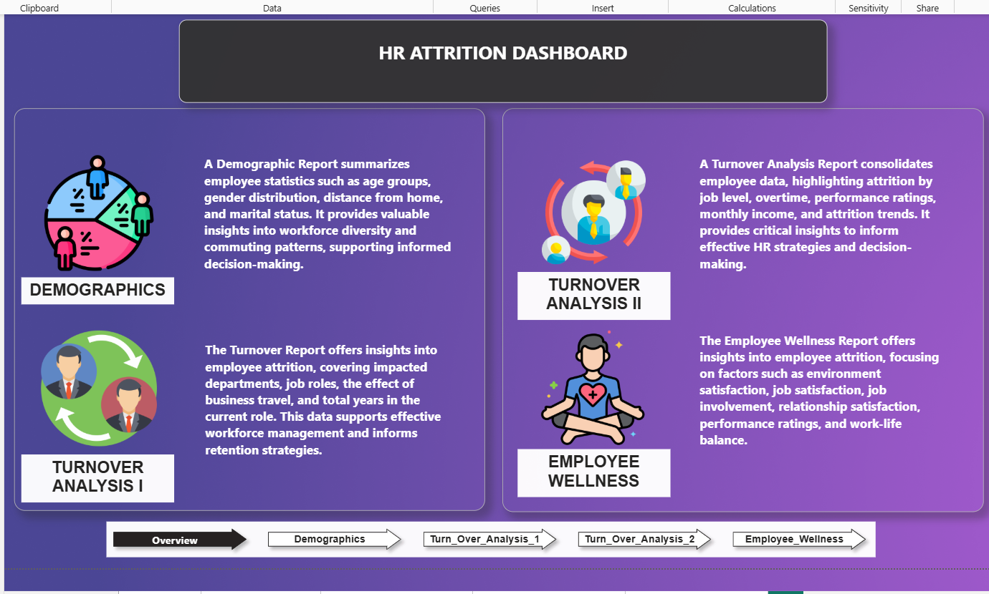
Dashboard Page 1: Overview
Navigation hub and executive context page
What this page explains
Purpose
Introduces the full HR Attrition Dashboard and guides users to detailed analysis pages.
Page structure
Four sections summarize demographics, turnover analysis I, turnover analysis II, and employee wellness.
Design change
Large icons and short descriptions make the report flow easy to understand.
Business value
Entry point for HR managers before detailed attrition driver analysis.
HR Attrition Dashboard | Power BI Portfolio Project
05

Slide 6
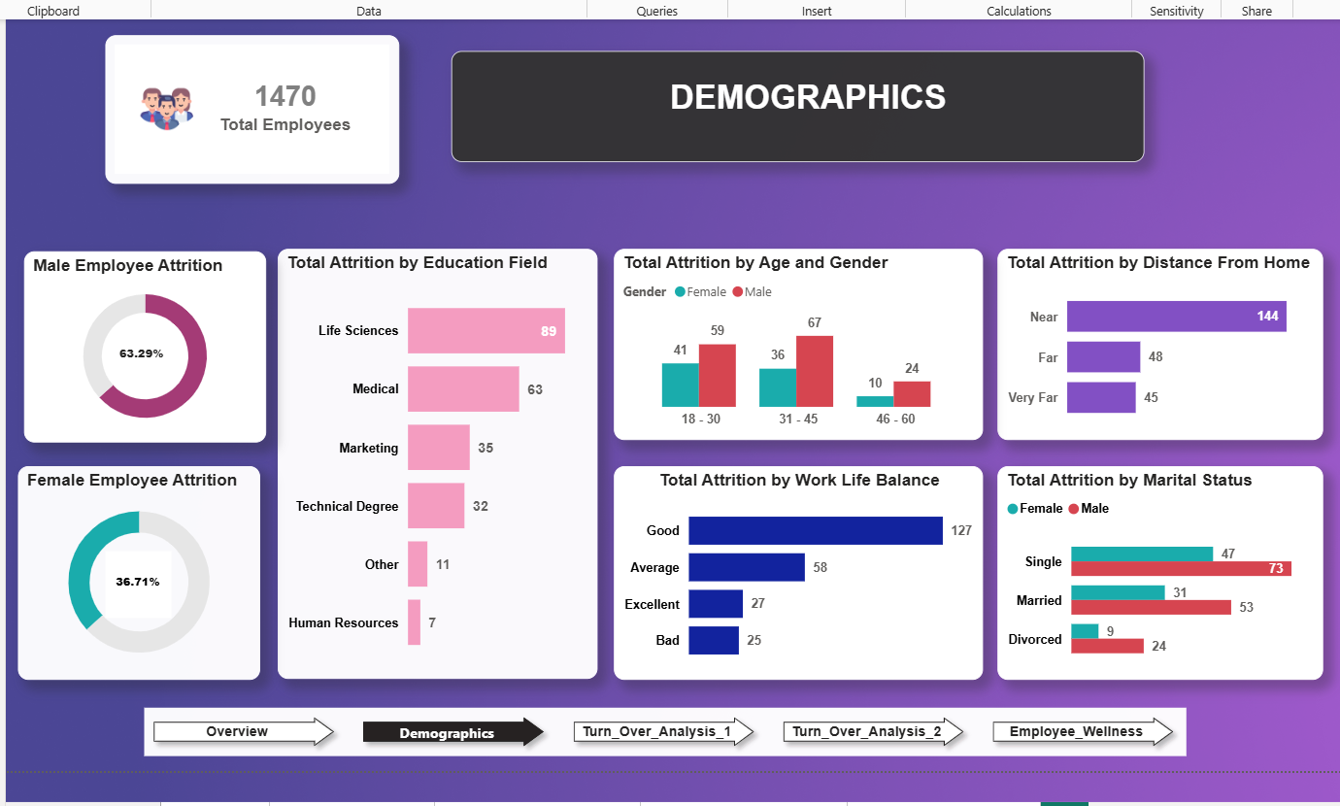
Dashboard Page 2: Demographics
Age, gender, education, distance, marital status and work-life balance
What this page explains
Total employees
Card shows the dataset size: 1,470 employee records analyzed.
Gender attrition
Donut charts split attrition share by male and female employees.
Age & education
Bar charts highlight attrition concentration by age group and education field.
Personal context
Distance from home, marital status, and work-life balance explain demographic risk.
HR Attrition Dashboard | Power BI Portfolio Project
06

Slide 7
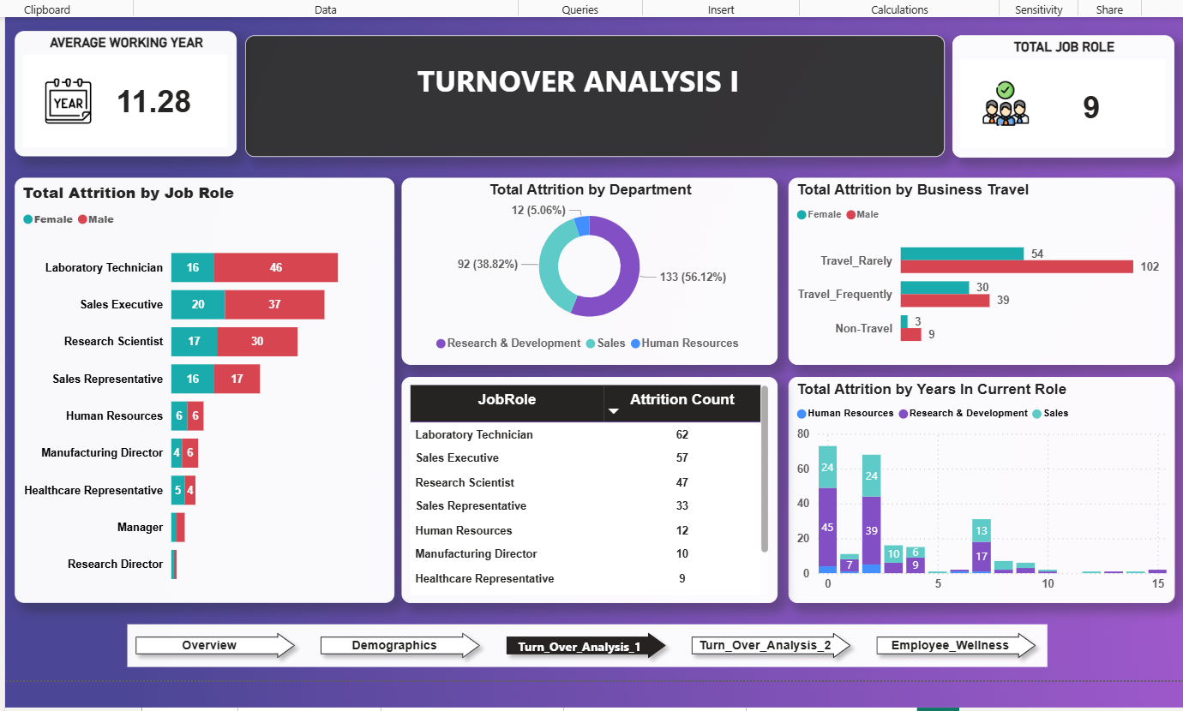
Dashboard Page 3: Turnover Analysis I
Role, department, business travel and years in current role
What this page explains
Job-role risk
Laboratory Technician, Sales Executive and Research Scientist show the highest attrition counts.
Department view
Donut chart compares attrition across Research & Development, Sales and Human Resources.
Travel impact
Business travel chart compares Travel_Rarely, Travel_Frequently and Non-Travel employees.
Tenure signal
Years in current role chart shows when employees are most likely to leave.
HR Attrition Dashboard | Power BI Portfolio Project
07

Slide 8
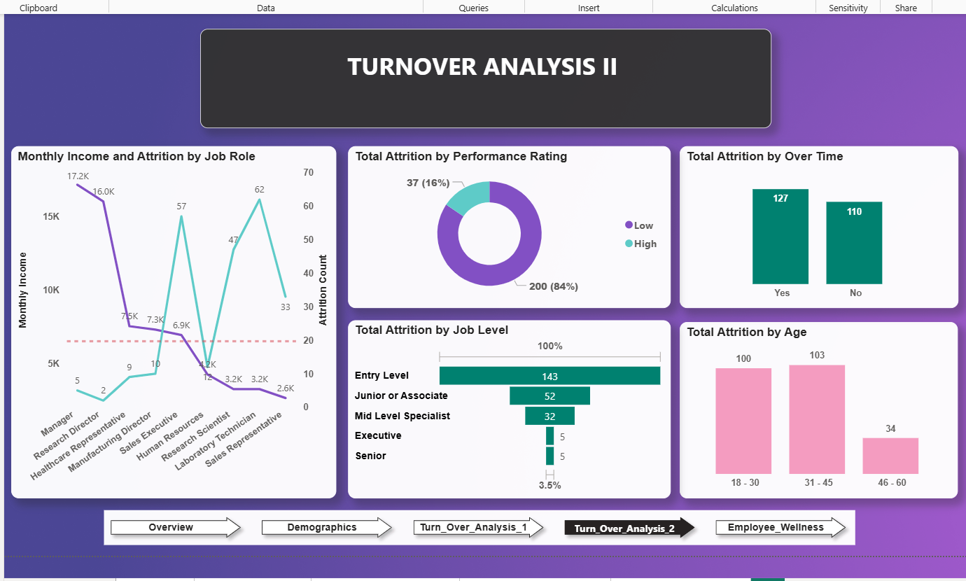
Dashboard Page 4: Turnover Analysis II
Income, performance, overtime, job level and age-based attrition
What this page explains
Income vs attrition
Line chart compares monthly income patterns with attrition count by job role.
Overtime effect
Overtime chart shows attrition count among overtime and non-overtime employees.
Job level
Funnel chart shows entry-level employees have the largest attrition count.
Age trend
18–30 and 31–45 groups are the main attrition-heavy age segments.
HR Attrition Dashboard | Power BI Portfolio Project
08

Slide 9
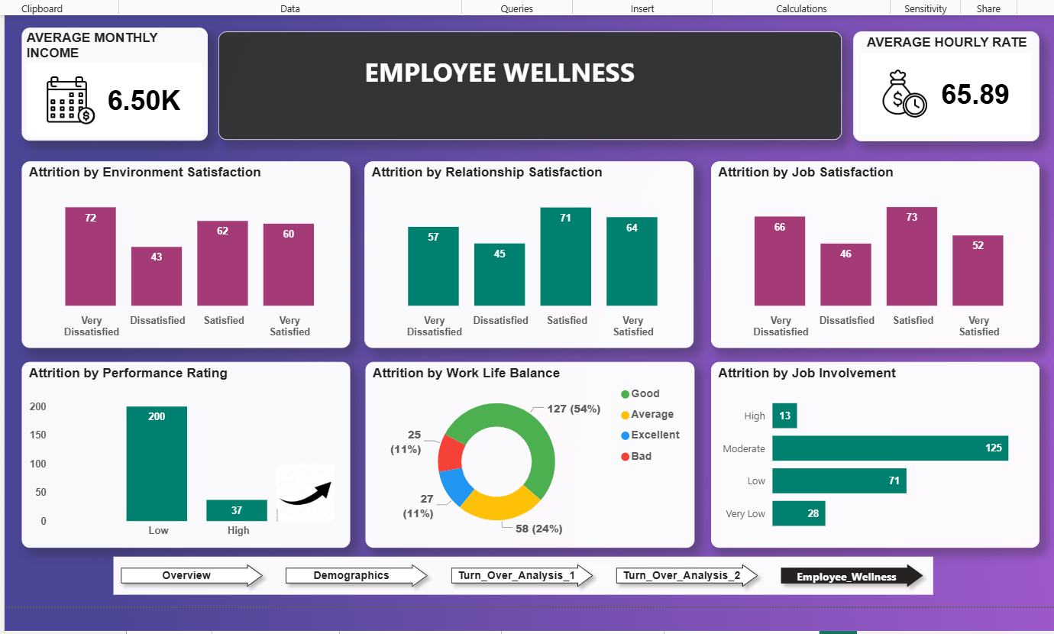
Dashboard Page 5: Employee Wellness
Satisfaction, involvement, performance and work-life balance indicators
What this page explains
Average income/rate
Cards show average monthly income and average hourly rate.
Satisfaction metrics
Charts compare attrition by environment, relationship and job satisfaction.
Performance view
Performance rating chart shows attrition distribution for low vs high groups.
Wellness risk
Work-life balance and job involvement show non-salary reasons behind attrition.
HR Attrition Dashboard | Power BI Portfolio Project
09

Slide 10
Key Results from the Dashboard
Main insights observed from the optimized Power BI report
Attrition is concentrated
237 employees left out of 1,470, giving an attrition rate of about 16.12%.
Specific roles need attention
Laboratory Technician, Sales Executive and Research Scientist show high attrition counts.
Younger and mid-career groups are critical
18–30 and 31–45 age groups contribute most to attrition.
Overtime is a strong warning signal
Employees doing overtime show higher attrition than those not doing overtime.
Wellness factors matter
Low satisfaction, weaker work-life balance and lower job involvement are linked with employee exit risk.
HR Attrition Dashboard | Power BI Portfolio Project
10

Slide 11
Business Recommendations
How HR can use the dashboard findings
Reduce overtime pressure
Strengthen wellness programs
Review teams with high overtime and redesign workload allocation.
Use satisfaction and work-life balance signals for engagement interventions.
Create role-specific retention plans
Monitor monthly
Focus first on Laboratory Technicians, Sales Executives and Research Scientists.
Refresh the dashboard with updated HR data and track whether interventions reduce attrition.
Improve early-career progression
Offer training, mentorship and promotion paths for 18–30 and 31–45 employees.
HR Attrition Dashboard | Power BI Portfolio Project
11

Slide 12
Conclusion & Portfolio Value
What this project demonstrates
Final outcome
GitHub-ready files
An optimized 5-page Power BI dashboard that turns HR attrition data into actionable retention insights. The project demonstrates data importing, transformation, KPI design, chart selection, dashboard navigation and business storytelling.
Recommended repository contents:
• HR_Dashboard.pbix
• HR-Employee-Attrition.csv or .xlsx
• README.md
• Screenshots folder
• Presentation PPTX
• Short project explanation and insights
Project perspective: not just a dashboard design exercise — it is an HR decision-support system for identifying attrition drivers and planning retention strategies.
HR Attrition Dashboard | Power BI Portfolio Project
12

