Slide 1
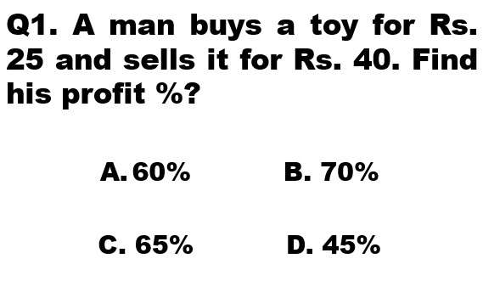

Slide 2
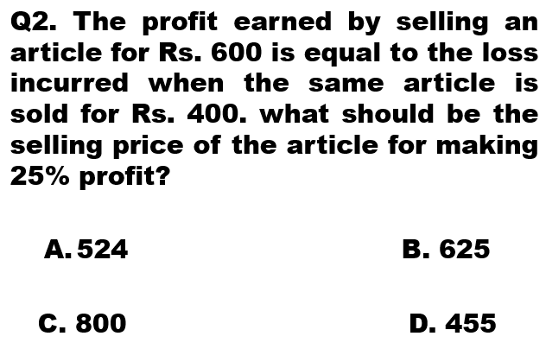

Slide 3
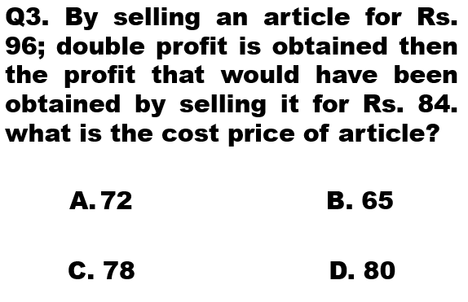

Slide 4
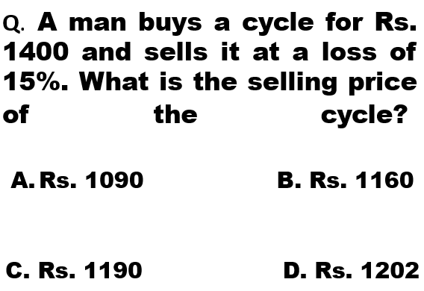

Slide 5
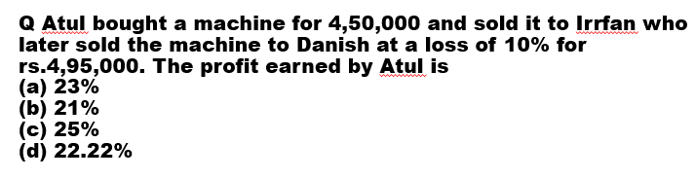

Slide 6
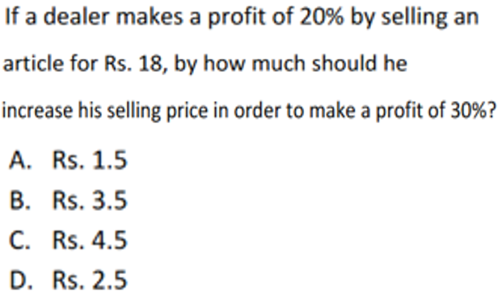

Slide 7

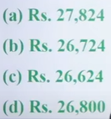

Slide 8
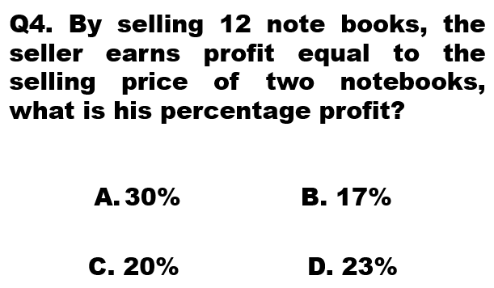

Slide 9
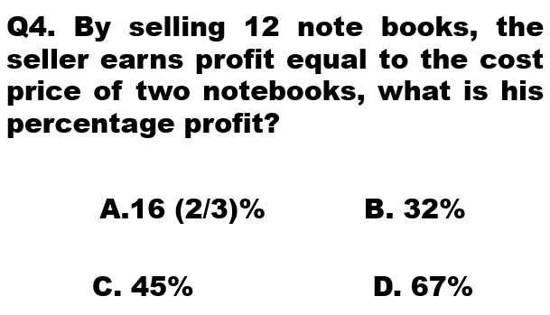

Slide 10
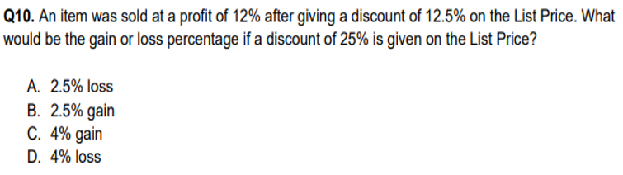

Slide 11
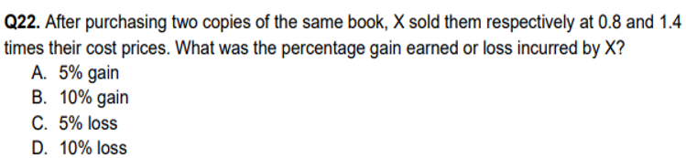

Slide 12
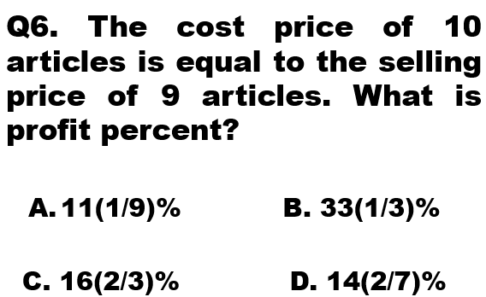

Slide 13
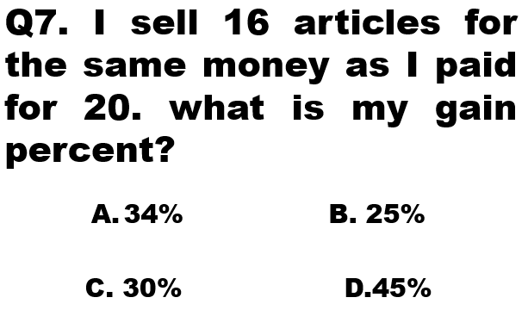

Slide 14
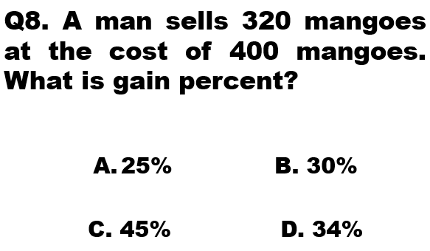

Slide 15
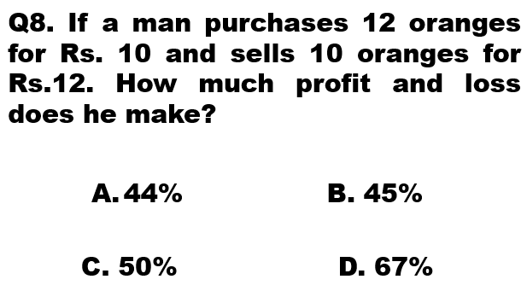

Slide 16
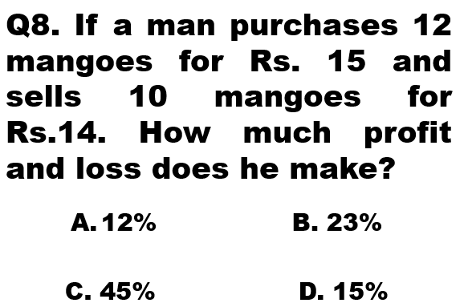

Slide 17
Q8. If a man purchases 12 mangoes for Rs. 15 and sells 10 mangoes for Rs.14. How much profit and loss does he make?
12% B. 23%
C. 45% D. 15%

Slide 18
Q9. A man buys 10 articles for Rs. 8 and sells them at the rate of Rs. 1.25 per article. What is his gain percent?
55% B. 56.25%
C. 60% D. 35%

Slide 19
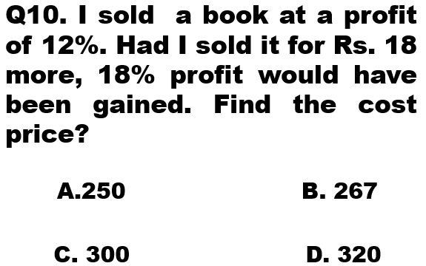

Slide 20
Q10. I sold a book at a profit of 12%. Had I sold it for Rs. 18 more, 18% profit would have been gained. Find the cost price?
A.250 B. 267
C. 300 D. 320

Slide 21
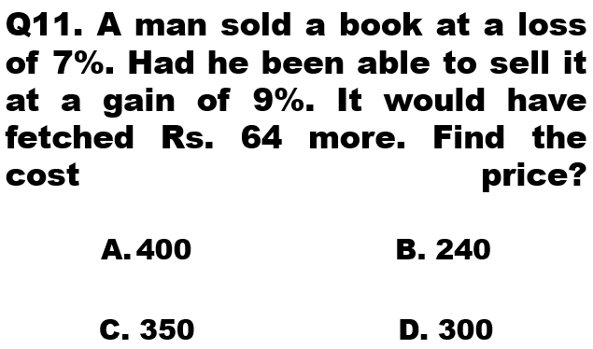

Slide 22
Q11. A man sold a book at a loss of 7%. Had he been able to sell it at a gain of 9%. It would have fetched Rs. 64 more. Find the cost price?
400 B. 240
C. 350 D. 300

Slide 23
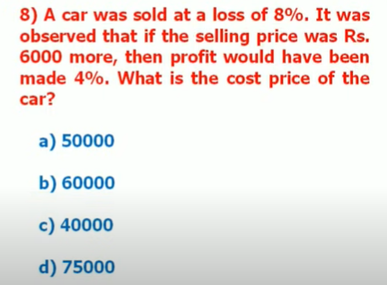

Slide 24
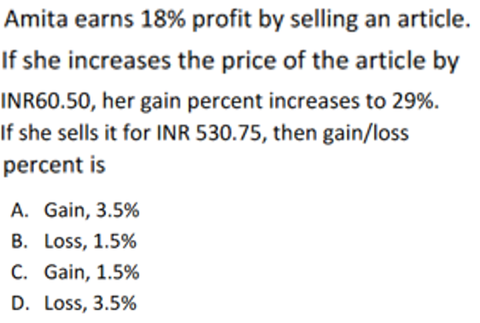

Slide 25


Slide 26
Q12. A man had to sell wheat at a loss of 10%. If he increases the price by Rs. 5/ Kg, he would make a profit of 20%. Find the cost price per Kg of the wheat?
A. Rs.16(2/3)/Kg B. Rs15/Kg
C. Rs. 18/Kg D. Rs. 22/Kg

Slide 27
Q. You buy 10 apples for Rs. 300 and 12 oranges for Rs. 60. You sell the apples for Rs. 350 and the oranges for Rs. 55. What percentage net profit or loss did you make in the entire transaction?
A. 45 B. 12.5
C. 8.33 D. 20

Slide 28
Q. A person bought two watch for Rs. 480.He sold one at a loss of 15% and the other at a gain of 19% and he found that each watch was sold at the same price. Find the cost price of the watch sold at a loss of 15%?
A. 280 B. 245
C. 300 D. 423

Slide 29
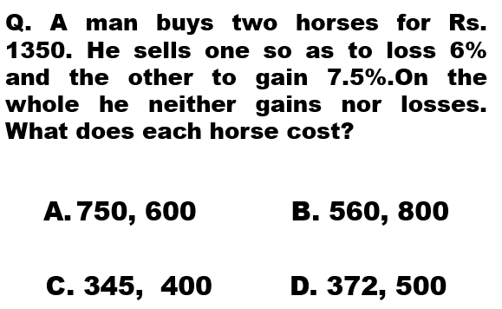

Slide 30
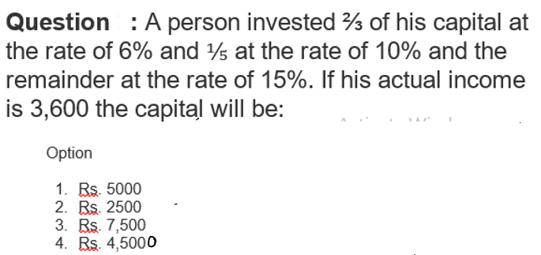

Slide 31


Slide 32
Q. A man buys two horses for Rs. 1350. He sells one so as to loss 6% and the other to gain 7.5%.On the whole he neither gains nor losses. What does each horse cost?
750, 600 B. 560, 800
C. 345, 400 D. 372, 500

