Slide 1

AutoML - Automating Machine Learning /Deep Learning tasks & phases

Slide 2

Why AutoML…?
Today the success of Machine Learning techniques in a wide range of applications.
AutoML is fundamentally changing the face of ML-based solutions today by enabling people from diverse backgrounds to use machine learning models to address complex scenarios.
There is a shortage of experienced and seasoned data scientists in the industry.
The demand for machine learning experts has outpaced the supply.
A lot of machine learning steps require more experience than knowledge, especially when deciding which models to train and how to evaluate them.
Automated Machine learning may be an answer to such impediments.

Slide 3
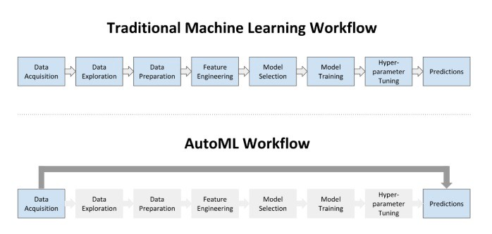
Traditional ML Vs AutoML

Slide 4
What is AutoML?
Automated machine learning (AutoML) is the process of automating the end-to-end process of applying machine learning to real-world problems.
AutoML tends to automate the maximum number of steps in an ML pipeline — with a minimum amount of human effort — without compromising the model’s performance.
Automated machine learning can be thought of as the standard machine learning process with the automation of some of the steps involved

Slide 5
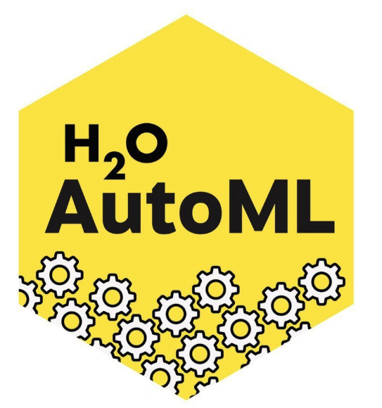
Introduction to H2O’s AutoML:-
H2O is a fully open-source, distributed in-memory machine learning platform with linear scalability.
H2O supports the most widely used statistical & machine learning algorithms, including gradient boosted machines, generalized linear models, deep learning, and many more.
Features of H2O AutoML
Open-source, distributed (multi-core + multi-node) implementations of cutting edge ML algorithms.
Availability of core algorithms in high-performance Java. including APIs in R, Python, Scala, web GUI.
Easily deployable models to production as pure Java code.
Seamlessly works on Hadoop, Spark, AWS, your laptop, etc.

Slide 6
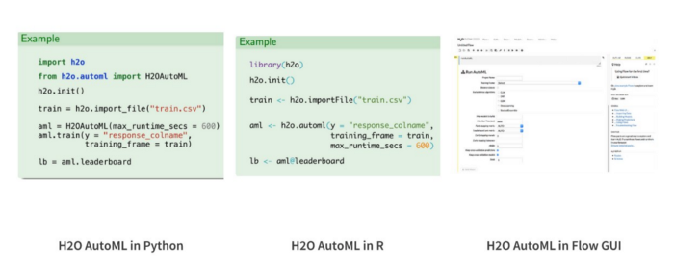
AutoML Interface
H2O AutoML has an R and Python interface along with a web GUI called Flow
The H2O AutoML interface is designed to have as few parameters as possible so that all the user needs to do is to point to their dataset, identify the response column and optionally specify a time constraint or limit on the number of total models trained.
H2O AutoML is available in R, Python, and a web GUI.

Slide 7
H2O AutoML used Case

