Slide 1
Symmetric-Key Encrypted Message with Digital Signature
Matthew Williams and Adriana Miller

Slide 2
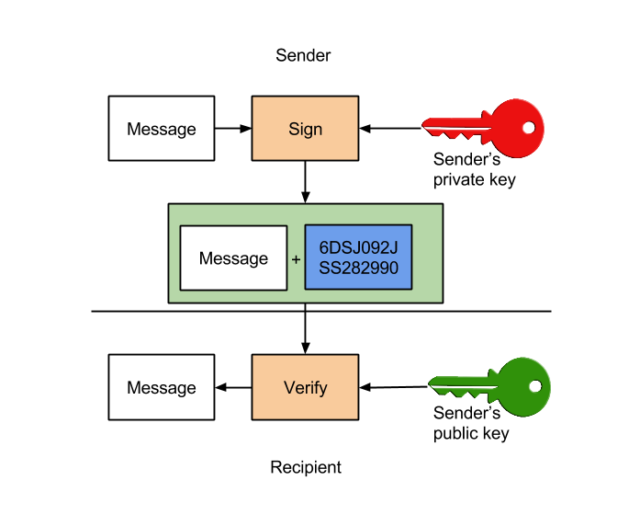
Symmetric-Key Encrypted Message with Digital Signature
Necessary keys:
X is sender with private key Kx-
Encryption:
Calculate: AES-EnKXY(RSA-EnKx-(SHA256(M)||M)
Y is receiver using public key Kx+:
Decryption:
Calculate: AES-DeKXY(

Slide 3
Key Generator File:
Class KeyGen:
Creates a scanner to read user inputs
Public static main: Generate keys
KeyPair: Class to create an asymmetric key pair (public and private)
KeyFactory.getInstance("RSA"): Returns object to convert receiver and sender’s public/private keys for RSA algorithm (RSA = asymmetric encryption algorithm)
The algorithm then saves the key parameters to files (where x is the sender and Y is the receiver) . Throw invalid key spec exception if specification is incorrect.
private static KeyPair genRSAKeys(): Generates and returns a pair of keys
SecureRandom: Generate strong random number for RSA key pair creation
generator.initialize(1024, random): key size = 124 bits (RSA is plaintext block). The size needs to be <=117 bytes, the cipher text block will always be 128 bytes/1024 bits

Slide 4
Key Generator File Part 2:
public static void saveToFile: Save public/private key parameter to key file (Mod then exponent) using ObjectOutputStream oOutStream
public static void saveToFile: Save RSAPublicKeySpec parameters for public and private strings to a file using .getModulus(); and getPublicExponent;
private static void genSymmetricKey(): Get symmetric key from user’s 16 character string input and writes it to a file. If the string is less than or greater than 16 characters, ask user to re-enter new string.
Uses byte[] symKey: Writes the keys to transform string input to UTF_8 format
Uses BufferedOutputStream symKeyFile: Writes converted AES key to file

Slide 5
Sender.java File:
public static void main: Copy/load key files from KeyGen.java (xPublicK, xPrivateK, yPublicK, yPrivateK)
private static void loadMessage(): Ask user to input the name of the message file to be encrypted and read each line of the message using String msgFileName = sysIn.nextLine();
private static PublicKey readPubKeyFromFile(): Read modulus and exponent from file using BigInteger m and e
private static byte[] loadSymmetricKey(): Load symmetric key (16 bytes) from the user input and write it to a file ASDFQWERTYPRfVIB

