Slide 1


CS 149: Operating Systems
February 3 Class Meeting
Department of Computer Science
San Jose State University
Spring 2015
Instructor: Ron Mak
www.cs.sjsu.edu/~mak

Slide 2
Processes
A process is basically an
abstraction of a running program.
The most central concept
in any operating system.
Each process runs in its own address space.
_

Slide 3

Context Switching
A process’s state
information is kept
in its process control
block (PCB).
Operating Systems: Design and Implementation, 3rd ed.
Andrew Tanenbaum & Albert Woodhull
(c) 2006 Prentice-Hall, Inc. 0-13-142938-8

Slide 4
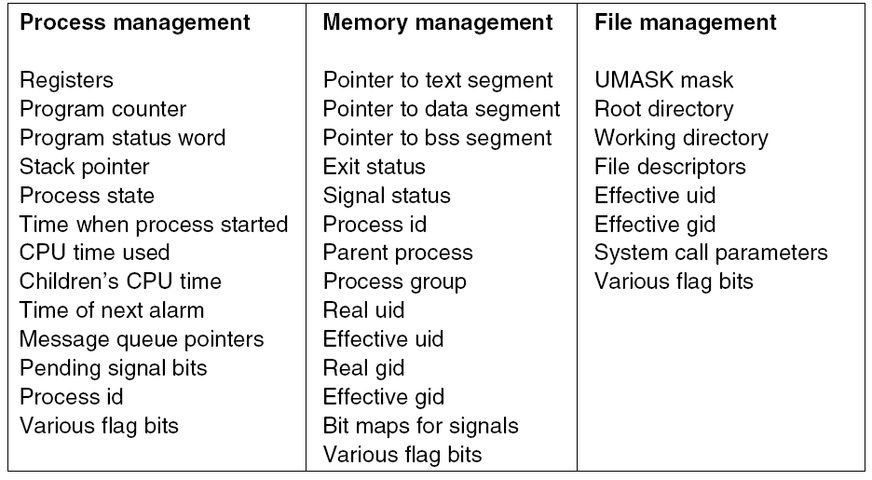
Contents of a Process Control Block (PCB)
Operating Systems: Design and Implementation
Tanenbaum & Woodhull
(c) 2006 Prentice-Hall, Inc. All rights reserved. 0-13-142938-8

Slide 5
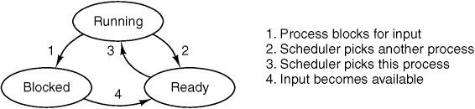
Process States
Running
  Actually using the CPU at that instant.
Ready
  Runnable, but temporarily stopped to let another process run.
Blocked
  Unable to run until some external event happens.
Operating Systems: Design and Implementation, 3rd ed.
Andrew Tanenbaum & Albert Woodhull
(c) 2006 Prentice-Hall, Inc. 0-13-142938-8

Slide 6
Process Scheduler
Transitions 2 and 3 are caused by the
process scheduler.
  A part of the operating system.
  A process does not know about the transitions.
Transition 2 can happen at the end of a time slice.
Transition 3 can happen when it’s the process’s turn again to run.

Slide 7
Process Scheduling Goals
The process scheduler decides which process can run, i.e., which process can have the CPU.
The goal is to keep all parts of the
computer system as busy as possible.
Which scheduling algorithm to use depends on
  The type of system
  How it’s used
  What policies are in place

Slide 8
Process Behavior
A process may be:
  Computing: using the CPU
  Performing I/O
A compute-bound process spends most of its time computing.
  Long CPU bursts and infrequent I/O waits.
An I/O-bound process spends most of its time waiting for I/O operations to complete.
  Long I/O waits punctuated by short CPU bursts.

Slide 9
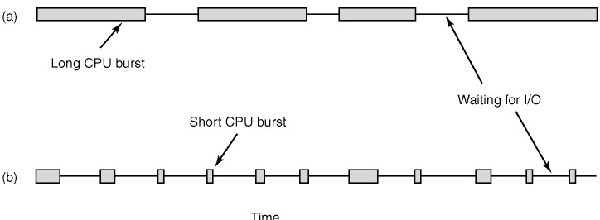
Process Behavior, cont’d
As CPUs become faster relative to disks:
  Programs are becoming more I/O bound.
  Scheduling I/O-bound processes
  becomes more important.
Operating Systems: Design and Implementation
Tanenbaum & Woodhull
(c) 2006 Prentice-Hall, Inc. All rights reserved. 0-13-142938-8

Slide 10

Process Behavior, cont’d
Histogram of CPU burst durations.
  CPU-bound process: A few long bursts.
  I/O bound process: Many short bursts.
Silberschatz, Galvin, and Gagne
Operating Systems Concepts with Java, 8th edition
(c) 2010 John Wiley & Sons. All rights reserved. 0-13-142938-8

Slide 11
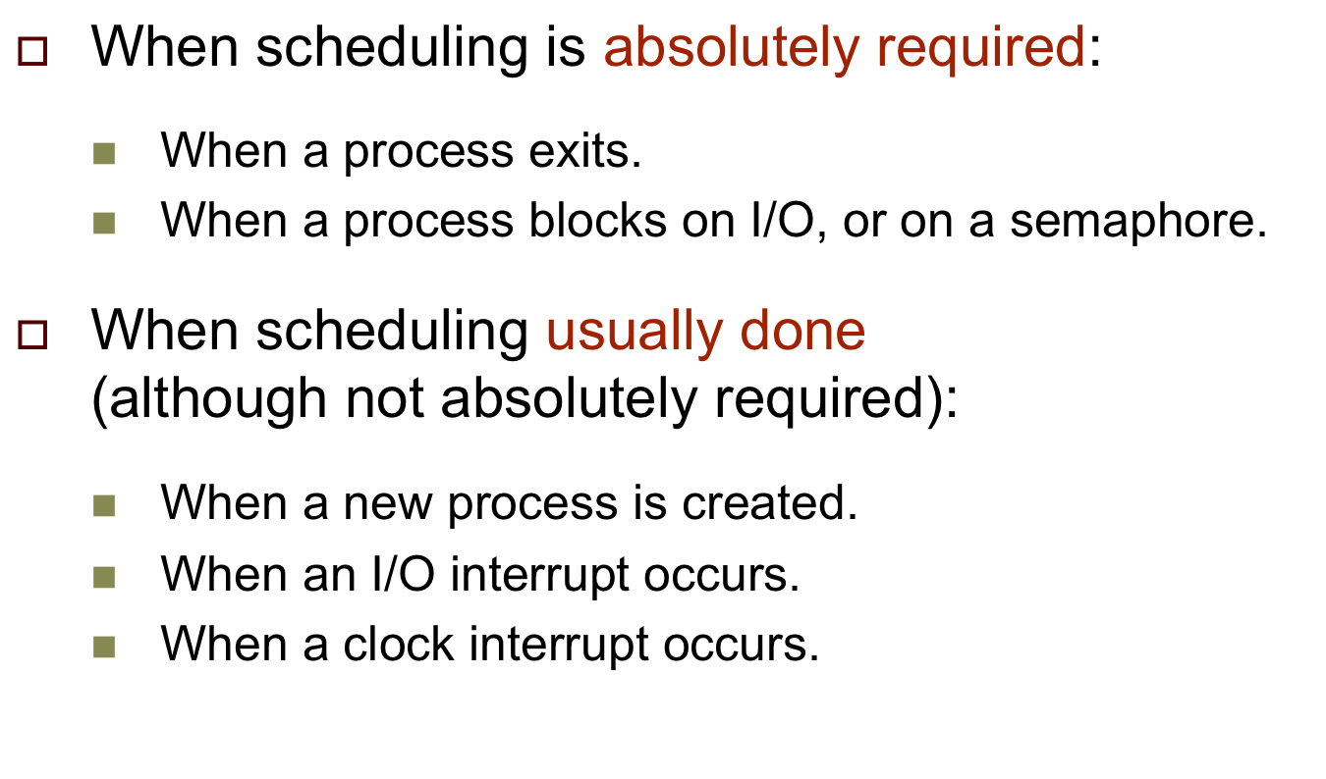
When to Schedule

Slide 12
Types of Scheduling Algorithms
Preemptive
  Each process is assigned a time interval to run,
  called the quantum or time slice.
  At the end of a process’s time quantum,
  the scheduler suspends the process and
  schedules another process to run.
Non-preemptive
  The scheduler allows a process to run until it blocks:
    Waiting for I/O.
    Waiting for another process.
  The process voluntarily releases the CPU.

Slide 13
Scheduling Criteria
CPU utilization
  Keep the CPU as busy as possible.
Throughput
  Number of processes that complete their execution
  per time unit.
Turnaround time
  The amount of elapsed time from when a process
  enters the ready queue to when it completes execution.

Slide 14
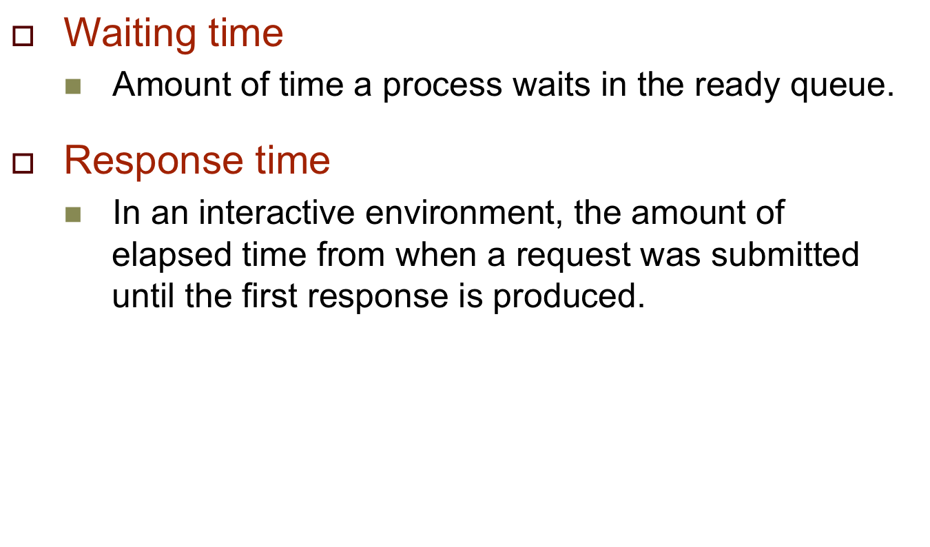
Scheduling Criteria, cont’d

Slide 15
Scheduling Criteria, cont’d
Proportionality
  “Simple” tasks (as perceived by human users)
  should take little time.
  “Complex” tasks can take longer time.

Slide 16
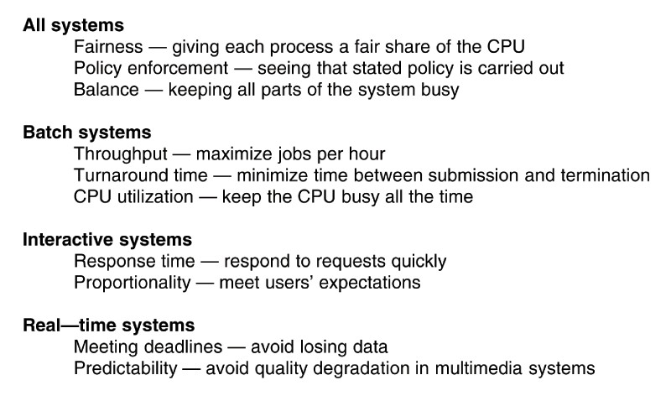
Scheduling Goals
Operating Systems: Design and Implementation
Tanenbaum & Woodhull
(c) 2006 Prentice-Hall, Inc. All rights reserved. 0-13-142938-8

Slide 17
First-Come First-Served (FCFS)
Process Burst Time
P₁ 24
P₂ 3
P₃ 3
Suppose that the processes arrive in the order:
P₁ , P₂ , P₃ .
The timeline for the schedule is:
Waiting time for P₁ = 0; P₂ = 24; P₃ = 27
Average waiting time: (0 + 24 + 27)/3 = 17
P₁
P₂
P₃
0
24
27
30
Operating Systems Concepts with Java, 8th edition
Silberschatz, Galvin, and Gagne
(c) 2010 John Wiley & Sons. All rights reserved. 0-13-142938-8

Slide 18
Shortest Job First (SJF)
Now suppose that the processes arrive in the order:
P₂ , P₃ , P₁
The timeline for the schedule is:
Waiting time for P₁ = 6; P₂ = 0; P₃ = 3
Average waiting time: (6 + 0 + 3)/3 = 3
Much better than previous case.
Schedule short processes ahead of long processes.
Process Burst Time
P1 24
P2 3
P3 3
P₂
P₃
P₁
0
3
6
30
Operating Systems Concepts with Java, 8th edition
Silberschatz, Galvin, and Gagne
(c) 2010 John Wiley & Sons. All rights reserved. 0-13-142938-8
Operating Systems Concepts with Java, 8th edition
Silberschatz, Galvin, and Gagne
(c) 2010 John Wiley & Sons. All rights reserved. 0-13-142938-8

Slide 19
Shortest Job First (SJF), cont’d
Shortest Job First (SJF) gives the
optimal average waiting time
for a given set of processes.
How can you know in advance
each process’s expected run time?
  It’s possible if you run the same jobs frequently.

Slide 20
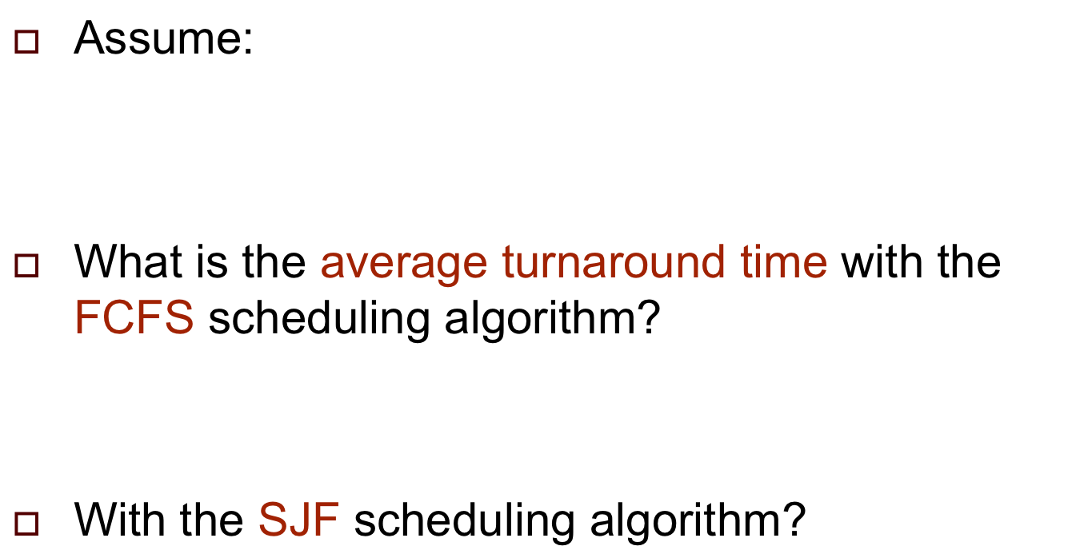
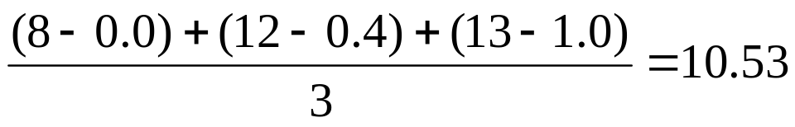
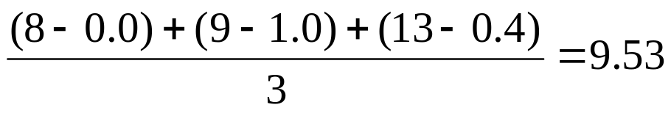
Practice Problem #1
Process | Arrival Time | Burst Time
P1 | 0.0 | 8
P2 | 0.4 | 4
P3 | 1.0 | 1
P1 P2 P3
P1 P3 P2

Slide 21
Shortest Remaining Time (SRT)
When a new job (process) arrives, its expected run time is compared to the expected remaining run time of the currently executing process.
If the new job needs less time to finish
than the current process, the scheduler
suspends the current process
and starts the new job.
New short jobs get good service.
As with Shortest Job First, you must know
in advance each process’s expected run time.

Slide 22
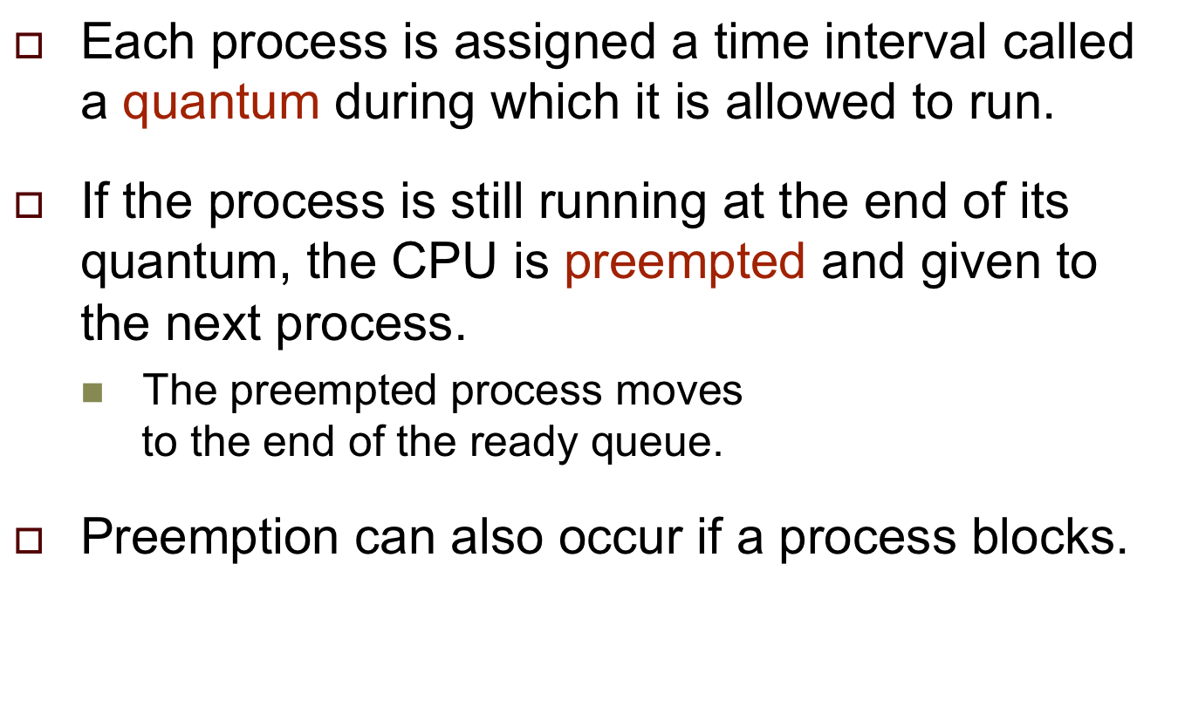
Round Robin (RR)

Slide 23
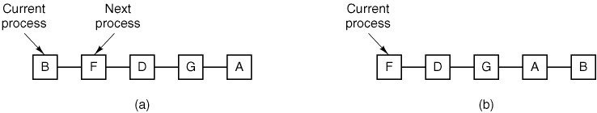
Round Robin (RR), cont’d
Operating Systems: Design and Implementation
Tanenbaum & Woodhull
(c) 2006 Prentice-Hall, Inc. All rights reserved. 0-13-142938-8

Slide 24
Round Robin (RR), cont’d
Round Robin example with time quantum 4:
Process Burst Time
P₁ 24
P₂ 3
P₃ 3
The timeline is:
Typically, higher average turnaround
than SJF, but with better response time.
P₁
P₂
P₃
P₁
P₁
P₁
P₁
P₁
0
4
7
10
14
18
22
26
30
Operating Systems Concepts with Java, 8th edition
Silberschatz, Galvin, and Gagne
(c) 2010 John Wiley & Sons. All rights reserved. 0-13-142938-8

Slide 25

Time Quantum vs. Context Switch Time
A smaller time quantum increases the number
of processor switches.
  Recall each context switch takes time.
Operating Systems Concepts with Java, 8th edition
Silberschatz, Galvin, and Gagne
(c) 2010 John Wiley & Sons. All rights reserved. 0-13-142938-8

Slide 26
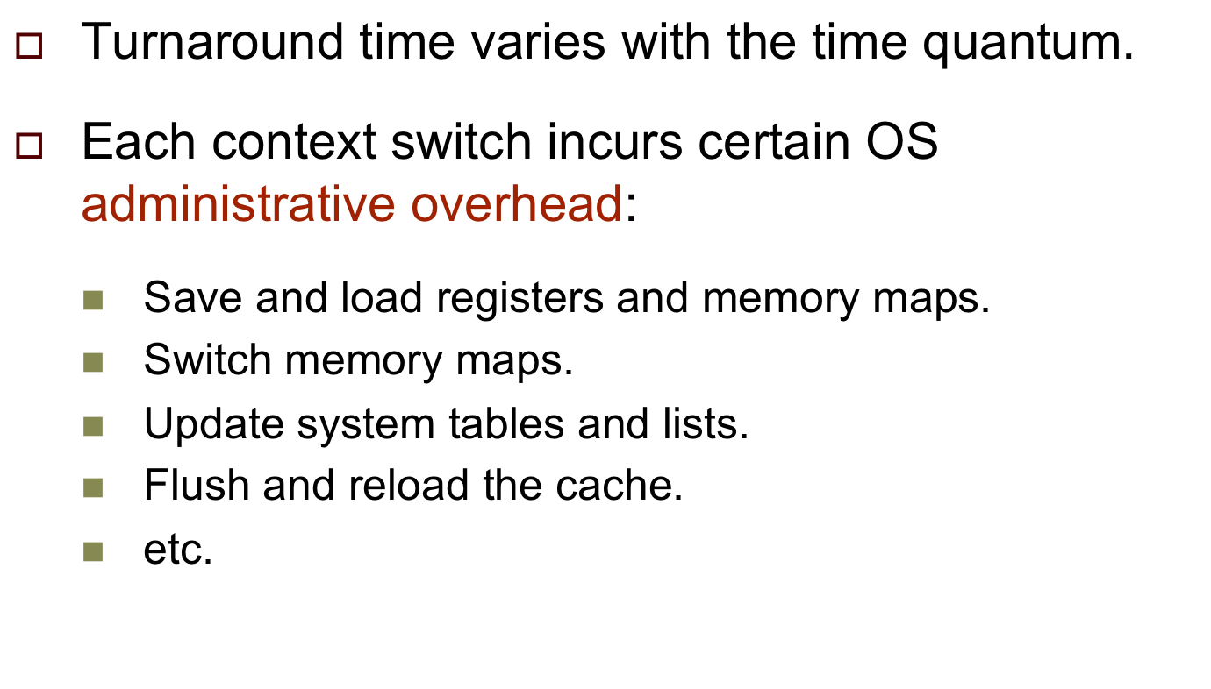
Scheduling Interactive Systems

Slide 27
Scheduling Interactive Systems, cont’d
Increasing the time quantum
can increase response time.
Example with 100 msec quantum:
  10 users press carriage return simultaneously.
  The last user has to wait 1 second for a response

Slide 28

Highest Priority First (HPF)
Operating Systems Concepts with Java, 8th edition
Silberschatz, Galvin, and Gagne
(c) 2010 John Wiley & Sons. All rights reserved. 0-13-142938-8

Slide 29
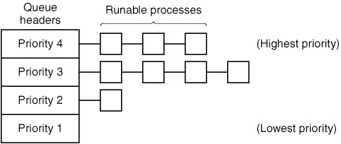
Highest Priority First (HPF), cont’d
HPF scheduling with four priority classes:
Use Round Robin scheduling
within each priority class.
Operating Systems: Design and Implementation
Tanenbaum & Woodhull
(c) 2006 Prentice-Hall, Inc. All rights reserved. 0-13-142938-8

Slide 30
Highest Priority First (HPF), cont’d
A serious problem with HPF is starvation.
  The lowest priority processes
  may never get to execute.
A solution is aging.
  As time progresses, the process scheduler
  automatically raises the process’s priority.
HPF can be preemptive.
  A higher priority task that’s arriving can preempt
  a currently executing process with a lower priority.

Slide 31
Practice Problem #2
Assume:
Draw timelines for the scheduling algorithms
FCFS, SJF, HPF (nonpreemptive), and RR.
What is the turnaround time of each process for each
of these scheduling algorithms?
What is the total waiting time for each process for each
of these scheduling algorithms?
Which of these scheduling algorithms results in the
minimum average waiting time over all the processes?
Process | Burst Time | Priority
P1 | 10 | 3
P2 | 1 | 1
P3 | 2 | 3
P4 | 1 | 4
P5 | 5 | 2
All arrived at time 0 in the
order P1, P2, P3, P4, P5.
Highest priority = 1
Time quantum = 1

Slide 32
Practice Problem #2
Timelines:
 | 1 | 2 | 3 | 4 | 5 | 6 | 7 | 8 | 9 | 10 | 11 | 12 | 13 | 14 | 15 | 16 | 17 | 18 | 19
FCFS | P1 | P1 | P1 | P1 | P1 | P1 | P1 | P1 | P1 | P1 | P2 | P3 | P3 | P4 | P5 | P5 | P5 | P5 | P5
SJF | P2 | P4 | P3 | P3 | P5 | P5 | P5 | P5 | P5 | P1 | P1 | P1 | P1 | P1 | P1 | P1 | P1 | P1 | P1
HPF | P2 | P5 | P5 | P5 | P5 | P5 | P1 | P1 | P1 | P1 | P1 | P1 | P1 | P1 | P1 | P1 | P3 | P3 | P4
RR | P1 | P2 | P3 | P4 | P5 | P1 | P3 | P5 | P1 | P5 | P1 | P5 | P1 | P5 | P1 | P1 | P1 | P1 | P1
Turnaround times:
 | P1 | P2 | P3 | P4 | P5
FCFS | 10 | 11 | 13 | 14 | 19
SJF | 19 | 1 | 4 | 2 | 9
HPF | 16 | 1 | 18 | 19 | 6
RR | 19 | 2 | 7 | 4 | 14

