Slide 1
Redux
Redux is a predictable state container.

Slide 2

Pros For Redux
Transparent state
Know why the DOM changed
Instantly change state of the app
Removes nested prop passing
Shared state is less complex
Time Travel

Slide 3

Cons For Redux
More Complexity
More Boiler Plate
More things for the team to learn
More time to get something up and running

Slide 4

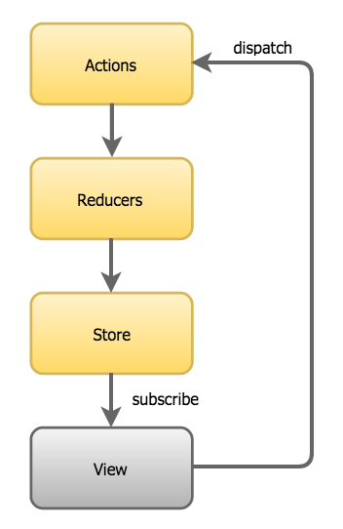
How does Redux work?
Three Main Parts
  Store
  Actions
  Reducers

Slide 5

Store
Holds application state
Immutable but replaceable
Triggers changes in the view

Slide 6

Actions
Just an Object
Represents a state change

Slide 7
What touches an action
Is passed to dispatch
Reducer will know what to
do with the action
Action gets created by an
action creator
ASync code usually comes back with an action object to dispatch

Slide 8

Reducers
Must be a pure functions
Takes in an action
Replace don’t alter state
Only place store is changed
Usually consists switch statement looking for a specific action

Slide 9
Questions?

