Slide 1
Belgium Business Registry Analyses
Juillet 2025

Slide 2
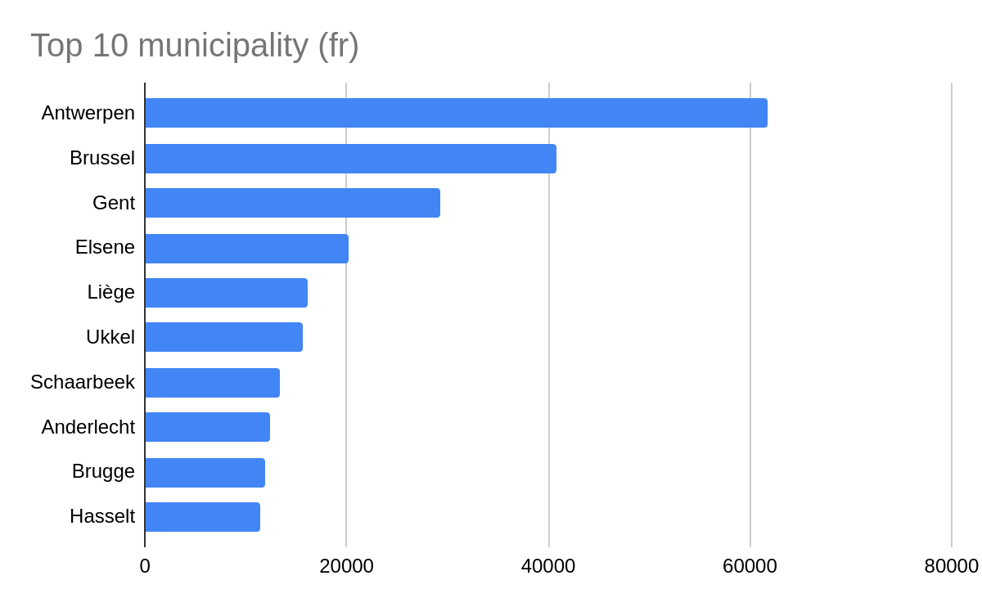
Top 10 municipality with most entities

Slide 3
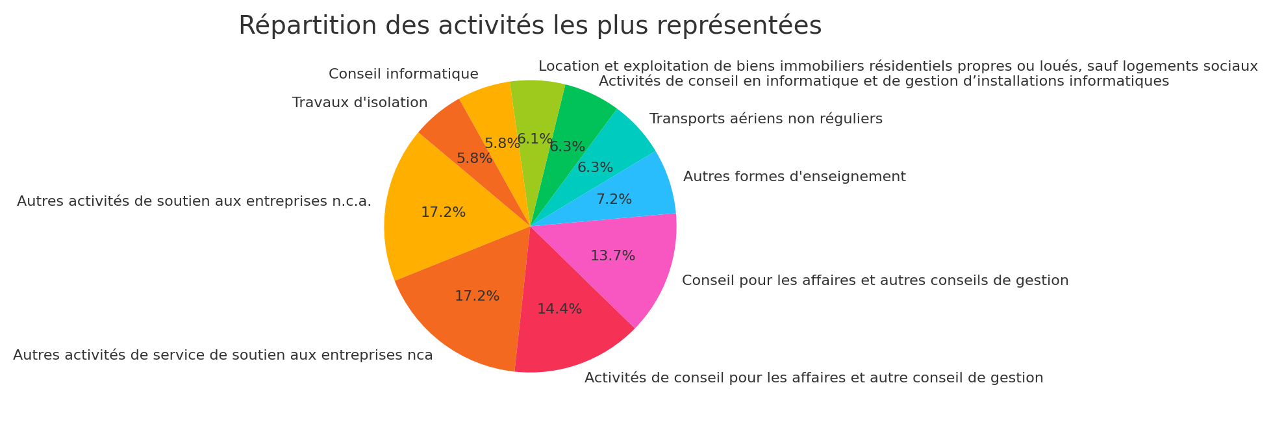
Distribution of the most represented activities (in %)

