Slide 1
Tableau Project
THIS COMPLETE PROJECT IS ABOUT THE BIKE SALES IN EUROPE AND USING THIS DATA, CAME UP WITH THE VALUEABLE INSIGHTS IN A DASHBOARD.
THIS COMPLETE DATA SET HAS 21 COLUMNS AND TOTAL 51290 ROWS
AND THE FIELDS OR TERMS WHICH THIS DATASET HAS ARE AS FOLLOWS:
order_id, order_date, ship_date, ship_mode, customer_name segment, state, country, market, region, product_id, category, sub_category, product_name, sales, quantity, discount, profit ,shipping_cost, order_priority, year.

Slide 2
PROBLEM STATEMENTS
SALES PER SEGMENT
MARKET VS PROFIT
SHIPPING PER REGION
SALES VS PROFIT

Slide 3
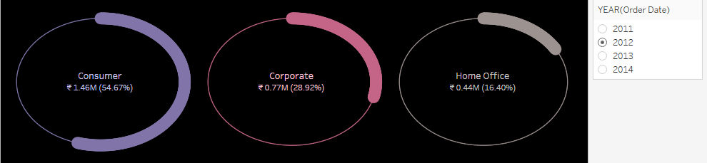
SALES PER SEGMENT

Slide 4
Sales per segment
INSIGHT:
EVERY YEAR SALES WAS FLUCTUATING FOR ALL THREE SEGMENTS.
STAKEHOLDER NEED TO CHOOSE THE YEAR WHICH FOR THEY WANT TO
SEE THE DETAILS.
AS THIS IS DYNAIC DASHBOARD.

Slide 5
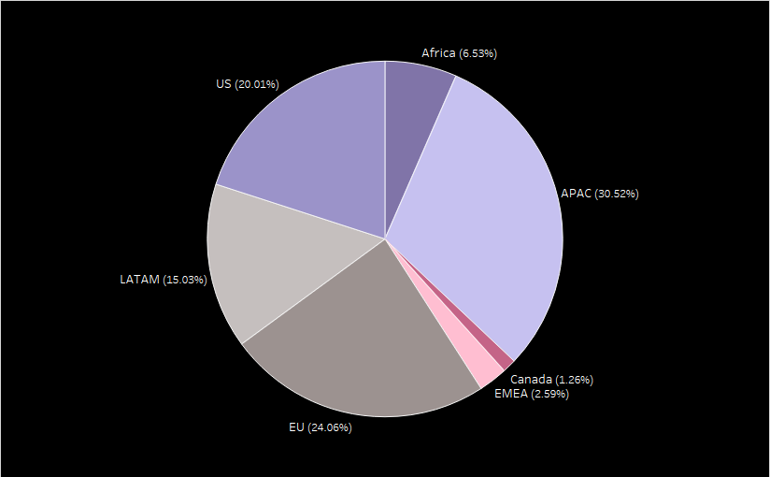
MARKET VS PROFIT

Slide 6
MARKET VS PROFIT
INSIGHT:
OVERHERE, THERE ARE 7 COUNTRIES & WITH THE HELP OF PIE CHART WE ARE MEASURING FROM WHICH COUNTRY WE ARE GETTING HOW MUCH PROFIT .
SINCE THIS DASHBOARD IS DYNAMIC WE CAN VIEW MARKET SIZE BASED ON PROFIT FOR ALL YEAR.

Slide 7
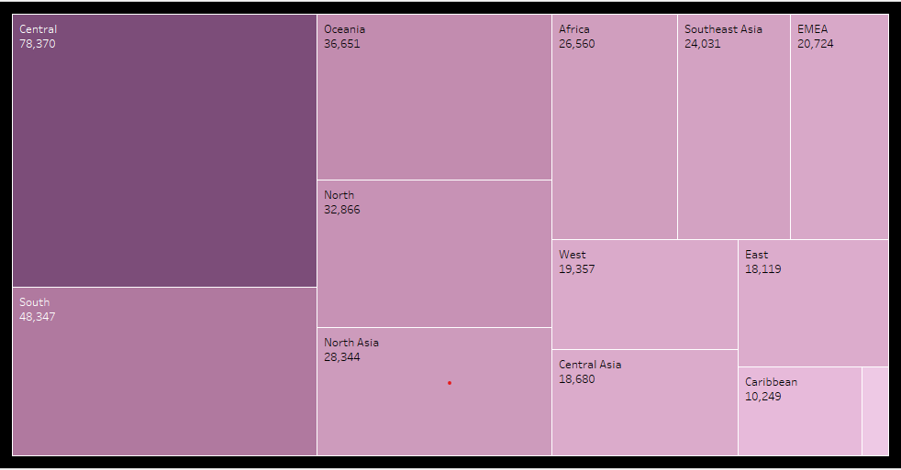
SHIPPING PER REGION

Slide 8
SHIPPING PER REGION
INSIGHTS:
IN THIS DATA VISULAIZATION , IN TOTAL THERE ARE 12 REGION FOR WHICH WE ARE MEASURING THE SHIPPING COST.
WE CAN VIEW THE SHIPPING COST OF ALL YEAR SINCE IT’S A DYNAMIC DASHBOARD.

Slide 9
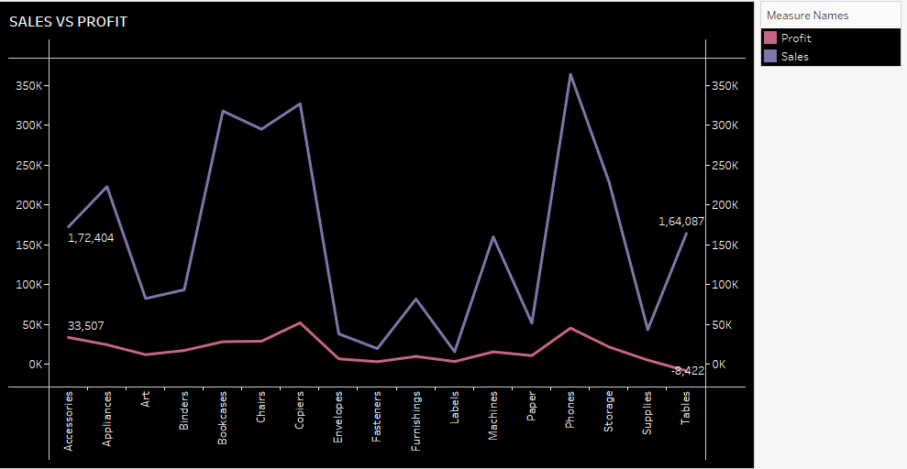
SALES VS PROFIT

Slide 10
Sales vs profit
INSIGHTS:
THIS CHART DEMONSTRATE THE PROFIT & SALES OF THE PRODUCT FOR WHICH EVER ALL YEAR .
AS THIS IS DYNAMIC DASHOBARD.

Slide 11
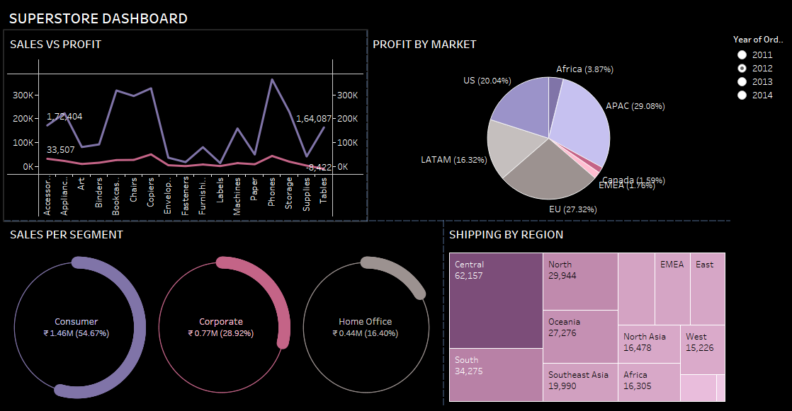
DASHBOARD

Slide 12
INSIGHTS:
THIS DASHBOARD WILL SHOW ALL THE DETAILS RELATED TO FINANCIAL MATTERS SUCH AS PROFIT PER MARKET, SALES PER SEGMENT, SHIPPING PER REGION, SALES VS PROFIT.
FOR ALL 4 YEARS STATEHOLDER CAN VIEW THE DASHBOARD AS THIS DASHBOARD IS INTERACTIVE.

Slide 13
DATA SOURCE
DATA SOURCE :
KAGGLE
TABLEAU DASHBOARD : https://public.tableau.com/app/profile/dave7231/viz/SUPERSTOREDB/SUPERSTOREDB

Slide 14
THANK YOU ☺

