Slide 1
TABLEAU PROJECT
THIS COMPLETE PROJECT IS ABOUT THE SALES PERFORMANCE AND USING THIS DATA, CAME UP WITH THE VALUEABLE INSIGHTS IN A DASHBOARD.

Slide 2
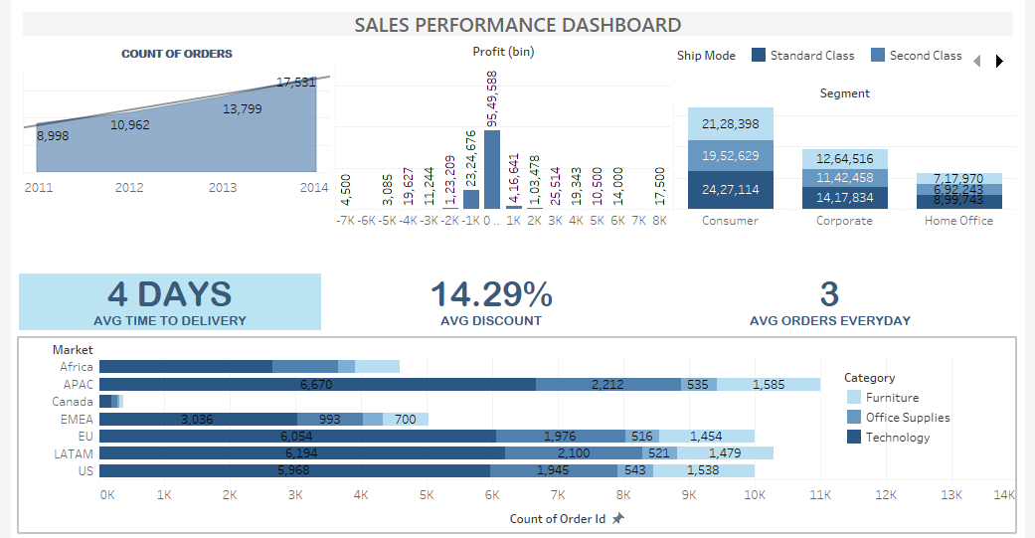
DASHBOARD

Slide 3
INSIGHTS:
WE HAVE CREATED DASHBOARD BY USING KEY PERFORMANCE INDICATOR (KPI’s).
STATEHOLDERS CAN ALSO VIEW COUNTS OF ORDERS.
HIGHEST ORDER: 17,531 (YEAR: 2014)
LOWEST ORDER: 8,998 (YEAR: 2011)

Slide 4
INSIGHTS:
HERE WE HAVE USED 3 KPI’s THAT WILL SHOW AVERAGE TIME TO DELIVERY, AVERAGE ORDER’s PER DAY, AVERAGE DISCOUNT.
AVERAGE DATA IS BASED ON CURRENT DATASET.

Slide 5
INSIGHTS:
WE HAVE DEMONSTRATED SEGMENT SALES PER CATEGORY.
HERE WE HAVE MENTIONED IN TOTAL SALES WITH LABEL ON DASHBOARD FOR DIFFERENT CATEGORY.

Slide 6
INSIGHTS:
IN THE END, STACKED BAR CHART DEMONSTRATE THAT WHAT IS THE CORDER COUNT OF ALL MARKET IN ALL CATEGORIES.
THIS WILL HELP OUT THE STAKEHOLDER’s TO FIND OUT EXCAT COUNT OF ORDER’s IN ALL CATEGORIES.
FROM THIS THEY CAN MANAGE THERE PRODUCTION LEVEL.

Slide 7
THANK YOU ☺

