Slide 1


Multi-Digit Number Recognition using Deep Convolutional Neural Networks
This presentation focuses on recognizing multi-digit numbers from street view imagery using deep convolutional neural networks

Slide 2





Covered Sections
Import all necessary libraries.
Open the SVHN dataset in HDF5 format and split it into training, validation, and test sets.
Visualize the dataset by showing the number of images of each digit and displaying random samples of the images.
Preprocess the images by scaling them and reshaping them to fit the input shape of the CNN.
Build a CNN model using the TensorFlow library.
Compile the model and train the CNN on the training set.
Evaluate model performance on the Training set.
Save the trained model.
Display its classification report .
Visualize the performance of the CNN by displaying the ROC curve and the confusion matrix.
Visualization of Predictions with Confidence

Slide 3

Import all necessary libraries
Libraries used: numpy, pandash5py, matplotlib, Seaborn, Tensorflow, Sklearn, Scikitplot, Keras and warnings.

Slide 4
Dataset
Dataset used is from The Street View House Numbers (SVHN) dataset.
Link: https://www.kaggle.com/datasets/sasha18/street-view-house-nos-h5-file

Slide 5
Open the SVHN dataset in HDF5 format and split it into training, validation, and test sets.
The dataset is loaded in the HDF5 format.
Converted the dataset from HDF5 format to numpy arrays.
Checking type of the converted array.
Resplitting the training set into training and validation sets.

Slide 6
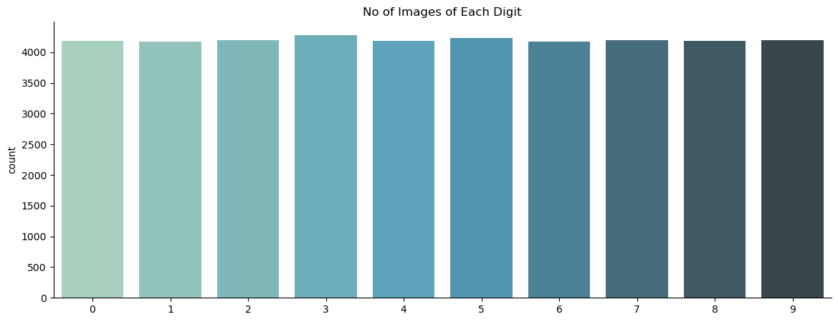
Visualize the dataset by showing the number of images of each digit

Slide 7
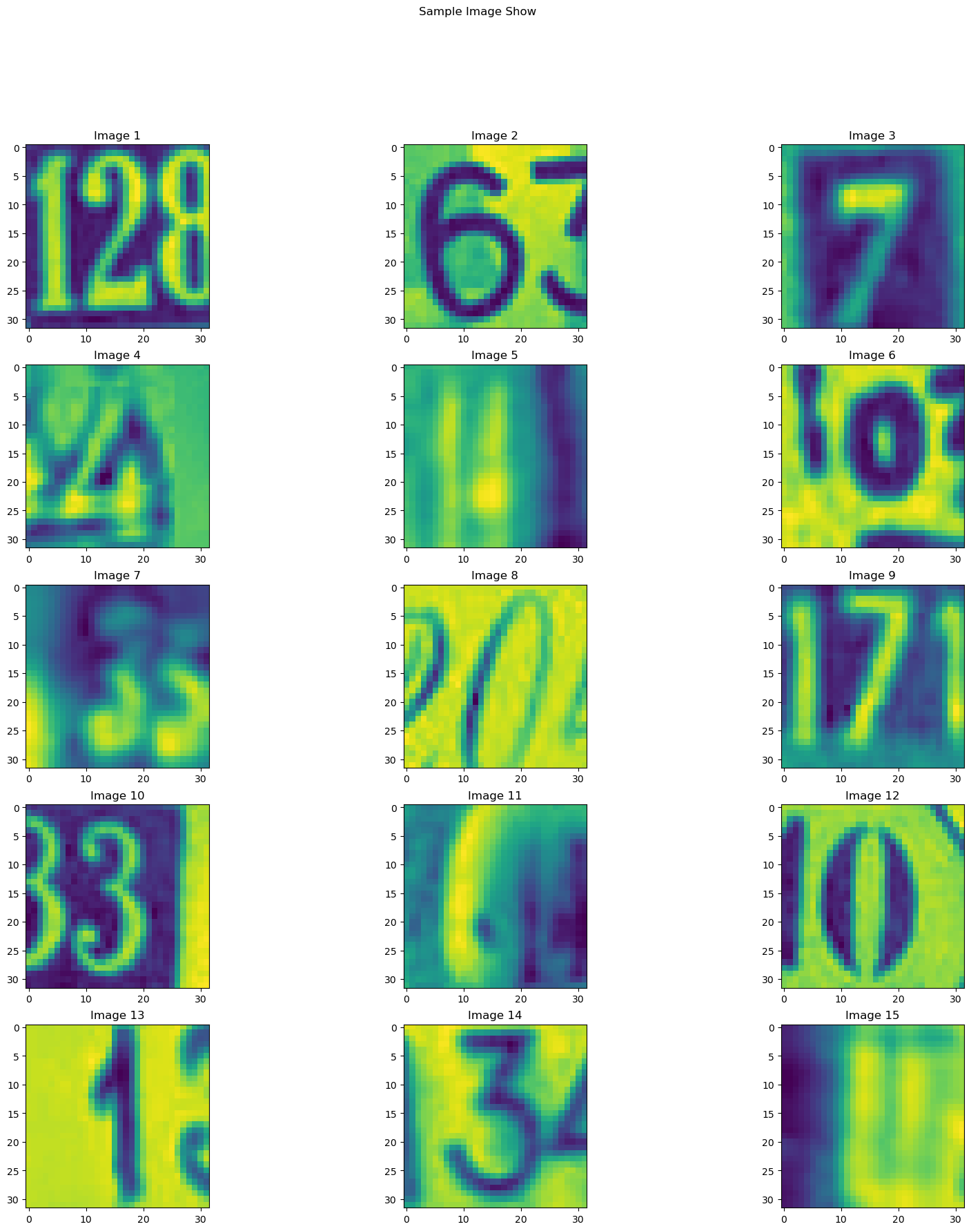
Visualize the dataset by displaying random samples of the images

Slide 8
Preprocess the images by scaling them and reshaping them to fit the input shape of the CNN.

Slide 9
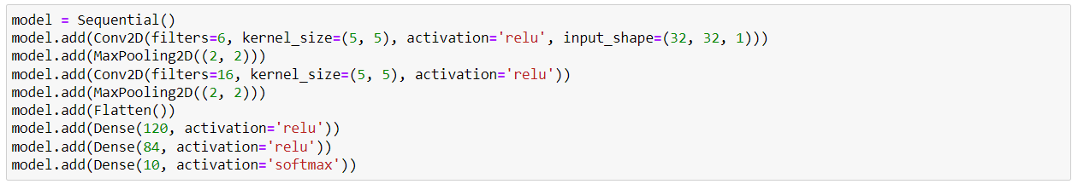
Build a CNN model using the TensorFlow library.

Slide 10
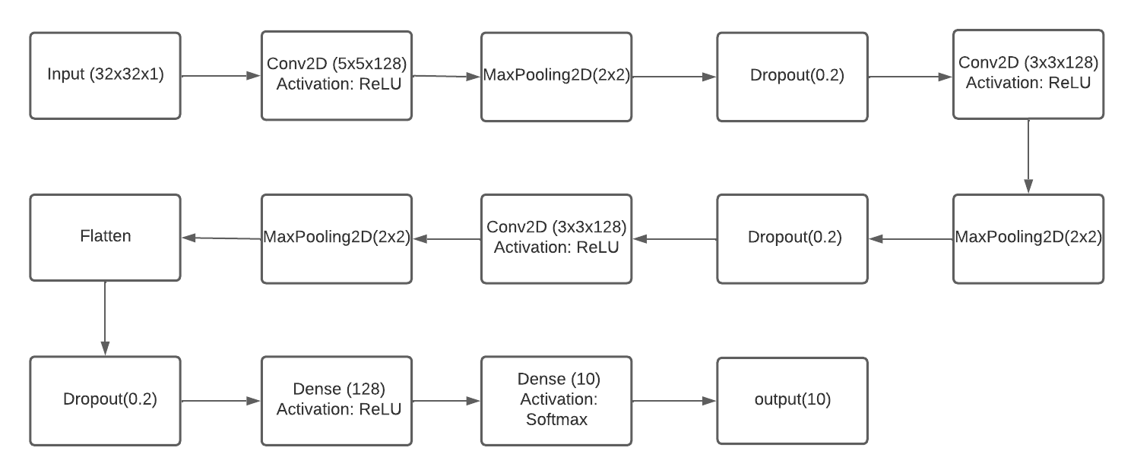
Block Diagram for CNN model.

Slide 11
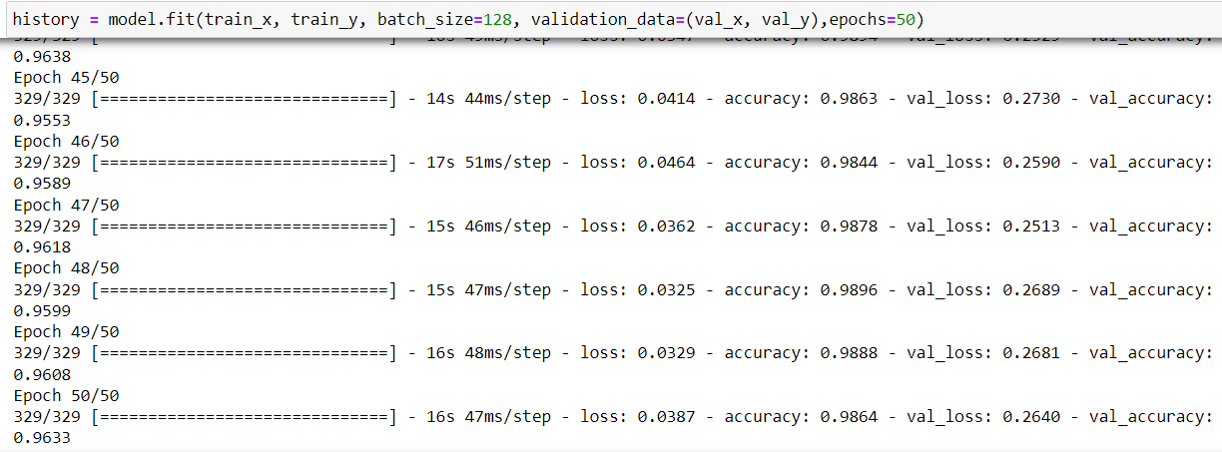
Compile the model and train the CNN on the training set

Slide 12
Evaluate model performance on the training set.

Slide 13
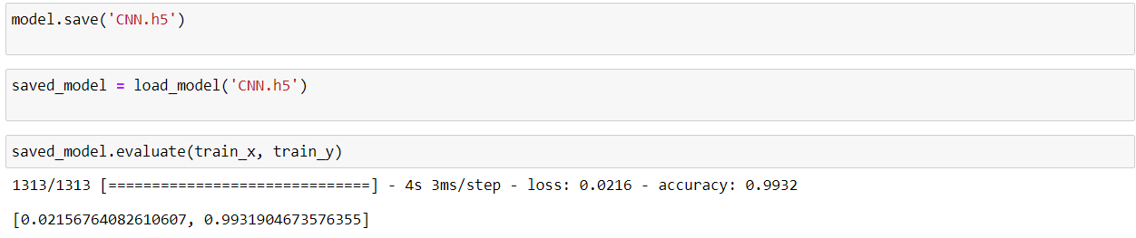
Save the trained model

Slide 14
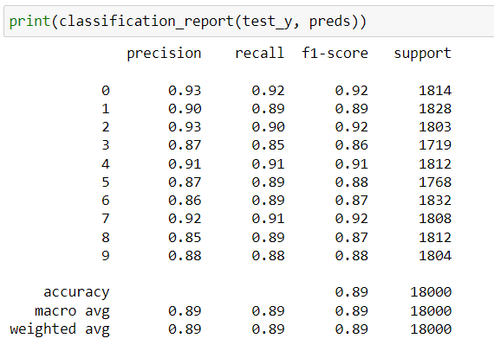
Display Classification Report

Slide 15
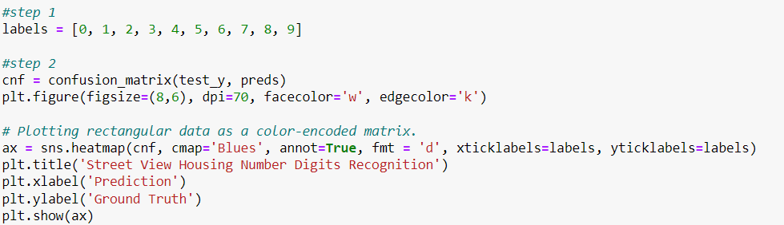
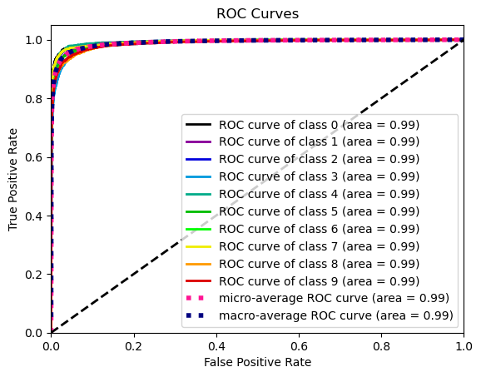
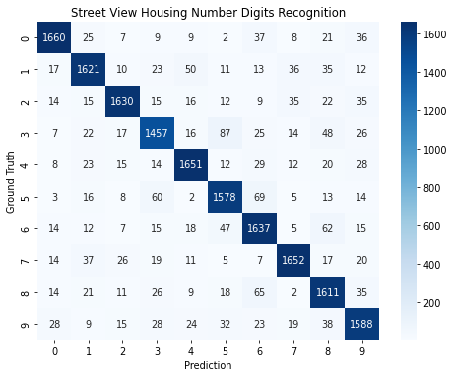
Visualize the performance of the CNN by displaying the ROC curve and the confusion matrix

Slide 16
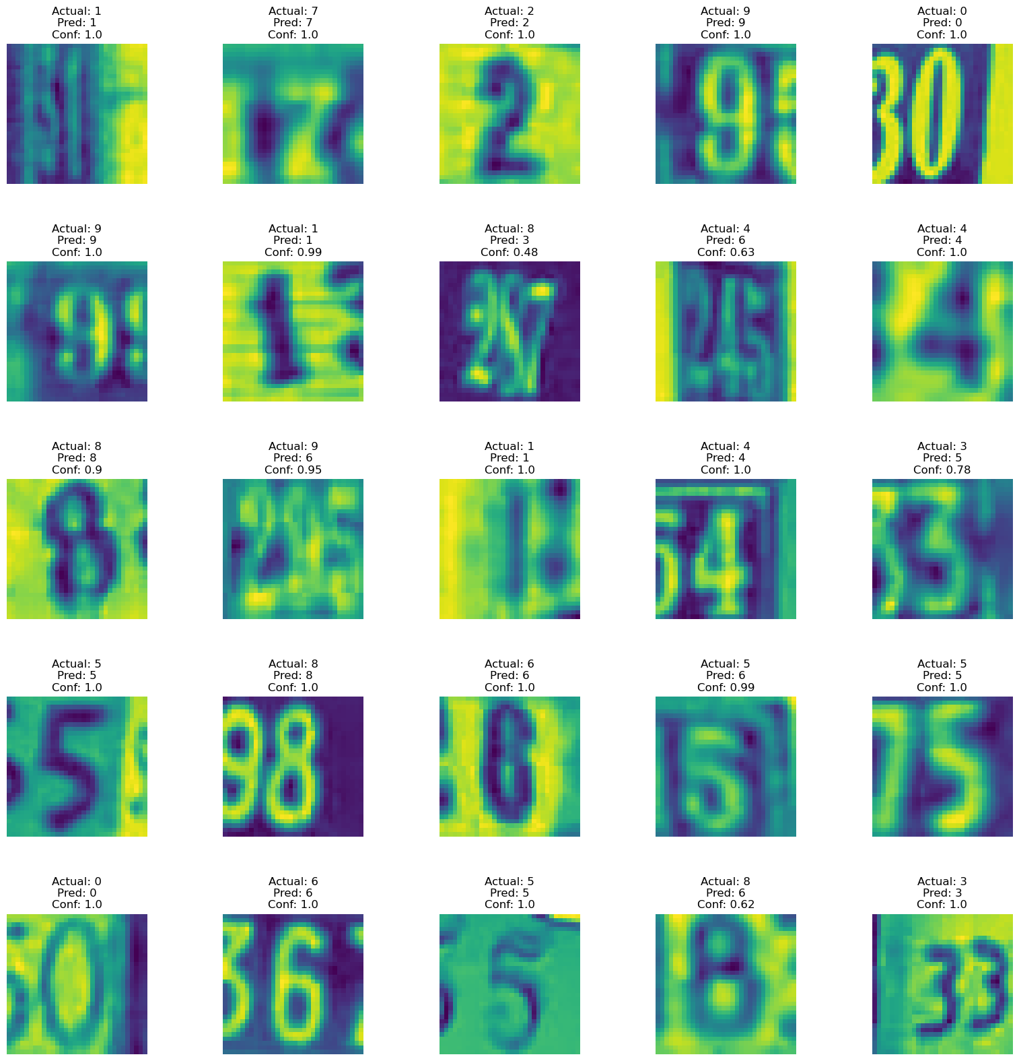
Visualization of Predictions with Confidence

