Slide 2
Improving Local Collisions: New Attacks on Reduced SHA-256 (and further research)
Simeon Wuthier
https://link.springer.com/chapter/10.1007%2F978-3-642-38348-9_16
https://link.springer.com/content/pdf/10.1007%2F978-3-642-38348-9_16.pdf

Slide 3
4 Slides - - - - Importance
4 Slides - - - - How it works
2 Slides - - - - Attacks
6 Slides - - - - The paper
6 Slides - - - - My work
A lot cover

Slide 4
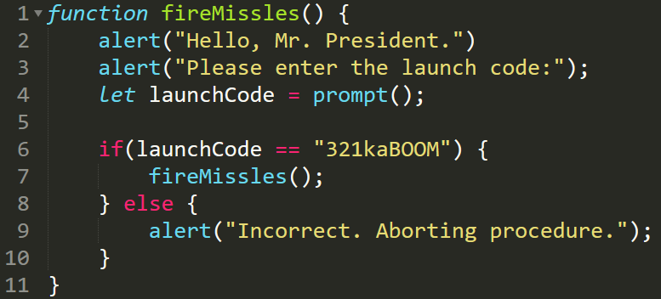
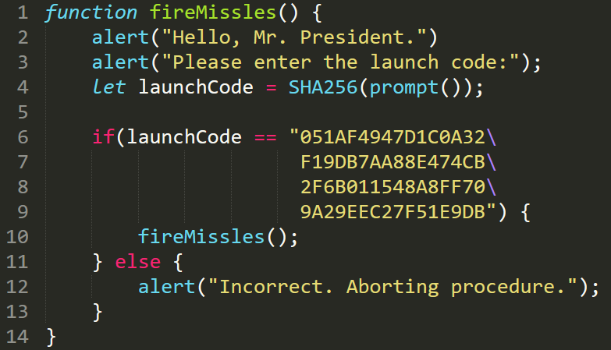
Why is hashing necessary?
Sensitive information needs to be stored somehow...
How do we protect compromised data?
Don’t forget the salt
H(password) = Bad
H(password + salt) = Good
Notes:
Salt is used to prevent an attacker from brute forcing an input

Slide 5
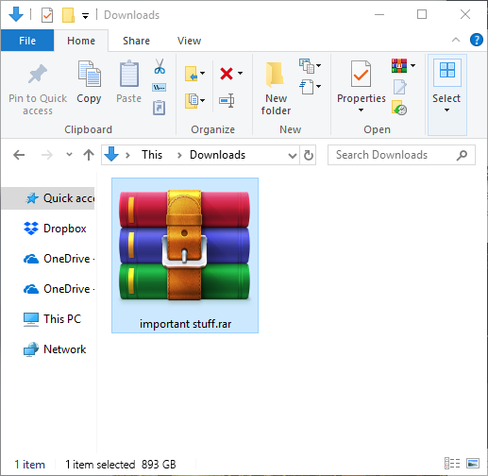
Usage Case #2
How do you ensure a file downloaded from the internet is untampered with?
Solution 1
Compare all bits of the file one-by-one through a VPN.
Very slow, inefficient, does not scale well, cannot trust the VPN provider, …
Solution 2
Compare SHA-256 checksums.
An attacker cannot get away with tampering, unless their tampered file hashes to the same output (i.e. a 2nd preimage attack).
Because of the avalanche effect, if a single bit within the large file has changed, then the hashes will be ENTIRELY different.
Notes:
Download the file, then go offline, compare hashes Many more applications than these
Hashtables
Search engines

Slide 6
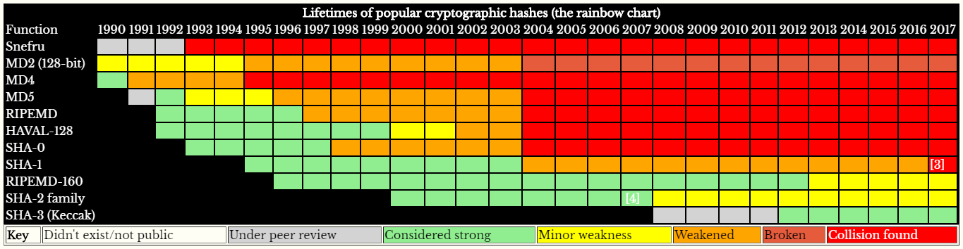
Brief History
SHA-2 is the standard. SHA-3 will become the next standard, but is 2-3 times slower (at best)
As soon as a collision is found, the algorithm is considered insecure, and replaced by the next hashing function.
There are many things an attacker can do with a collision
Didn’t exist/not public

Slide 7
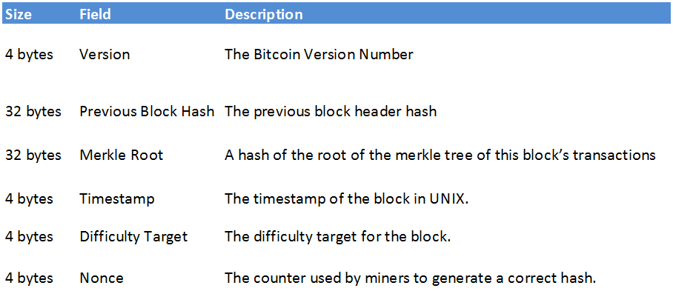
Bitcoin’s security depends on SHA-256’s security
$144,536,067,193 in circulation as of February 11, 2018
H
H
= PoW
Reference: https://www.cryptocompare.com/coins/guides/what-is-a-block-header-in-bitcoin/
Hash the 640-bit header twice, check if the output qualifies as a Proof of Work
Notes:
144 billion dollars in circulation

Slide 8
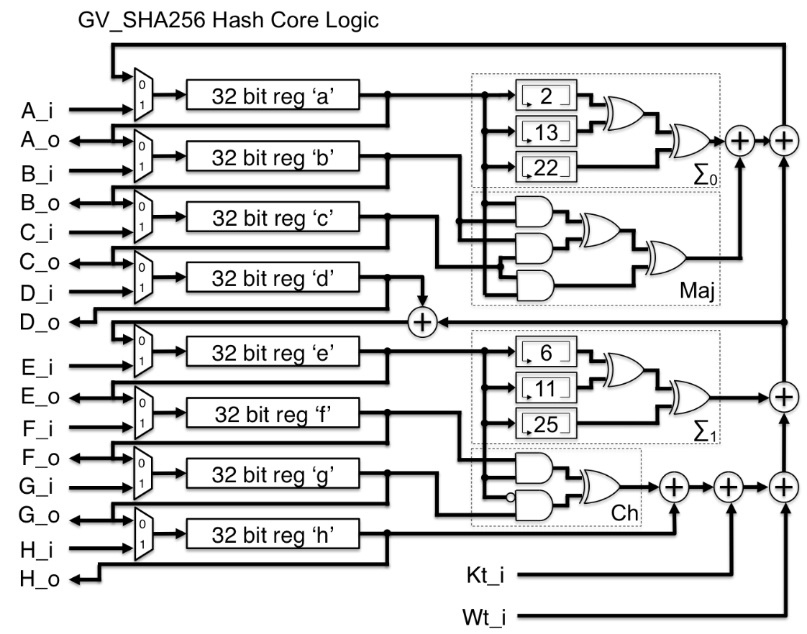
SHA-256 Overview
Created in 2001 by the National Security Agency
Open-source, publicly available
High performance, uses no conditional logic between variables (except for the iterator)
The SHA-2 family of algorithms are
SHA-224, SHA-256, SHA-384, and SHA-512
But SHA-256 is the most widely used.
SHA-256 uses 64 rounds
No collisions have been found yet
Reference: https://opencores.org/project/sha256_hash_core
Notes:
SHA-512 uses 80 rounds
- Closest attempt 57 out of 80 rounds

Slide 9
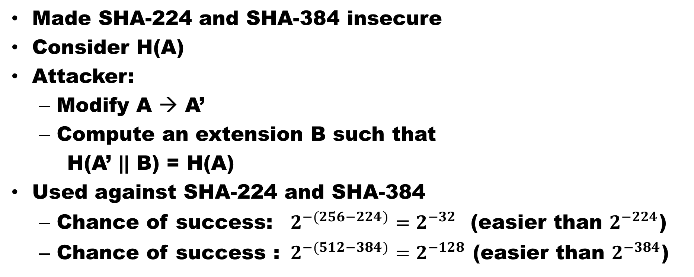
The Length Extension Attack
Made SHA-224 and SHA-384 insecure
Consider H(A)
Attacker:
Modify A → A’
Compute an extension B such that
H(A’ || B) = H(A)
Used against SHA-224 and SHA-384
Chance of success: $2^{−(256−224)}=2^{−32}$ (easier than $2^{−224}$)
Chance of success : $2^{−(512−384)}=2^{−128}$ (easier than $2^{−384}$)

Slide 10
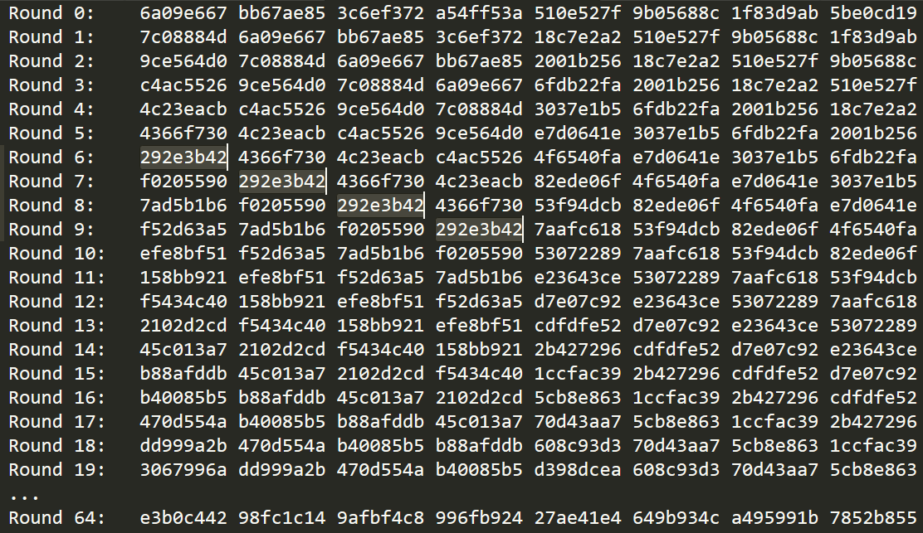
Only two variable states change each round
Hence, the invention of reduced-round attacks
Notes:
Row = State of each hash
Split into 8 words, where each word is 32 bits (integer)

Slide 11

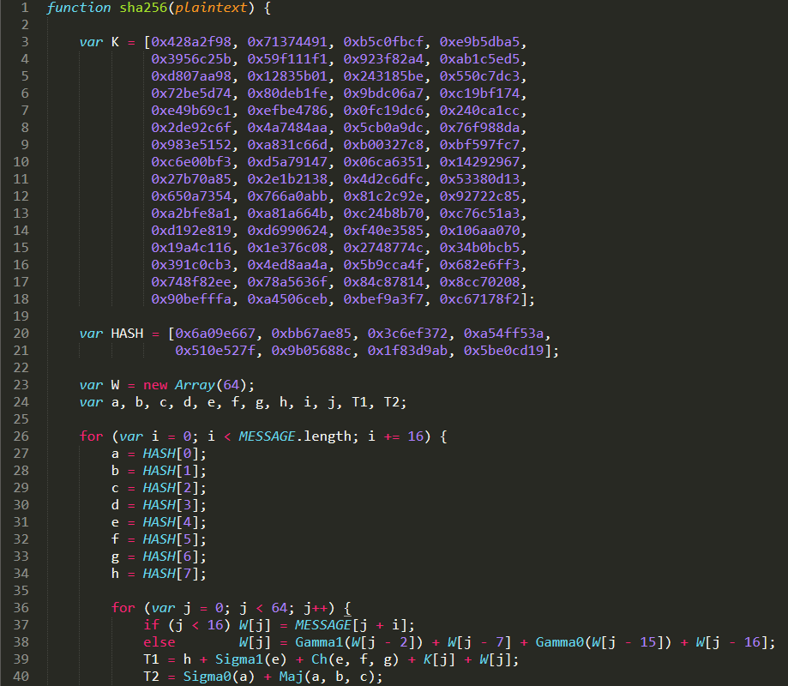
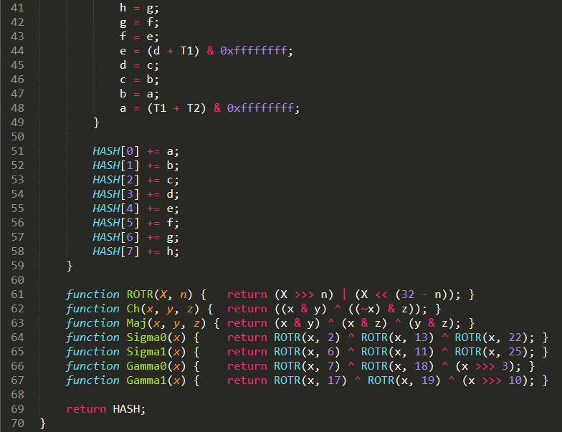
Two state variables change every round (the state update stage) (SHA-1 had only one)
Add additional checksum info to the message
Initial constants
After the 64 rounds, [a,b,c,d,e,f,g,h] now hold the hash.
If there are more chunks of the message, repeat.
Iterate through each chunk of 512 bits
Feed in the plaintext 32 bits at a time
The math part of the hash function (the message expansion stage)
Notes:
Maj = majority of the three inputs
Ch = choose, if the bit in x is 0, choose y, otherwise choose z, for every bit
(in circuit terms, a 2-input-multiplexor)

Slide 12
Three Attack Categories
Preimage Attack
Given: H(A)
Find: A
2nd Preimage Attack
Given: A
Find: B such that H(A) = H(B)
Collision Resistance
Given: Nothing
Find: A, B such that H(A) = H(B)
Constraints: A lot
Constraints: Some
Constraints: None

Slide 13
The Initial Hash Value (H₀= )
H is an array of 8 words, which make an 8*32 = 256-bit hash
Collision
Choose any A, B such that: H(H₀, A) = H(H₀, B)
Semi-free-start Collision
Choose any A, B, H’₀ such that: H(H’₀, A) = H(H’₀, B)
Free-start Collision
The H₀ values do not need to match
Choose any A, B, H’₀, H’’₀ such that: H(H’₀, A) = H(H’’₀, B)
Difficulty: Hard
Difficulty: Medium
Pseudo Collisions
Difficulty: Easy

Slide 14
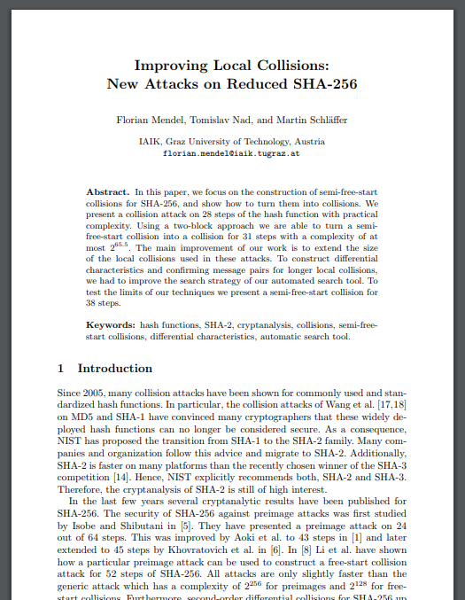
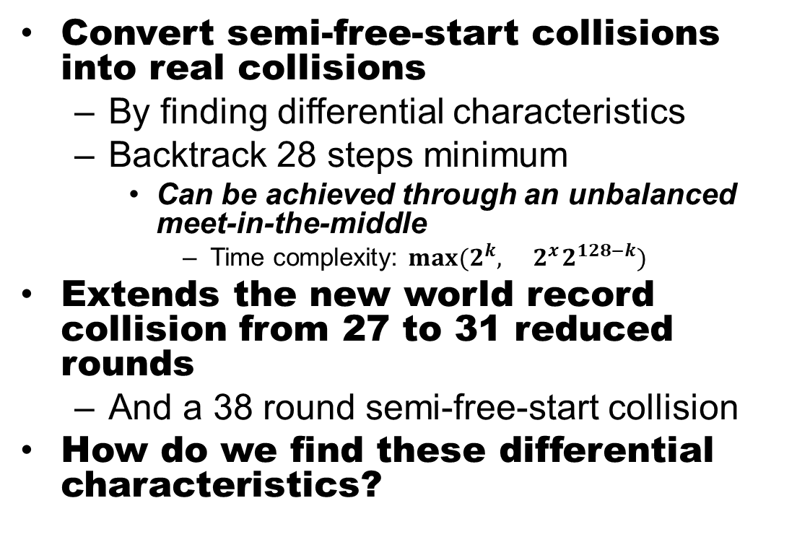
The Paper
Convert semi-free-start collisions into real collisions
By finding differential characteristics
Backtrack 28 steps minimum
Can be achieved through an unbalanced meet-in-the-middle
Time complexity: $max⁡(2^{k},{ 2}^{x}2^{128−k})$
Extends the new world record collision from 27 to 31 reduced rounds
And a 38 round semi-free-start collision
How do we find these differential characteristics?

Slide 15
Differential Characteristics
Determine message words with differences
Almost impossible to do by hand
Create an automated search for differential characteristics
Intentionally broad terms
Decision (Guessing) | Deduction (Propagation) | Backtracking (Correction)
Pick the bit randomly according to a heuristic Impose new constraints on this bit | Propagate the new information to other variables and equations If an inconsistency is detected, backtrack, else continue to step 1 | Try a different choice for the bit If all choices return an inconsistency, mark the bit as critical Jump back until the critical bit is resolved Continue to step 1

Slide 16
Differential Characteristics (added notes)
The difficulty lies in fine-tuning the search algorithm
Split the set of bits into sub-sets according to each bit’s difficulty
Sparser sets allow the search to terminate faster
By reducing rounds, less bits change, smaller search space
Three stages
Find all consistent bits within the message expansion section, (detecting them earlier gives more freedom later)
Continue to search the state update section, adding to the consistent bit set
Search for confirming inputs

Slide 17
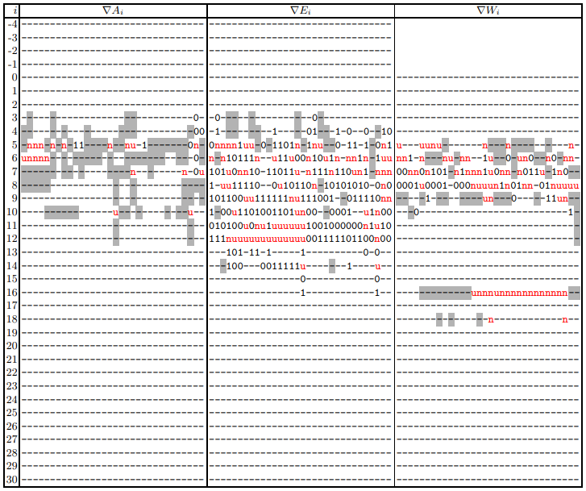
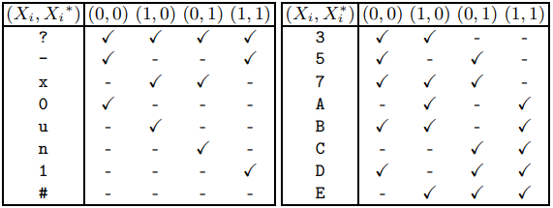
Result (31 steps)
Took 21 hours (single CPU)
Gray background means there is at least one additional condition
Each bit has two possible states:
0 (0, 0)
1 (1, 1)
u (1, 0)
n (0, 1)

Slide 18
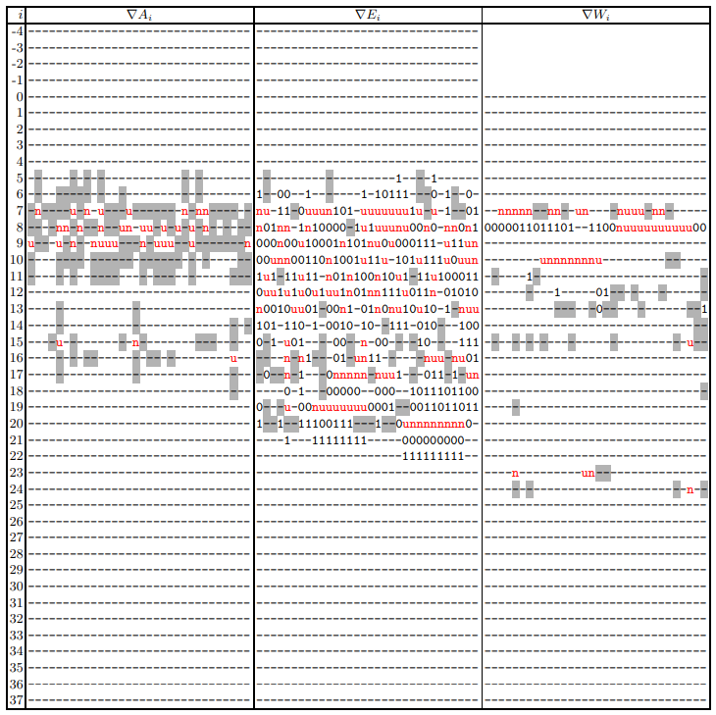
Result (38 steps)
Took 8 hours (single CPU)
Gray background means there is at least one additional condition
Each bit has two possible states:
0 (0, 0)
1 (1, 1)
u (1, 0)
n (0, 1)

Slide 19
Issues
Inconsistencies
Only succeeded 1/12th of the time for 31 rounds ( “verified experimentally” )
Possibility of bugs / issues with their logic
Failed on 38 rounds
But they still got a semi-free-start collision
Never analyzed the operations separately, and therefore never tackled the complexity issue head on
Still had to use brute force to some extent
Never disclosed their “Search Algorithm”

Slide 20
The World Records (as of November, 2018)
SHA-256
Collision
52 out of 64 rounds
Pseudo collision
46 rounds
SHA-512
Collision
57 out of 80 rounds
For every new round, the time complexity is exponentially more difficult

Slide 22
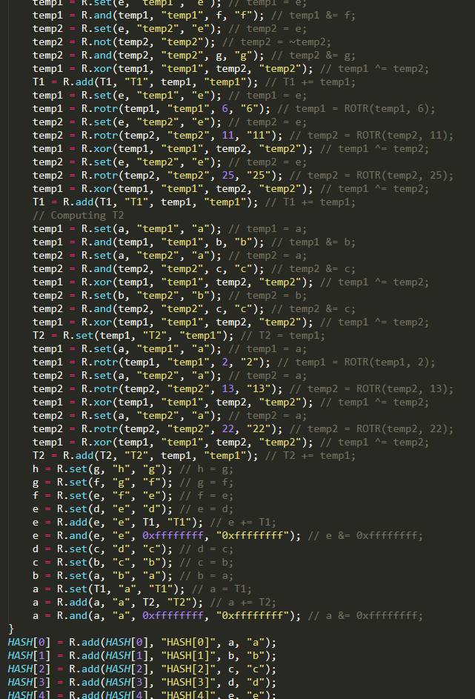
My work
Provide an ordered and deterministic method instead of brute forcing.
SHA-256 has eight elementary operations:
Set =
Bitwise AND &=
Bitwise OR |=
Bitwise XOR ^=
Bitwise NOT =~
Zero-fill shift right (by a constant) >>>=
Circular rotate right (by a constant) ROTR(X, Y)
Addition +=
Separate all operations (one per line)
Log each operation before running that operation
Unrolls all loops, extracts all operations from the expressions
Export the logged data to a new code file
Run the new file, verify the outputs are the same

Slide 23
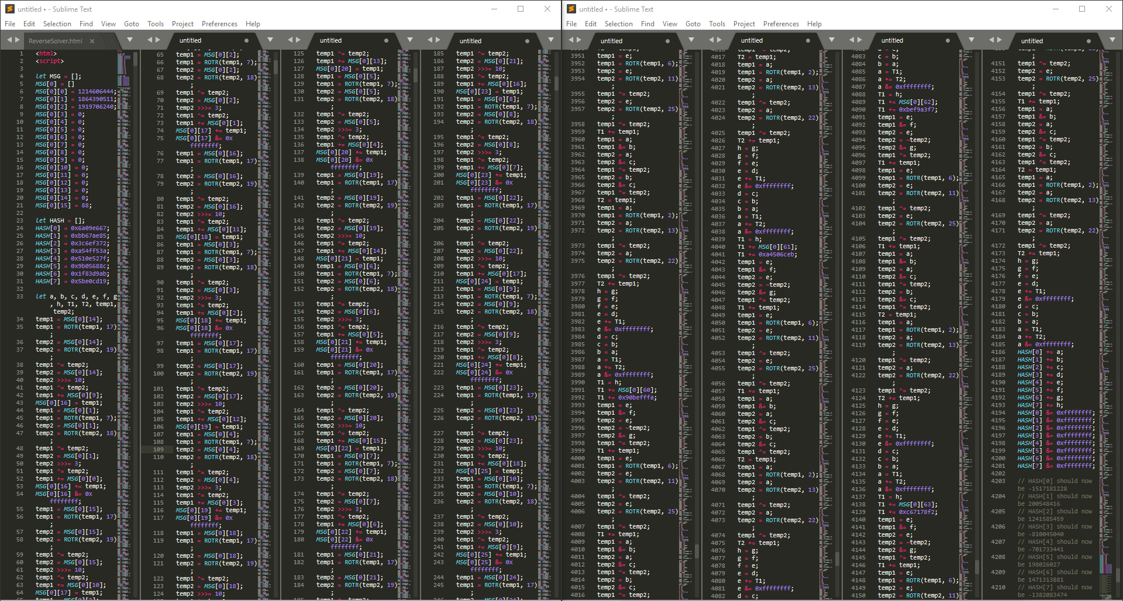
Solved
The goal:
Step through the operations in reverse, until we reach the beginning and have a new hash input
Start
Notes:
Lines 1 to 245
Lines 3951 to 4210

Slide 24
Analysis of the data
Plaintext length | Number of operations
0 to 55 | 4192 operations
56 to 119 | 8376 operations
120 to 183 | 12560 operations
184 to 247 | 16744 operations
248 to 311 | 20928 operations
312 to 375 | 25112 operations
Again, SHA-256’s has eight elementary operations:
Set (=)
Bitwise AND (&=)
Bitwise OR (|=)
Bitwise XOR (^=)
Bitwise NOT (=~)
Zero-fill shift right (>>>=)
Circular rotate right (ROTR)
Addition (+=)
Using the equal sign notation forces two of the three variables to already be known
OUT = IN1 ֍ IN2
↑ ↑ ↑
Given Need Given
Notes:
Greatly reduces the complexity

Slide 25
Reversing Each Operation
We know the value of B.
We know the value of C.
We need the value of A.
ζ = Random value from 0 to 0xffffffff
Operator | Set | AND | OR | XOR
Scenario | A = C | C = A & B | C = A | B | C = A ^ B
Inverse | if C == A then A = ζ else BACKTRACK | if C & ~B = 0 then A = (ζ | B | C) & (B | ~C) else BACKTRACK X10X = A & 0110 = B --------- = 0100 = C | if B & ~C = 0 then A = (ζ & B & C) | (B & ~C) else BACKTRACK 1XX0 = A | 0110 = B --------- = 1110 = C | A = B ^ C Lossless
Operator | NOT | Shift right | ROTR | Addition
Scenario | C = ~A | C = A >>> B | C = ROTR(A, B) | C = A + B
Inverse | A = ~C Lossless | if C starts with B zeros then A = ζ >>> (32 - B) << B else BACKTRACK 11XX = A >>> 2 = B --------- = 0011 = C | A = ROTL(C, B) Lossless | A = C – B Lossless
Operation | Free Bits
A = B | 0xffffffff
C = A & B | ~ (B | C)
C = A | B | B & C
C = A ^ B | 0
C = ~A | 0
C = A >>> B | 0xffffffff >>> (32 - B)
C = A >>>> B | 0
C = A + B | 0

Slide 26

Backtracking
B must be 0x0eeeeeff
Calculate which bits of B need to change
By XORing the two values
Is there an operation to backtrack to?
No: Break the simulation, proved unsolvable.
Yes:
Step back an operation
Absorb the relevant free bits
Free bits must be for the same variable
Only absorb the free bits that are necessary
Do any more bits of B need to change?
Yes: Go to step 2
No:
Go back to the wall, it can now be passed.
Instruction 1
Variable B
Value 0x02ecffff
Free bits 0x0f000f00
Instruction 2
Variable A
Value 0xa1ef0045
Free bits 0xf0000000
Instruction 3
Variable B
Value 0x00001234
Free bits 0x00fff000
Instruction 4
Variable A
Value 0xa1ef0045
Free bits 0xf0000000
Demo http://S1Meon.art/ReverseSolver.html

