Slide 2
Do You Hear What I Hear? Fingerprinting Smart Devices Through Embedded Acoustic Components
ACM SIGSAC Conference on Computer and Communications Security (CCS), 2014
Simeon Wuthier
Research Paper Critique

Slide 3
Author Introduction
Authors
Anupam Das
Nikita Borisov
Matthew Caesar
University of Illinois

Slide 4
Background and Problem Statement
Physical devices vary in software and hardware
Mobile apps oftentimes have direct access to the microphone and speaker on the device
Depending on the application category
Components on smart devices have imperfections
Speaker
Microphone
Combined speaker and microphone
An adversary can use these imperfections to gain additional information about the device
Make and Model
Notes:
Devices are different, vary in software / hardware
Mobile apps are given access to the microphone and speaker
(Depending on the application)

Slide 5


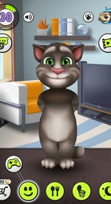
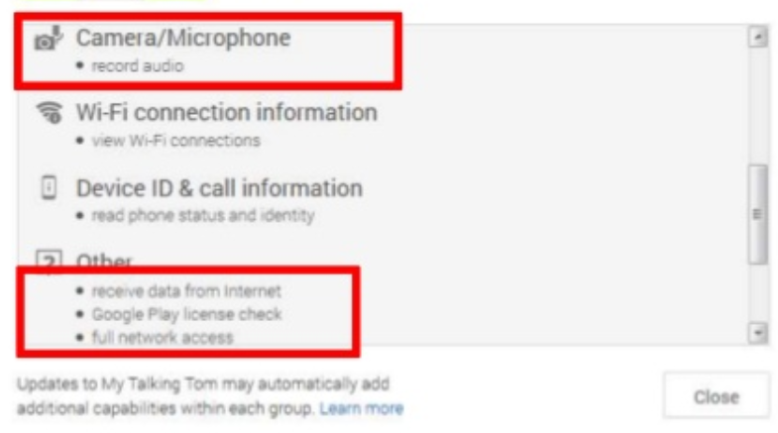
Background and Problem Statement
Combined speaker and microphone
Notes:
Talking Tom: Extremely sketchy app known to violate privacy

Slide 6
Related Work: Overview
Timing analysis over a WLAN through 802.11
MAC headers exploit device-specific traffic patterns
Remotely fingerprint OS’s identifying unique TCP/IP responses
Open source software like Nmap, Xprobe
NIC clock skews affect TCP/ICMP timestamps
Dependent upon experimentation environment
Idiosyncrasies inside smartphone accelerometer
External adversaries do not have access to this
Software-based JavaScript attacks to fingerprint devices
Analyzing month-long logs of Bing and Hotmail usage
Notes:
WLAN = Wireless Local Area Network
NIC = Network Interface Cards
Software-based fingerprinting depends on non-static configurations,

Slide 7
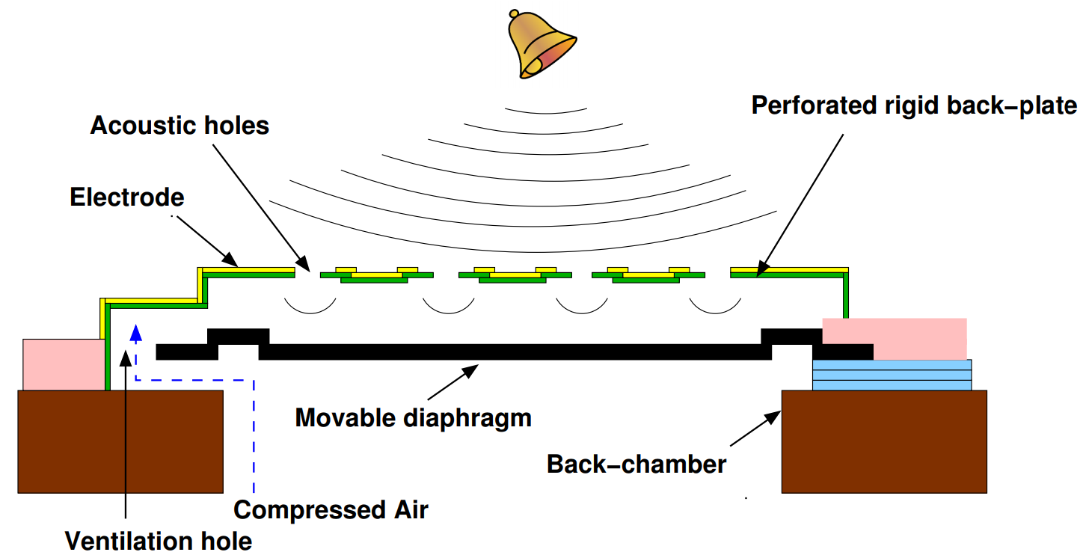
The Microphone
Micro Electro Mechanical Systems (MEMS)
Also known as “silicon microphones”
Used by modern smartphones
Oftentimes more than one on a device
iPhone x has four
Sound waves
Mechanical energy
Capacitive change
Voltage change

Slide 8
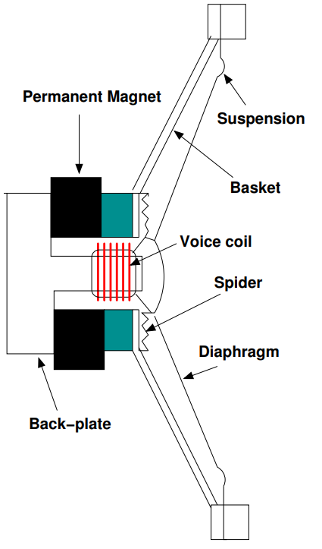
The Microspeaker
Also a Micro Electro Mechanical System (MEMS)
Generated sound varies by
Distance and rate which voice coil moves
Device electromagnetic properties
Manufacturing imperfections
Electrical current
Magnetic field around voice coil
Mechanical energy
Sound waves
Notes:
Diaphragm: Made of paper, plastic, or metal, connected by a flexible suspension
Voice coil: held in place by the Spider

Slide 9
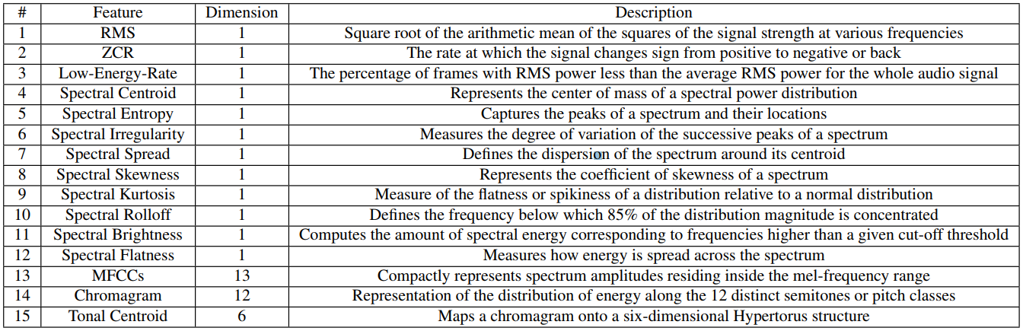
15 Acoustic Features
Notes:
Made from the different observations around the speaker or microphone
13 different levels for amplitude in mel-frequency range
12 different levels for pitch and semitones
6 dimensions for the tonal centroid chromagram
MFCCs turn out to be the dominant feature

Slide 10
Classification of Data
K-NN algorithm
K-nearest neighbors, take a majority vote on the k closest training records in a feature space
Useful for analyzing real world data with complex distributions
Computationally expensive
GMM
Gaussian mixture model, assumes gaussian distribution, gives the highest likelihood that a datapoint falls into a pre-computed class of samples
Used in biometric systems
Most notably, voice recognition systems
Notes:
K-NN does not consider distributions
GMM assumes all variables belong to Gaussian distribution
(BUT NOT I.I.D.)

Slide 11
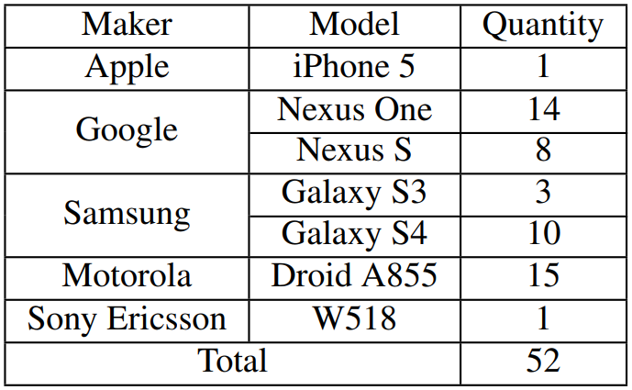
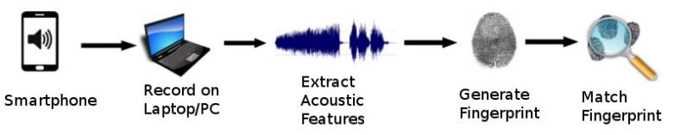
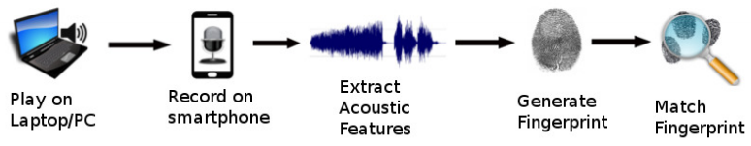
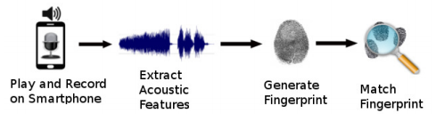
Test Environment
266 ft² (14’ by 19’) classroom
Types of audio excerpts:
Instrumental
Human speech
Songs
Procedure
Play each audio 10 times
Record each audio 10 times
Notes:
266 square foot room, they explained all the features of the room in detail
What walls were used, ceiling height, filled with desks and chairs (obviously a University classroom)

Slide 12
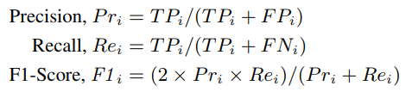
Classifying Performance and Precision
True Positive (TP)
False Positive (FP)
False Negative (FN)
Take the average over all samples:
F1-Score
Harmonic mean of precision and recall
Good measurement of the tradeoff between precision and recall

Slide 13
Classifying Performance and Precision
True Positive (TP)
False Positive (FP)
False Negative (FN)
Take the average over all samples
F1-Score
Harmonic mean of precision and recall
Good measurement of the tradeoff between precision and recall
Range between 0 and 100
Notes:
Notice precision and recall dependent upon TP, FP, and FN
F1 Score dependent upon precision and recall
GOAL: Maximize the F1-Score
F1-Scores in the 90s means successful fingerprinting by an adversary

Slide 14
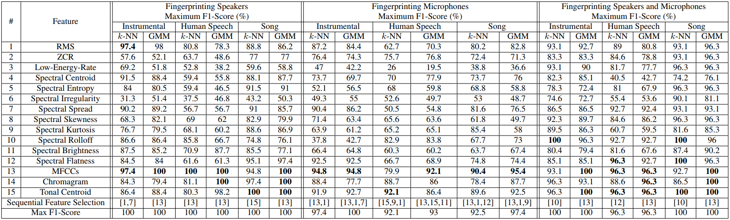
Key Results: Same maker and model
Melfrequency Cepstral Coefficients (MFCCs) are the dominant features

Slide 15
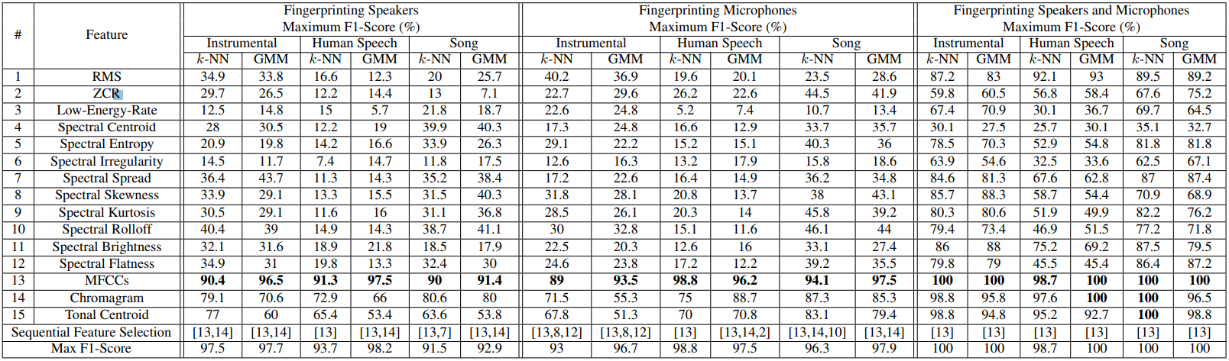
Key Results: Different maker and model
Melfrequency Cepstral Coefficients (MFCCs) are the dominant features

Slide 16
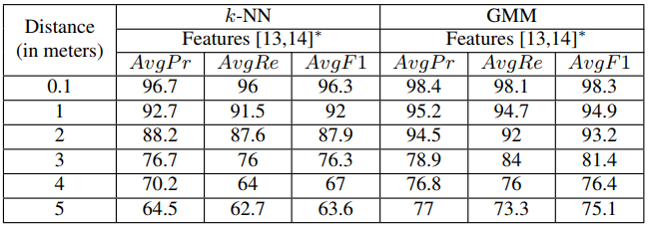
Contributions
High accuracy when monitoring device is under 2 meters
The GMM algorithm worked better.
Worked in a controlled environment, and with ambient noise

Slide 17
Analysis and Critique
Strengths
Detailed descriptions of their tests
Reproducibility
Explained their reasoning behind almost every decision they made
Used a lot of devices for stable analysis
Analyzed a lot of additional data to stabilize their conclusions
Sensitivity, sampling rate, adding ambient background noise, varying the training size, varying the distance.
Weaknesses
15 acoustic features seemed to come out of nowhere
The condition of each device was not specified (wear-and-tear may be a factor)
Lacking in practical implications / fairly weak attack
Having access to the microphone is typically more dangerous than having access to the device make and model
Only two algorithms used
No machine learning !?
Notes:
Single computer: good because consistent results, bad because it also includes any issues with the computer’s microphone

Slide 18
Analysis and Critique
Validation of results
Solid foundation for research, straightforward tests
Biased results to make and model, more tests with some than others
Didn’t mention the component manufacturers themselves to see direct similarities or differences
May be missing crucial information
Only a single computer was used to record the phone audio
Results were biased with respect to the computer microphone / speaker
Practical
Because it’s very difficult to mitigate attacks in this category
Not a very critical attack, but proves it’s existence
Notes:
Single computer: good because consistent results, bad because it also includes any issues with the computer’s microphone

Slide 19
Questions / Feedback?

