Slide 1
PROJECT I: DATA ANALYSIS BOOTCAMP
Starla Halliday | Moussa Diop | Yemi Gebremikael | Amberlie Clutterbuck

Slide 2
PROJECT OVERVIEW
Perform exploratory data analysis of drug & biologic federal contract funding for minority-owned pharmaceutical & manufacturing organizations to uncover patterns in government spending during FY2020-2022
Notes:
An executive summary or overview of the project and project goals:
Explain how the project relates to the industry you selected.
All of us

Slide 3
hypothesis
There is a change in U.S. Government Drugs & Biologicals spending in minority-owned pharmaceutical & medicine manufacturing businesses between FY20-FY22
Null hypothesis
There is no change in U.S. Government Drugs & Biologicals spending in minority-owned pharmaceutical & medicine manufacturing businesses between FY20-FY22
Notes:
AC

Slide 4
INPUT PARAMETERS
CONTRACT TYPE
NORTH AMERICAN INDUSTRY CLASSIFICATION SYSTEM (NAICS)
BPA, Purchase Order, Delivery Contract, & Definitive Contract
Pharmaceutical & Medicine Manufacturing
FISCAL YEARS
PERFORMANCE LOCATION
FY2020 – FY2022 (October 1st, 2019 – September 30th, 2022)
United States of America
PRODUCT SERVICE CODE
MINORITY-OWNED BUSINESSES
Drugs & Biologics
Notes:
AC

Slide 5
OUTPUT PARAMETERS
FEDERAL AWARD AMOUNT
AWARDING FEDERAL AGENCY
Obligated dollar amount from federal agencies with congressionally appropriated money
Department of Defense Department of Health & Human Services Department of Veteran's Affairs
FISCAL YEARS/QUARTERS
PERFORMANCE STATES
FY2020 – FY2022 (October 1st, 2019 – September 30th, 2022)
CA | CO | DE | FL | GA | HI | IL | KY | MA | MD | MI | MO | NJ | NY | OH | SC | TN | TX | VA | WA
Notes:
AC

Slide 6
Data collection & curation
DATABASE
USASpending.Gov: official open data source of federal spending information, including information about federal awards such as contracts, grants, & loans
API
API.USASpending.Gov: allows public to access comprehensive U.S. government award data; federal law requires data to be publicly accessible via the DATA Act at http://fedspendingtransparency.github.io
Calendar year to fiscal year conversion
Pandas Fiscal Year – Get Financial Year with Pandas. (2021, January 21). https://datagy.io/pandas-fiscal-year/.https://www.statology.org/pandas-group-by-quarter
Currency conversion
Format numbers in pandas as currency in thousands or millions. (n.d.). Stack Overflow. https://stackoverflow.com/questions/41271673/format-numbers-in-pandas-as-currency-in-thousands-or-millions
Notes:
An overview of the data collection, cleanup, and exploration processes:
Describe the source of your data and why you chose it for your project.
Describe the collection, exploration, and cleanup process.
AC

Slide 7
DATA ANALYSES

Slide 8
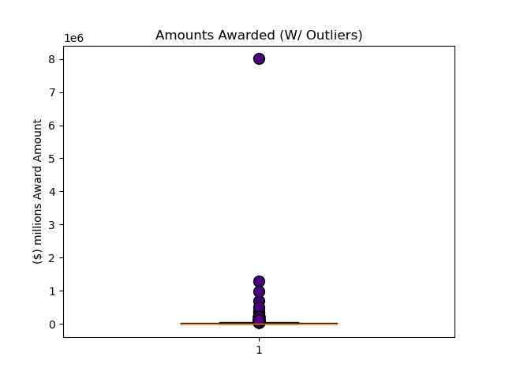
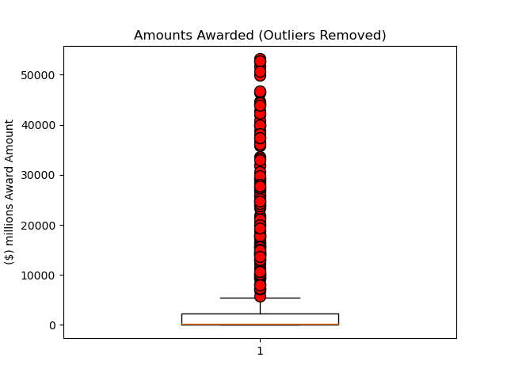
CLEAN DATA OF Outliers first…
Outlier = $8,003,500,000,000
The lower quartile of award amount is: $85.00
The upper quartile of award amount is: $21,513.12
The interquartile range of award amount is: $21,428.12
The median of award amount is: $353.80
Values below (-)$32,057.18 could be outliers
Values above $53,655.30 could be outliers

Slide 9
PROJECT QUESTIONS
PROJECT OVERVIEW
Perform exploratory data analysis of drug & biologic federal contract funding for minority-owned pharmaceutical & manufacturing organizations to uncover patterns in government spending during FY2020-2022
I
How many contracts & how much funding was awarded to minority-owned pharmaceutical & manufacturing organizations during FY2020 – FY2022?
II
Is there a spike in federal funding of minority-owned pharmaceutical & manufacturing organizations depending on the fiscal quarter/year?
III
Which federal agencies awarded the most federal dollars to minority-owned pharmaceutical & manufacturing organizations?
Iv
Which U.S. states received the most # of contracts & funding?
Notes:
The approach that your group took to achieve the project goals:
Include any relevant code or demonstrations of the application or analysis.
Discuss any unanticipated insights or problems that arose and how you resolved them.

Slide 10
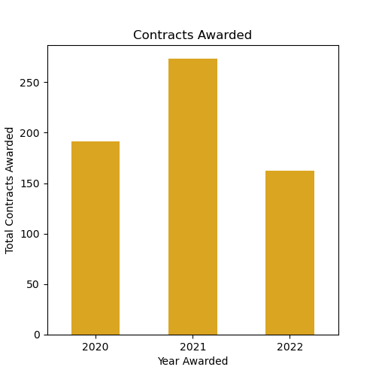
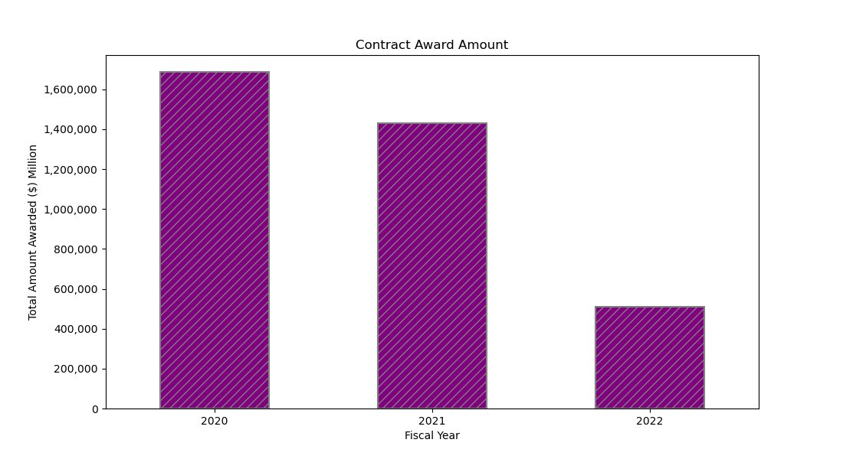
i) How many contracts & how much funding was awarded to minority-owned pharmaceutical & manufacturing organizations during FY2020 – FY2022?
INSIGHT: Award amounts per contract likely decreased as the fiscal years passed

Slide 11
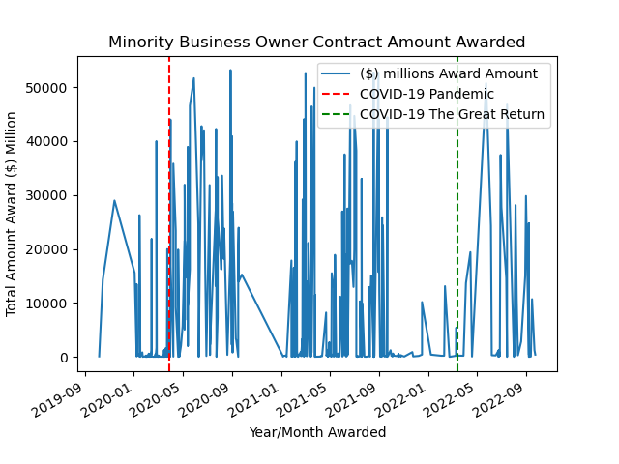
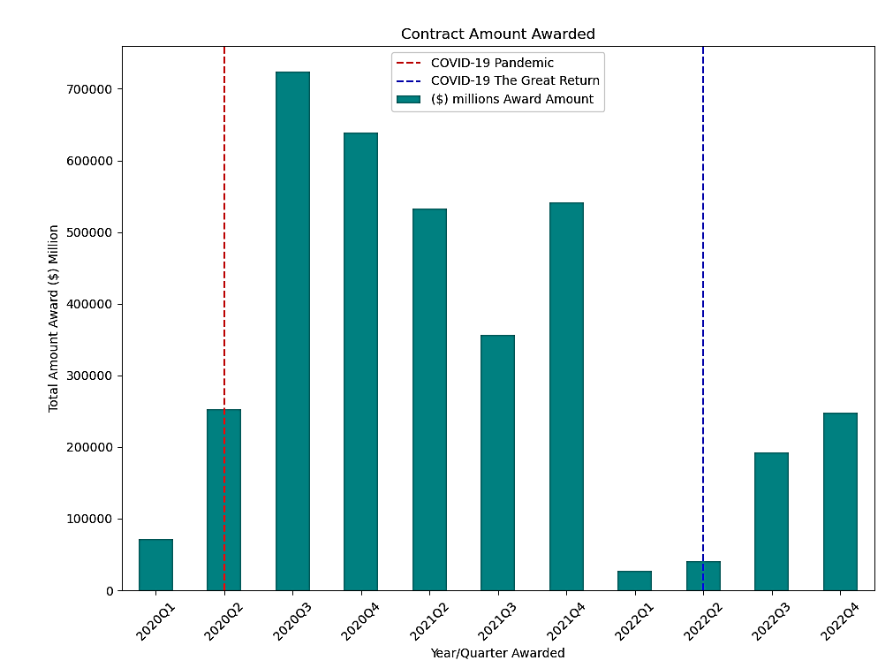
iI) Is there a spike in federal funding of minority-owned pharmaceutical & manufacturing organizations depending on the fiscal quarter/year?
INSIGHT: Government funding significantly increased during the COVID-19 PANDEMIC

Slide 12
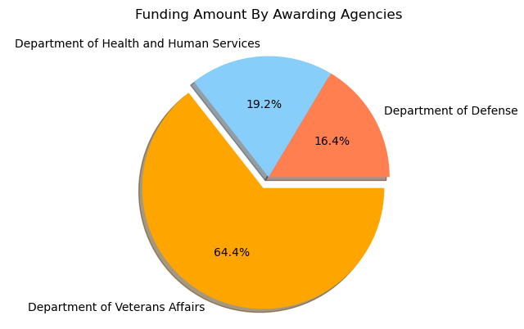
iII) Which federal agencies awarded the most federal dollars to minority-owned pharmaceutical & manufacturing organizations?
$694,683,190,000
$595,200,750,000
$2,336,287,590,000
INSIGHT: Department of Veteran’s Affairs provided nearly 2/3 of funding
FY2020-FY2022

Slide 13
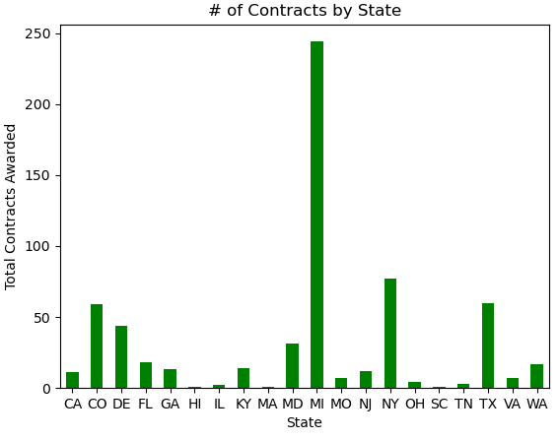
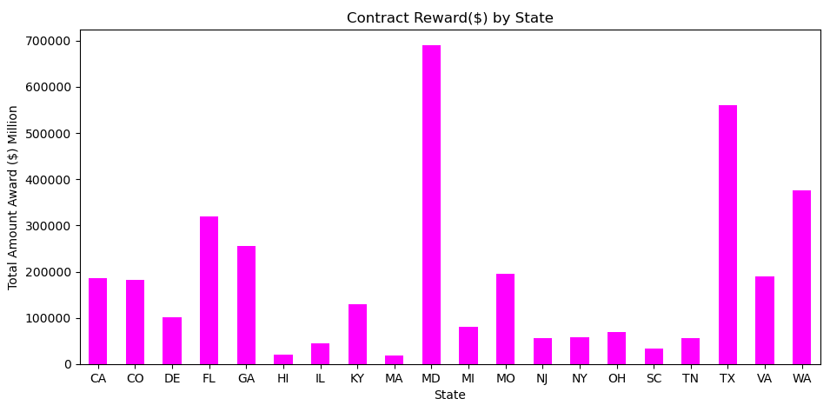
iV) Which U.S. states received the most # of contracts & funding?
INSIGHT: CERTAIN STATES REPRESENT A LARGER MINORITY-OWNED
PHAMACEUTICAL & MANUFACTURING FOOTPRINT THAN OTHERS, I.E. MD, MI, NY, TX, WA

Slide 14
CHALLENGES
I
Number of contracts in original raw dataset (1.4 million contracts)
II
Using POST APIs instead of GET APIs
III
Indentifying APIs to support project focus without scope creep
Iv
Creating a Geoapify Location plot for state award information
Notes:
The approach that your group took to achieve the project goals:
Include any relevant code or demonstrations of the application or analysis.
Discuss any unanticipated insights or problems that arose and how you resolved them.

Slide 15
SUMMARY
DID THE DATA SUPPORT THE HYPOTHESIS?
FUTURE DIRECTION TO FURTHER SUPPORT HYPOTHESIS
There is a change in U.S. Government Drugs & Biologicals spending in minority-owned pharmaceutical & medicine manufacturing businesses between FY20-FY22.
Used Paired T-Test
Variables were 1) Amount Awarded & 2) Fiscal Years
P Value = <<0.00, therefore the null hypothesis could be rejected & results are not by chance
Further breakdown minority-owned organizations to:
Asian-Pacific-American Owned
Black-American Owned
Hispanic-American Owned
Native-American Owned
Women-Owned
Small Business vs. Non-Small Business
For-Profit vs. Non-Profit Business
Notes:
The results/conclusions of the application or analysis:
Include relevant images or examples to support your work.
If the project goal was not achieved, discuss the issues and how you attempted to resolve them.
Ttest_indResult(statistic=8.048422386981931, pvalue=4.236811439575075e-15)

Slide 16
THANK YOU

Slide 18
