Slide 1
RAG Pipeline & Open-Source LLM Benchmarking
Moussa BADDOUR, M.Sc. R&D Engineer NLP & Large Language Models University of Rennes / b-com Ph.D. Candidate in Computer Science (Defense 6 May 2026)

Slide 2

Problem & Motivation
Scientific articles are long and difficult to read
Important information is spread across many sections
It takes time to find precise answers manually
Standard LLMs:
Can give incorrect or hallucinated answers
Do not rely on source documents
Are not trustworthy for scientific use
Notes:
The goal is to build a system that answers questions accurately using real documents, while reducing hallucinations and evaluating model performance.

Slide 3
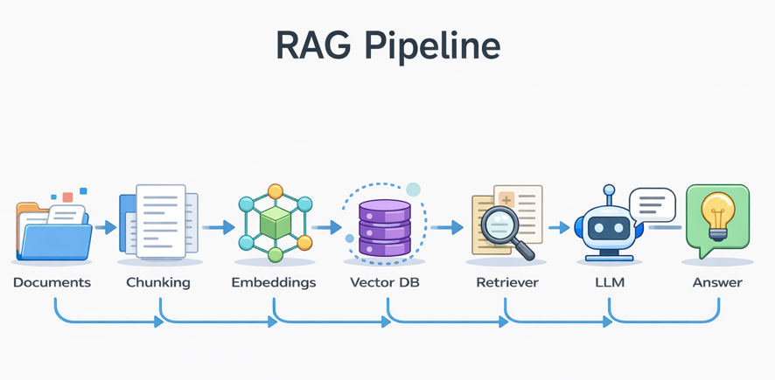

Slide 4
Technologies Used in My RAG System
Document Loaders — Data Ingestion
Text Splitter — Chunking
SentenceTransformers — Embeddings
FAISS — Vector Database
Retriever — Similarity Search
llama.cpp — Local LLM Inference
Prompting + RAG Chain — Answer Generation

Slide 5
Document Loaders — Data Ingestion
Used to load scientific articles (PDF/TXT)
Based on LangChain document loaders (PyPDFLoader, TextLoader)
Converts raw files into structured text documents
Handles different file formats easily
Role in pipeline:
Extract and structure raw document content for processing

Slide 6
Text Splitter — Chunking
Splits large documents into smaller chunks
Using RecursiveCharacterTextSplitter (LangChain)
Preserves semantic coherence within chunks
Improves retrieval accuracy and efficiency
Role in pipeline:
Create manageable text segments for embedding and retrieval

Slide 7
SentenceTransformers — Embeddings
Converts text into dense vector representations
Captures semantic meaning, not just keywords
Enables similarity search between:
- user question
- document chunks
Lightweight and works offline
Role in pipeline: Represent documents and queries in the same vector space

Slide 8
FAISS — Vector Database
Stores embeddings efficiently
Performs fast similarity search
Works fully offline
Scales to large datasets
Role in pipeline:
Store and retrieve relevant document chunks using vector similarity
Notes:
Onother options Chroma / Pinecone / Weaviate

Slide 9
Retriever — Similarity Search
Retrieves top-k most relevant chunks
Based on cosine similarity (via FAISS)
Filters useful context from large document collections
Critical for grounding the LLM
Role in pipeline:
Select the most relevant information for answering the query

Slide 10
llama.cpp — Local LLM Inference
Runs LLMs locally using GGUF models
Supports models like: Mistral , TinyLlama and Gemma
No API required → fully offline
Efficient inference on CPU/GPU
Role in pipeline:
Generate answers using retrieved context

Slide 11
Prompting + RAG Chain — Answer Generation
Combines:
retrieved context
user question
Uses LangChain pipeline / custom RAG chain
Ensures answers are:
grounded
relevant
less hallucinated
Role in pipeline: Produce final answer conditioned on retrieved knowledge
Notes:
Our system integrates LangChain for orchestration, SentenceTransformers for semantic encoding, FAISS for efficient retrieval, and llama.cpp for fully local and grounded answer generation.

Slide 12
System Architecture
📄 Document Loader
✂️ Text Splitter
🔍 Vector Store (FAISS)
🤖 LLM (local GGUF models)
🔁 RAG chain
Notes:
We used Runnable-based pipeline with context preservation.

Slide 13

Models Evaluated
Mistral 7B
TinyLlama 1.1B
Gemma 2B
Qwen 1.5B
Phi-3 mini
Notes:
We compare models with different sizes to analyze quality vs latency trade-offs.

Slide 14
Dataset
4 papers:
EigenGAN
MFGAN
CMGAN
Ontology Depth
Each:
Questions
Ground-truth keywords
“We designed structured evaluation queries with semantic ground truth.”

Slide 15
Evaluation Metrics
Answer Quality
Semantic similarity (embeddings)
Faithfulness
Alignment between answer and context
Context Utilization
Coverage of retrieved chunks
Latency
Time per query
Notes:
We used embedding-based metrics to enable fully offline evaluation without LLM judges.”

Slide 16
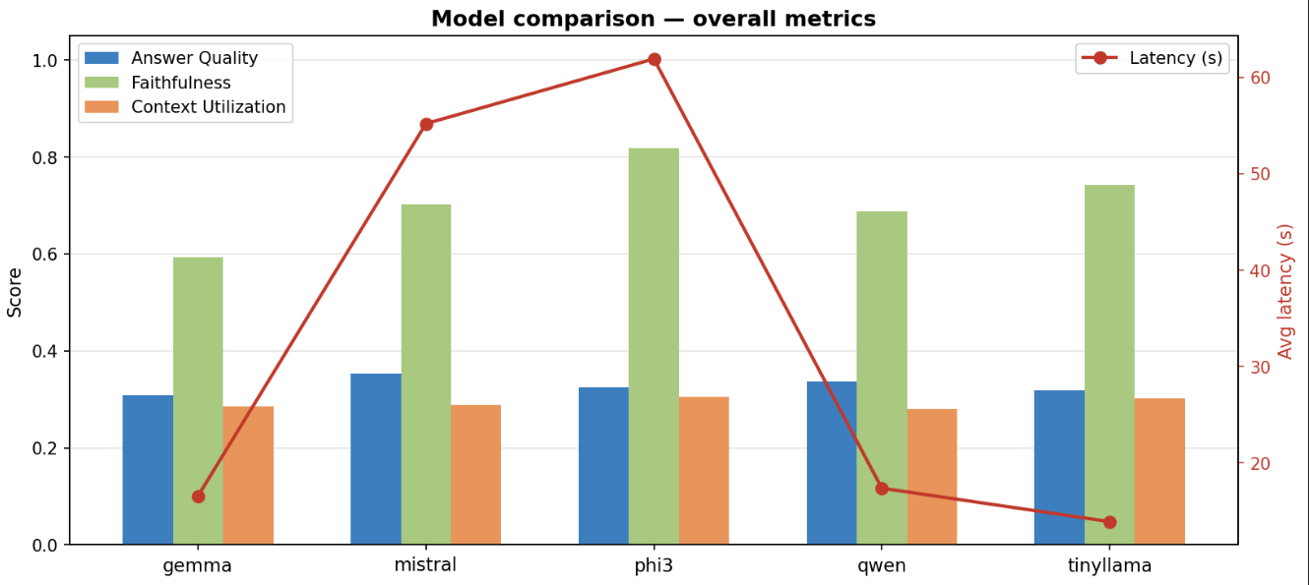
Results

Slide 17
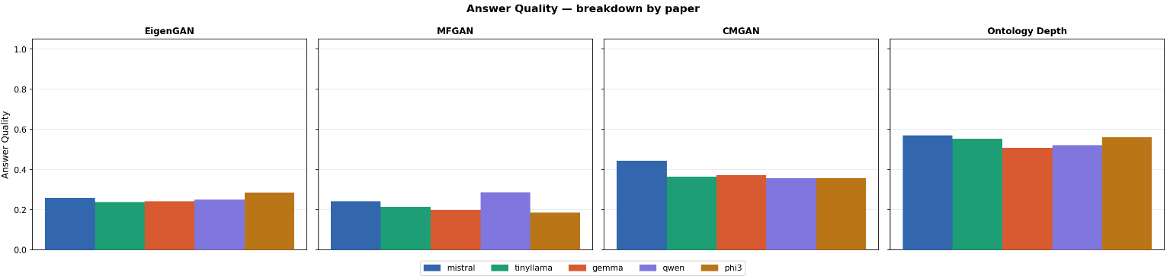
Results

Slide 18
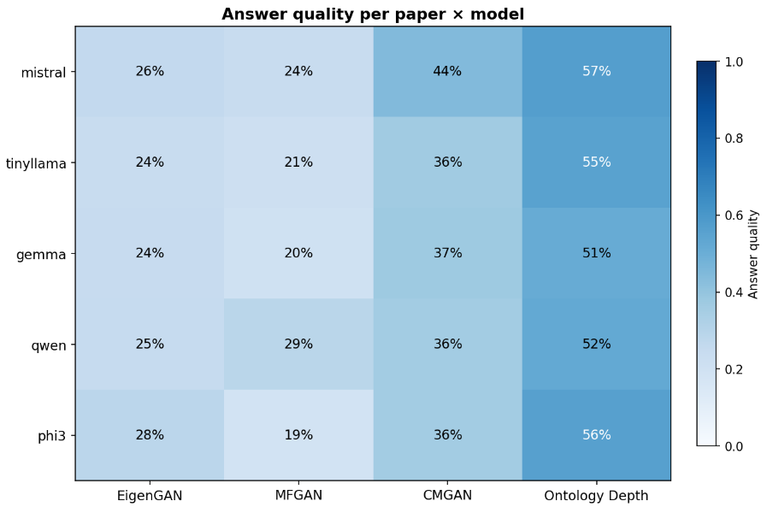
Results

Slide 19
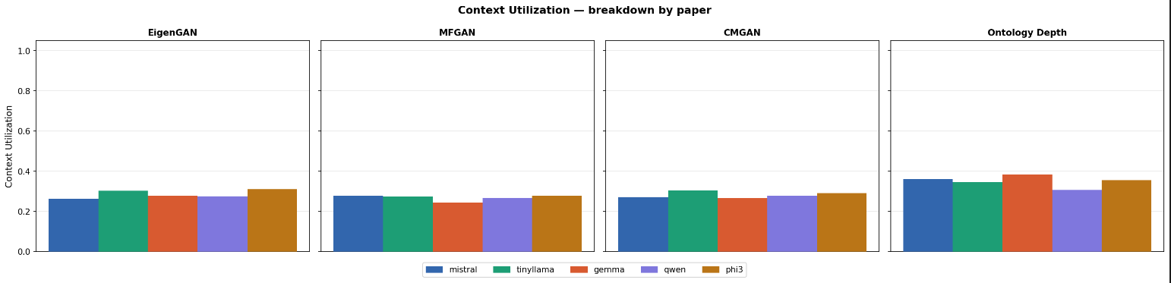
Results

Slide 20
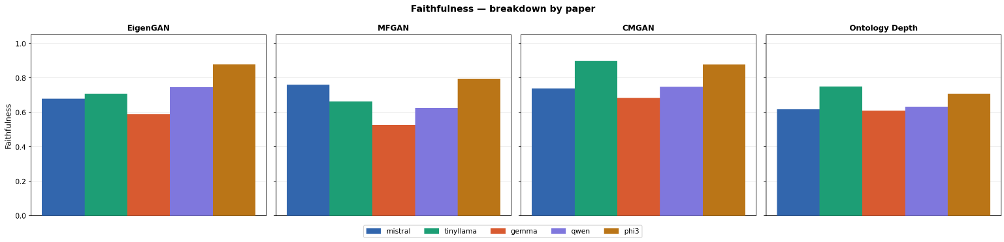
Results

Slide 21
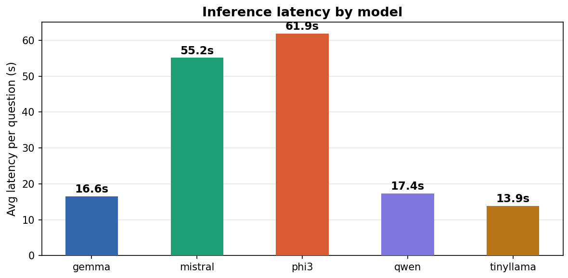
Results

Slide 22
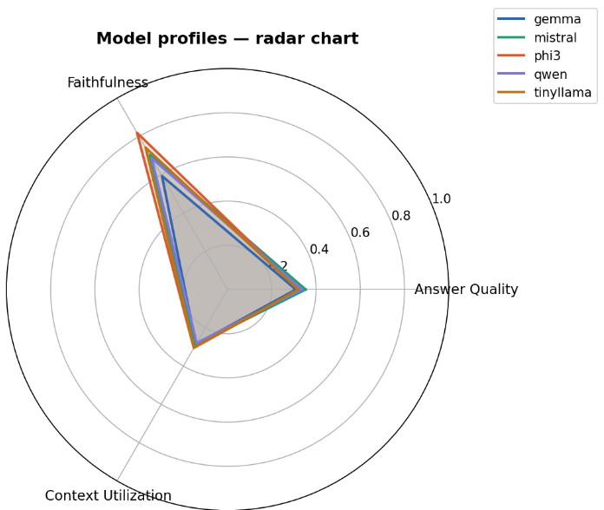
Results

Slide 23
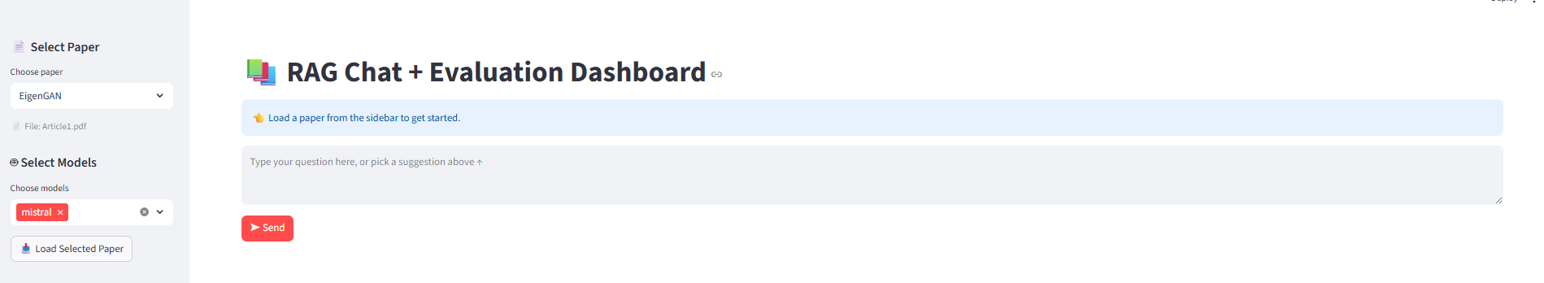
Interactive Demo

Slide 24
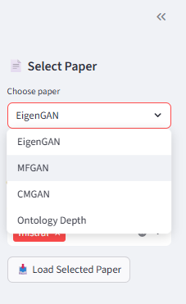
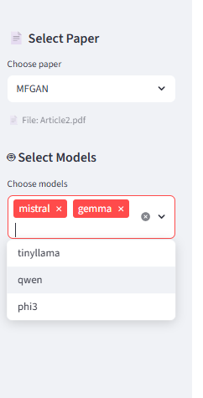
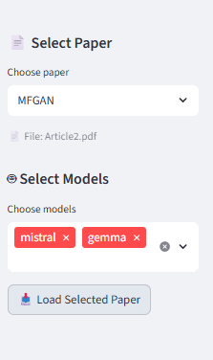

Interactive Demo

Slide 25
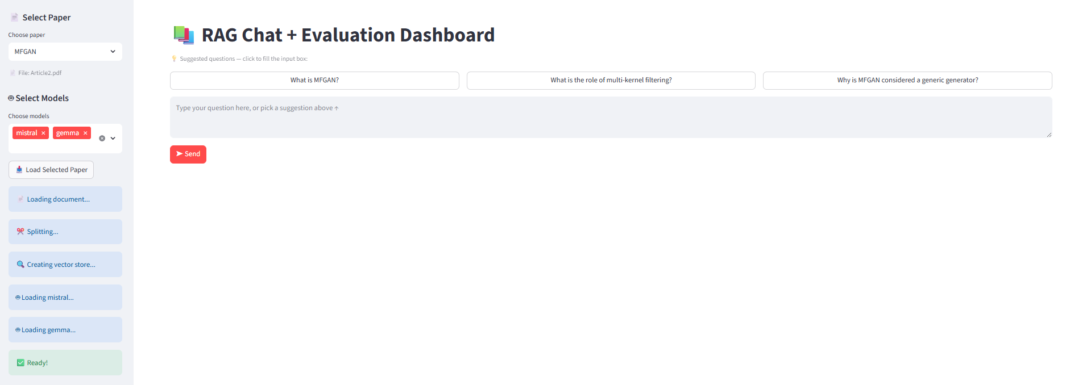
Interactive Demo

Slide 26
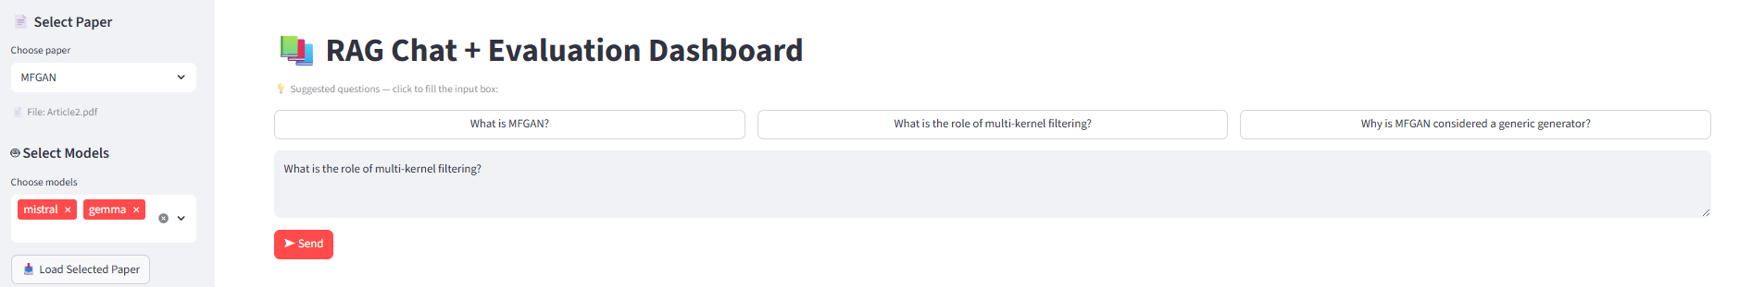
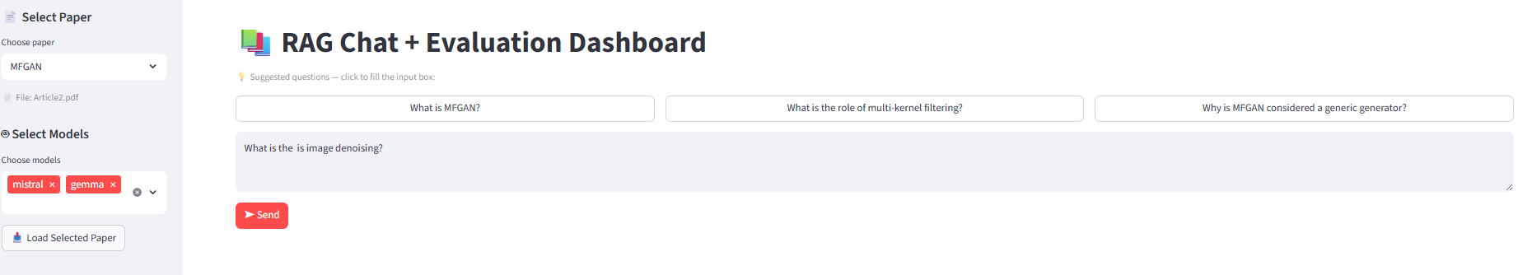
Interactive Demo

Slide 27
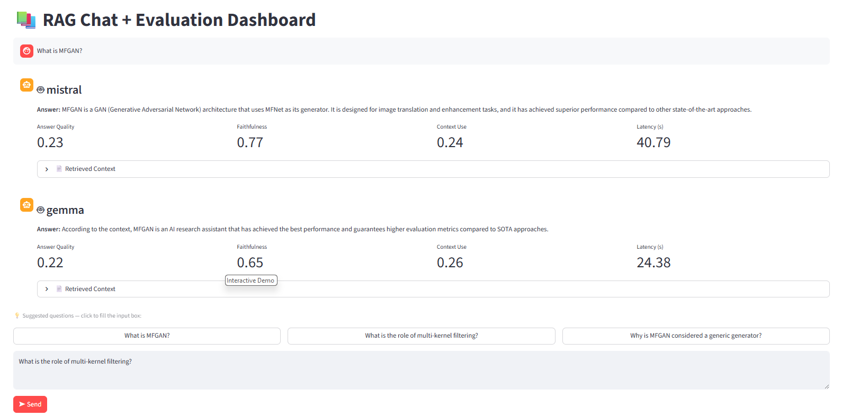
Interactive Demo

Slide 28
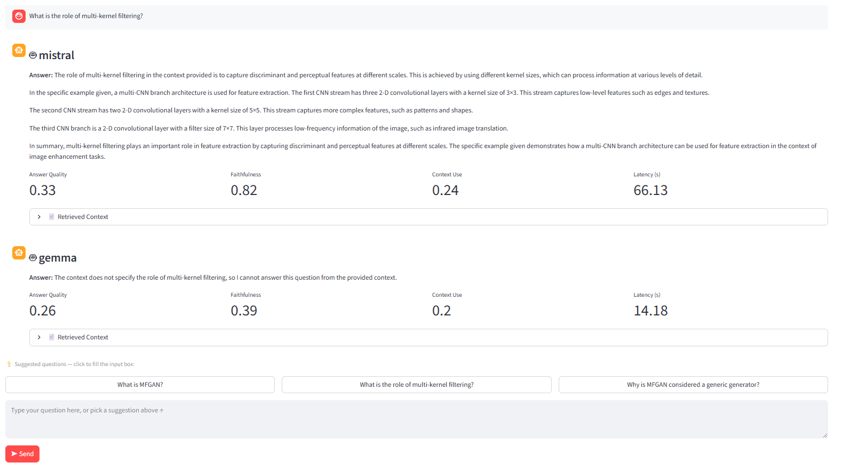
Interactive Demo

Slide 29
Conclusion
Key findings:
RAG improves grounding
Model size impacts quality vs latency
Local pipeline is feasible
Limitations:
Simple dataset
Limited reranking
Future work:
Add reranker (cross-encoder)
Larger datasets
Better evaluation (LLM-as-judge)

Slide 30
Why My approach is valuable
Fully offline
Reproducible
Interpretable metrics
Interactive system

Slide 31
Thank you for Listening

