Slide 1
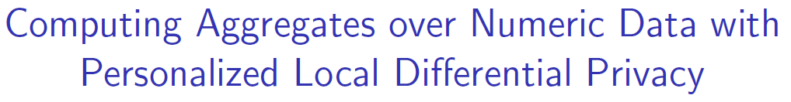
Mousumi Akter and Tanzima Hashem
Department of Computer Science & Engineering
Bangladesh University of Engineering and Technology

Slide 2

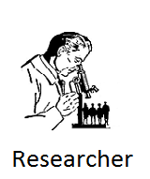

Motivation
Real time data helps to contribute in different domains to improve human lives

Slide 3
Privacy of Collected Data
Shared data can reveal sensitive and private information
It may bring serious privacy concerns
Share data with a trusted party!!!

Slide 4


Privacy Leak from a Trusted Party
Leakage of data from a trusted party may cause a massive devastation

Slide 5
Overview of Our Problem
Compute aggregate statistics over private numeric data
Do not share user data with anyone
Preserve privacy of shared data
Ensure utility of data

Slide 6
Related Work
Techniques for data privacy
K-Anonymity
Perturbation
Sampling
Cryptography
Secure multi-party computation (SMC)

Slide 7
Differential Privacy (DP)
Guarantees privacy theoretically
Processing overhead is low
Main Idea
A trusted accumulator gathers actual data from users
Shares the statistics after ensuring the requirements of DP
No one can identify user data with more than a certain confidence level
Limitation
Users need to trust the data accumulator

Slide 8
Local Differential Privacy (LDP)
Differential privacy in the local setting
Achieve privacy beyond trusting the central authority and other users
Main Idea
User shares a randomized value instead of the actual one
Reverse engineering is impossible with a certain confidence level within a safe range

Slide 9
Related Work
Ensure LDP for computing histograms and ordinal queries¹
Protect LDP of numeric data for computing aggregates ²
Is our problem solved with LDP?
LDP assumes same privacy level for all user
Chance of privacy leakage exists if privacy level of one user releases
Accuracy degrades when the range of values is very large
Adversaries may have background knowledge about range of values

Slide 10
Literature Review
Personalized LDP (PLDP) gives users flexibility to set individual privacy levels
Proposed PLDP has limited application to counting query¹

Slide 11
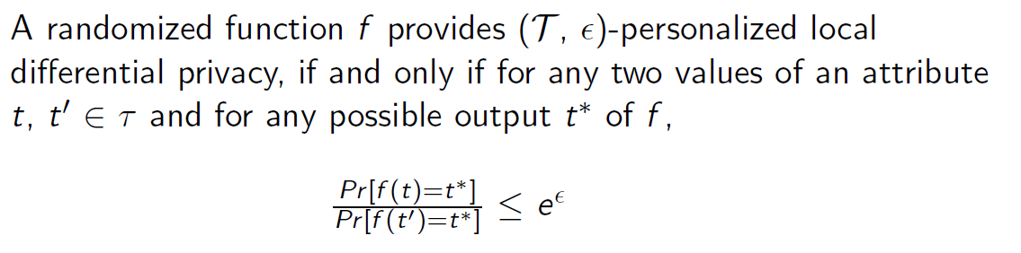

Personalized Local Differential Privacy (PLDP)
 | Actual Data | Shared Range
User | $700 | $0-10000

Slide 12
Personalized Local Differential Privacy (PLDP)
Safe Range
 | Actual Data | Shared Range
User | $700 | $0-10000

Slide 13

Personalized Local Differential Privacy (PLDP)
Safe Range
 | Actual Data | Shared Range
User | $700 | $0-10000

Slide 14
Problem Formulation
Adversaries:
Accumulator
Other users
Eavesdroppers
User Requirement:
Do not want their numeric data to be identified in a safe range
Every users have a different required privacy level
Target of Accumulator:
Computing aggregate functions over collected users data
Preserving utility of data

Slide 15
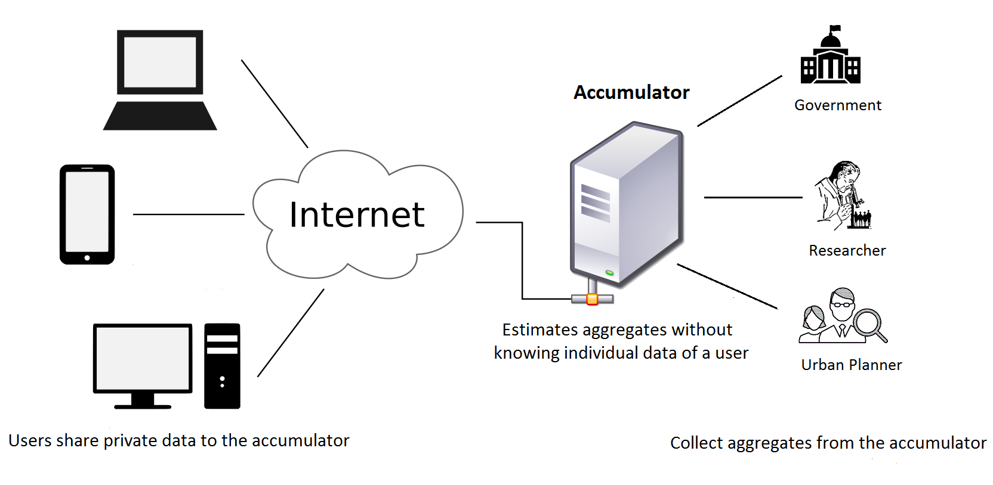
System Architecture

Slide 16
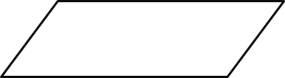
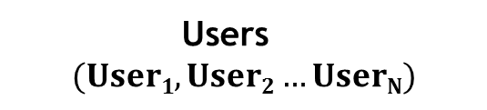
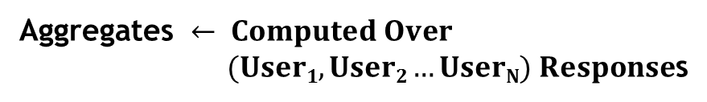

Private Estimation of Numeric Aggregates (PENA)
Users
$$(User1,User2…UserN)$$
Random Response $←$ LRR
Aggregates $← Computed Over$
$(User1,User2…UserN) Response$s
Result $←$Aggregates*Safe Range
Publish Result

Slide 17

Private Estimation of Numeric Aggregates (PENA)
Users
$$(User1,User2…UserN)$$
Random Response $←$ LRR
Aggregates $← Computed Over$
$(User1,User2…UserN) Response$s
Result $←$Aggregates*Safe Range
Publish Result

Slide 18



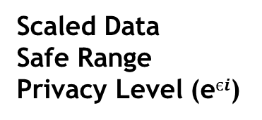
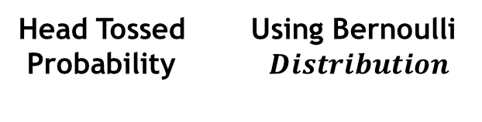
Local Random Responser (LRR)
Scaled Data
Safe Range
Privacy Level (e$єi$)
Head Tossed Using Bernoulli
Probability $Distribution$
Toss Coin
Head Found
Random
Response
Random
Response

Slide 19



Simulation Submit Data within Safe Range ( ) 0-10000 Actual Data 800 Privacy Level (e€_{i}) 0.2

Slide 20


Simulation
Actual Data Scaled Data (t_{i}) to [-1,1] using 800 -0.84
Probability of Head tossed using Bernoulli Distribution
0.46
= 10.03
Random Responses
=-10.03

Slide 21



Simulation
Users send response with Collect responses and compute aggregates
computed probability

Slide 22



Theoretical Analysis

Slide 23






Theoretical Analysis

Slide 24
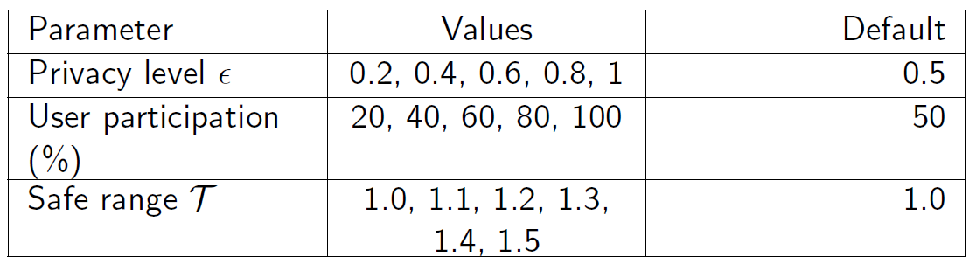
Experiments
Data Sets: IPUMS
3.15M total family income records of USA
Table: Parameter Settings for Experiments

Slide 25
Experiments
Effect of Privacy Level (є) :
(a) average (b) minimum

Slide 26
Experiments
Effect of Safe Range ( ) :
(a) average (b) minimum

Slide 27
Experiments
Effect of Percentage of User Participation:
(a) average (b) minimum

Slide 28
Conclusion
Not involves a central trusted authority
Guarantees PLDP
Computes any aggregate (avg, min or max)
Provides users flexibility to control privacy levels
PENA outperforms modified LDP based approach

Slide 29
Thank You

Slide 30
Any Question?
Email: mousumiakter22@gmail.com

