Slide 1
Progressive Web Apps

Slide 2
The Shift
Desktop Apps
Web Apps
Mobile Apps
Progressive Web Apps

Slide 3
Progressive Web Apps
Goodness of native apps
Power of Web Technology
Progressive Web Apps

Slide 4
Progressive Web Apps are…
Installable
Worthy of home screen
Incredibly fast

Slide 5
Behind the magic of PWA…
Promises
An object used for asynchronous computation
Service Worker
A script that browser runs in the background, separate from the web page.

Slide 6
Promises
A promise is an object used for asynchronous computation
A promise represents a value which may be available now, or in future, or never
A promise object has three states: - Pending - Fulfilled or Resolved - Rejected
A promise is executed just once, and it can end up either in fulfilled or rejected state

Slide 7
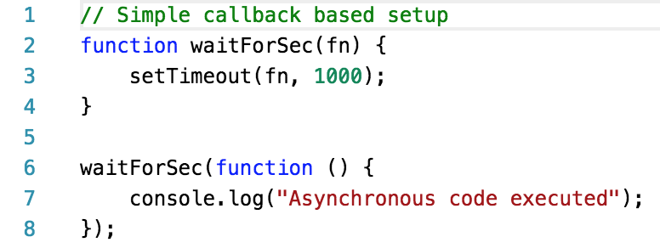
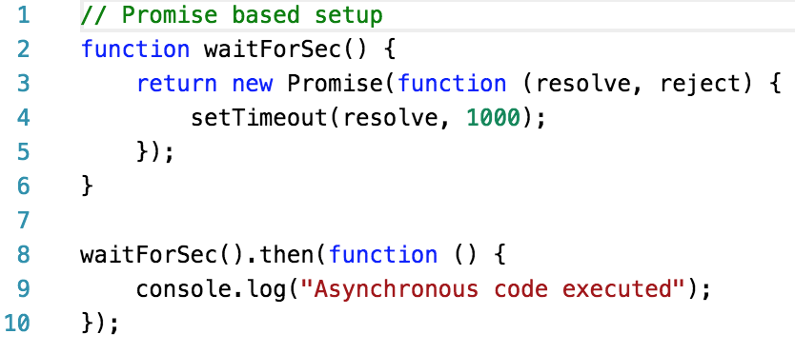
Promise Example

Slide 8
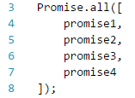

Advantages of using Promises
Flexibility
Better error handling
Chainable
Reduces boilerplate code

Slide 9
Disadvantages of using Promises
Performance hit in serial computation
Inefficient in mixed environment
Exception handling (try… catch fiasco)
Thenable assimilation (what if your promise returned an object as value that has a then method, but is not a promise?)

Slide 10
ServiceWorker uses Promises
Behold! Exciting stuff ahead…

Slide 11
What is ServiceWorker?
It’s a JavaScript worker
Runs separately from web page
Can access AppCache and Indexed DBs
Provides features like offline experience, push notification and background sync

Slide 12
What is AppCache?
Introduced in HTML5
Provide features like offline browsing, speed and reduced server load

Slide 13

How to use AppCache (the old way)
Create a manifest file (example: manifest.appcache)
Add the list of URL(s) which need to be cached in the manifest file as follows:
Include manifest file in HTML code as follows

Slide 14
Disadvantages of using manifest file for caching assets
Works only for single page apps
Lack of flexibility … And that’s why we need service workers

Slide 15
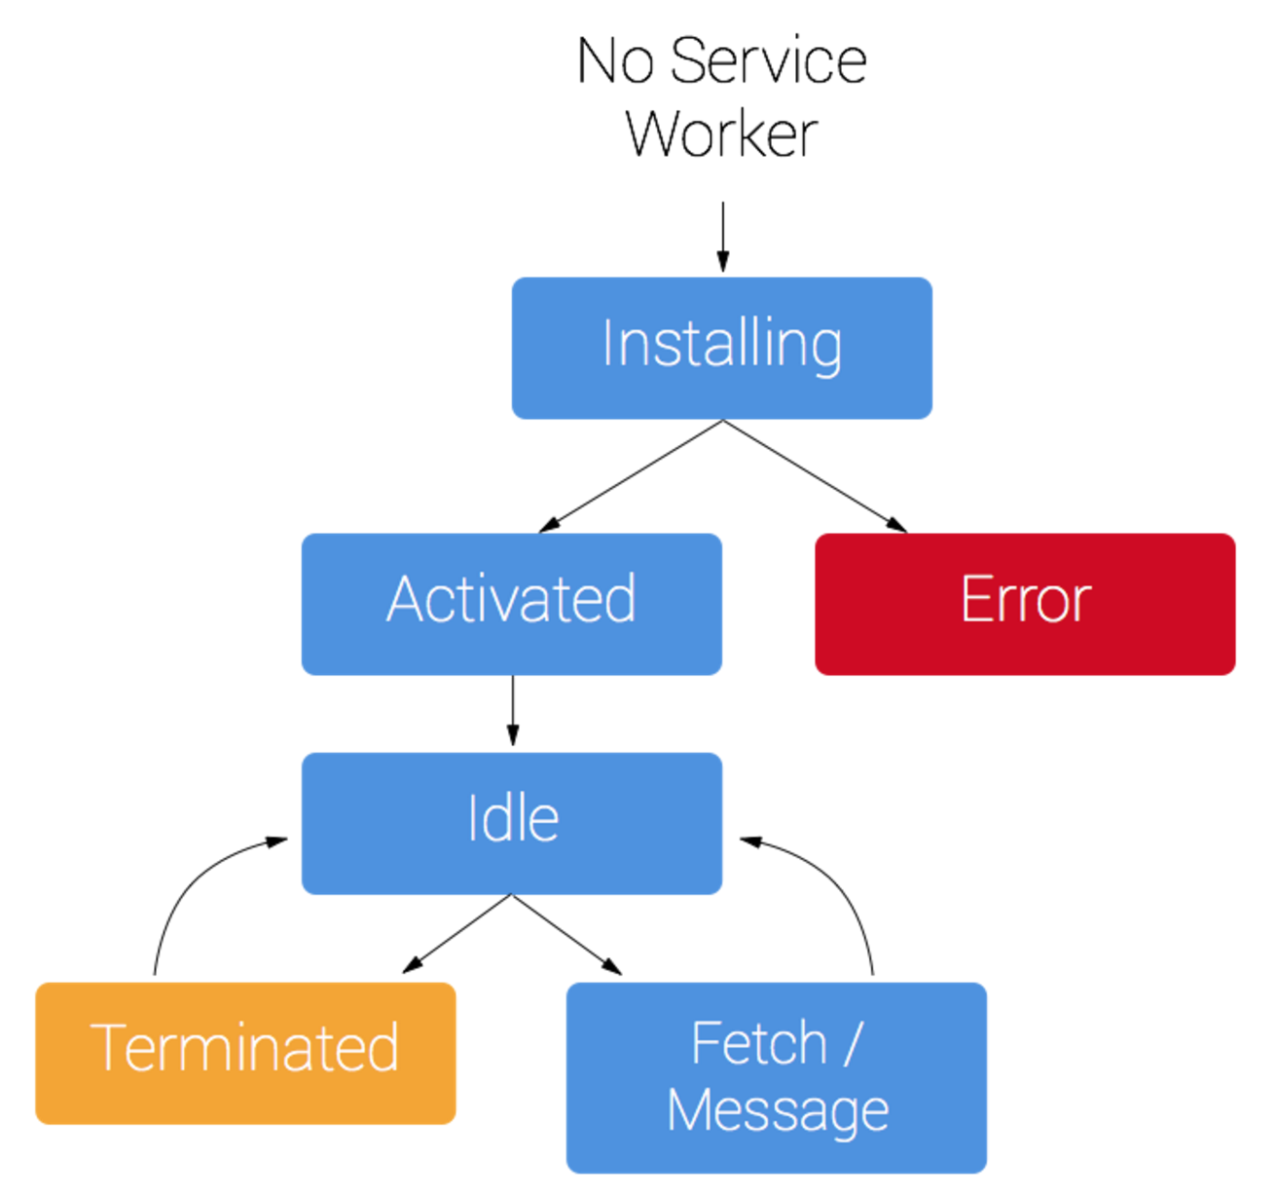
ServiceWorker lifecycle

Slide 16
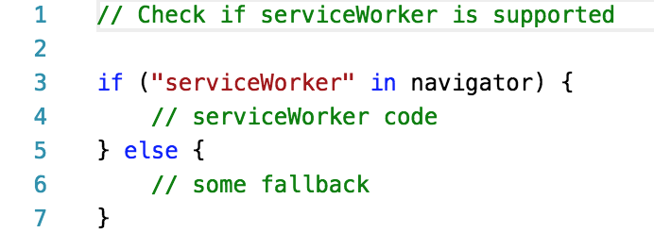
Does your browser support ServiceWorker?

Slide 17
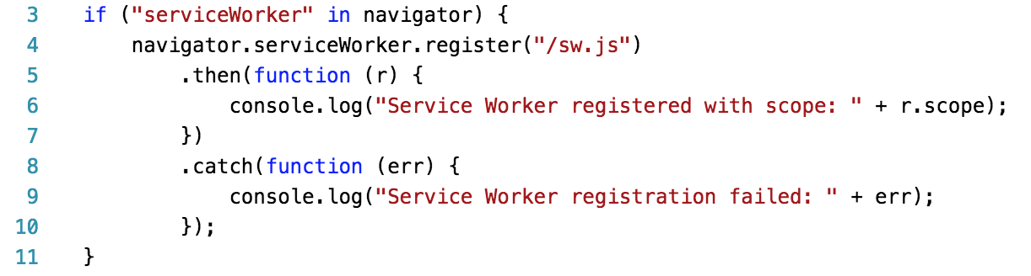
ServiceWorker registration

Slide 18
ServiceWorker registration
Once registered, it stays there …
If needed, you can manually unregister it in “Application” tab OR you can programmatically unregister it
HOWEVER,
It’s not needed

Slide 19
Inside sw.js
There are three important events
“install” event
“activate” event
“fetch” event

Slide 20
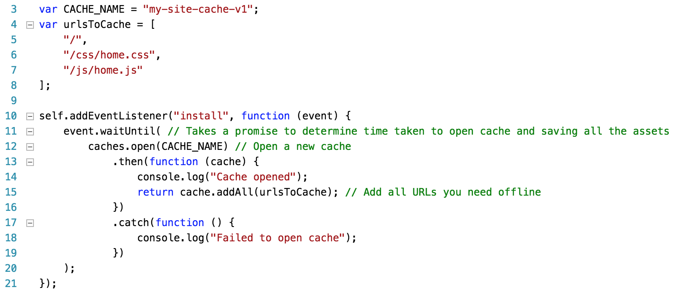
“install” event
Install event is triggered once the service worker is registered
At this time, you can save files and images that you need offline

Slide 21
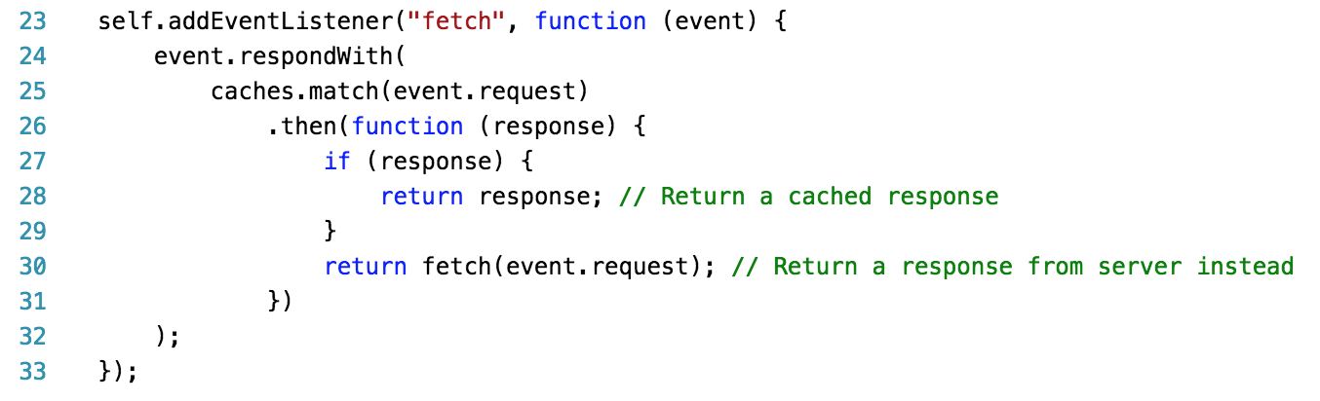
“fetch” event
A “fetch” event is triggered when browser sends a request to a server
Listening to this event would allow us to fetch pages and assets from caches instead of server directly

Slide 22
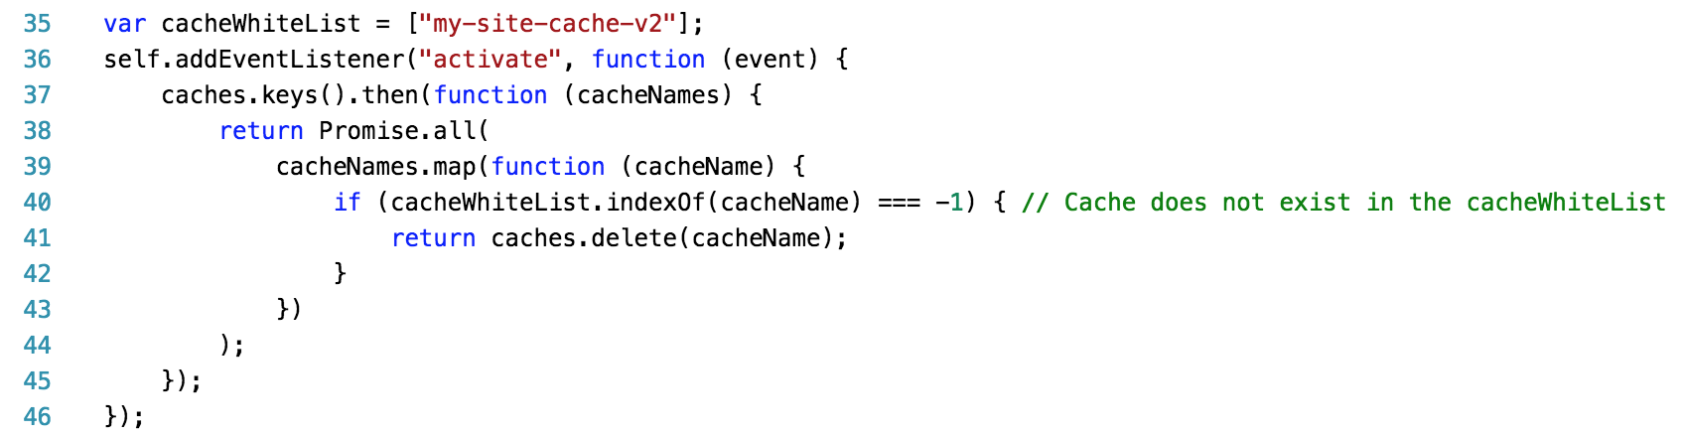
”activate” event
Activate event is triggered after install event OR
When the service worker is updated
You can use it to manage caches

Slide 23
FAQs
What is “self”?
How do we debug a service worker file?
How do we use service workers to develop PWA?
What are the common/known issues we face with service workers?
Is it reliable?
All of these questions (and the ones not listed here) will be answered in the next session …

Slide 24
Stay tuned…

