Slide 1
Progressive Web App
Session II

Slide 2
What is Progressive Web App?
Progressive – Works for every user regardlesss of browser choice
Responsive – Fits any form factor: desktop, mobile, tablet or whatever is next
Connectivity Independent – Enhanced with service workers to work offline
App-Like – Feels like an app to the user with app-style interactions and navigation
Fresh – Always up to date thanks to SW update process
Safe – Served via HTTPS to prevent snooping
Discoverable – Is identified as an app thanks to W3C manifesh and SW registration scope
Installable – Allows user to keep apps they find most useful on their homescreen without the hassle of an app store
Linkable – Easily share via URL, does not require complex installation

Slide 3
What we already learned so far…
Promises, it’s advantages/disadvantages and use
Service Workers and how it can be useful to cache user requests and data
SW events: install, fetch, update

Slide 4
What you’ll learn
How to design and construct an app using the “app-shell” method
How to make your app work offline
How to store data for use offline later

Slide 5
What you’ll need?
Chrome 52+
A web server of your choice
Text editor
Basic knowledge of HTML, CSS, JavaScript and Chrome DevTools

Slide 6
PWA architecture
PWA
App Shell
Header
Footer
Content
Hamburger menu

Slide 7
Why use the App-shell architecture?
Speed
Instant Loading
Regular updates

Slide 8
Few resources before we start building our first progressive web app
https://github.com/sachinsingh-nodejs/pwa
Clone this repository to your local

Slide 9
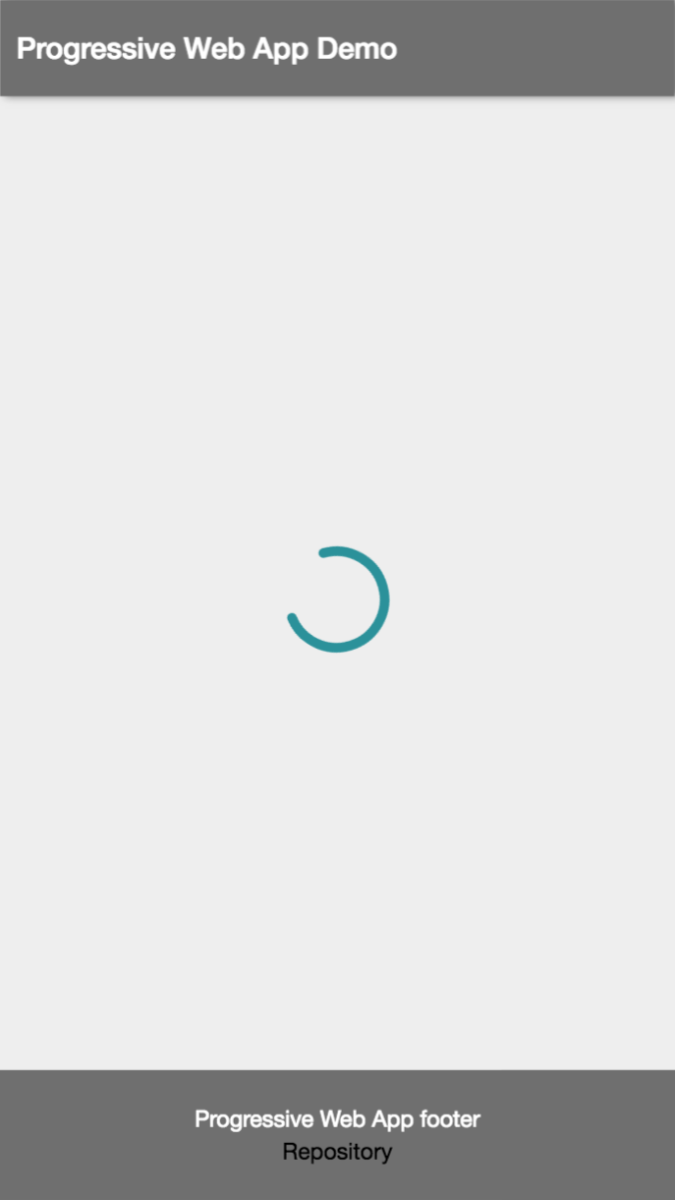
Creating app shell
If you head over to your project folder and type “npm start”, it will open up the browser window to display the basic app shell of the project

Slide 10
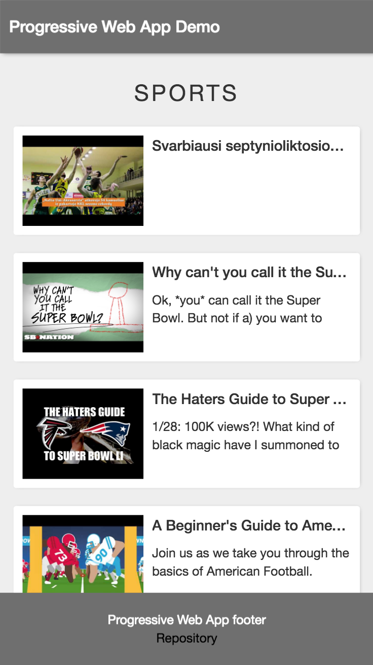
After adding content…
The final page should look like this:

Slide 11
Let’s add the magic of progressive web app
Continue demo…

