Slide 1
Map­reduce: Design patterns for BigData Computing
Bibliographic Research Work
Mário Ferreira
Vitor Teixeira
Pedro Sousa
Pedro Faria

Slide 2
What is MapReduce?
MapReduce is a programming model, inspired by the map and reduce functions, and an associated implementation for processing and generating large data sets with a parallel, distributed algorithm on a cluster.
The Map function performs filtering and sorting by processing a key/value pair to generate a set of intermediate key/value pairs.
The Reduce function that performs a summary operation and merges all intermediate values associated with the same intermediate key.

Slide 3
MapReduce features/benefits
In multi-threaded implementations of MapReduce the scalability, fault-tolerance and performance of the program are largely increased when compared with single-threaded implementations of MapReduce or non-MapReduce.
MapReduce programs are automatically parallelized and executed on a large cluster. The run-time system takes care of the details of partitioning the input data, scheduling the program' s execution across a set of machines, handling machine failures, and managing the required inter-machine communication.
This allows programmers without any experience with parallel and distributed systems to easily utilize the resources of a large distributed system

Slide 4
Programming model
Input/ Output: key/value pairs.
Map, defined by the user, takes an input pair and produces a set of intermediate key/value pairs. The MapReduce library groups together all intermediate values associated with the same intermediate key X and passes them to the Reduce function.
The Reduce function, also provided by the user, accepts an intermediate key X and a set of values for that key . It merges together these values to form a possibly smaller set of values. Typically just zero or one output value is produced per Reduce in vocation. The intermediate values are supplied to the user' s reduce function via an iterator . This allows to handle lists of values that are too large to fit in memory

Slide 5
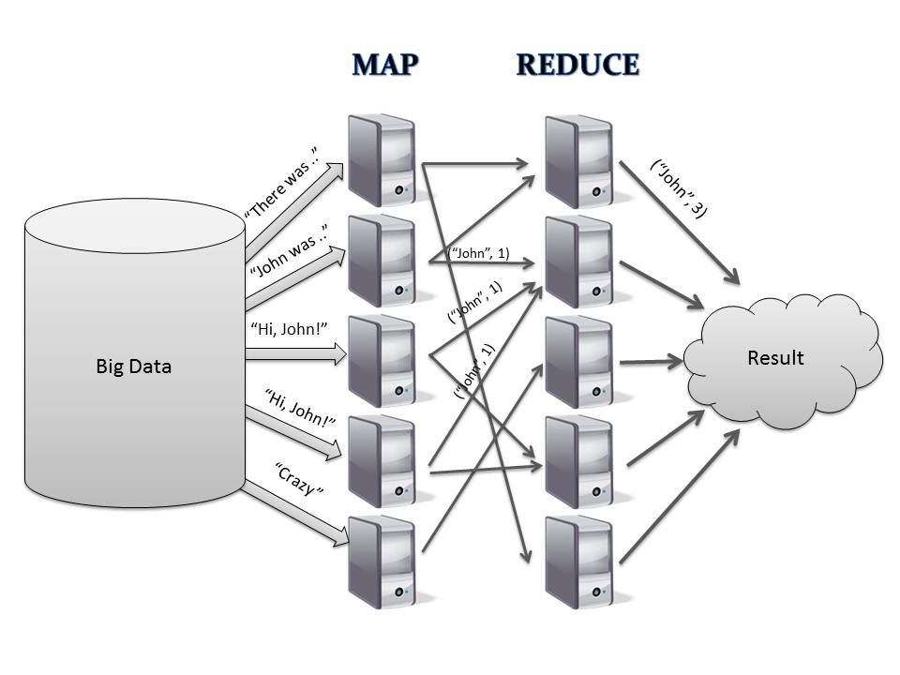
Practical example
Mapping the number of occurrences of a certain word in a collection of books.

